Slide 1
Hot Topics in Pediatric Acute Care
Laura Bode, DO
Oklahoma State University
Department of Pediatrics

Slide 2
Disclosures
I have no financial disclosures or conflicts of interest.

Slide 3
Learning Objectives
At the conclusion of this educational presentation, the participant will be able to:
Apply changes in recommendations from "2020 Focused Updates to Asthma Management Guidelines” to their management of patients with asthma
Define SMART therapy
List risk factors in pediatric patients associated with severe COVID-19 and COVID related hospitalizations
Identify clinical characteristics of Multisystem Inflammatory Syndrome in Children (MIS-C)

Slide 4
2020 Focused Update to the Asthma Management Guidelines
NIH- National Heart Lung Blood Institute, December 2020

Slide 6
Intermittent Asthma, Ages 0-4
In children ages 0–4 years with recurrent wheezing triggered by respiratory tract infections and no wheezing between infections, the Expert Panel conditionally recommends starting a short course (7-10 days) of daily ICS at the onset of a respiratory tract infection with as-needed SABA for quick-relief therapy compared to as-needed SABA for quick-relief therapy only.
Notes:
Recurrent: 3 + episodes in lifetime, or 2 in past year.
Asymptomatic between
Caregivers can initiate intermittent ICS treatment at home without a visit to a health care provider when they have clear instructions. Clinicians should give caregivers written instructions on how to implement the recommended action plan at the onset of a respiratory infection. In addition, clinicians should review the plan with the caregiver at regular intervals.
The main potential benefit of intermittent ICS use during respiratory tract infections is the reduction in exacerbations requiring systemic corticosteroids. Clinicians should inform caregivers that this treatment could affect growth, and they should carefully monitor growth in children who use this recommended treatment.

Slide 7
Intermittent Asthma, Ages 0-4
Studied regimen: Budesonide 1 mg BID x 7 days
As effective as chronic daily budesonide (0.5mg nightly) with respect to exacerbations requiring oral steroids
Lower cumulative exposure to budesonide

Slide 9
Inhaled Corticosteroids, Ages 0-4
Medication | Low Dose | Medium Dose | High Dose
Budesonide Nebules (0.25mg/2mL, 0.5mg/2ml, 1mg/2ml) | 0.25 to 0.5 mg once daily or as 2 divided doses | 0.75 to 1 mg once daily or divided into 2-3 doses | 1.25 to 2 mg once daily or as 2 divided doses
Fluticasone HFA (44mcg/puff, 110 mcg/puff, 250 mcg/puff) | 44 mcg/puff 2 puffs BID | 44 mcg/puff 2-4 puffs BID or 110 mcg/puff 1 puff BID | 110 mcg/puff 2 puffs BID or 220 mcg/puff 1 puff BID

Slide 12
SMART Therapy
For individuals with moderate to severe persistent asthma already taking low- or medium- dose ICS, the preferred treatment is a single inhaler with ICS-formoterol (referred to as single maintenance and reliever therapy, or “SMART”) used both daily and as needed.
Budesonide/Formoterol (Symbicort) MDI 2 puffs BID
80mcg/4.5mcg (low dose) or 60mcg/4.5mcg (med dose)
1 to 2 puffs as needed up to a maximum total daily maintenance and rescue dose of 8 puffs (36 mcg).
Do not use ICS-formoterol as reliever therapy in individuals taking ICS-salmeterol as maintenance therapy.
Notes:
In children ages 4–11 years, there may be a lower risk of growth suppression among those taking SMART versus daily higher-dose ICS treatment.

Slide 14
Subcutaneous Immunotherapy
Subcutaneous immunotherapy (SCIT) is recommended as an adjunct treatment for individuals who have demonstrated allergic sensitization and evidence of worsening asthma symptoms after exposure to the relevant antigen or antigens.
Do not initiate, increase, or administer maintenance SCIT doses while individuals have asthma symptoms.
Do not administer SCIT in individuals with severe asthma

Slide 17
Mild Persistent Asthma,12+ Years
For individuals with mild persistent asthma, either of the following two treatments are recommended as part of Step 2 therapy: 1) a daily low-dose ICS and as-needed SABA for quick-relief therapy, or 2) intermittent as-needed SABA and ICS used one after the other for worsening asthma.
Notes:
Individuals with either low or high perception of symptoms may not be good candidates for as-needed ICS therapy. Daily low-dose ICS with as-needed SABA may be preferred.

Slide 18
Notes:
A 1-month supply of ICS-formoterol medication that is sufficient for maintenance therapy may not last a month if the inhaler is used for reliever therapy as well.
This recommendation might not be appropriate for some individuals with asthma because of cost, formulary considerations, or medication intolerance.

Slide 19
SMART Therapy
For individuals with moderate to severe persistent asthma already taking low- or medium-dose ICS, the preferred treatment is a single inhaler with ICS-formoterol used both daily and as needed.
1 to 2 puffs as needed up to a maximum total daily maintenance and rescue dose of 12 puffs (54 mcg).

Slide 20
Notes:
LABA > LAMAs, but in uncontrolled persistent asthma, adding a LAMA (such as Spiriva) to a ICS-LABA is recommended.

Slide 21
Acute COVID-19

Slide 22
Clinical Presentation
Most common symptoms: Cough and/or Fever
16-50% Asymptomatic

Slide 24
Severity of Illness
Obesity
Asthma/Chronic lung disease
Medically complex
Infants <12 mo

Slide 25
Management- Hospitalized
Mild- Moderate (No new/increased O2 requirement)
Supportive care
Severe Disease (New/increased supplemental O2)
Remdesivir (antiviral) up to 5 days
+/- Dexamethasone
Critical Disease (ventilatory support, sepsis, multiorgan failure)
Dexamethasone
+/- Remdesivir

Slide 26
Management- Outpatient with risk factors
Bamlanivimab + etesevimab
EUA ≥12years and ≥40kg who are at risk for progression to severe COVID-19 and/or hospitalization
BMI ≥85th percentile
Sickle cell disease
Congenital/Acquired Heart Disease
Neurodevelopmental Disorders (i.e. CP)
Medical technology dependent (i.e. Trach)
Asthma or Chronic Respiratrory Disease that requires daily medication

Slide 27
Prevention
Vaccinate!
BNT162b2 (Pfizer-BioNTech) indicated for 16 and older

Slide 28
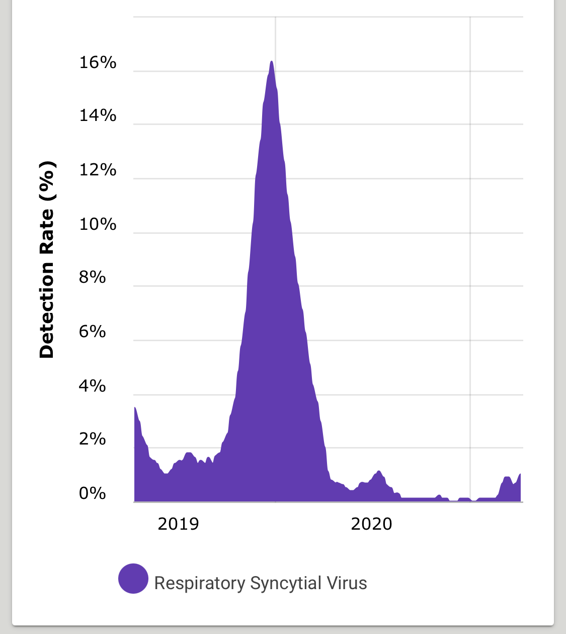
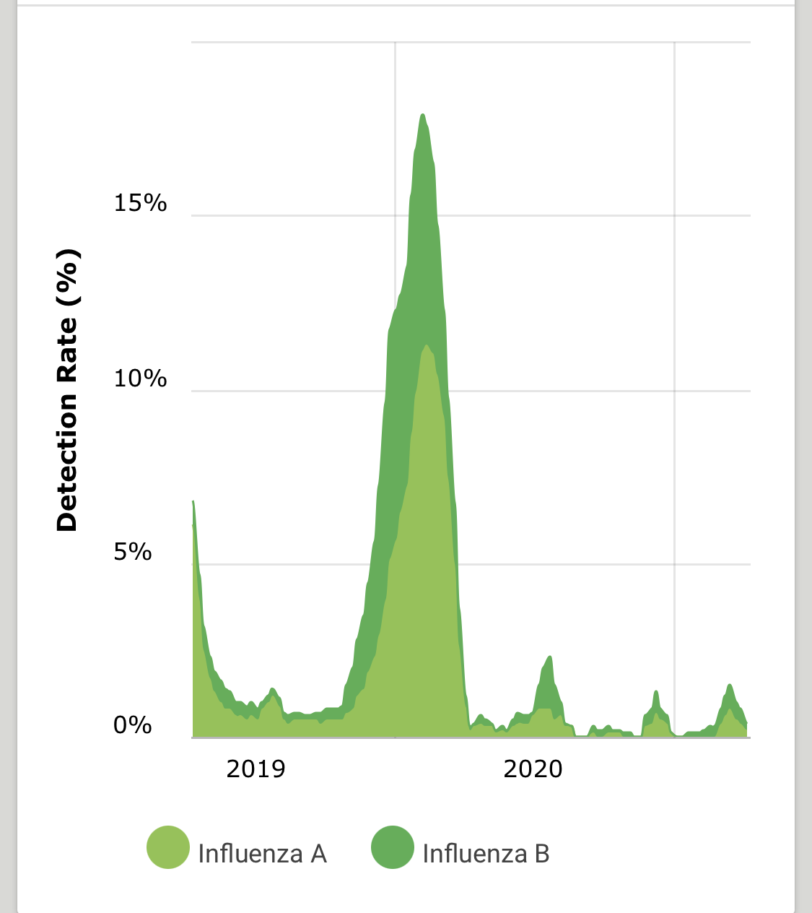
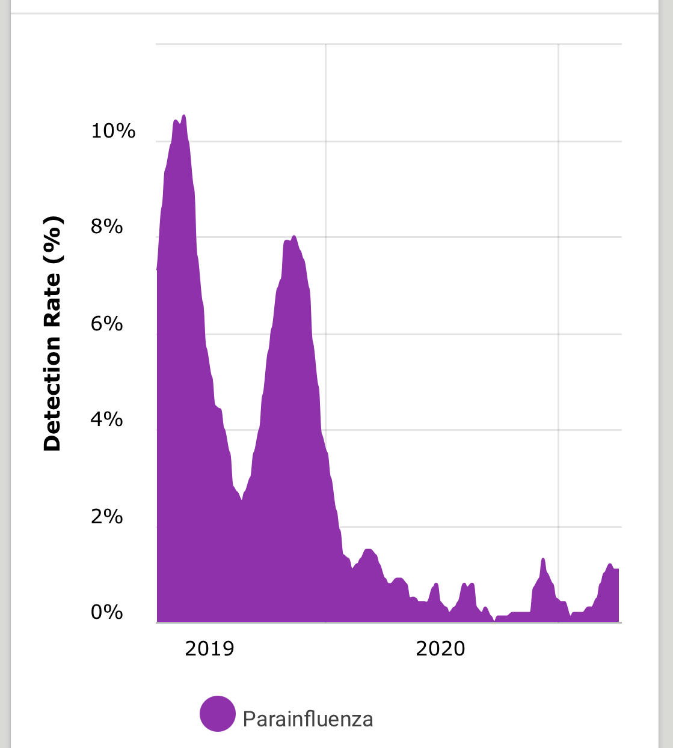

Slide 29
Multisystem Inflammatory Syndrome in Children (MIS-C)

Slide 30
Case Definition
An individual aged <21 years presenting with fever, laboratory evidence of inflammation**, and evidence of clinically severe illness requiring hospitalization, with multisystem (>2) organ involvement (cardiac, renal, respiratory, hematologic, gastrointestinal, dermatologic or neurological); AND
No alternative plausible diagnoses; AND
Positive for current or recent SARS-CoV-2 infection by RT-PCR, serology, or antigen test; or exposure to a suspected or confirmed COVID-19 case within the 4 weeks prior to the onset of symptoms.

Slide 31
Epidemiology
Middle Childhood
Median 9y (5-13 interquartile)
Black and Hispanic children disproportionately high
Mild or Asymptomatic Covid infection
Spikes in MIS-C cases lag 2-5 weeks of peak Covid cases
58% admitted for intensive care
Notes:
Most MIS-C illnesses are believed to result from asymptomatic or mild COVID-19 with hyperinflammation coinciding with peak antibody production several weeks after initial SARS-CoV-2 infection.

Slide 32
Signs and Symptoms
Fever
Gastrointestinal (60-100%)
Abdominal Pain
Diarrhea
Nausea/Vomiting
Kawasaki-like features
Conjunctival hyperemia (30-80%)
Rash (45-75%)
Mucus Membrane involvement
Red or Swollen hands and feet
Lymphadenopathy
Neurocognitive
Headache
Lethargy
Confusion/ Irritibility

Slide 33
Kawasaki Overlap
Some individuals may fulfill full or partial criteria for Kawasaki disease, but should be reported as MIS-C if meets case definition for MIS-C
“KawaShocky”

Slide 34
Lab findings
↑ Inflammatory Markers
CRP
ESR
D-Dimer
Fibrinogen
Procalcitonin
Ferritin
IL-6
CBC
Neutrophilia
Lymphocytopenia
Mild Anemia
Thrombocytopenia
↑ Cardiac Markers
Troponin
BNP
Low Albumin
Mildly elevated LFTs
Elevated LDH
Hypertriglyceridemia
Notes:
↑

Slide 35
Other Studies
Echocardiography
LV function depressed
Coronary artery abnormalities
Mitral Regurgitation
Pericardial Effusion
EKG
Obtain baseline
1st degree AV block
Imaging findings
Abdominal US or CT
Free fluid, ascites
Enteritis
Mesenteric adenopathy
Pericholecystic edema, Gallbladder hydrops, Acalculous cholecystitis

Slide 36
Multisystem involvement
2 or more organ systems involved:
Cardiovascular (eg, shock, elevated troponin, elevated BNP, abnormal echocardiogram, arrhythmia)
Respiratory (eg, pneumonia, ARDS, pulmonary embolism)
Renal (eg, AKI, renal failure)
Neurologic (eg, seizure, stroke, aseptic meningitis)
Hematologic (eg, coagulopathy)
Gastrointestinal (eg, abdominal pain, vomiting, diarrhea, elevated liver enzymes, ileus, gastrointestinal bleeding)
Dermatologic (eg, erythroderma, mucositis, other rash)

Slide 37
Management- ABCs
Respiratory Support
Supplemental O2
Ventilation
Hypotension/Shock
Standard Protocols- fluid resuscitation 10-20 ml/kg, reassessing, until hypotension resolves or signs of fluid overload develop up to 40 ml/kg
However, vasodilatory shock refractory to volume expansion,
Consider epinephrine/norepinephrine
Notes:
If appears hypotensive and septic, don’t forget antibiotics until bacterial infection ruled ut

Slide 38
Management
Intravenous Immune Globulin
(+)
Methylprednisolone
Notes:
2 grams/kg IVIG
patients who do not improve clinically, or whose laboratory values do not improve, have also been treated with steroid therapy; March- large observational study found that initial treatment with both IVIG and steroid therapy led to earlier resolution of fever compared to IVIG alone.

Slide 39
Management
Antithrombotic Therapy
Low Dose Aspirin
Consideration of LMWH
Age >12-13 or other high risk factors for VTE
Moderate-Severe Systolic Dysfunction

Slide 40
Follow up and Outcomes
Generally discharged with steroid taper x 2-3 weeks
ASA through cardio follow up
Cardiology
Normal Function/CA: Echo in 1-2 weeks, may be more frequent if abnormal
Possible physical activity restrictions for several months until cardiac function fully recovers
IVIG : wait 11 months before giving MMR/Varicella

Slide 41
References
Belay ED, Abrams J, Oster ME, et al. Trends in Geographic and Temporal Distribution of US Children With Multisystem Inflammatory Syndrome During the COVID-19 Pandemic. JAMA Pediatr. Published online April 06, 2021. doi:10.1001/jamapediatrics.2021.0630
American Academy of Pediatrics clinical guidance: Multisystem Inflammatory Syndrome in Children (MIS-C), available at: https://services.aap.org/en/pages/2019-novel-coronavirus-covid-19-infections/clinical-guidance/multisystem-inflammatory-syndrome-in-children-mis-c-interim-guidance/
Feldstein LR, Tenforde MW, et al. Characteristics and Outcomes of US Children and Adolescents with Multisystem Inflammatory Syndrome in Children (MIS-C) Compared with Severe Acute COVID-19. JAMA 2021; 325: 1074.
Association of Intravenous Immunoglobulins Plus Methylprednisolone vs Immunoglobulins Alone With Course of Fever in Multisystem Inflammatory Syndrome in Children. Ouldali N, Toubiana J, et al. JAMA. 2021;325(9):855.
Multisystem Inflammatory Syndrome in Children: An International Survey. Bautista-Rodriguez C et al; Pediatrics 2021; 147

Slide 42
References
Expert Panel Working Group of the National Heart, Lung, and Blood Institute (NHLBI) administered and coordinated National Asthma Education and Prevention Program Coordinating Committee (NAEPPCC). 2020 Focused Updates to the Asthma Management Guidelines: A Report from the National Asthma Education and Prevention Program Coordinating Committee Expert Panel Working Group. J Allergy Clin Immunol. 2020 Dec;146(6):1217-1270.
COVID-NET. A weekly summary of US COVID-19 hospitaliztion data. Available at: gis.cdc.gov/grasp/COVIDNet/COVID19_5.html
American Academy of Pediatrics. Critical updates on COVID-19. Clinical guidance. services.aap.org/en/pages/2019-novel-coronavirus-covid-19-infections/clinical-guidance/
United States Centers for Disease Control and Prevention. Information for pediatric healthcare providers. Available at: www.cdc.gov/coronavirus/2019-ncov/hcp/pediatric-hcp.html
Multicenter Interim Guidance on Use of Antivirals for Children With Coronavirus Disease 2019/Severe Acute Respiratory Syndrome Coronavirus Pediatric Infect Dis Soc. 2021;10(1):34.
Fact sheet for health care providers. Emergency use authorization (EUA) of bamlanivimab and etesevimab. www.fda.gov/media/145802/download

