Slide 1



FOR

Slide 2

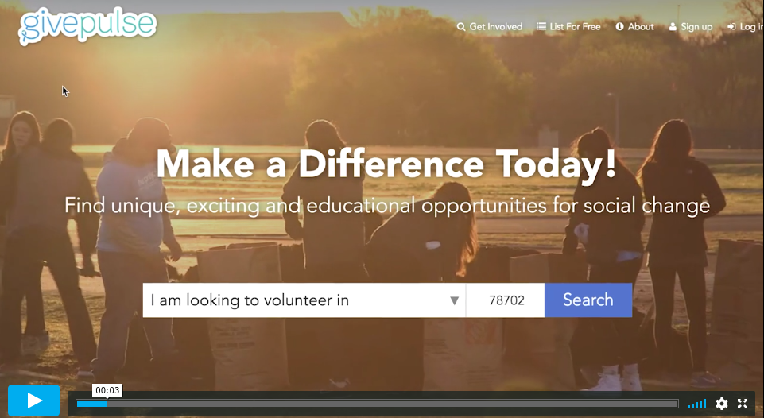
WHAT IS
A community engagement platform designed with students in mind.
Students can use it to:
find opportunities for community engagement
track and share service hours/impacts/touch points
create a community engagement transcript

Slide 3
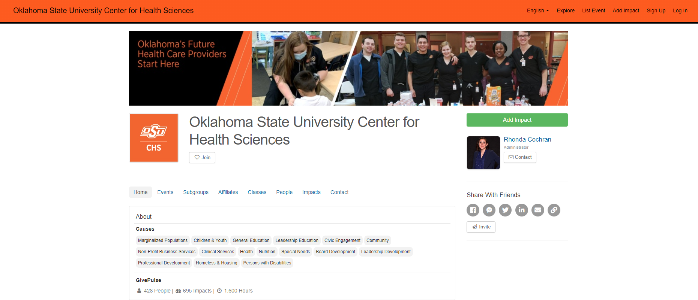
WHAT IS GIVEPULSE FOR OUS CHS
OSU CHS uses GivePulse to track community engagement, support Service-Learning classes, and manage community partnerships. The group page for OSU CHS lists:
Opportunities
Work Experiences
Subgroups
Community Partners
List of Classes with community-based learning
Impacts
Documents
Contact information

Slide 4
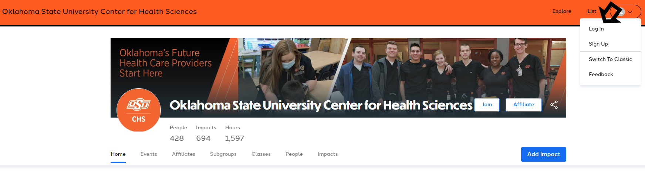
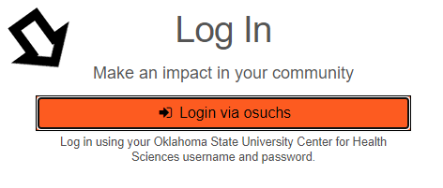
LOGGING IN
Start from osuchs.givepulse.com
Select the Log in link in the top right corner
From the next screen, select the “Log in via osuchs” which will redirect you to sign in through your OKEY account

Slide 5
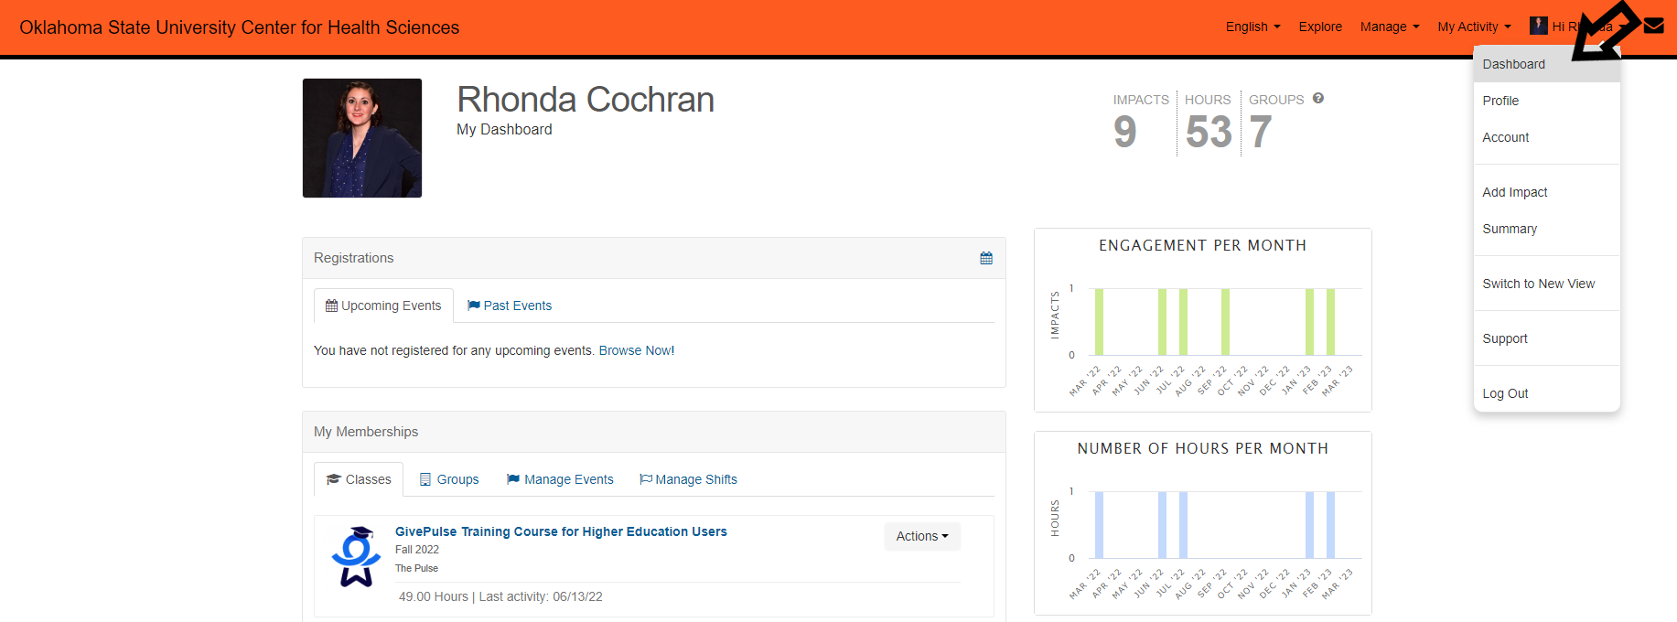

Once you have logged in, you should navigate to your dashboard. In the top right corner, select "Hi [Name]," then “Dashboard” in the dropdown menu
From the dashboard, you can:
View your memberships
  Any of your classes with a SL assignment
  Groups you are involved with
Record your hours by adding impacts
See upcoming registrations both as a list and as a calendar view, allowing you to see what you have signed up for.
Search for volunteer opportunities
DASHBOARD
Support Page
for this topic

Slide 6
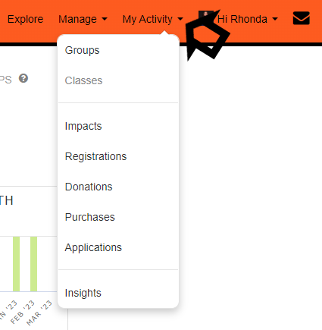

NAVIGATION MENU: MY ACTIVITY
The "My Activity" tab allows you to navigate quickly to a list of your:
Groups
Classes
Impacts
Registrations
Donations
Purchases
Surveys/applications
Insights
Support Page
for this topic
Video: My Activity Navigation

Slide 7
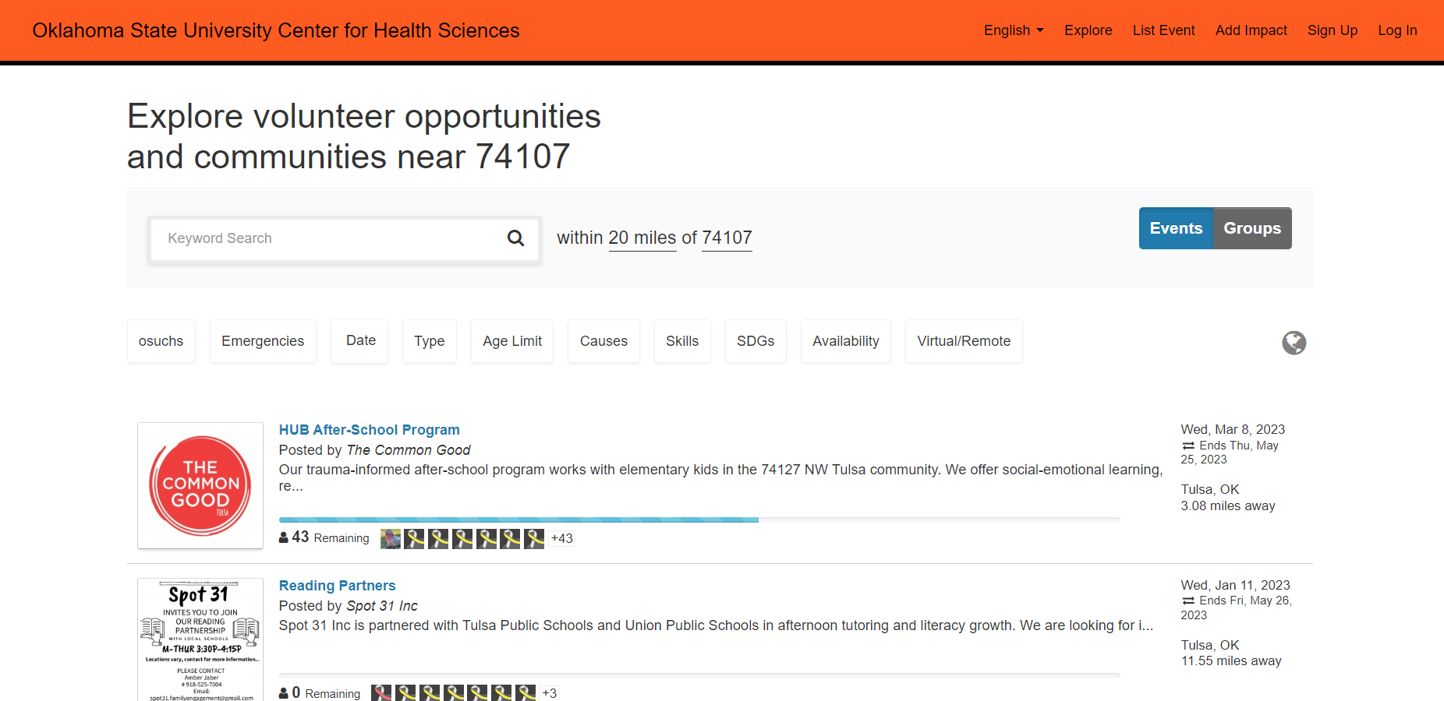
SEARCHING FOR EVENTS AND GROUPS
Search via the “Explore” page
Use the filters to narrow down your search results
Toggle between Events and Groups to either search for specific events or specific community organizations
Support Page
for this topic
Video: Finding Opportunities
Video: Finding Organizations

Slide 8
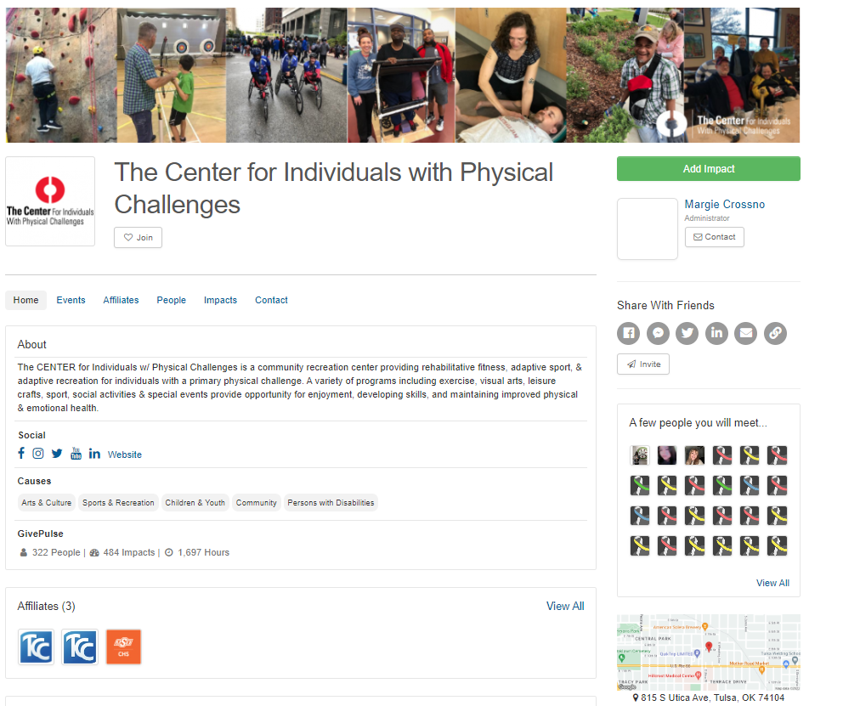
GROUPS
Group pages will have more details about the organization and any events they are promoting through GivePulse.
On a group’s page you can:
Becoming a Member (similar to liking/following)
Contact the Group Admin
Register for events
Add Impacts
Community partners may not list all their volunteer opportunities on GivePulse. Visit their website or reach out to their administrator if you are interested in partnering with them.
Support Page
for this topic

Slide 9
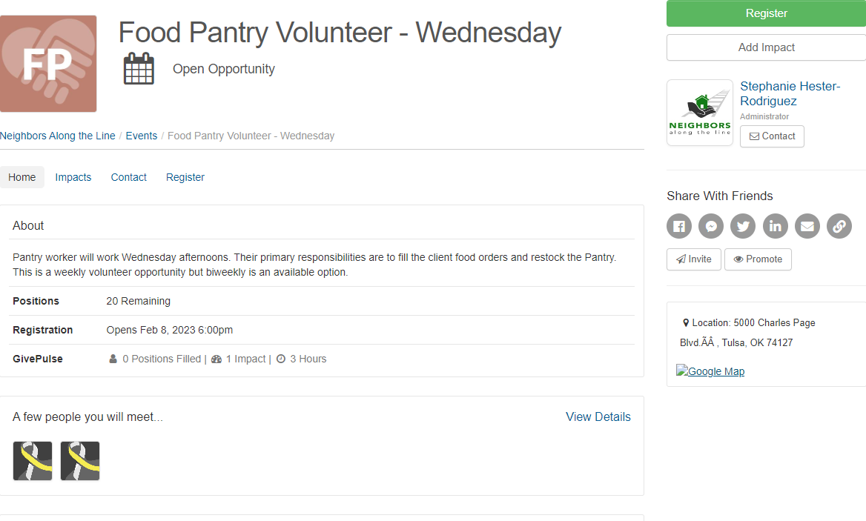
EVENTS
Through GivePulse, groups can post the following types of events:
Volunteer Opportunity
Event
Fundraiser
Ticketed Event
Registering* for events will notify the group that you are interested in volunteering or participating.
*Please note, groups may also require you to complete additional registration steps.
Support Page
for this topic
Video: Register for an Event
Video: Updating Your Registration

Slide 10
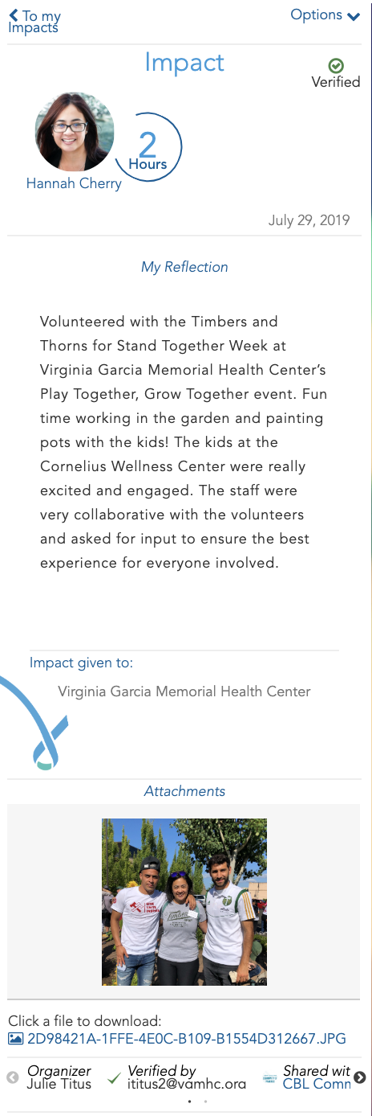
IMPACTS
What is an impact?
Every time you volunteer, serve or donate to a social impact initiative, you are making an Impact!
Adding an impact, or "sharing information about what you did in the community that made an impact of some kind," empowers you to record your engagement with the community.
Impacts help provide data for reporting purposes, to get feedback on the quality of the experience, and to better understand the impact of the work and how we are moving the needle.
Support Page
for this topic

Slide 11
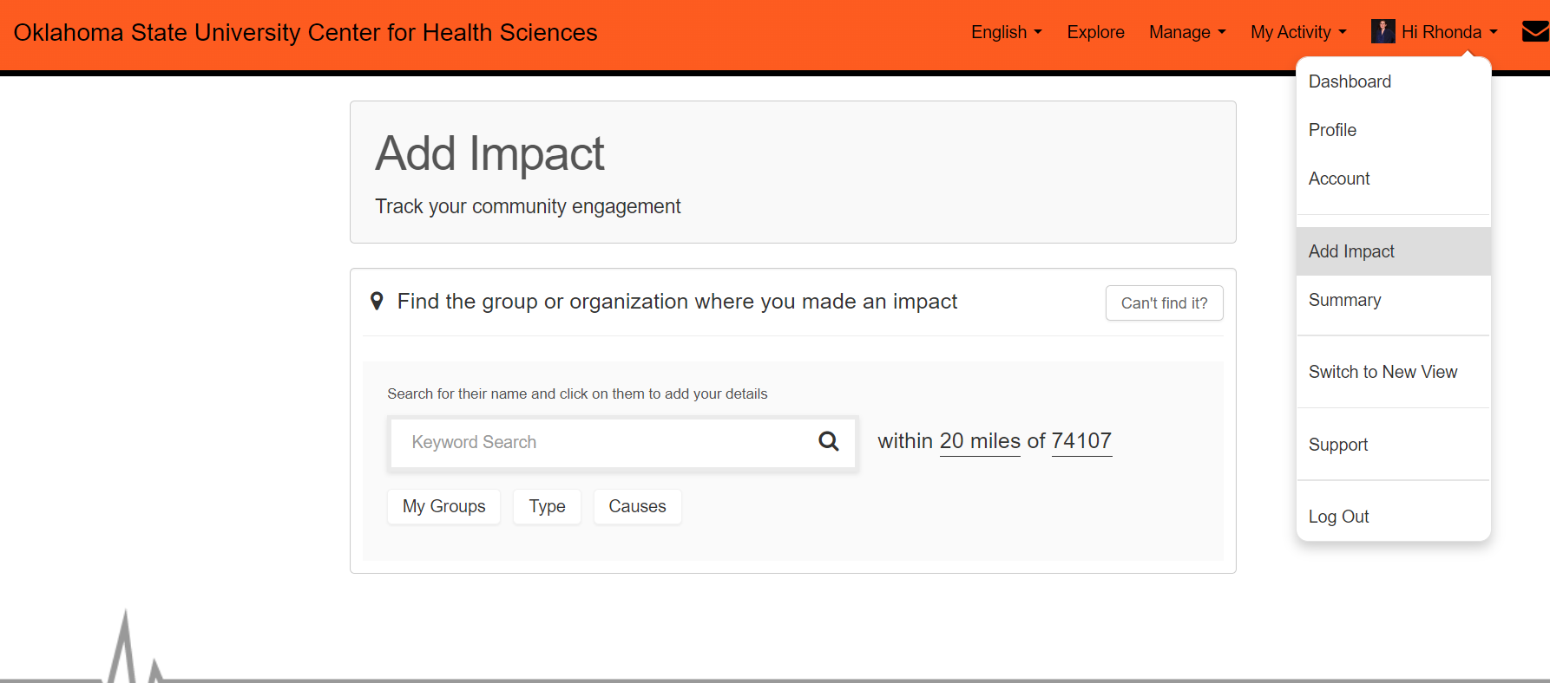
RECORD YOUR COMMUNITY ENGAGEMENT
BY ADDING IMPACTS
How to add an impact
Go to the top right of the page and select "Hi [Name]," then select "Add Impact" from the drop-down menu.
You will then be asked where you created an impact. You can search by name or location (if you search by name, make sure you update the location to reflect the location of the group you are looking for)
What if the organization, event or program is currently not displayed or set up in the system?
In these circumstances, you can select the "Can't Find It?" option. You will be prompted to add the group/program description, the person who will help verify your attendance, and additional relevant information.
Support Page for:
Adding Impacts
”Can’t Find It” option

Slide 12
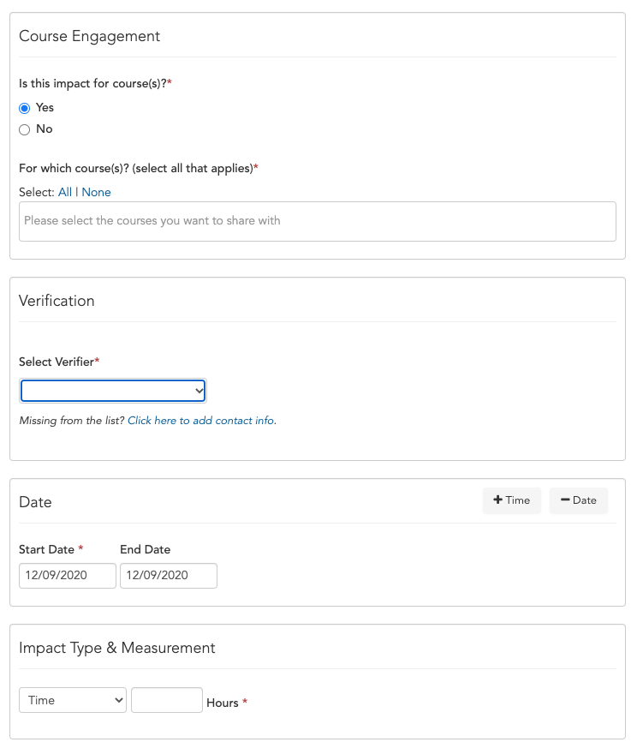
RECORD YOUR COMMUNITY ENGAGEMENT
BY ADDING IMPACTS
Once you select the group, the following screen will be where you fill out the impact details.
  If you select a specific event, some details might automatically be filled in for you.
If your impact is for a course assignment/project, complete the Course Engagement fields. Any SL courses you are enrolled in will be automatically populated
Support Page
for this topic

Slide 13
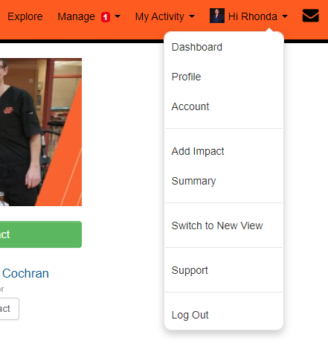
IMPACT SUMMARY/SERVICE TRANSCRIPT
You can generate an impact summary (service transcript) for your own reporting purposes. This service transcript allows you to generate a pdf with each verified impact and its summary. It includes a breakdown of your impacts by group/organization and term.
How to view/print your transcript
Go to the top right of the page and select "Hi [Name]," then select "Summary" from the drop-down menu.
Using your internet browser options, you can either print or download/save the transcript.
Support Page
for this topic

Slide 14
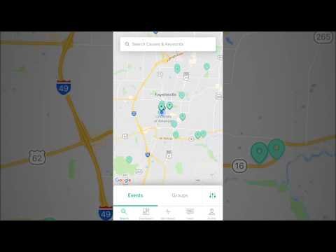
GIVEPULSE APP
The GivePulse app, available for Apple and Android mobile devices, provides a quick and helpful way to keep track of your engagement.
To find the app, simply search in the app store for "GivePulse" and download the GivePulse app.
Support Page
for this topic

Slide 15

Questions?
Rhonda Cochran
Manager of Service-Learning
OSU Center for Health Sciences
P 918-561-1843 E rcochra@okstate.edu
Support.givepulse.com support@givepulse.com

