Slide 1
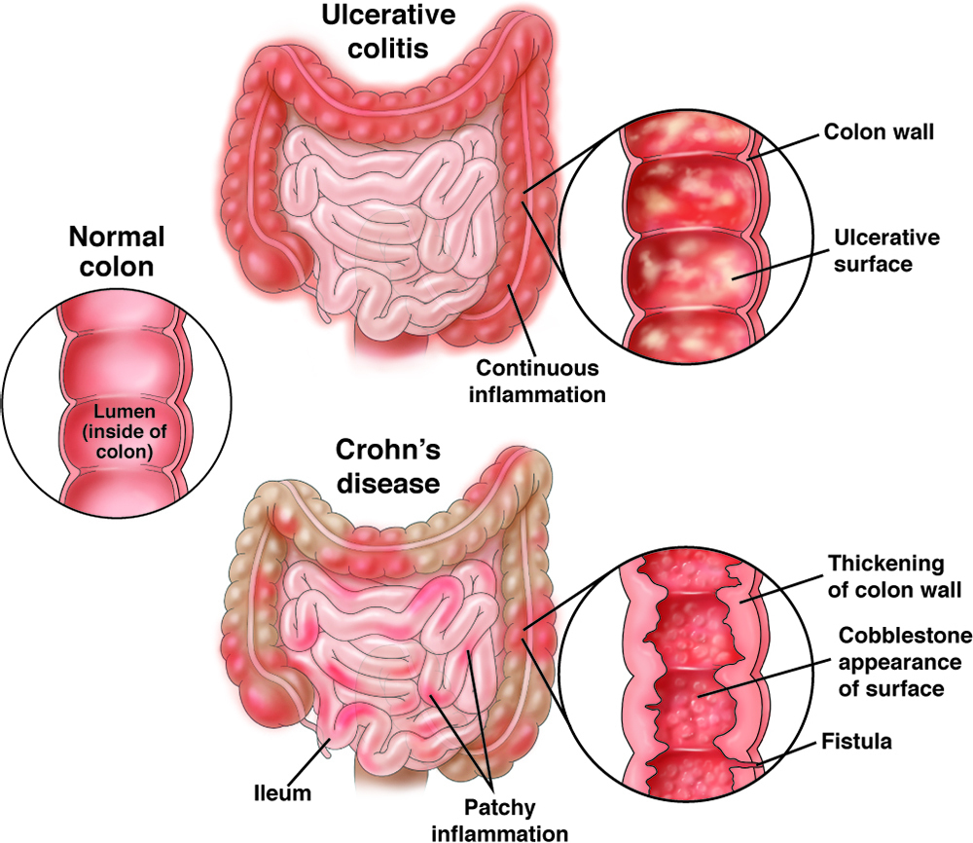
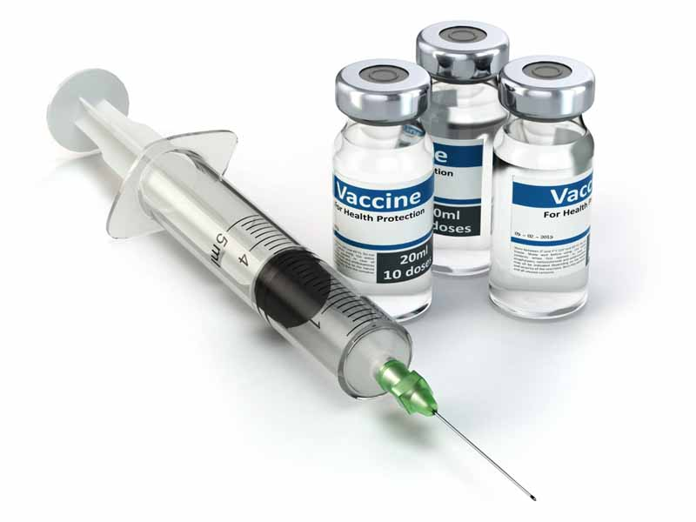
SCHOOL / DEPARTMENT
Improving vaccination adherence in IBD
John, F MD(Advisor) Aran, B DO. Heavener, T DO. Warren, M DO. Patel, C DO. Cobbs, T DO. Meehan, D DO. Al-Rifai, S DO.
INTRODUCTION
RESULTS
CONCLUSION
Inflammatory Bowel Disease (IBD) including Crohn’s and Ulcerative Colitis is an autoimmune disease affecting mostly the small and large intestine. Management of these diseases include biologic and immune modulatory medications. Due to this, patients are recommended to be up to date on recommended vaccinations. The American Gastroenterological Association recommends 11 immunizations for all patients with Crohn’s and Ulcerative Colitis
Patients with Inflammatory Bowel Disease are at risk for complicating infections. Updating their immunizations against recommended diseases will improve their health as IBD is a lifelong disease. One reason for such low vaccinated patients could be that these patients are being seen mostly by their gastroenterologist and see their primary doctor infrequently. By sending a letter to the PCP this will encourage follow up and improvement in health maintenance.
359
Current immunization records
Crohn’s and Ulcerative colitis
OBJECTIVES
Increase vaccination adherence to the AGA guidelines for patients with Ulcerative Colitis or Crohn’s. By enlisting the help of their Primary Care Physicians in improving health maintenance and up dating patients’ vaccinations
AGA recommended vaccines
METHODS
Covid 19 | Influenza | Hepatitis A
Hepatitis B | PCV13 | PCV23
HPV | Tdap | MMR
Varicella | Meningococcal | RZV
There are 359 patients with the diagnosis of Crohn’s or Ulcerative Colitis in the electronic medical record for our health system. Using “health maintenance” as a data collection, all of these patients were deficient in at least one of the recommended immunizations. We formulated a letter with all the recommended immunizations and sent them to the primary care physician office of these patients to encourage them to start the immunization process on these shared patients. After 6 months we will again study the data through “health maintenance” to assess improvements in immunizations.

