Slide 1
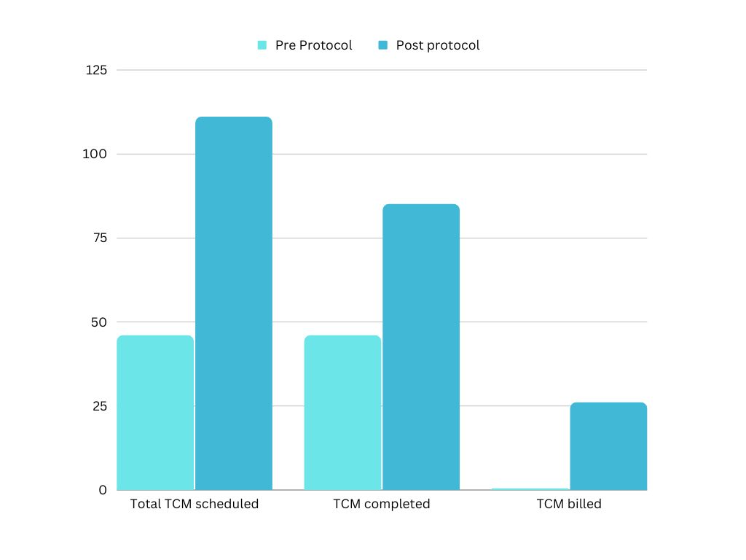
Improving Transitional Care in the Outpatient Setting
OSU / Family Medicine - Lawton
Dr. Jacob Fuller, Dr. D. Coulson Huntington, Dr. Mercedez Bernard, Tiffany Wooten, Amanda Ocker
Market Name | # Discharges | TCM <7 Days | TCM <14 Days | TCM Total
Comanche County | 1,335 | 1% | 1% | 3%
LCHC Fam Med Res | 111 | 20% | 22% | 41%
INTRODUCTION
Transitional Care Management (TCM) is a face to face visit with a patient upon discharge to the community setting.
In Comanche County, only 3% of 1,335 hospital discharged patients were shown to have a TCM visit.
Increasing the number of patients that receive TCM visits will help to reduce readmissions, improve medication adherence, lower patients' healthcare costs, and ensure appropriate specialist follow up.
Following hospital discharge, patients are more likely to show-up for an out-patient office visit if an established protocol exists to schedule their Transition of Care appointment.
Market Name | E&M <7 Days | E&M <14 Days | E&M <30 Days | E&M Total | IP & SNF Readmission
Comanche County | 30% | 20% | 20% | 70% | 13%
LCHC Fam Med Res | N/A | 77% | 0% | 77% | N/A
OBJECTIVES
For the Comanche County Memorial Hospital Family Medicine residency program, we aim to:
Increase the awareness of our patients hospitalizations
Reduce the number of patients who don't receive hospital follow ups
Code appropriately for TCM visits for reimbursement incentives
REFERENCES
METHODS
“Transitional Care Management: Practical Processes for Your Practice”, NEELA K. PATEL, MD, MPH, CMD, RUBY MATHEW, ACNP, RN, MSN, CHIDINMA ANIEMEKE, MD, CHANDANA TRIPATHY, MD, CARLOS ROBERTO JAÉN, MD, PHD, FAAFP, AND JAMES TYSINGER, PHD
Lin, M. P., Burke, R. C., & Orav, E. J. (2020, October 9). Ambulatory follow-up and outcomes among Medicare beneficiaries after Ed Discharge. JAMA Network Open. Retrieved January 6, 2023, from https://jamanetwork.com/journals/jamanetworkopen/fullarticle/2771526
(2023, Summer 17). LifeCare – Comanche County Market [Review of LifeCare – Comanche County Market]. Imperium Health. ACO Conference Provider Workshop on ACO Basics. Ref. slides: 14;33
Jackson, C., Shahsahebi, M., Wedlake, T., & DuBard, C. A. (2015). Timeliness of outpatient follow-up: an evidence-based approach for planning after hospital discharge. Annals of family medicine, 13(2), 115–122. https://doi.org/10.1370/afm.1753
Develop a reporting system with Comanche County Memorial Hospital case managers and our clinic scheduler to ensure contact within two days of discharge.
Create an appointment type in our EMR to specify a TCM visit.
Educate nursing staff about TCM visits and need to present provider with discharge summary at morning sign off.
Create an easy to use template for both a one week TCM visit (CPT 99496) and a two week TCM visit (CPT 99495).
CONCLUSION
Pre protocol numbers over a 3 month period: 46 scheduled and completed hospital follow ups, no TCMs coded
Post protocol numbers over a 3 month period: 111 hospital follow ups scheduled, 85 completed, and 46 TCM visits coded. That is a 76.6% show rate for hospital follow ups. TCM’s were coded appropriate 54% of the time.
ACKNOWLEDGEMENTS
This optional section is where you would acknowledge Mentors, Sponsors, Grants

