Slide 1
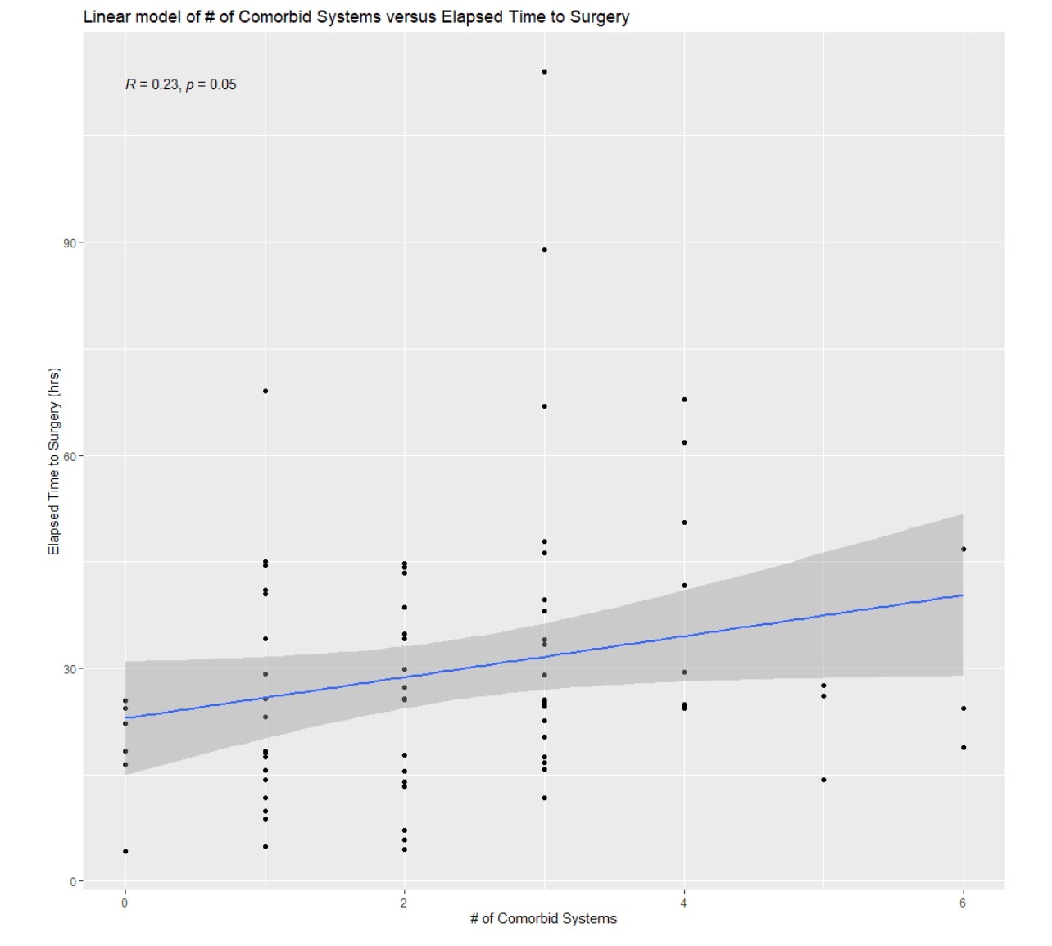
Oklahoma State University Department of Orthopedic Surgery
Evaluation of Time to Surgery for Geriatric Hip Fractures and the Impact of Multiple Comorbidities
Jeremy Scott, DO; Amar Patel, DO; Arjun K. Reddy, BA; Griffin K. Hughes BS, BA; Brent Norris, MD
INTRODUCTION
RESULTS
Discussion
With more than 300,000 occurrences each year in the United States, geriatric hip fractures have become a significant medical and financial burden (Brauer et al. 2009). It is estimated that the direct financial burden of all hip fractures in the United States is just under $6 billion (Adeyemi and Delhougne 2019). Older patients who suffer hip fractures typically have multiple coexisting medical conditions that impact their overall health, treatments, and outcomes (Menzies et al. 2012). These same comorbidities can delay the time to surgery (Hoehmann et al. 2020), perioperative complications (Lefaivre et al. 2009), and length of stay(Al-Ani et al. 2008). However, current research supports earlier operative fixation with increased risk of complications such as DVTs and pneumonia after 24 hours (Shiga et al. 2008) and elevated risk of 30 day and 1 year mortality with delays greater than 48 hours (Roberts et al. 2003).
The purpose of this study was to evaluate the time to surgery in geriatric hip fractures and to determine if concomitant medical comorbidities significantly delayed surgical intervention. We hypothesize that time to surgery will be greater in those patients with more medical comorbidity. Our primary outcome measure is to determine mean time to surgery. Our secondary outcomes are to identify those illnesses or combination of illnesses that cause delay in surgical intervention and to evaluate time to discharge.
Table: Relationship between Comorbidities and Time to Surgery
 | Number of patients | p-value*
Cardiology | 62 | 0.08875
Pulmonology | 22 | 0.06616
GI | 21 | 0.95591
GU | 13 | 0.93894
Rheumatology | 21 | 0.85239
Renal | 13 | 0.62078
Psychiatry | 25 | 0.84627
*Stats comparing with and without comorbidity
Operative Delays for geriatric hip fractures can increase patient morbidity and mortality. Our average time for all hip fractures to the OR is 29.8 hours, which approaches the gold standard of <24 hours. Geriatric hip fracture patients with comorbidities are quickly being medically stabilized. Our data shows that there is no difference in time to surgery for patients with and without medical comorbidities. For all ortho surgeons who regularly treat hip fractures at OSU, OR availability is the main hurdle to achieving this standard.
Time to discharge was 5.1 days, which falls within the lowest likelihood for patient mortality according to Nikel et al. Further studies will be needed to evaluate factors affecting length of stay.
Our 1-year mortality rate is 13.3, which is less than the national average, per Schnell et al.
CONCLUSION
METHODS
We aimed to analyze the overall time to surgery and the effects multiple comorbidities have on time to surgery and time to discharge. Our department goal is to have patients in the operating room within 24 hours and no later than 48 hours. We are largely successful with a mean time to the OR of 29.8 hours. Statistical analysis demonstrated no statistically significant delays with additional medical comorbidities.
All hip fractures treated at OSU between 7/1/21 and 8/30/22 were retrospectively identified and added to our study for a total of 75 patients (41 Fem, 34 Male). There were 49 Femoral neck fractures, 25 intertrochanteric hip fractures, and 1 periprosthetic hip fracture.
Time to surgery was recorded from the first note of arrival in the ER to the anesthesia start time listed on the procedural note. Average time to surgery was recorded.
Time to discharge was calculated using the anesthesia stop time from the procedural note to the time of discharge from hospital. Average time to discharge was recorded.
Comorbidities were recorded based on their problem list as established by their primary team. Comorbid conditions were grouped under 7 categories: Cardiovascular, Pulmonary, GI, GU, Renal, Rheumatologic, Psychologic
Statistical analysis was performed to determine the impact multiple comorbidities played on time to surgery.
Mean Time to Surgery: 29.8 hours, Median = 25.5 hours
Mean Time to Discharge: 123.4 hours (5.1 days), Median = 101.1 hours (4.2 days)
Average Comorbidities: 2.4
Most common: Cardio (64), Psych (25), Pulm (22)
No individual comorbidity showed a significant increase in time to surgery
Closest comorbidities to statistical significance were Pulmonology and Cardiology
There was no statistical significance in time to surgery of patients with comorbidities compared to those with none. An increase in concomitant comorbidities did not significantly increase time to surgery.
Three patients died within 30 days. An additional seven patients were deceased within one year of surgery. (13.3%)
70% of deceased patients had at least 3 comorbidities. All of them had some form of cardiovascular pathology.
While there is an increase in time for to surgery with increased comorbidities, an R= .23 demonstrates a small effect size, demonstrating that our action to surgery is minimally affected by number of comorbidites
REFERENCES
Adeyemi A, Delhougne G. Incidence and Economic Burden of Intertrochanteric Fracture: A Medicare Claims Database Analysis. JB JS Open Access. 2019 Feb 27;4(1):e0045.
Al-Ani AN, Samuelsson B, Tidermark J. Early operation on patients with a hip fracture improved the ability to return to independent living. A prospective study of 850 patients. J Bone Joint Surg Am. 2008;90(7):1436-1442.
Brauer CA, Coca-Perraillon M, Cutler DM. Incidence and mortality of hip fractures in the United States. JAMA. 2009;302:1573-1579.
Lefaivre KA, Macadam SA, Davidson DJ, Gandhi R, Chan H, Broekhuyse HM. Length of Stay, Mortality, morbidity, and delay to surgery in hip fractures. J Bone Joint Surg Br. 2009;91(7):922-927.
Menzies I, Mendelson D, Kates S, Friedman S. The impact of comorbidity on Perioperative Outcomes of Hip Fractures in a Geriatric Fracture Model. Geriatr Orthop Surg Regabil. 2012 Sep;3(3):129-134
Nikkel LE, Kates SL, Schreck M, Maceroli M, Mahmood B, Elfar JC. Length of hospital stay after hip fracture and risk of early mortality after discharge in New York state: retrospective cohort study. BMJ. 2015 Dec 10;351:h6246
Schnell S, Friedman SM, Mendelson DA, Bingham KW, Kates SL. The 1-year mortality of patients treated in a hip fracture program for elders. Geriatr Orthop Surg Rehabil. 2010 Sep;1(1):6-14.

