Slide 1
Anxiety and Depression in the COPD patient
Aaron Pierce, DO

Slide 2
Disclosure
I have no relevant financial relationships or affiliations with commercial interests to disclose.

Slide 3
Objectives
Briefly review COPD pathology and treatment
Review
  Prevalence of anxiety and depression in COPD
  Possible effect of anxiety and depression on COPD and vice versa
  Explore treatment options
Briefly review smoking cessation in COPD

Slide 4
Chronic Obstructive Pulmonary Disease
Progressive obstruction of small airways
  Chronic bronchitis
    Excessive mucous production and inflammation
  Emphysema
    Destruction of elastic tissue and enlargement of airspace
  Most patients have elements of both
  80-90% secondary to smoking
  4th leading cause of death
  Diagnosis confirmed by FEV₁/FVC less than 0.7
Notes:
Category of lung disease including primarily chronic bronchitis and emphysema that is marked by obstruction of the small airways that is poorly reversible it is almost always secondary to abnormal inflammatory response to irritants
CB- narrowing because of inflammation and exudates
Emphysema- Tissue destruction of alveolar walls and attachments and enlargement of airspace resulting in increased compliance of lung
Patients with asthma with poorly reversible airway obstruction also have a form of COPD
COPD secondary to abnormal inflammatory response to irritants only 10-15% of smokers will get it however
Suspected in those with risk factors and dyspnea with rest or exertion, cough with or without sputum production, and wheezing
FEV1 the amount of air a person can breathe out in one second forcefully after taking a deep breath

Slide 5
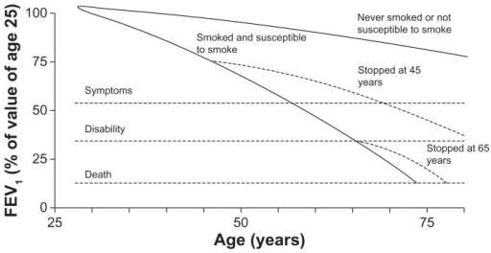
Notes:
Most patients with COPD have mild COPD that may improve or stabilize with smoking cessation

Slide 6
COPD exacerbations
Global Initiative for Chronic Lung Disease (GOLD)
  Acute event characterized by worsening of respiratory symptoms that is beyond day-to-day variations and leads to a change in medication
  Increase in cough frequency or severity
  Increase in sputum production
  Worsening of dyspnea
Severity based on treatment required
Notes:
Mild- increase in home medications
Moderate- Steroids &/or Abx
Severe- hospitalization

Slide 7
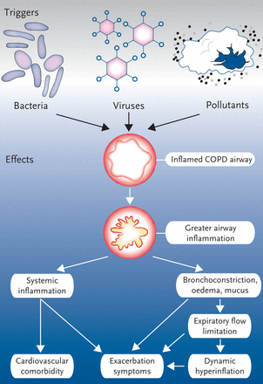
Notes:
Majority of COPD exacerbations are triggered by respiratory viral infections especially the common cold.
Providers may provide patients with a COPD action plan with lists of symptoms that may be present and what to do about them should they occur. E.g., coughing more than usual, using inhaler or nebulizer more often, etc where they may be directed to start an oral corticosteroid or antibiotic, or use of oxygen and to call provider if symptoms do not improve or may be directed to seek care immediately with symptoms such as severe SOB even with rest or feeling confused or drowsy.

Slide 8
COPD treatment
Treatment
  Smoking cessation
  Pharmacotherapy with inhaled bronchodilators and corticosteroids
  Vaccinations
  Oxygen therapy
  Pulmonary rehabilitation
Notes:
Flu and pneumococcal vaccines
Long term o2 therapy for hypoxic patients
Pulmonary rehabilitation consists of structured programs with multidisciplinary health care teams to provide exercise training, education, nutritional counseling, and behavioral modification

Slide 9
Anxiety disorders in COPD
Generalized anxiety disorder 6-33%
  1.9-5.15 general population
Panic disorder 6-67%
  Even with conservative estimates >10X general population
Social phobia 5-11%
  1-2% general elderly population
Notes:
panic disorder is distinguishable in COPD patients by anticipatory anxiety about future panic attacks, and the unexpected and unpredictable nature of at least some of these attacks, that do not occur solely in response to situations inevitably causing shortness of breath in COPD (such as physical exertion, or infective exacerbations).

Slide 10
Effect of anxiety
Difficulty with smoking cessation
Alcohol abuse
Avoidance of physical activity
Treatment compliance
Worsened dyspnea and exercise tolerance
Overall worsening of QOL independent of COPD
At greater risk of exacerbations
Notes:
Avoiding physical activity could also affect time spent with others in activities and thus social support in addition to further deconditioning
Non-adherence to treatment with medications is common for patients with depression and anxiety
Worsened dyspnea which may lead to unnecessary medical attention and admissions to the hospital.

Slide 11

Biological factors of panic in COPD
CO₂/H⁺ sensitive neurons involved with ventilation and panic symptoms
  Induction of panic by infusion of lactate or inhaled CO₂ in PD pts.
  Low intracellular pH trigger for NE release
Anxiety $→$Hyperventilation $→$ Hyperinflation $→$ Increased dyspnea $→$ Anxiety
Beta agonists and oral corticosteroids
Nicotine withdrawal
Notes:
CO2/H+ sensitive neurons such as those found in medulla and locus ceruleus
Higher sensitivity to carbon dioxide has been associated with
more dyspnea among patients with COPD

Slide 12
Biological factors of panic in COPD
Increased sensitivity to CO₂ associated with more dyspnea in COPD
39 COPD patients exposed to increased CO₂ tension
FEV₁ not significantly different
Normal CO₂ sensitivity
  Severe dyspnea
  Normal blood gases
Decreased CO₂ sensitivity
  Mild dyspnea
  Increased PaCO₂
  Hypoxemia
Notes:
Decreased sensitivity to CO₂ common in COPD

Slide 13
Biological factors of panic in COPD
Serotonin
  May modulate respiration in part by decreasing sensitivity to CO₂
  Sertraline shown to improve dyspnea without change in objective parameters
  Direct or indirect effect
Notes:
Such as FEV1 or blood gases

Slide 14
Cognitive factors of panic in COPD
Cognitive model
  Panic arises from catastrophic misinterpretation of bodily or mental sensations
Interaction of belief and trigger
  Trigger- slight increase in dyspnea when walking to mailbox
  Belief- “worsening SOB means that I will certainly be hospitalized again and need to be intubated”
  Result- panic symptoms and worsening SOB and future avoidance of activity
Notes:
Meaning those with panic interpret these sensations as being more dangerous than they actually are…
Trait- cognitive disposition, e.g., shortness of breath means that I will certainly end up hospitalized…
Trigger- internal or external

Slide 15
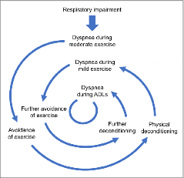

Slide 16
Cognitive factors of panic in COPD
Dyspnea
  Similarity to pain
    Neurological and emotional aspects
    No external reference to measure by
    Influenced by beliefs and sense of control

Slide 17
Differences in pulmonary function with anxiety in COPD
No difference in PFT’s and response to bronchodilators in COPD with panic attacks and those without
Moore and Zebb (1999)
  28 pts with COPD or asthma
  32% with panic disorder
    No significant difference in FVC or FEV₁ versus non-panic group
Regvat et al. (2011)
  50 pts hospitalized with AECOPD
  50% with anxiety and/or depression
  No difference in FEV₁
  Those with anxiety and/or depression had significantly higher PaO₂, lower PaCO₂, and higher pH

Slide 18
Differences in pulmonary function with anxiety in COPD
Vogele and Leupoldt (2008)
  20 hospitalized pts mild/mod COPD
  No significant difference in FEV₁/FVC or PaO₂ in those with and without anxiety
  Self-report Inventory of Somatic Symptoms
    Higher somatic symptom perception in several domains in anxious group
Notes:
There was no systematic association between anxiety levels and respiratory function in the whole COPD group, but a positive correlation between anxiety levels and perceived physical symptoms (po0.001) as well as negative cognitions (po0.001 and po0.05, respectively) for COPD patients with anxiety disorder (N 1⁄4 11).
Cardiovascular, respiratory, GI, Musculoskeletal. Questionnaire uses 1-7 scale of frequency of noticing somatic symptoms

Slide 19
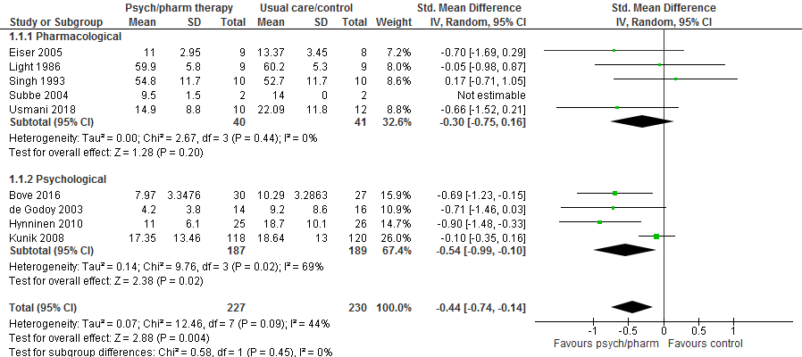
Notes:
Authors do note that poor methodological quality and small sample sized may be contribute to small effect or no effect from medications.
Paxil, Doxepin, Buspirone, Celexa, Paxil
SSRI’s inconclusive
May help with dyspnea
Usmani et al. 2018 meta analysis
Only five studies met criteria
SMD -0.30 (CI -0.75 to 0.16, p=0.20)
Poor methodological quality and small sample sizes
Contradictory reports for buspirone
Global Initiative for Obstructive Lung Disease (GOLD)
Anxiety and depression in COPD patients should be approached no differently than with other patients
Global Initiative for Obstructive Lung Disease (GOLD)
Anxiety and depression in COPD patients should be approached no differently than with other patients

Slide 20
Treatment of anxiety in COPD- Medications
Momtaz et al. (2014)
50 pts with severe COPD with depression and/or anxiety
  Group I- Prozac 20mg daily X 3months
  Group II- TAU
Group I-
  Dyspnea scale, oxygenation, and PFT’s significantly improved from baseline and not in Group II
  HAM-A 24.45 → 20.56 (p=0.01)
    Significantly negative correlation with FEV₁ (r: -0.74, p=0.001)

Slide 21
Treatment of anxiety in COPD- Medications
Benzodiazepines
  May blunt response to hypoxia which may worsen hypercapnia
  Low doses (<1/3 of usual dose)
    Not associated with increased admissions or mortality
  Higher doses
    Not associated with increased admissions
    Mortality was increased in a dose-dependent fashion
  May help respiratory efficiency
  Short acting benzodiazepines preferred
Gabapentoids
  Lower dosage range safe
Notes:
COPD patients may have lower sensitivity to CO2 and rely on lowered O2 levels to drive respiration.

Slide 22
Treatment of anxiety in COPD- Psychotherapy
Heslopp-Marshall et al (2018)
  RCT of cognitive behavioral therapy
  279 COPD patients with anxiety
  Randomized to brief CBT or self-help leaflets
  Outcome based on anxiety subscale of Hospital Anxiety and Depression Scale
    Minimal clinically important difference = 1.32
  Mean difference in CBT group vs. control = 1.52 (p=0.003)
  Fewer hospital admissions and and ED visits in CBT group
Notes:
Delivered by respiratory nurses

Slide 23
Treatment of anxiety in COPD- Progressive Muscle Relaxation
Progressive muscle relaxation
  Tensing specific muscle groups and slowly relaxing them in order
  Breathing exercises and guided imagery may also be used
Renfroe (1988)
  RCT of 20 COPD patients
  PMR group given instruction and audio tape of relaxation exercise, encouraged to practice
  Evidence of mastery
    Significantly greater decrease in HR, 6.76 and RR, 3.33 versus control
  Reduction in anxiety, dyspnea, and FVC compared to control group
Notes:
Patients were divided into a treatment group (n = 12) and a control group (n = 8). Patients in the treatment group underwent four weekly sessions of live PMR plus daily home practice with taped instructions. The effect of the independent variable, PMR, was measured during each session and at the end of 4 weeks. Measurements were made before and after treatment of the dependent variables, dyspnea and anxiety. Instruments used were Spielberger's State Anxiety Inventory for anxiety and a 20 cm visual analogue scale for dyspnea. Heart rate (HR), respiratory rate (RR), forced vital capacity (FVC), and forced expiratory volume in 1 second (FEV1) were also measured. Data analysis was done by using two-tailed t tests and Pearson's correlation coefficient. Reductions in anxiety and dyspnea were positively correlated during each session (r = 0.37) and at the end of 4 weeks (r = 0.60). PMR was shown by t tests to be more effective than the control in reducing dyspnea (p = 0.04), anxiety (p = 0.001), RR (p = 0.000), and HR (p = 0.05) during each session but only RR (p = 0.04) at the end of the 4-week period. Dyspnea and RR were correlated positively during each session (r = 0.21). Dyspnea and state anxiety were correlated positively at the end of 4 weeks with RR (r = 0.62) and HR (r = 0.50).

Slide 24
Treatment of anxiety in COPD- Progressive Muscle Relaxation
Gift et al. (1992)
  RCT of 26 pts
  PMR group used prerecorded instruction and encouraged to practice at home
  Mastery demonstrated by increase in temp of 2.2◦C, decrease in HR and RR of 6.5 and 4.8 respectively
  Significantly decreased anxiety, dyspnea, and increased peak flow

Slide 25
Treatment of anxiety in COPD- Pulmonary Rehab
Pulmonary rehabilitation
  Exercise program
  Breathing exercises
  Education
    Managing exacerbations
    Proper use of medications and oxygen
  Nutrition counseling
  Stress management
  Smoking cessation
Several mechanisms of change in anxiety
Notes:
The ideal patient for PR is one with functional limitations, moderate-to-severe lung disease, who is stable on standard therapy, without comorbid serious or unstable medical conditions, willing to learn about the disease, and motivated to devote time and effort necessary to benefit from a comprehensive care program.188
The interdisciplinary team of health-care professionals in PR may include physicians, nurses, respiratory and physical therapists, psychologists, and exercise specialists.15
PR programs operate by means of progressive exercise, training of respiratory function, and psychoeducation, so that patients obtain better exercise tolerance with less dyspnea. The goal is to restore the patient to the highest possible level of independent function.189 Patients are educated about their disease and learn breathing techniques to reduce air hunger and exercises to optimize oxygen use, and this in turn improves exercise tolerance. Key outcomes such as exercise capacity and overall health-related quality of life may be accurately measured.190–192
In PR settings, patients learn that they can have increases in activity levels and in dyspnea without perceiving that increase in dyspnea as a medical crisis. When patients experience their symptoms safely, they become desensitized by learning to distinguish between physical and emotional symptoms. They come to learn what shortness of breath is okay and what shortness of breath is not okay.

Slide 26
Treatment of anxiety in COPD- Pulmonary Rehab
Coventry and Hind (2007)
  Systematic review and meta-analysis
  Three studies (n=269) showed that comprehensive PR significantly more effective vs standard care in reducing anxiety (SMD = -0.33, CI: -0.57 to -0.09, p=.008)
  Education alone and exercise alone did not significantly reduce anxiety

Slide 27
Treatment of anxiety in COPD- Pulmonary Rehab
Emery et al. (2003)
  Supervised 10 week program
    Exercise
    Education
    Stress management techniques
  Significant reduction in anxiety and improved endurance
  Attendance at education and stress management sessions alone did not help
Notes:
In COPD patients, several studies have shown that pulmonary
rehabilitation reduces anxiety [37, 39, 62–65]. EMERY et al. [66]
demonstrated that supervised exercise training performed
over 10 weeks, combined with education sessions that included stress management techniques, yielded significant
reductions in symptoms of anxiety. In contrast, attendance at
the education and stress management sessions without
supervised exercise training did not improve anxiety, indicating
that exercise training, rather than education, is the
component of a comprehensive pulmonary rehabilitation
programme capable of improving such symptoms [66].
Nevertheless, without adherence to an effective exercise
maintenance programme, the longevity of any reduction in
anxiety demonstrated on completion of a comprehensive
pulmonary rehabilitation programme was ,12 months [63,
67]. The addition of target-flow inspiratory muscle training to
pulmonary rehabilitation did not confer additional benefit [68].
The effects of chronic disease self-management on symptoms
of anxiety have not been established [12, 22].

Slide 28
Depression in COPD
Around 40% of those with COPD have significant depression
More common in COPD than some other chronic illnesses
Quality of life more correlated to depression than FEV₁
Notes:
Some differences in the way that depression was measured but probably 40% of those with COPD have clinically significant depression
Such as those with heart disease and cancer
The correlation between depressed mood and disease severity is modest;21 but depression
symptoms are important correlates of perceived selfreported
physical disability and poorer quality of life.85 Guilty
feelings stemming from the sense of burden patients impose
to their environment, in combination with the responsibility
they might think they have for the occurrence of the disease,
especially concerning ex-smokers, aggravates depressive
symptomatology.92

Slide 29
Depression in COPD
Bidirectional relationship likely between COPD and depression
COPD may increase risk of developing depression
  Highest within first year following diagnosis
Depression may increase risk of exacerbations requiring admission and mortality
Notes:
In a prospective population based study in newly diagnosed (n = 38, 010) COPD patients in four to eight years follow-up, the new onset of depression was 88% higher in COPD patients compared to their aged sex-matched controls [15]. The risk of developing depression was the highest within the first year following the diagnosis of COPD and tends to decline over-time.
Fan et al- increased risk of mortality even after adjusting for disease severity
Laurin- However, because of the limited sample sizes and the weaknesses of each individual study included, the conclusions drawn from a pooled analysis needed to be interpreted with caution. The need for further well-conducted prospective studies powered to look at the specific and independent impact of anxiety and depression on COPD exacerbations is therefore still apparent

Slide 30
Effect of COPD on depression
Inflammation
  Anxiety and depressed mood induced by endotoxin exposure
    Positively correlated with cytokine secretion
  MDD occurs in about a quarter of pts given interferon for Hep C
  COPD associated with increased inflammatory markers
    CRP, WBC, IL-6,IL-8, and fibrinogen
  Remission of depression accompanied by normalization of inflammatory markers
  Inconsistent associations found between inflammatory markers in COPD and depression

Slide 31
Effect of COPD on depression
Loss of functionality
  Decreased mobility
  Inability to continue work or recreational activities
  Shifted roles in family or work
  Social isolation
Notes:
Loss of functionality is a strong mediator of development of depression in chronic illness.
For those with severe illness who may have to use mobility devices. Consideration has to be made to not running out of oxygen when planning outings for those who need it.

Slide 32
Effect of Depression on COPD
Depression associated with chronic low-grade inflammatory response
Stress may play role in release of pro-inflammatory cytokines
  Reduced availability of tryptophan possible mechanism
Hyperactivity of HPA axis and hypercortisolemia associated with stress and depression
Relationship and causality not clear
Possible worsening of COPD symptoms secondary to weakened immunity and increased inflammation?
Notes:
Antidepressants particularly SSRIs seem to decrease the production of pro-inflammatory cytokines. Lowering of IL-6 associated with response to antidepressants.
Schiepers et al. 2005 The central action of cytokines may also account for the hypothalamic-pituitary-adrenal (HPA) axis hyperactivity that is frequently observed in depressive disorders, as proinflammatory cytokines may cause HPA axis hyperactivity by disturbing the negative feedback inhibition of circulating corticosteroids (CSs) on the HPA axis. Concerning the deficiency in serotonergic (5-HT) neurotransmission that is concomitant with major depression, cytokines may reduce 5-HT levels by lowering the availability of its precursor tryptophan (TRP) through activation of the TRP-metabolising enzyme indoleamine-2,3-dioxygenase (IDO). Although the central effects of proinflammatory cytokines appear to be able to account for most of the symptoms occurring in depression, it remains to be established whether cytokines play a causal role in depressive illness or represent epiphenomena without major significance.
There is now evidence that in experimental animals, different types of psychosocial stressors increase systemic and CNS levels of pro-inflammatory cytokines, including IL-1 and IL-6. In humans, there is evidence that different types of
psychosocial stressors may stimulate the pro-inflammatory cytokine network, including increases in IL-6 and TNFα [25-28]

Slide 33
Effect of Depression on COPD
Depressed pts more likely to
  Start smoking and continue smoking
  Have poor adherence to medications and pulmonary rehabilitation
  Have decreased physical activity
  Fail to report symptom deterioration and seek help
Notes:
Decreased physical activity and further deconditioning
Low motivation and energy and hopelessness may impact decision to seek help when needed. This may be one reason that those with depression seem to have a higher rate of in hospital treated exacerbations as those with anxiety who may report symptoms sooner.

Slide 34
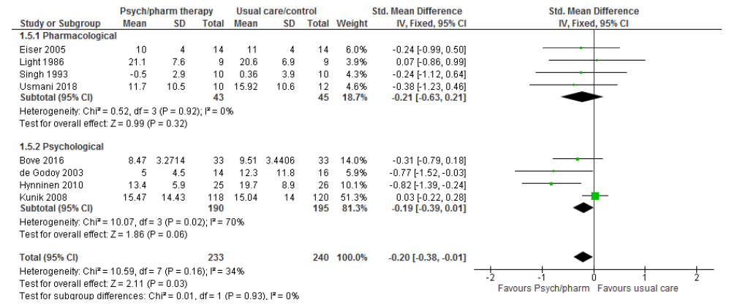
Notes:
Antidepressants
Current lack of quality studies to prove benefit
Some studies do show benefit
Depression
Dyspnea
Walking distance
Quality of life
National Institute of Clinical Excellence guideline NICE
Recommends AD therapy for mod-severe depression in physical illnesses including COPD

Slide 35
Safety of Antidepressants in COPD
Vozoris et al. 2018
  Retrospective study
  Small but significant increases in
    Hospitalization or pneumonia (HR 1.15, 95% CI 1.05-1.25)
    ER visits for COPD or pneumonia (HR 1.13 95% CI 1.03-1.24)
    All-cause mortality (HR 1.20 95% CI 1.11-1.29)
Qian et al. 2013
  Retrospective study
  Lower mortality with antidepressant treatment
    HR=0.43 95% CI 0.36-0.51

Slide 36
Treatment of Depression in COPD- Pulmonary Rehab
Pulmonary rehabilitation
  Retrospective study
  105 pts completing >6 sessions
  73% with significant improvement in depression
  19% with no change
  8% with worsening depression
  Higher depression at baseline more likely to respond
Notes:
Typically, pulmonary rehabilitation integrates several components that include assessment, education, exercise, nutritional intervention, psychological support, and evaluation

Slide 37
Treatment of Depression in COPD- Pulmonary Rehab
Small RCT (n=24)
8 weeks of PR in treatment group
Significant improvement
  Depression
  Overall symptoms, activity, impact of illness
  Dyspnea
Improvement in depression not correlated with improvement in dyspnea
Notes:
Exercise, education, energy conservation techniques, and relaxation exercises.
Probably more than just improvement in dyspnea to account for improved mood.

Slide 38
Smoking cessation in COPD
Most effective measure for controlling progression
Improves responses to bronchodilator drugs and inhaled CS
Reduces incidence of acute exacerbations and bronchial infections
About 40% of COPD patients are active smokers
Some studies show no difference in motivation to quit versus non-COPD smokers

Slide 39
Smoking cessation in COPD
Education of importance of stopping
  Slowing progression
  Decreased dyspnea, cough, exacerbations, infections
Assessment of motivation and self-efficacy
  Low self efficacy- treatment and support critical
  Low motivation- effective health education and motivational interviewing
    RCT using spirometry to show lung age
      Significant difference in success compared to control
      NNT=14
Notes:
Self-efficacy can be determined by asking how confident of success they would be if they were to quit smoking
Although evidence is lacking to support routine screening with spirometry, one RCT showed that providing smokers older than 35 years with their lung age through spirometry in addition to patient education promoted successful smoking cessation at one year compared with a control group (13.6% and 6.4%, respectively; P = .005; number needed to treat [NNT] = 14).14
Parkes G, Greenhalgh T, Griffin M, Dent R. Effect on smoking quit rate of telling patients their lung age: the Step2quit randomised controlled trial. BMJ. 2008;336(7644):598-600.

Slide 40
Smoking cessation in COPD
Assessment of nicotine dependence
  May still be high despite low total number of cigarettes/d
  Smoking within 30 minutes of awakening sign of high dependence
Discussion of previous attempts at quitting
  Most take 4-7 times to successfully quit
Counselling
  Education
  Setting quit date
  Non-judgmental stance
  Motivational interviewing techniques
  Group interventions equally effective as individual support

Slide 41
Smoking Cessation in COPD
Nicotine replacement therapy
  Several forms
  Increase risk of quitting 50-70%
  No clear differences between forms
  Combining patch with oral form more effective than either alone
Notes:
Gum, patch, nasal spray, inhaler, lozenges

Slide 42
Smoking cessation in COPD
Varenicline
  RCT of 504 smokers with COPD
  Continuous abstinence rate weeks 9-52 18.6% versus 5.6% (OR, 4.04; 95% CI, 2.13-7.67; P<.0001)
Bupropion 150mg bid
  RCT of 404 smokers with mild-mod COPD
    Abstinence rate of 16% versus 9% for placebo at 6 months (p=<0.05)
  Somewhat less effective than combination NRT or varenicline
Combined varenicline and buproprion more effective than varenicline alone
  71% abstinence rate versus 43.8% (CI, 1.11-8.92; p=0.16)
  Only in heavily dependent smokers

Slide 43
Summary
Anxiety and depression are common problems in COPD
Bidirectional relationships between COPD and anxiety and depression likely
Approach to treatment multifaceted
  Medications
  Psychotherapy
  Pulmonary rehabilitation
Smoking cessation critical in COPD and more difficult with untreated anxiety and depression

