Slide 1
Evaluation and Management of Hip Pain in the Primary Care Setting
Nicholas Thompson D.O. CAQSM
Warren Clinic Orthopedics and Sports Medicine

Slide 2
Disclosures
I have no relevant financial relationships or affiliations with commercial interests to disclose.

Slide 3
Objectives
Discuss differential diagnosis of hip pain
Develop approach for evaluation of hip pain
Review structure and function of the hip
Summarize special tests used in the evaluation of hip pain
Become more comfortable with treating common hip complaints in your office

Slide 4
Why Do We Care?
Hip pain is a common presentation in primary care and can affect patients of all ages. In one study, 14.3% of adults 60 years and older reported significant hip pain on most days over the previous six weeks. ⁴
Differential diagnosis for hip pain is vast.
Knowing location and common diagnoses can guide treatment decisions
Many of these can be treated in the primary care office.
Christmas C, Crespo CJ, Franckowiak SC, et al

Slide 5
Causes of Hip Pain
Extra-articular causes
Extra-articular bony impingement
Trochanteric-pelvic impingement
Ischio-femoral impingement
Subspine impingement
Capsular problems
Capsular laxity or atraumatic instability
Adhesive capsulitis
Snapping hip
Internal (iliopsoas over iliopectineal eminence, FH, or LT)
External (posterior border of ITB or anterior GM tendon over GT)
Snapping bottom (proximal hamstring over ischial tuberosity)
Lateral hip pain
Recalcitrant trochanteric bursitis
Gluteus medius and minimus tears
Piriformis syndrome/deep gluteal syndrome
Pubic pain
Osteitis pubis
Athletic pubalgia/sports hernia/Gilmore’s groin
Sacroiliac joint pain
Myotendinous injuries about the hip and pelvis
Proximal adductor
Rectus femoris
Proximal hamstring
Avulsion injuries (ASIS, iliac crest, AIIS, pubis, ischial tuberosity, GT, and LT)
Stress fracture
Nerve compression syndromes
Intra-articular causes
Labral tears
Chondral injury
Ligamentum teres tears
Femoroacetabular impingement (cam, pincer, or combined)
Synovitis
Loose bodies—tumors (SOC, PVNS, OCD, DJD, and AVN)

Slide 6
Let’s Simplify Things

Slide 7
History
Age of the patient?
Pediatric
Adult
Timing of the pain?
Constant
Intermittent
Nocturnal
Where is the pain located?
Anterior- true hip pain
Lateral- tendinitis/ bursitis
Posterior- referred back pain
Wilson⁸

Slide 8
Exam: Bony Landmarks

Slide 9
Bony Landmarks
Radiology Assistant

Slide 10
Exam: Range of Motion
Abduction
Gluteus Medius
Gluteus minimus
TFL
0-45 degrees
Bates Guide to Physical Exam

Slide 11
Exam: Range of Motion
Adduction
Pectineus
Adductor magnus
Adductor minimus
Adductor longus
Adductor brevis
Gracilis
0-30 degrees
Bates Guide to Physical Exam

Slide 12
Exam: Range of Motion
Extension
Gluteus Maximus
Hamstring
Biceps femoris- long head
Semitendinosus
Semimembranosus
0-10 degrees
Bates Guide to Physical Exam

Slide 13
Exam: Range of Motion
Flexion
Iliopsoas
Rectus femoris
Sartorius
Pectineus
Iliacus
0-140 degrees
Bates Guide to Physical Exam

Slide 14
Exam: Range of Motion
Internal Rotation
Adductor longus
Adductor magnus
Adductor brevis
Gluteus medius
Gluteus minimus
Tensor fasciae latae
Pectineus
Gracilis
30 degrees
External Rotation
6 muscles
Piriformis
Gemellus Superior
Gemellus Inferior
Obturator Internus
Obturator Externus
Quadratus Femoris
50 degrees

Slide 15
Innervation
Hip adduction - obturator nerve (L2-4)
Thigh abduction - superior gluteal nerve (L4-S1)
Hip flexion - femoral nerve (L2-4)
Hip extension - inferior gluteal nerve (L5, S1-2)

Slide 16
Anterior Hip

Slide 17
Posterior Hip

Slide 18
Exam: Special Tests
Internally and externally rotate leg with patient in supine position.
Clicking or popping suggest acetabular labral tear

Slide 19
Exam: Special Tests
Flexion
Abduction
External Rotation

Slide 20
Exam: Special Tests
Flexion
Adduction
Internal Rotation

Slide 21
Exam: Special Tests
Patient actively flexes the opposite hip toward the chest
Positive test is knee flexion in the extended leg
Suggests tightness in the hip flexors and psoas

Slide 22
Exam: Special Tests
Utilized to evaluate for tightness of IT Band
Extend and abduct the hip joint.
Slowly lower the leg toward the table -adduct hip- until motion is restricted.

Slide 23
Exam: Special Tests
Lateral Recumbent position
Flexion
Adduction
Internal Rotation

Slide 24
Exam: Special Tests
Trendelenburg test
Positive test indicative of week hip abductors
Gluteus Medius
Gluteus Minimus

Slide 25
Exam: Imaging
X-ray
X-ray
X-ray
AP Pelvis with lateral view of painful side
Dunn view
hip joint is flexed 90° and abducted 20° while the pelvis remains in neutral rotation
Modified Dunn view
45° hip flexion in a neutral rotation
Not improving with conservative treatment → MRI

Slide 26
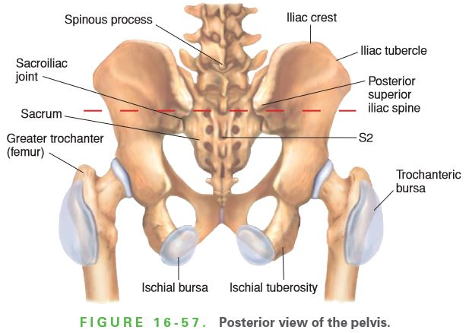
Diagnosis
HIP PAIN
Anterior
Lateral
Posterior
Intra-articular Pathology
Hip Flexor Injury
Apophyseal Avulsion Injuries
Greater Trochanteric Pain Syndrome
Meralgia Paresthetica
ITB Syndrome
Lumbar Radiculopathy
Piriformis Syndrome
SI Joint

Slide 27
Potential Diagnosis Based on Location
Foster, Z.

Slide 28
Case 1:
59 y.o. male presents today with c/o left knee pain that started 3 months ago. There was not an injury associated with the episode. The patient currently rates the pain at a 9. Pain is made worse with activity better with rest. Previously tried conservative therapies include none
Upon exam, patient noted to have severe limitations with hip ROM.
Knee Exam:
Knee Effusion: None.
Ecchymosis: none
Knee ROM: normal
Tenderness: none
Hip Exam
+FABER, +FADIR, severely reduced IR and ER of the left hip, flexion to 90 degrees.

Slide 29
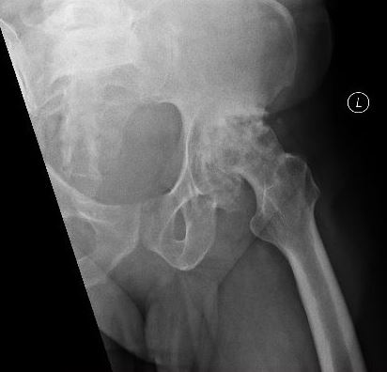
Osteoarthritis

Slide 30
Hip Osteoarthritis
The lifetime risk is of developing symptomatic hip osteoarthritis is 25%.
Osteoarthritis is the most common cause of disability in adults.
Osteoarthritis ranks fifth among all forms of disability worldwide
Hip and knee osteoarthritis represent a substantial cause of disability worldwide and are responsible for approximately 17 million years lived with disability globally.

Slide 31
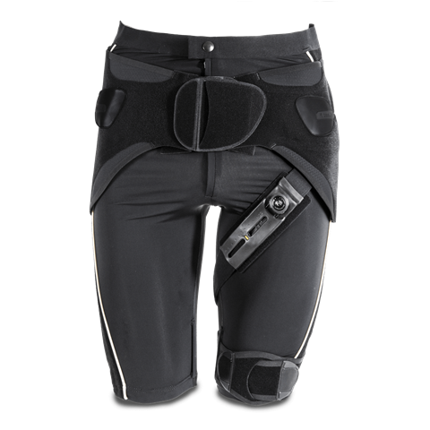
Osteoarthritis
Treatments
RICE
NSAIDs
Injections
Intra-articular under fluoroscopy or US guidance
Physical Therapy
Offloading with cane or walking stick
Offloading brace
Pain control with tramadol
Surgery

Slide 32
Osteoarthritis

Slide 33
Case 2:
59-year-old female presents for evaluation of right hip pain ongoing for 2 years.
She relates no known injury.
She was evaluated by her primary care physician and given a steroid injection into the right greater trochanteric region. She got about 2 months relief of her pain however symptoms have returned.
Gait: abnormal gait pattern
ROM: normal, full and equal
Strength:
3/5 hip abduction
4/5 hip adduction
5/5 hip flexion
Tenderness greater trochanter
Special testing:
FADIR negative
FABER negative
Log Roll negative
Thomas negative
Ober's positive

Slide 34
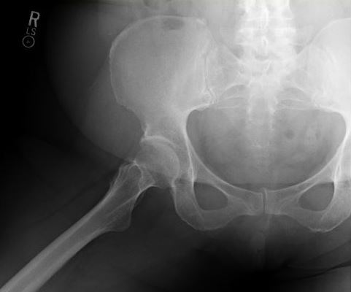
Greater Trochanteric Pain Syndrome

Slide 35
Greater Trochanteric Pain Syndrome
Up to 4 times more common in women⁴
Increased incidence in 40-60 year old’s⁴
Affects 10-25% general population⁴
Patient with persisting pain despite conservative treatment.
Proceeded with MRI

Slide 36
Greater Trochanteric Pain Syndrome

Slide 37
Greater Trochanteric Pain Syndrome
Treatments
Oral or topical NSAIDs
Home exercise plan
Physical Therapy
Injection
Would recommend 3 inch spinal needle for most patients
Dry Needling
ASTYM®
Tenotomy
PRP
MRI
Patient returned to office for follow up and review of MRI.
Persisting pain
Repeated trochanteric injection under US guidance
Sent to Physical Therapy
90% improvement

Slide 38
Injections
Greater Trochanteric Injection
Patient lays on the unaffected side.
Palpation over the symptomatic hip with localization to maximal tenderness
Clean the area
Consider lidocaine for skin anesthesia
While utilizing a 3 inch spinal needle, direct down over the point of maximal tenderness until you reach the greater trochanter
Aspirate
Proceed with injection
Remove needle and apply bandage.

Slide 39
Pediatric Hip Pain- Special Considerations

Slide 40
Case 3:
8 y/o male with left groin pain ongoing for about 3 years.
Initially started after doing splits.
The pain was rated 7/10.
He had been sent to PT and was taking Tylenol.
Concern for testicular issue and had been seen and evaluated by Urology with normal workup.
Was getting in trouble at school because he was unable to sit with crisscrossed legs on the floor
Gait: abnormal with guarding left side
ROM:
90 degrees flexion, 10 degrees extension, 10 degrees internal rotation, 10 degrees external rotation, 20 degrees abduction and 10 degrees adduction
Strength: limited by pain
Tenderness: groin
Special testing:
FADIR positive
FABER positive
Log Roll positive
Thomas positive
Ober's negative

Slide 41
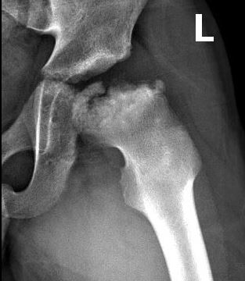
Legg Calve Perthes

Slide 42
Legg Calve Perthes
Idiopathic avascular necrosis of the proximal femoral epiphysis in children.
4-8 years is most common age of presentation
Male to female ratio is 5:1
Patient was sent to Pediatric Orthopedic Surgery in Oklahoma City
Had tenotomy performed and currently NWB in wheelchair

Slide 43
Pediatric Hip Pain
Radiology Assistant

Slide 44
Case 4:
13 y/o male with 8/10 left groin pain that started after kicking a football with his left foot and slipped but continued to kick it with forced hip flexion 2 weeks ago.
Patient heard a pop at time of injury.
Immediate onset of pain.
Pain with weightbearing.
He has tried NSAIDs and ice for the symptoms.
Gait: Walks with limp
ROM: limited by pain
Strength: normal
Tenderness: Left AIIS
Pain with resisted hip flexion
Special testing:
FADIR negative
FABER negative
Log Roll negative
Thomas negative
Ober's negative

Slide 45
Avulsion injury

Slide 46
Avulsion Injuries
Radiology Assistant

Slide 47
Avulsion Injuries
Avulsion injuries almost exclusively in adolescent patients
Ischial avulsion (54%)- Most Common
AIIS avulsion (22%)
ASIS avulsion (19%)
Pubic symphysis (3%)
Iliac crest (1%)
Treatment
< 2 cm displacement
Protected Weight Bearing Followed by therapy
> 2 cm displacement
ORIF

Slide 48
Rectus Femoris Avulsion
PWB
Advanced to PT
NSAID
Pain free

Slide 49
Case 5
58 y.o. male presents with c/o left hip pain that started 5 months prior. Pain is located on the anterior hip.
Patient bent down to pick up his heavy toolbox and felt a pop.
Pain is made worse with activity better with rest.
Was seen at an UC and also by PCP. XR obtained at PCP and reviewed.
ROM: 80 degrees flexion before pain, 10 degrees extension, 15 degrees internal rotation, 45 degrees external rotation, 40 degrees abduction and 10 degrees adduction
Stability: stable to testing
Strength: limited by pain
Tenderness TTP ASIS
Pain with resisted hip flexion.
Special testing:
FADIR positive
FABER positive
Log Roll negative
Thomas positive
Ober's negative

Slide 50
X-ray at PCP office
Diagnosed with OA of left hip

Slide 51
Repeat X-ray

Slide 52
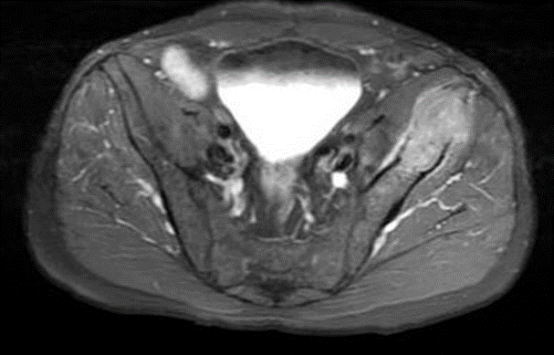
Metastatic Pulmonary Adenocarcinoma
MRI with and without contrast obtained which showed several large destructive masses.
Concerning for metastasis vs multiple myeloma
Referred to Orthopedic Oncology
PET/CT showed pulmonary lesion later diagnosed as adenocarcinoma

Slide 53
In Summary
Hip pain is a common complaint seen in the primary care office
Age of patient, location of pain, and timing of pain will offer diagnostic clues
Always get an x-ray
Consider advance imaging if pain is persisting despite conservative treatment
Treatment can be done by primary care physician in most cases
Refer if not responding as expected or for surgical considerations

Slide 54
Thank You

Slide 55
References
Battista, Chris. “Hip Physical Exam - Adult.” Orthobullets, 2018, www.orthobullets.com/recon/5037/hip-physical-exam--adult.
Bickley, Lynn S., et al. Bates' Guide to Physical Examination and History-Taking. Wolters Kluwer Health/Lippincott Williams & Wilkins, 2013.
Buhr, Craig. “Arthritis Facts.” Www.arthritis.org, 2017, www.arthritis.org/about-arthritis/understanding-arthritis/arthritis-statistics-facts.php.
Buono, A. Del, et al. “Management of the Greater Trochanteric Pain Syndrome: a Systematic Review.” British Medical Bulletin, vol. 102, no. 1, 2011, pp. 115–131., doi:10.1093/bmb/ldr038.
Christmas C, Crespo CJ, Franckowiak SC, et al. How common is hip pain among older adults? Results from the Third National Health and Nutrition Examination Survey. J Fam Pract. 2002;51(4):345–348.
Foster, Zoe. “Diagnostic Approach to Hip Pain .” 2018.
Gulick, Dawn. “ORTHOPEDIC SPECIAL TESTS: LOWER EXTREMITY.” ORTHOPEDIC SPECIAL TESTS: LOWER EXTREMITY, 2016, pdhtherapy.com/wp-content/uploads/2016/09/PROOF6_PDH_OrthopedicSpecialTests_LOWER-Extremity_StandAloneCourse.pdf.
Poultsides, Lazaros A., et al. “An Algorithmic Approach to Mechanical Hip Pain.” HSS Journal ®, vol. 8, no. 3, 2012, pp. 213–224., doi:10.1007/s11420-012-9304-x.
Wilson JJ, Furukawa M. Evaluation of the patient with hip pain. American Family Physician. 2014; 89(1): 27-34

