Slide 1
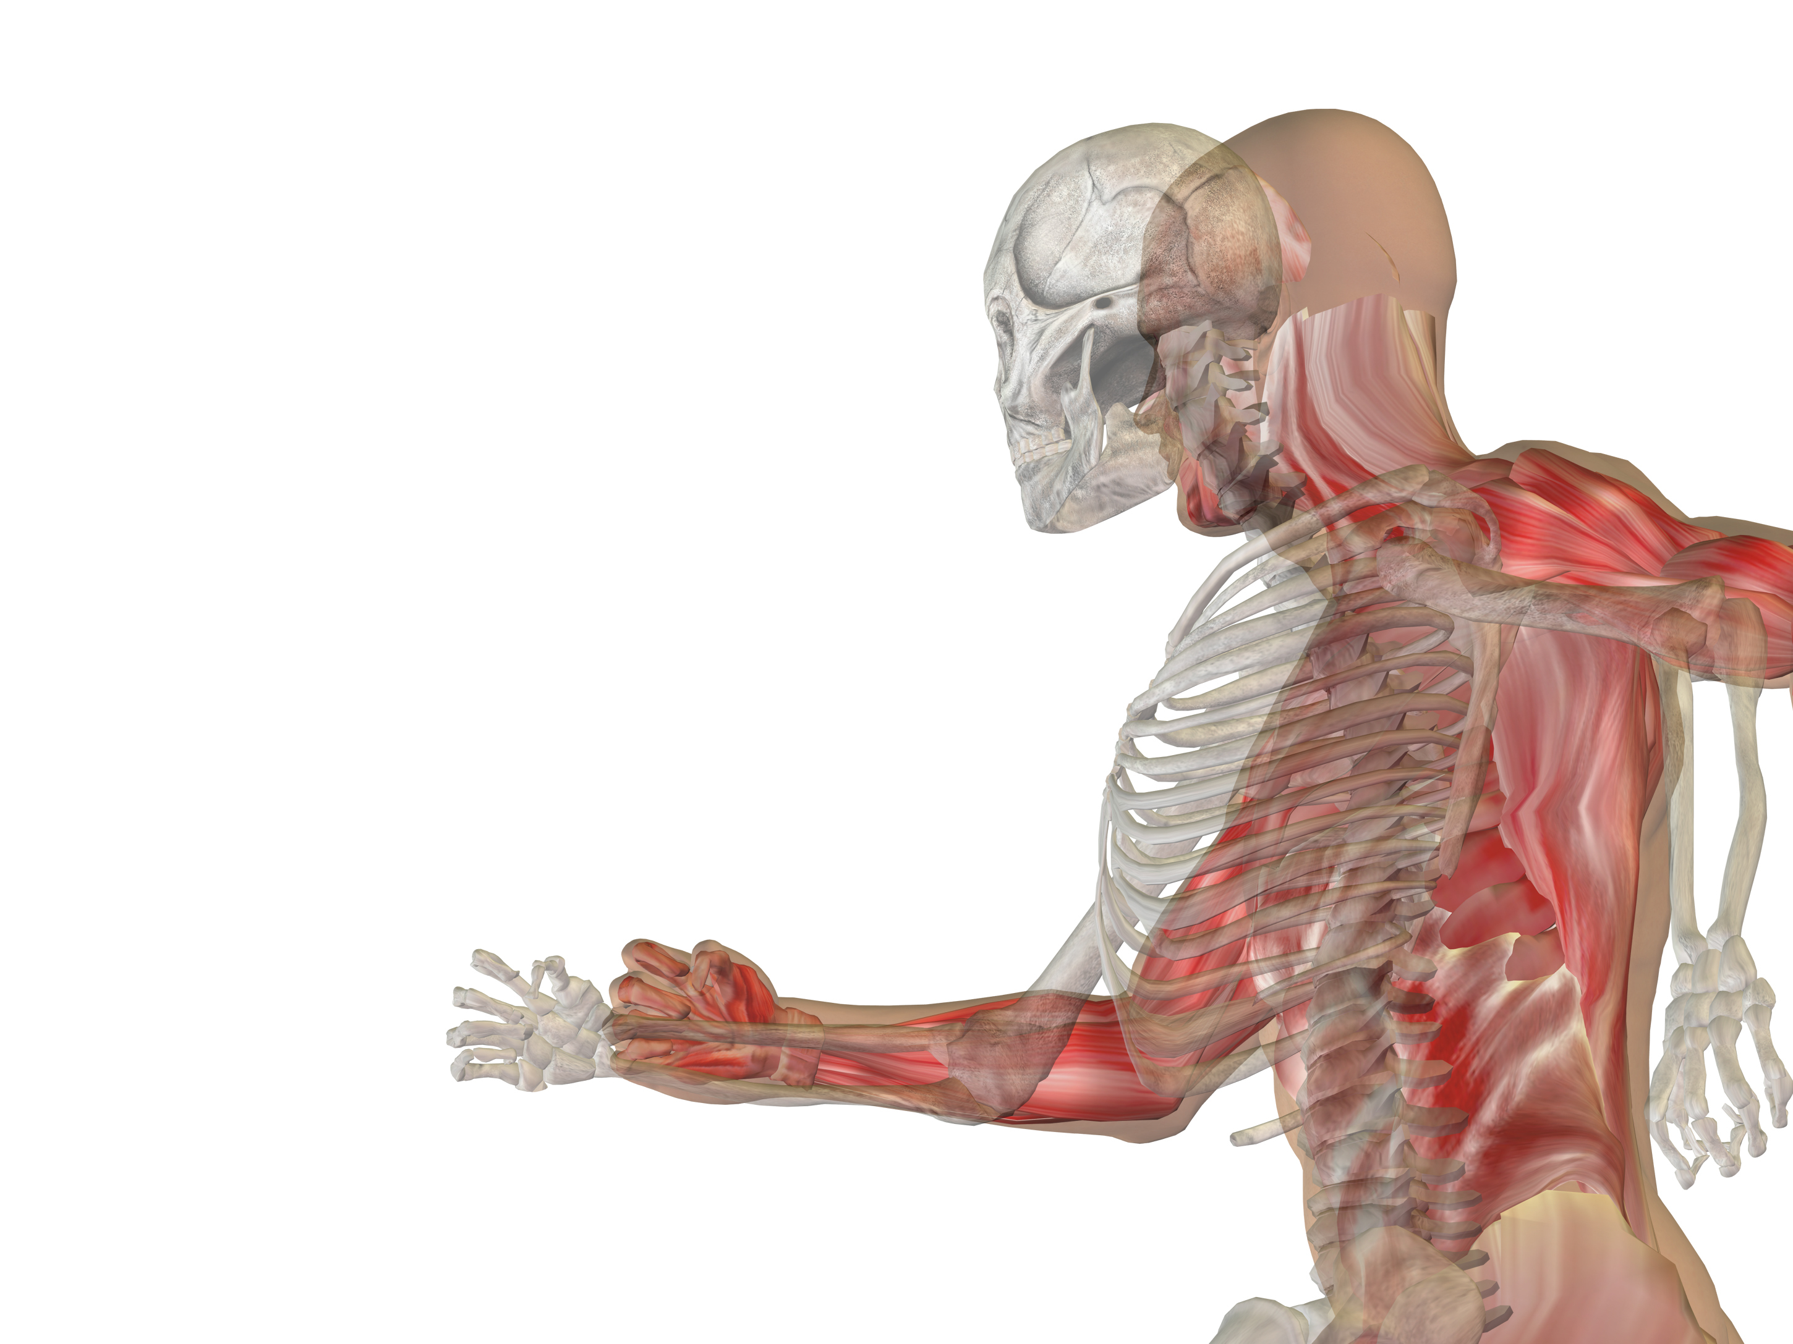

The Future of Osteopathic Medicine

Slide 2
Objectives
Discuss the state of Osteopathic Medicine today
Motivate us to maintain our unique approach to patient care as the medical system evolves.
DISCLOSURES
I have no conflicts of interest to report
I am speaking of my own opinions and not that of my institution or the AOA
The Future of Osteopathic Medicine
OSU Spring Fling 2019

Slide 3
WHY I BECAME A DO
The Future of Osteopathic Medicine
OSU Spring Fling 2019
Notes:
Wrestling, nutrition, exercise science, optimizing the health of the body. Fortunate to have found osteopathic medicine and OMM

Slide 4
WHAT IS OSTEOPATHIC MEDICINE
The Future of Osteopathic Medicine
OSU Spring Fling 2019
Notes:
Challenge of fighting for equality, new challenge is maintaining distinction. Story of MD pediatrician

Slide 5
WHAT IS AN OSTEOPATHIC PHYSICIAN?
DISTINCTIVES
FULLY QULAIFIED PHYSICIAN
PATIENT-CENTERED, HEALTH ORIENTED
HANDS ON SKILLS + MEDICAL ADVANCES
MOST COMPREHENSIVE CARE
A fully qualified physician
Trained within a context of a distinct patient centered, healthy oriented philosophy
To offer the most comprehensive care available.
Combines specialized diagnostic and therapeutic hands-on skills (OMM) with the latest advances in medical technology
The Future of Osteopathic Medicine
OSU Spring Fling 2019

Slide 6
OSTEOPATHIC MEDICINE
PHILOSOPHY
Disease is a result of a disruption in the body’s ability to heal itself.
Role of Physician is to assist healing by choosing treatment directed at patient’s mind, body + spirit
ALLOPATHIC MEDICINE
(OVERSIMPLIFIED)
Disease is primary caused by pathogen or biochemical imbalance.
Attempt to “cure” disease by choosing an intervention aimed at a specific disease
The Future of Osteopathic Medicine
OSU Spring Fling 2019

Slide 7
TENENTS OF OSTEOPATHIC MEDICINE
Treating the whole person, not just the diagnosis
Impact of emotion, trauma, environment
“The body is a unit of mind, body, and spirit”
1
“The body is capable of self-regulation, self-healing, and health maintenance”
What clears an infection? How does surgery work?
How do broken bones heal?
2
Lungs and alveoli
Capillaries vs Arteries
Stem cells grow based on environment
“Structure and function are reciprocally inter-related”
3
“Rational therapy is based on the above tenets”
“Within man’s body there is a capacity for health. If this capacity is recognized and normalized, disease can be both prevented and treated.”--- A. T. Still.
4

Slide 8
Do you have to use OMT to practice
Osteopathic Medicine?
What else distinguishes us from our MD collegues?
The Future of Osteopathic Medicine
OSU Spring Fling 2019
Notes:
Don’t have to use OMT, but hopefully the elements of OMT are considered at is used for a wide variety of conditions (referral). DO anesthesiologist feels osteopathic training shaped him differently

Slide 9
What is the current status of Osteopathic Medicine?
The Future of Osteopathic Medicine
OSU Spring Fling 2019
Notes:
Rapid growth and expansion, trying to find the direction of the future

Slide 10
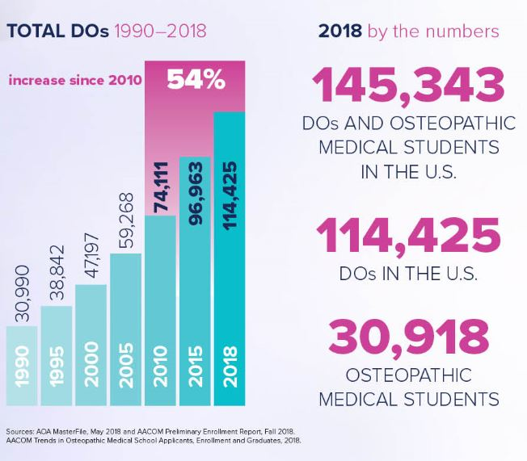
Growth of Osteopathic Medicine
The number of DO’s in the United States has tripled over the last 30 years
Slide borrowed from AOA Board of Trustees & PAC Midyear Retreat Meeting | February 24–26, 2019
The Future of Osteopathic Medicine
OSU Spring Fling 2019

Slide 11
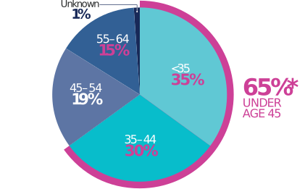
Osteopathic Physicians Are Young
Actively Practicing DO’s by age:
All Physicians by Age:
Slide borrowed from AOA Board of Trustees & PAC Midyear Retreat Meeting | February 24–26, 2019
The Future of Osteopathic Medicine
OSU Spring Fling 2019

Slide 12
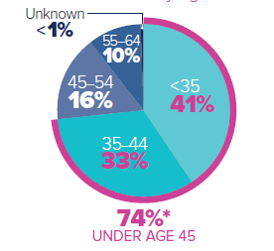
Osteopathic Physicians: Gender Diversity
Share of Female DO’s:
Female DO’s by age:
Females among ALL physicians
*More than doubled in 25 years
Slide borrowed from AOA Board of Trustees & PAC Midyear Retreat Meeting | February 24–26, 2019
The Future of Osteopathic Medicine
OSU Spring Fling 2019

Slide 13
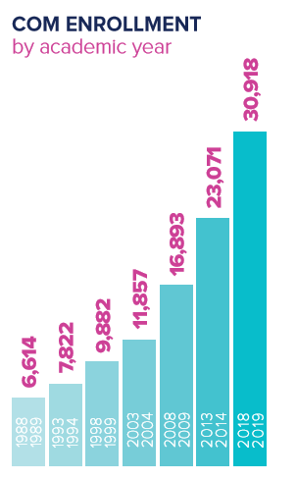
Growth of Osteopathic Colleges
1 in 4 medical student is in a COM
35 Colleges
55 Locations
30,918 Osteopathic Students
Slide borrowed from AOA Board of Trustees & PAC Midyear Retreat Meeting | February 24–26, 2019
The Future of Osteopathic Medicine
OSU Spring Fling 2019

Slide 14
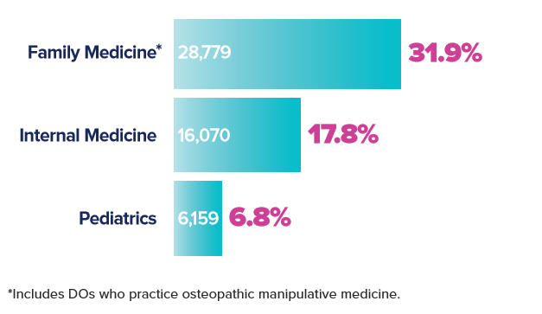
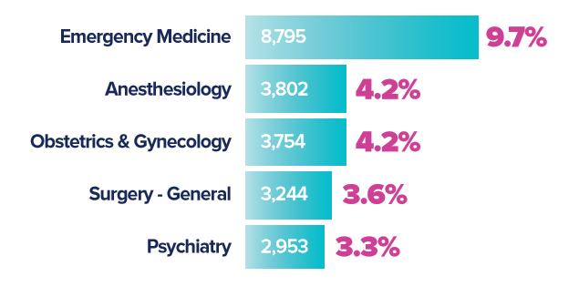
Osteopathic Physicians: By Specialty
56% of DO’s Practice in Primary Care
44% of DO’s practice in specialties
Slide borrowed from AOA Board of Trustees & PAC Midyear Retreat Meeting | February 24–26, 2019
The Future of Osteopathic Medicine
OSU Spring Fling 2019

Slide 15
ACGME Merger
Students undergo one combined match
All residency programs are under ACGME and not under AOA
This does not change the requirement for DO students to pass COMLEX
There are still board certification pathways through the AOA
The Future of Osteopathic Medicine
OSU Spring Fling 2019
Notes:
Changing environment

Slide 16
Where do we go from here?
Is there still an Osteopathic distinctiveness?
The Future of Osteopathic Medicine
OSU Spring Fling 2019
Notes:
These are the questions we will wrestle with next

Slide 17
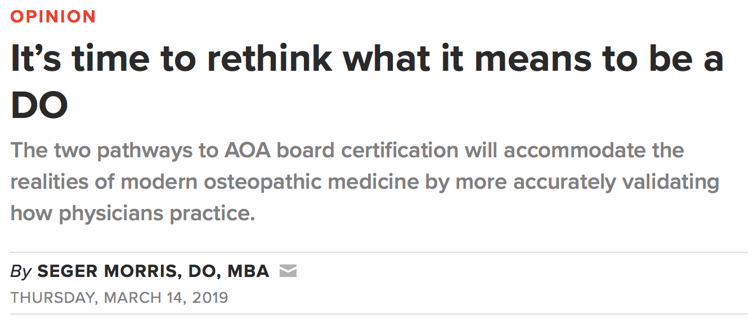
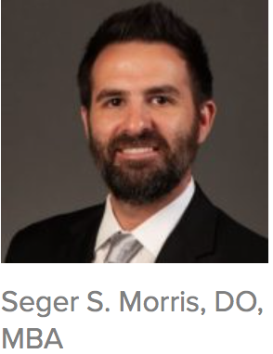

Differing Opinions
the majority of DOs enter residencies without osteopathic recognition, obtain board certification through ABMS rather than the AOA, and rarely (if ever) use osteopathic manipulative treatment in their daily practice of medicine. This isn’t to say we aren’t a different breed of physicians than our allopathic colleagues. We still pride ourselves on less objective measurements of “The DO Difference” like empathy, bedside manner, communication skills and our holistic approach to healing the patient. However, we no longer have a patent on this approach to patient care. MD schools and ACGME standards are now emphasizing these characteristics more.
The Future of Osteopathic Medicine
OSU Spring Fling 2019
Notes:
If MD schools are emphasizing this portion of our philosophy, should we hold on to it as our uniqueness?

Slide 18
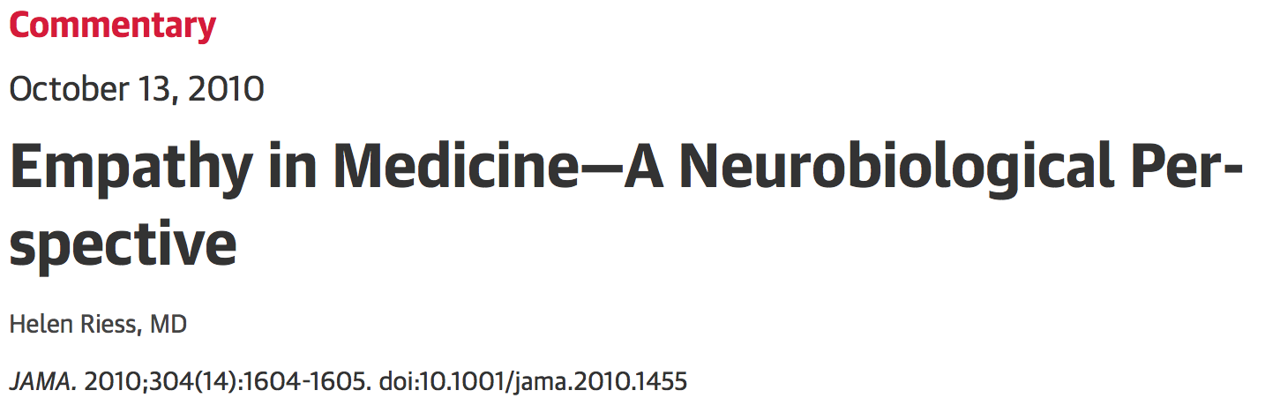
Empathy
The importance of doctor-patient relationship
Empathy
Is there a DO difference?
Article currently in press with the JAOA attempts to investigate this question
The Future of Osteopathic Medicine
OSU Spring Fling 2019
Notes:
We may still have an edge in this area- an upcoming study may add some proof.

Slide 19
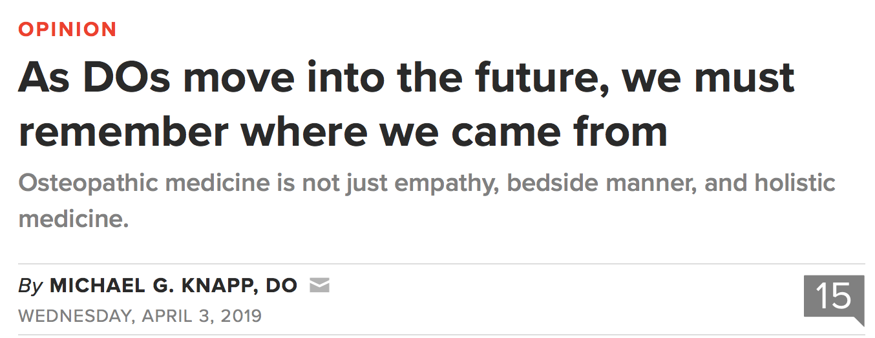
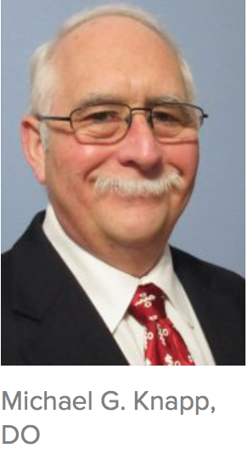
Differing Opinions
Osteopathic medicine is not just empathy, bedside manner, and holistic medicine.
It is the incorporation of musculoskeletal findings into patient care and using them, along with knowledge of the interrelationship of structure and function, to promote patient health and alter disease processes.
Using the musculoskeletal system to effect a change in a viscerosomatic reflex is the real “DO Difference.”
The Future of Osteopathic Medicine
OSU Spring Fling 2019
Notes:
Dr. Knapp pushes back by saying our structure and function focus hold more of our “distinctiveness”

Slide 20

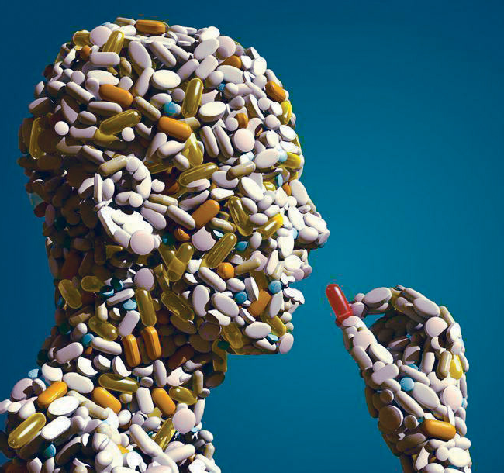
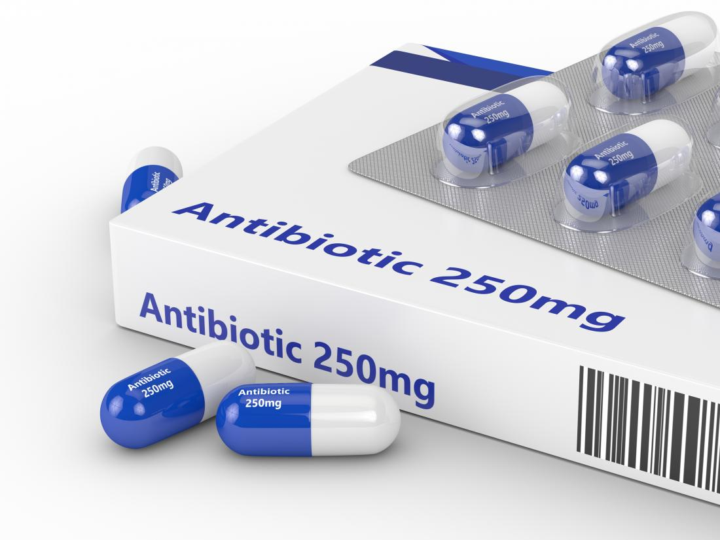
HEALTHCARE CHALLENGES:
MEET THE OBSTACLES
COST
OPIOID CRISIS
ANTIBIOTICS
THE MONEY
THE PAIN
THE RESISTANCE
The Future of Osteopathic Medicine
OSU Spring Fling 2019
Notes:
Some examples of challenges today to use as discussion points for possible osteopathic distinctiveness

Slide 21
HEALTHCARE CHALLENGES:
MEET THE OBSTACLES
COST
OPIOID CRISIS
ANTIBIOTICS
THE MONEY
THE PAIN
THE RESISTANCE
The Future of Osteopathic Medicine
OSU Spring Fling 2019

Slide 22
Rationale Therapy
Decreasing Health Care Costs
Health Care costs keep rising
  Employee portion is $11,033
From Millman Medical Index: www. Millman.com
The Future of Osteopathic Medicine
OSU Spring Fling 2019

Slide 23
Rationale Therapy
Decreasing Health Care Costs
Health Care costs keep rising
  USA spends $7530 per capita
From Kaiser: kff.org
The Future of Osteopathic Medicine
OSU Spring Fling 2019

Slide 24
Rationale Therapy
OMT can reduce hospital length of stay
Average cost of hospital stay in USA is $1889-$2488
OMT decreased length of stay by 0.8 days in pneumonia patients
  Noll DR, et al. Multicenter Osteopathic Pneumonia Study in the Elderly: Subgroup Analysis on Hospital Length of Stay, Ventilator-Dependent Respiratory Failure Rate, and In-hospital Mortality Rate. J Am Osteopathic Assoc. 2016 Sep 1; 116(9):574-87
5.4 days decreased length of stay after abdominal surgery
  Baltazar GA, et al. Effect of Osteopathic Manipulative Treatment on Incidence of Postoperative Ileus and Hospital Length of Stay in General Surgical Patients .J Am Osteopath Assoc. 2013;113(3):204-209
The Future of Osteopathic Medicine
OSU Spring Fling 2019
Notes:
And not only cost, but if you get people out of the hospital quickly, could that decrease complications and nosocomial infections?

Slide 25
HEALTHCARE CHALLENGES:
MEET THE OBSTACLES
COST
OPIOID CRISIS
ANTIBIOTICS
THE MONEY
THE PAIN
THE RESISTANCE
The Future of Osteopathic Medicine
OSU Spring Fling 2019

Slide 26
Opioid Crisis
Causes and Impact
An Institute of Medicine report attributed the rise in chronic pain prevalence during the 1990s to the following:
greater patient expectations for pain relief,
musculoskeletal disorders of an aging population,
obesity,
increased survivorship after injury and cancer, and
increasing frequency and complexity of surgery.
The Future of Osteopathic Medicine
OSU Spring Fling 2019
Notes:
However, if we don’t have any skills or tools to look for sources of pain beyond what imaging shows then physicians feel unequipped to care for patients who are suffering.

Slide 27

To find health should be the object of the doctor. Anyone can find disease.
-A.T Still MD, DO. Philosophy of Osteopathy
The Future of Osteopathic Medicine
OSU Spring Fling 2019

Slide 28
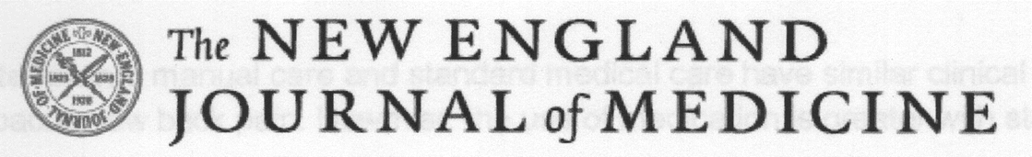
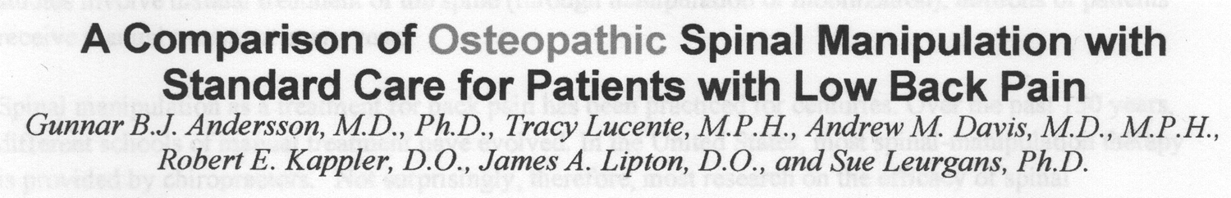
Volume 341:1426-1431 November 4, 1999 Number 19
Results: The osteopathic-treatment group required significantly less medication (analgesics, anti-inflammatory agents, and muscle relaxants) (P< 0.001) and used less physical therapy (0.2 percent vs. 2.6 percent, P<0.05

Slide 29
Treating the Cause
Osteopathic Manipulation for Low Back Pain
Low Back Pain
  OMT was not only more effective than ultrasound for treating low back pain, but its use also allowed participants to cut down on the amount of medication they took to treat their lower back pain throughout the 12-week study.
  Nearly two-thirds of the individuals who received OMT had a 30 percent reduction in their pain level, and half of those patients had a 50 percent reduction in their pain level, the study showed.
  Licciardone JC, et al. Outcomes of osteopathic manual treatment for chronic low back pain according to baseline pain severity: results from the Osteopathic Trial. Man Ther. 2013 Dec;18(6)533-540.
The Future of Osteopathic Medicine
OSU Spring Fling 2019
Notes:
Imagine if a drug had this result- imagine all the drug reps.

Slide 30
The body is capable of self-healing
OMT influencing wound healing
“A key osteopathic tenet involves the body’s ability to self-heal. Osteopathic manipulative treatment (OMT) has been evolved to improve this healing capacity. The authors' in vitro work has focused on modeling 2 common OMT modalities: myofascial release (MFR) and counterstrain. Their studies have evaluated the effects of these modalities on wound healing, cytokine secretion, and muscle repair. The key components of the host response to mechanical forces are fibroblasts, which are the main fascial cells that respond to different types of strain by secreting anti-inflammatory chemicals and growth factors, thus improving wound healing and muscle repair processes.”
  Zein-Hammoud M, Standley PR. Modeled osteopathic manipulative treatments: a review of their in vitro effects on fibroblast tissue preparations. J Am Osteopath Assoc. 2015 August (115)490-502.
The Future of Osteopathic Medicine
OSU Spring Fling 2019
Notes:
Looking at OMM beyond a purely structural lens- changing structure changes function and changes genes

Slide 31
Treating the Cause
Osteopathic Manipulation for Post-Op Pain
Post-Operative Pain
  Administration of postoperative OMT enhanced pre- and postoperative morphine analgesia in the immediate 48-hour period following elective hysterectomy, demonstrating that OMT can be a therapeutic adjunct in pain management following this procedure.
  Goldstein FJ, et. al. Preoperative Intravenous Morphine Sulfate With Postoperative Osteopathic Manipulative Treatment Reduces Patient Analgesic Use After Total Abdominal Hysterectomy. J Am Osteopath Assoc. 2005;105(6):273-279
The Future of Osteopathic Medicine
OSU Spring Fling 2019

Slide 32
Inflammation
Osteopathic Manipulation
OMT has been shown to decrease TNF-alpha in patients with low back pain.
  (Licciardone JC. Associations of cytokine concentrations with key osteopathic lesions… JAOA Vol 112 No9 September 2012)
The Future of Osteopathic Medicine
OSU Spring Fling 2019

Slide 33
The body is a unit of mind, body, and spirit
Pain processing
Being mindful reduces pain
  Higher Freiburg Mindfulness Inventory ratings were associated with lower pain intensity (P = 0.005) and pain unpleasantness ratings (P = 0.005). Whole brain analyses revealed that higher dispositional mindfulness was associated with greater deactivation of a brain region extending from the precuneus to posterior cingulate cortex during noxious heat. These novel findings demonstrate that mindful individuals feel less pain and evoke greater deactivation of brain regions supporting the engagement sensory, cognitive, and affective appraisals. We propose that mindfulness and the posterior cingulate cortex should be considered as important mechanistic targets for pain therapies.
  Zeidan F, et al. Neural mechanisms supporting the relationship between dispositional mindfulness and pain. Pain. 2018 Dec; 159(12):2477-2485.
The Future of Osteopathic Medicine
OSU Spring Fling 2019
Notes:
Can our training influence our understanding of what pain is?

Slide 34
Any variation from health has a cause, and the cause has a location. It is the business of the osteopath to locate and remove it (the cause), doing away with disease and getting health instead.
-A.T Still MD, DO. Osteopathy Research and Practice
The Future of Osteopathic Medicine
OSU Spring Fling 2019

Slide 35
HEALTHCARE CHALLENGES:
MEET THE OBSTACLES
COST
OPIOID CRISIS
ANTIBIOTICS
THE MONEY
THE PAIN
THE RESISTANCE
The Future of Osteopathic Medicine
OSU Spring Fling 2019

Slide 36
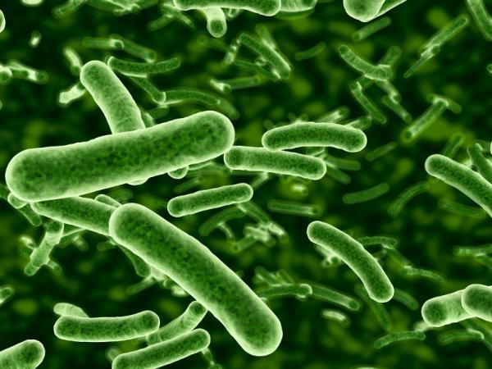
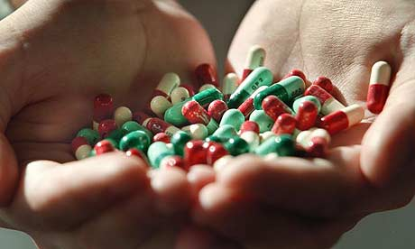
The body is capable of self-healing
How does the body fight disease?
  Bacteria
    Antibiotics
  Pneumonia
  Influenza
The Future of Osteopathic Medicine
OSU Spring Fling 2019
Notes:
I remind students to remember all they learned in immunology when they start learning about treatment of diseases

Slide 37
Rationale Therapy
Antibiotic Prescribing and Resistance
Antibiotics are incorrectly prescribed in 30-50% of cases
New antibiotics are not being developed as rapidly because they do not have a high return on investment
CDC says we are in the “post-antibiotic era”
World Health Organization describes the situation as ”dire”
  Ventola CL. The Antibiotic Resistance Crisis: Part 1: Causes and Threats. PT. 2015 Apr; (40(4): 277-283.
1918-1919 Flu Pandemic. Patients seen by DOs have 1/40th the mortality of those getting conventional care (.25% vs. 5%)
  Hruby RJ. Avian Influenza: An Osteopathic component to treatment. Osteopathic Medicine and Primary Care. 2007;1:10
The Future of Osteopathic Medicine
OSU Spring Fling 2019
Notes:
What do we do when the antibiotics aren't as effective? We have to augment the body's ability to fight an infection.

Slide 38
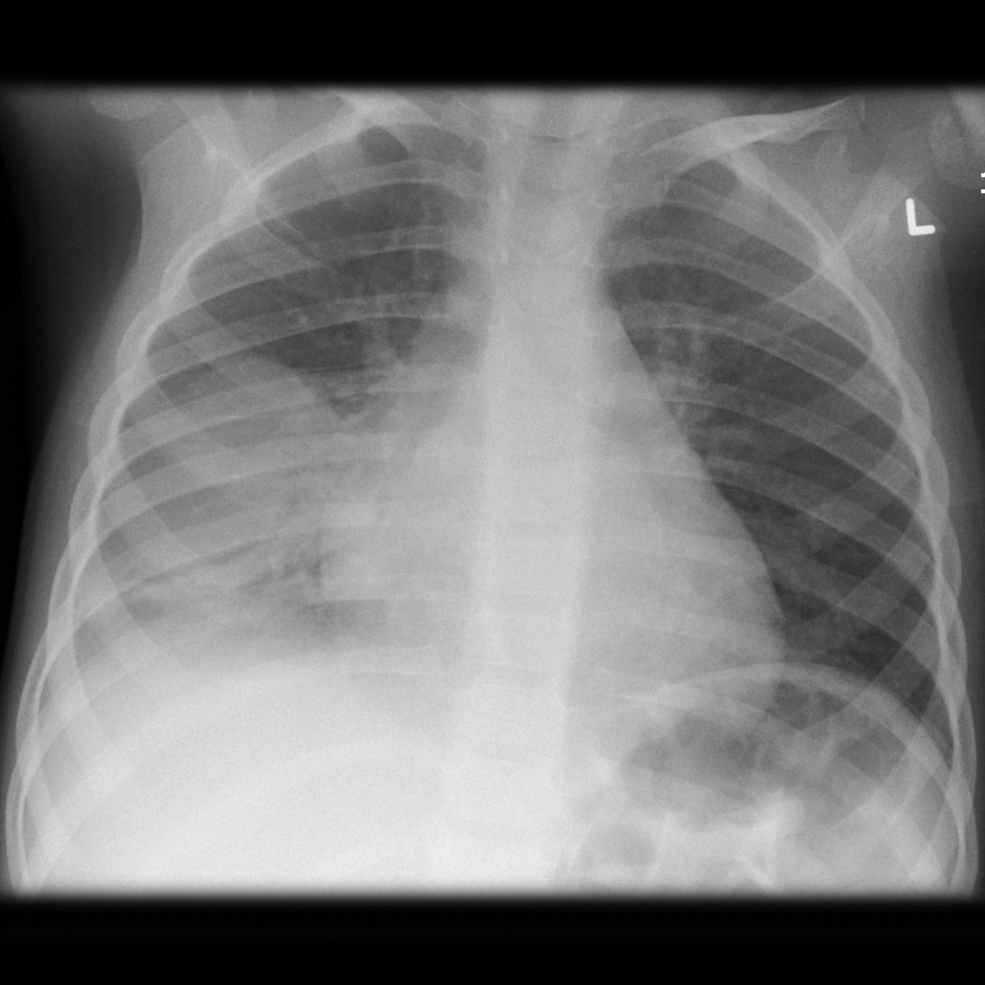
Case Example
67 year old female develops a productive cough, fever, and shortness of breath. Chest x-ray reveals a right lower lobe pneumonia.
  What “causes” pneumonia?
  What “cures” pneumonia?
The Future of Osteopathic Medicine
OSU Spring Fling 2019

Slide 39
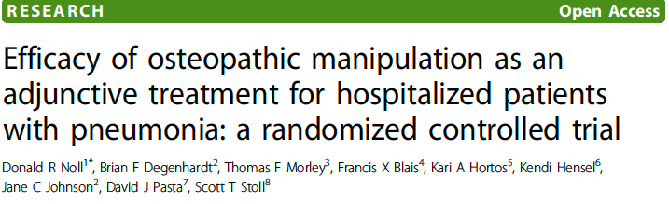
MOPSE Study
Per protocol analysis found significant reductions in length of stay, duration of intravenous antibiotics, and respiratory failure or death when OMT was compared to conventional care
The Future of Osteopathic Medicine
OSU Spring Fling 2019

Slide 40
Hodge, LM. Lymphatic Pump Treatment as an Adjunct to Antibiotics for Pneumonia in a Rat Model. The Journal of the American Osteopathic Association, May 2015, Vol. 115, 306-316.
Results: The combination of sham therapy and levofloxacin decreased bacterial load at 72 and 96 hours after infection, and LPT and levofloxacin significantly reduced CFU compared with sham therapy and levofloxacin at both time points (P<.05). Colony-forming units were not detected in the spleens at any time. No statistically significant differences in hematologic findings between any treatment groups were found at any time-point measured.
Conclusion: The results suggest that 3 applications of LPT induces an additional protective mechanism when combined with levofloxacin and support its use as an adjunctive therapy for the management of pneumonia; however, the mechanism responsible for this protection is unclear.
The Future of Osteopathic Medicine
OSU Spring Fling 2019

Slide 41
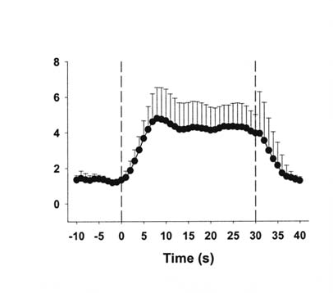
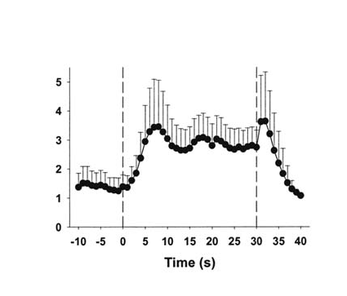
Lymphatic Pump Techniques
OMT has been proven to:
Abdominal LPT
Increases lymph flow
Increases the concentration of leukocytes in lymph
Stimulates the mobilization of GALT (gut-associated lymphoid tissues)-derived leukocytes into the lymphatic circulation and the release of leukocytes from mesenteric lymph nodes
Thoracic Lymph Flow (ml/min)
Thoracic LPT
Thoracic Lymph Flow (ml/min)
The Future of Osteopathic Medicine
OSU Spring Fling 2019
EM Knott, JD Tune, ST Stoll and HF Downey. JAOA 2005; 105(10): 447-56.

Slide 42
We conclude that when fluids of the body are stopped in the fascia, organs and other parts of the system, stagnation, fermentation, heat and general confusion will follow…
-A.T Still MD, DO. Osteopathy Research and Practice
The Future of Osteopathic Medicine
OSU Spring Fling 2019

Slide 43
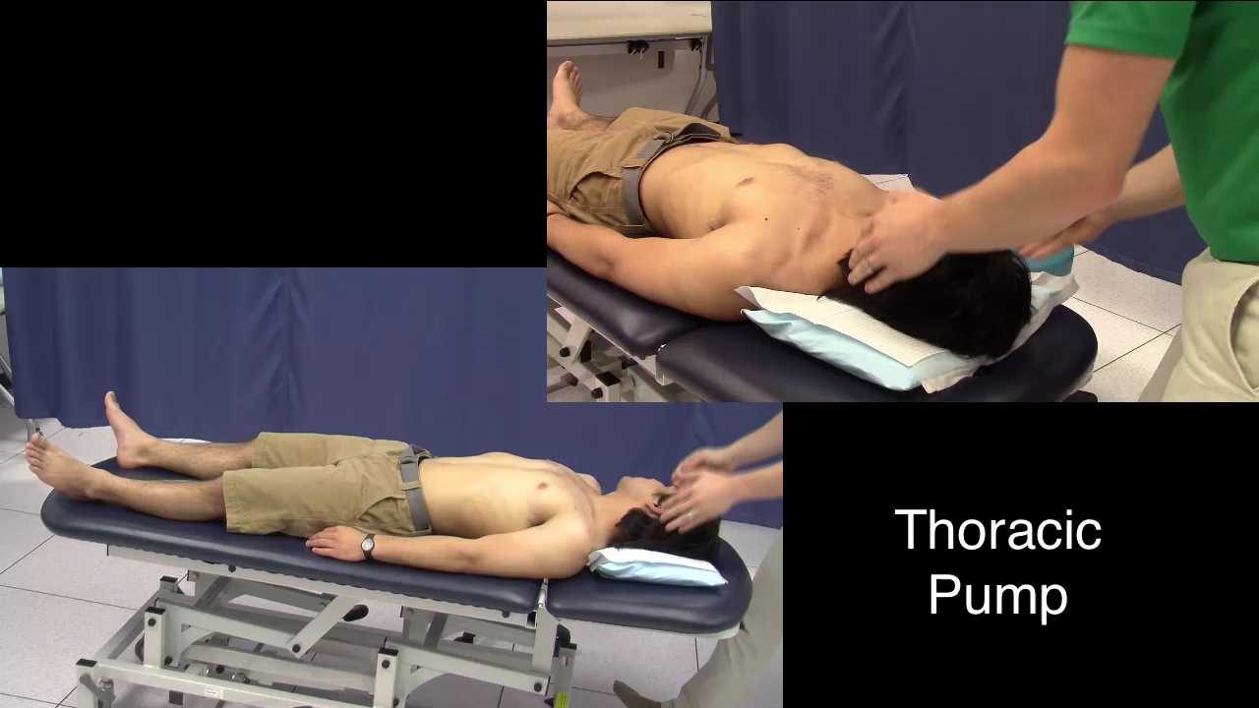
Lymphatic Pump Technique
Video
The Future of Osteopathic Medicine
OSU Spring Fling 2019

Slide 44
Recurrent Acute Otitis Media & OMT
Patients receiving OMT had:
  Fewer episodes of otitis media (mean group difference per month -0.14 [95% CI, -0.27 to 0.00]; P=.04)
  Fewer surgical procedures (1 vs 8 in control group, P=0.03)
  More mean surgery-free months (intervention patients, 6, control patients 5.25; P=.01)
  Increased frequency of more normal tympanograms, with an adjusted mean group difference 0.55 (95% CI, 0.08 to1.02; P=.02)
  No adverse events reported
Mills M, Henley C, Barnes L, Carreiro J, Degenhardt B. The Use of Osteopathic Manipulative Treatment as Adjuvant Therapy in Children with Recurrent Acute Otitis Media. Arch Pediatric Adolescent Medicine, Vol 157, Spt 2003 861-866
The Future of Osteopathic Medicine
OSU Spring Fling 2019

Slide 45
Where do we go from here?
Is there still an Osteopathic distinctiveness?
The Future of Osteopathic Medicine
OSU Spring Fling 2019

Slide 46
WHAT IS AN OSTEOPATHIC PHYSICIAN?
DISTINCTIVES
FULLY QULAIFIED PHYSICIAN
PATIENT-CENTERED, HEALTH ORIENTED
HANDS ON SKILLS + MEDICAL ADVANCES
MOST COMPREHENSIVE CARE
A fully qualified physician
Trained within a context of a distinct patient centered, healthy oriented philosophy
To offer the most comprehensive care available.
Combines specialized diagnostic and therapeutic hands-on skills (OMM) with the latest advances in medical technology
The Future of Osteopathic Medicine
OSU Spring Fling 2019

Slide 47
HEALTHCARE CHALLENGES:
Can Osteopathic Medicine meet these and other challenges?
?
COST
OPIOID CRISIS
ANTIBIOTICS
FUTURE
THE MONEY
THE PAIN
THE RESISTANCE
New Challenges
OMT can reduce the costs from length of hospital stay, tests ordered, and medications prescribed.
OMT decreases the need for opioids and other medications. DO’s should consider other aspects of pain including psychosocial issues.
OMT can augment the efficacy of antibiotics or may prevent certain illnesses that require their use.
OMT has shown improvements in neurodegenerative disease, inflammation, wound healing, cost-effectiveness
The Future of Osteopathic Medicine
OSU Spring Fling 2019

Slide 48
ANY QUESTIONS?
www.ryansealsdo.com
RYAN SEALS, D.O.

