Slide 1

Orthopedic Considerations Associated with Triathlon Training
Jennifer Volberding PhD, LAT, ATC
Associate Professor
Interim Department Chair Athletic Training
Athletic Training Program Director

Slide 2
Disclosure
I have no relevant financial relationships or affiliations with commercial interests to disclose.

Slide 3
Learning Objectives
Discuss the Differences in Triathlon Races
Discuss the Epidemiology of Injuries
Discuss Prevention Strategies through Biomechanics
Discuss Prevention Strategies through Rehabilitation
Evaluate Training Approaches

Slide 4
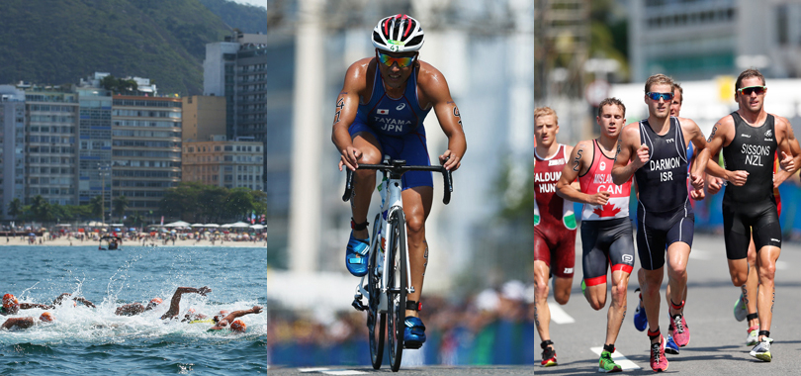
What Do We Mean by Triathlon?^{2,3}
Sprint Distance
  400-500 M swim
  20K bike
  5K Run
Olympic Distance
  1500 M Swim
  40K Bike
  10K Run
Ironman Distance
  3.8K swim
  180K Bike
  42K Run
Notes:
Most common recreational activity due to the cross training effect
63% of people who compete are within the age range of 26-35
OD 2-4 hours
IM 8-10 hours

Slide 5
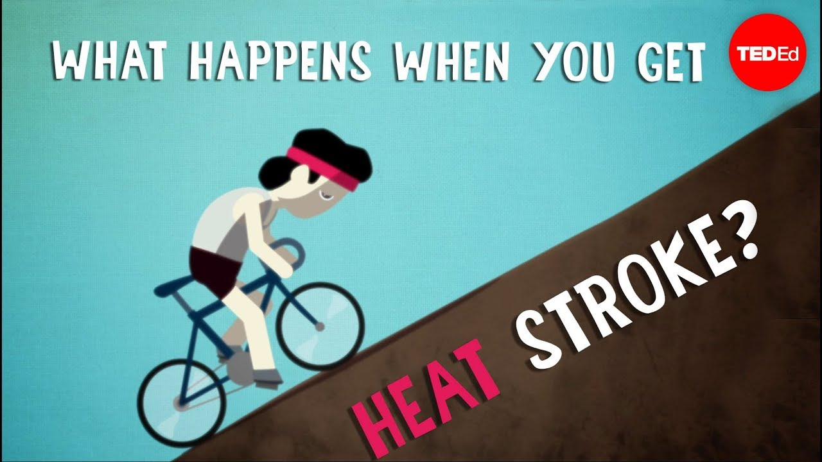
Epidemiology
1.5 Sudden Deaths per 100,000 participations¹
75% injury stops training for at least one day, decreases mileage, requires medication or medical evaluation^{1,5}
Heat Illness^{1,2,4}
  Dehydration
  Heat Illness
Overuse
  78.9%^{7,9}
Acute
  13-22% orthopedic⁴
  Bacterial infections²
Notes:
Running is the cause of most damage in entire lower extremtiy
During competition heat illness is the biggest issue
58-2%suffer from dehydration or heat illess, 5.7% exertional rhabdomylisis

Slide 6

Where do Injuries Occur During the Ironman?⁵
Knee 44%
Low Back 20%
Hamstring 20%
Calf 20%

Slide 7
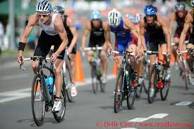
Where do Injuries Occur During Olympic Distance?⁵
Increased risk during transitions
Achilles 14.3%
Low Back 12.9%
Hamstring
Calf
Notes:
Falling off of the bike

Slide 8
Upper Versus Lower Extremity Injuries
Upper extremity 8%³
Lower extremity 72%⁷

Slide 9
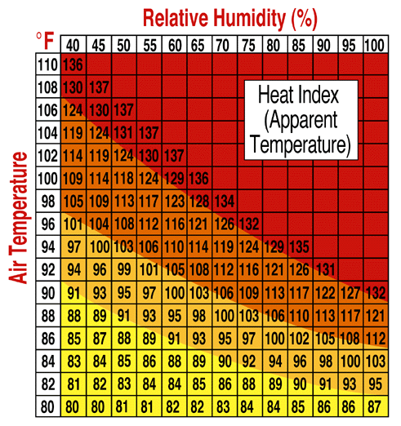
Heat Illness

Slide 10
Dehydration
Fluid deficit in intracellular and extracellular compartments in the body resulting from fluid intake not adequate enough to replenish water loss.
Blood plasma volume begins to decrease with as little as a 2% loss of body weight due to dehydration.

Slide 11
Dehydration: Effects on the Body
When dehydration occurs it:
  Impedes heat dissipation and reduce heat tolerance.
  Severely compromise cardiovascular function and exercise capacity.
  Reduced plasma volume increases blood plasma sodium concentration (osmolality).
  Cardiac output is decreased.
  Gastric emptying rate is slowed.
      Increases epigastric cramping and feeling of nausea.

Slide 12
Dehydration: Psychologic Effects
With dehydration an athlete experiences:
  Increased rate of perceived exertion (RPE).
  General impairment of mental function.
  Decreased motivation to exercise.
  Decreased time to exhaustion.

Slide 13
Dehydration: Effect on Performance
Muscle strength compromised at 5% (body weight loss) or more dehydration.
Muscle endurance compromised at 3-4%.
Maximal aerobic power compromised at 2-3%.
    In heat, 2.5% regardless of fitness level and heat acclimation.

Slide 14
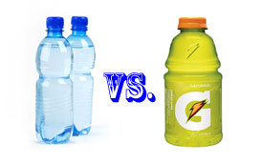
Thirst Mechanism
A fluid loss of 1.5 – 2 liters is necessary for thirst mechanism to kick in.
Initiated by the Hypothalmus due to an increase in plasma sodium concentration (osmalality).

Slide 15
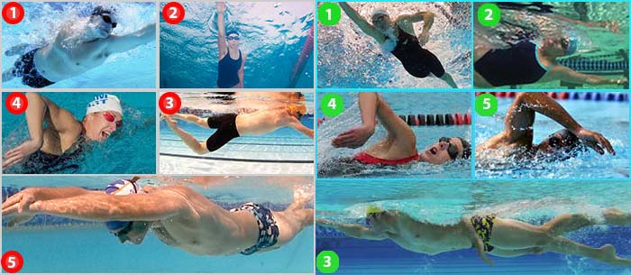
Prevention Through Biomechanics – Swim^{3,6}
Technique is key
Less kick
More Pull
Proper body roll
Head and trunk alignment

Slide 16
Prevention Through Biomechanics - Run
Running where injuries occur
Evaluate Gait
Evaluate Shoes

Slide 17
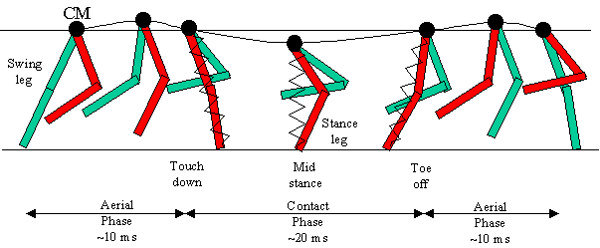
Gait
Efficient gait
  Minimal side-to-side motion
  Maximal forward motion
  Body rises and falls approx. 5 cm
Center of gravity
  Path is a sinusoidal curve

Slide 18
Running Gait Cycle
Differences from walking gait
  Flight phase — neither foot is in contact with a supportive surface
  No period of double limb support
  Vertical GRF
    2.0 – 6.0 x the body weight
  Stance phase time
As speed increases there are changes in
  Arm swing
  Stride length
  Cadence
  Knee flexion ROM
  Muscular force
  Speed of contraction
  Less up and down motion

Slide 19
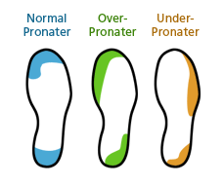
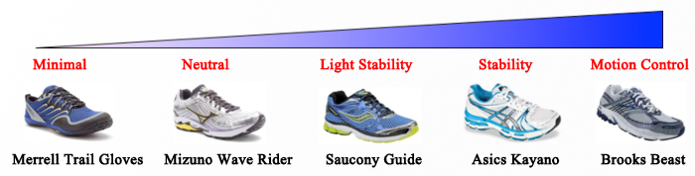

Slide 20
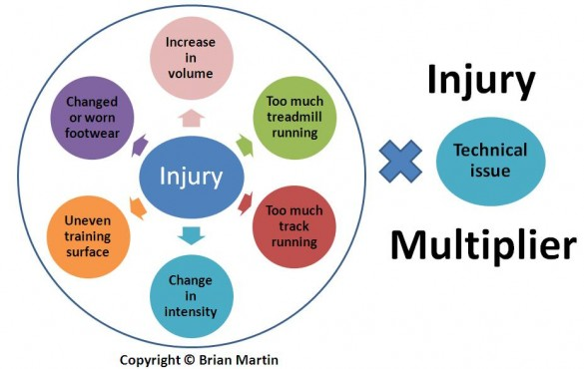
Common Training Errors
60% of injuries due to training errors^{1,10}
60% related to distance and intensity^{2,15}
  More than 2 long runs per week⁹
Surface²

Slide 21
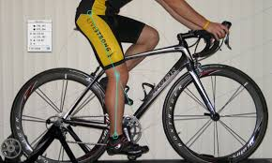
Prevention Through Biomechanics - Bike
Seat Position

Slide 22
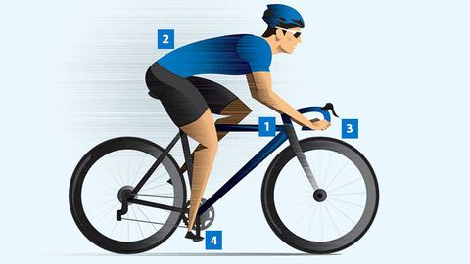
Prevention Through Biomechanics - Bike
Handlebar Height

Slide 23
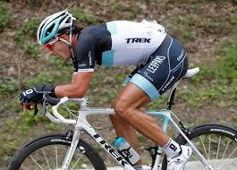
Prevention Through Biomechanics - Bike
Aerobars
  Increase lumbar flexibility
  Decreased mobility of hamstring

Slide 24
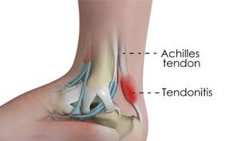
Rehabilitation - Achilles
STRETCHING!!!
Look at the heel counter of shoe for rubbing
Cross friction massage
Strengthen calf

Slide 25
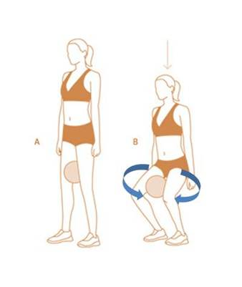
Rehabilitation Patella Femoral Pain Syndrome
Strengthen VMO
Eccentric training
Stretching
Bolstered knee brace
Shoes/orthotics

Slide 26
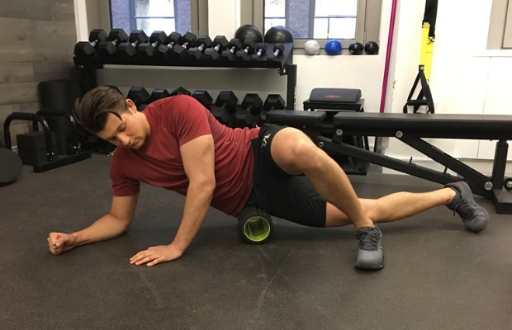
Rehabilitation IT Band Syndrome
Stretching
Foam Roller
ID biomechanical issues

Slide 27
Rehabilitation Low Back
Focus on the core
Stretching

Slide 28
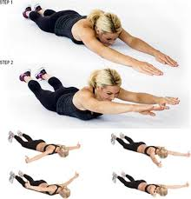
Rehabilitation - Shoulder
Scapular Stabilization
Rotator Cuff Focus

Slide 29
Key is Proper Stretch, Warm Up and Cool Down

Slide 30
Training Techniques
Key is mileage
Average 8-15 Hours per week
  Sweet spot it 8-10
  Less than 7 or more than 15 increase risk
Number of Workouts
  6 per week 45%
  7 per week 16%
  5 per week 30%

Slide 31
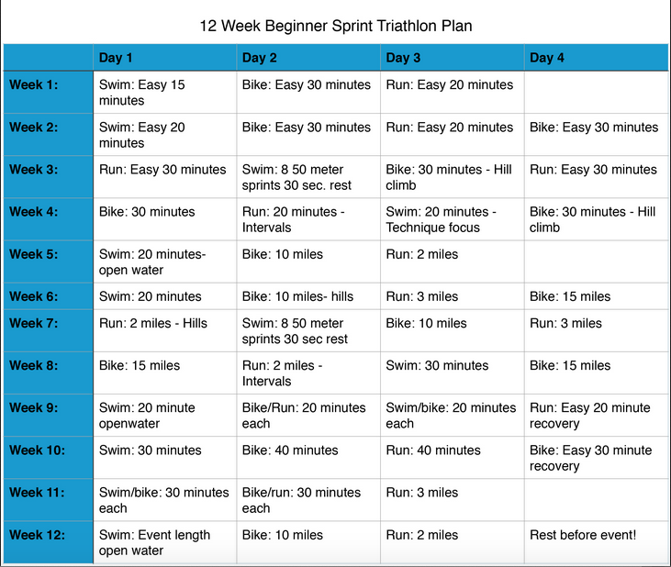
12 Week Sprint Training Protocol

