Slide 1
Pediatric OMT
Angela K Tyson, DO, FACOP
OSU Spring Fling 2019

Slide 2
Disclosure
I have no relevant financial relationships or affiliations with commercial interests to disclose.

Slide 3
Objectives
Review the 5 models of osteopathic patient care
Discuss osteopathic considerations in relation to the pediatric patient
Review an osteopathic approach to many common outpatient pediatric problems
Describe specific techniques to consider when approaching a pediatric patient

Slide 4
5 Models of Osteopathic Patient Care
Five models articulate how an osteopathic physician seeks to influence a patient’s physiological processes
Based on 5 avenues for diagnosis, treatment, and management
Structural/Biomechanical Model
Neurologic Model
Metabolic – Energetic Model
Behavioral Model
Respiratory – Circulatory Model

Slide 5
STRUCTURAL/
BIOMECHANICAL MODEL
NEUROLOGIC MODEL
RESPIRATORY - CIRCULATORY MODEL
MUSCULOSKELETAL SYSTEM
METABOLIC - ENERGETIC MODEL
BEHAVIORAL MODEL

Slide 6
STRUCTURAL/
BIOMECHANICAL MODEL
Muscles
Ligaments
Fascia
Joints
NEUROLOGIC MODEL
RESPIRATORY - CIRCULATORY MODEL
MUSCULOSKELETAL SYSTEM
METABOLIC - ENERGETIC MODEL
BEHAVIORAL MODEL

Slide 7
STRUCTURAL/
BIOMECHANICAL MODEL
NEUROLOGIC MODEL
RESPIRATORY - CIRCULATORY MODEL
MUSCULOSKELETAL SYSTEM
Ribs
Diaphragm
Blood/lymph circulation
METABOLIC - ENERGETIC MODEL
BEHAVIORAL MODEL

Slide 8
STRUCTURAL/
BIOMECHANICAL MODEL
NEUROLOGIC MODEL
RESPIRATORY - CIRCULATORY MODEL
MUSCULOSKELETAL SYSTEM
Facilitation
Pain
Nerve entrapment
Viscerosomatics
METABOLIC - ENERGETIC MODEL
BEHAVIORAL MODEL

Slide 9
STRUCTURAL/
BIOMECHANICAL MODEL
NEUROLOGIC MODEL
RESPIRATORY - CIRCULATORY MODEL
MUSCULOSKELETAL SYSTEM
METABOLIC - ENERGETIC MODEL
BEHAVIORAL MODEL
Nutrition
Biomechanical efficiency
Visceral function

Slide 10
STRUCTURAL/
BIOMECHANICAL MODEL
NEUROLOGIC MODEL
RESPIRATORY - CIRCULATORY MODEL
MUSCULOSKELETAL SYSTEM
METABOLIC - ENERGETIC MODEL
BEHAVIORAL MODEL
SNS input
Emotional context

Slide 11
Common Outpatient Pediatric Problems
Viral upper respiratory infections (URI)
Otitis Media
Headaches and migraines
Asthma

Slide 12
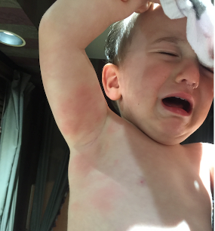
#1 Viral Upper Respiratory Tract Infections (URI)

Slide 13
Viral URI – The Facts
Over 200 varieties of viruses can cause symptoms of a common cold
Congestion, rhinorrhea, coughing, sneezing, fevers, watery eyes, headaches, fatigue, fussiness, poor sleep, sometimes nausea/vomiting/diarrhea, sometimes rashes, etc…
Transmitted usually through the air or through direct contact
Most children develop AT LEAST 6 – 8 colds a year, and more for kids in daycare
Leads to more doctors visits and school absences than any other illness each year in the pediatric population

Slide 14
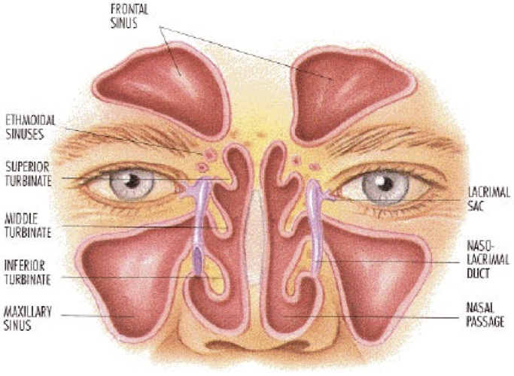
Viral URI – Review of Anatomy
American College of Osteopathic Pediatricians Pediatric Sinus Drainage OMT Module
Robert Hostoffer, DO FACOP, FAAP
Eric Hegybeli, DO, FAOCP

Slide 15
Muscles
Ligaments
Fascia
Joints
Consider facial anatomy and estuation tube anatomy
STRUCTURAL/
BIOMECHANICAL MODEL
Treat pain
Treat viscerosomatics
Sympathetic T1 – T4
NEUROLOGIC MODEL
RESPIRATORY - CIRCULATORY MODEL
Rib raising
Doming diaphragm
Lymphatic pump
MUSCULOSKELETAL SYSTEM
Consider:
Decreased appetite
Less energy
Visceral function
Consider:
Poor sleep
Cranky child
Stress for child and parent
METABOLIC - ENERGETIC MODEL
BEHAVIORAL MODEL

Slide 16
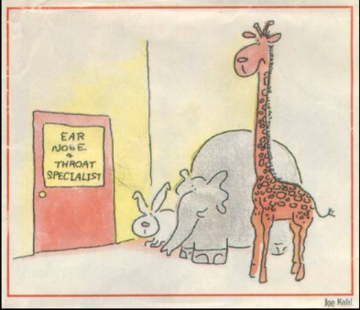
#2 Otitis Media

Slide 17
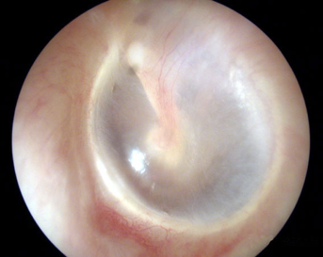
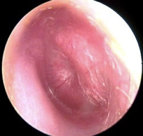
Otitis Media – The Facts
Inflammation of the middle ear
Located between the tympanic membrane (TM) and the inner ear, including eustachian tube
Most frequent diagnosis in sick children in US
Viral, bacterial, or fungal:
Most often viral and self-limited
Common bacterial causes include:
Streptococcus pneumoniae, nontypeable Haemophilus influenzae, and Moraxella catarrhalis
Signs/Symptoms
Discomfort, “popping”, pressure
Diagnosis:
Visualization of the TM, tympanic insufflator
Normal TM
Infected TM
American College of Osteopathic Pediatricians Osteopathic Manipulation for Acute Otitis Media in the Pediatric Patient
Robert Hostoffer, DO FACOP, FAAP
Eric Hegybeli, DO, FAOCP

Slide 18
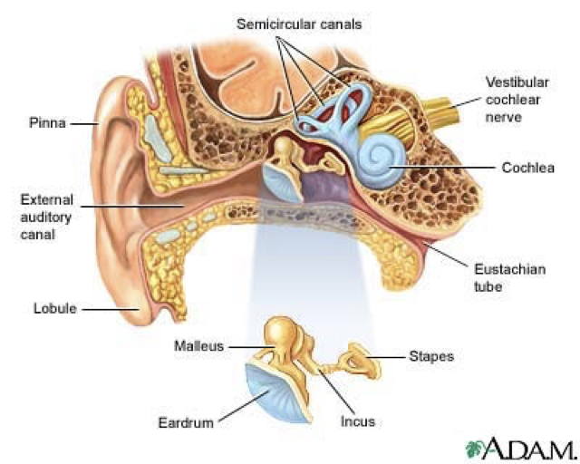
Otitis Media – Review of Anatomy
Outer Ear: Outside of Tympanic Membrane, Pinna, External Auditory Meatus
Middle Ear: Inside of Tympanic Membrane; 3 Ossicles: Malleus, Incus, and Stapes; Eustachian Tube
Inner Ear: Cochlea, Vestibule, Semi-circular Canals
American College of Osteopathic Pediatricians Pediatric Sinus Drainage OMT Module
Robert Hostoffer, DO FACOP, FAAP
Eric Hegybeli, DO, FAOCP

Slide 19
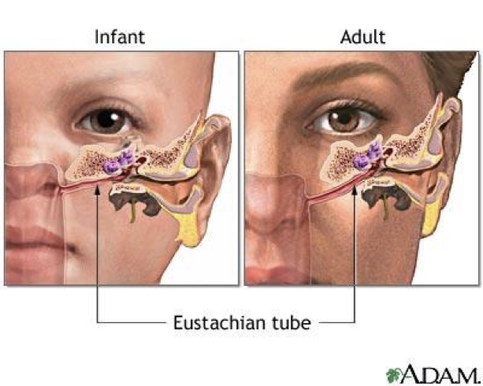
Otitis Media – Kids > Adults for Acute Otitis Media (AOM)
Shorter Eustachian Tubes
10mm in infancy to 18mm in adulthood
Eustachian Tubes oriented more horizontally
10 degrees to the horizontal in infancy, 45 degrees in adulthood
60-80% of infants have at least 1 episode of AOM by age 1 year
80-90% by age 2 to 3 years
American College of Osteopathic Pediatricians Osteopathic Manipulation for Acute Otitis Media in the Pediatric Patient
Robert Hostoffer, DO FACOP, FAAP
Eric Hegybeli, DO, FAOCP

Slide 20
Otitis Media – Progression to Infection
At an anatomic level, the tissues surrounding the eustachian tube swell due to an URI, allergies, or dysfunction of the tubes.
The eustachian tube remains blocked most of the time. The air present in the middle ear is slowly absorbed into the surrounding tissues.
A strong negative pressure creates a vacuum in the middle ear, and eventually the vacuum reaches a point where fluid from the surrounding tissues accumulates in the middle ear.
The fluid may become infected by dormant bacteria behind the TM.
American College of Osteopathic Pediatricians Osteopathic Manipulation for Acute Otitis Media in the Pediatric Patient
Robert Hostoffer, DO FACOP, FAAP
Eric Hegybeli, DO, FAOCP

Slide 21
Muscles
Ligaments
Fascia
Joints
Consider facial anatomy and estuation tube anatomy
STRUCTURAL/
BIOMECHANICAL MODEL
Treat pain
Treat viscerosomatics
Sympathetic T1 – T4
Rib raising
Doming diaphragm
Lymphatic pump
NEUROLOGIC MODEL
RESPIRATORY - CIRCULATORY MODEL
MUSCULOSKELETAL SYSTEM
Consider:
Decreased appetite
Less energy
Breastfeeding or formula
Visceral function
Consider:
Stress for child and parent
Smoke exposure
Pacifier use
Daycare attendance
METABOLIC - ENERGETIC MODEL
BEHAVIORAL MODEL

Slide 22
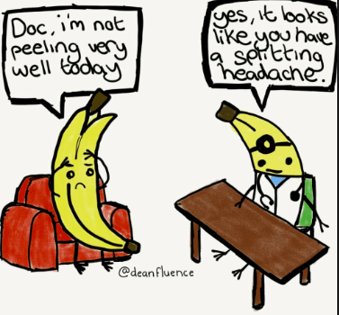
#3 Headaches and Migraines

Slide 23
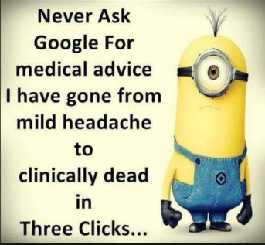
Headaches and Migraines – The Facts
Affect 17% of children in the US
50% of children who present to their PCP with a headache are diagnosed with a migraine
75% of migraine patients complain of neck or back pain during or immediately before a migraine
70% of pediatric migraine patients have a family history of migraines
Treatment focuses on symptomatic, preventative, and abortive options

Slide 24
Headaches and Migraines
Tension Headache
Migraines
Occurs with stressors
Involves neck and occiput
Continuous pain
Usually no GI symptoms (nausea/vomiting, abdominal pain)
Less likely to have family history of migraines
With aura – visual, sensory, motor, language, and/or cognitive disturbances
Complicated – neurological deficits
Hemiplegic/Hemisensory – unilateral motor/sensory weakness
Basilar – diplopia, vertigo, tinnitus, and/or ataxia
Acute confusion state (unusual) – varies from trouble speaking, memory loss, disorientation, and confusion, to unresponsiveness

Slide 25
Headaches and Migraines
Other reasons for pediatric headaches
Sinus headache
Trauma related headaches (e.g. falls, MVA, concussions, sports)
Intracranial mass-like headaches (e.g. tumors, cyst, cancer)
Benign intracranial hypertension (psuedotumor cerebri, idiopathic intracranial hypertension )
Infections (e.g. meningeal irritation with meningitis, abscess, viral infection)
Medication overuse headache (NSAIDS is a big cause of this)

Slide 26
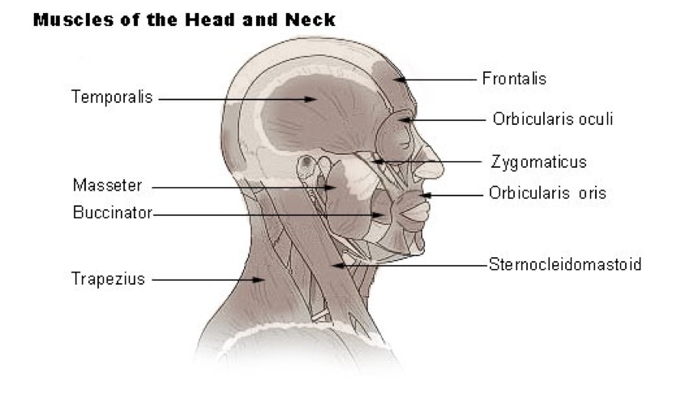
Headaches and Migraines – Review of Anatomy
American College of Osteopathic Pediatricians Pediatric Cervical OMT
Robert Hostoffer, DO FACOP, FAAP
Eric Hegybeli, DO, FAOCP

Slide 27
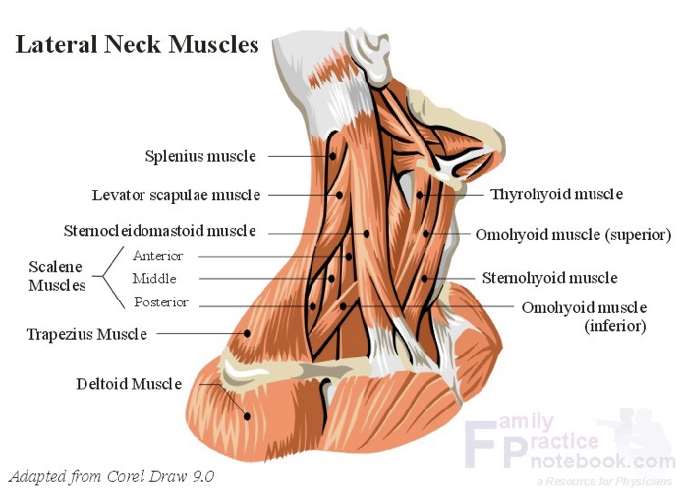
Headaches and Migraines – Review of Anatomy
American College of Osteopathic Pediatricians Pediatric Cervical OMT
Robert Hostoffer, DO FACOP, FAAP
Eric Hegybeli, DO, FAOCP

Slide 28
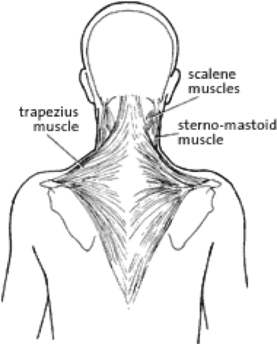
Headaches and Migraines – Review of Anatomy
American College of Osteopathic Pediatricians Pediatric Cervical OMT
Robert Hostoffer, DO FACOP, FAAP
Eric Hegybeli, DO, FAOCP

Slide 29
Muscles
Ligaments
Fascia
Joints
Consider neck, upper extremities, thoracic
STRUCTURAL/
BIOMECHANICAL MODEL
Treat pain
Treat viscerosomatics
OA
Sympathetic T1 – T4
Rib raising
Doming diaphragm
Lymphatic pump
NEUROLOGIC MODEL
RESPIRATORY - CIRCULATORY MODEL
MUSCULOSKELETAL SYSTEM
Consider:
Diet, hydration
Sleep
Concomitant illness
Visceral function
Consider:
Stress for child and parent
Drugs
Sleep hygiene
METABOLIC - ENERGETIC MODEL
BEHAVIORAL MODEL

Slide 30
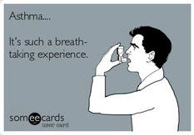
#4 Asthma

Slide 31
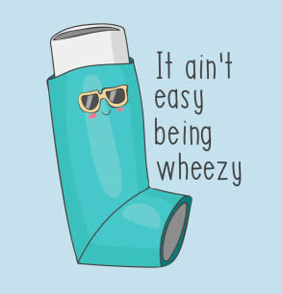
Asthma – The Facts
“Chronic lung disease that inflames and narrows the airway” - NIH
Affects 7 million children in the US
80% of children develop symptoms by age 5
One of the most common chronic diseases of childhood worldwide

Slide 32
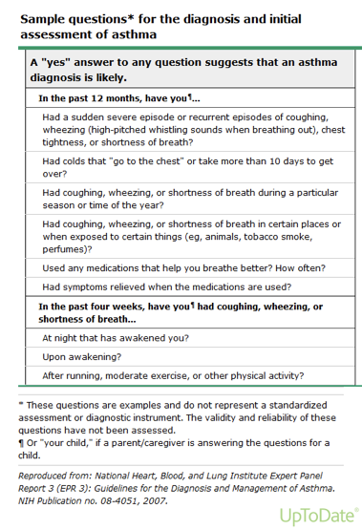
Asthma – Common Symptoms
Cough
nocturnal
occurs seasonally
occurs with certain exposures
prolonged cough (>3 weeks)
Wheeze
high-pitched, musical sound produced when air is forced through narrow airways
polyphonic
when severe, can occur with inspiration and expiration

Slide 33
Asthma – Triggers, Exposures, and Risks
Atopic kids are at risk for exacerbation:
allergic rhinitis, atopic dermatitis, and asthma
Family history of asthma
Significant PMH
Seasonal allergies and other allergens
Irritant exposure
Respiratory tract infections
Exercise/Physical Activity
Changes in weather
The child’s environment
Psychosocial profile
School attendance
Stress
Medications and adherence to them

Slide 34
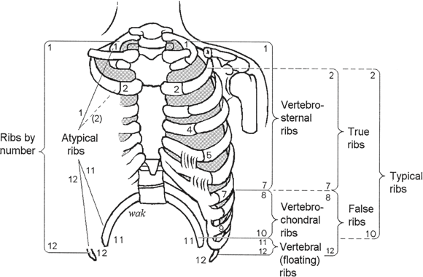
Asthma – Review of Anatomy
Chila, Anthony, et. al.
Foundations of Osteopathic Medicine. Rev 3rd Ed.
2011: 53 - 55, 331 - 334, 528 - 542, 883 - 888, 960 - 965

Slide 35
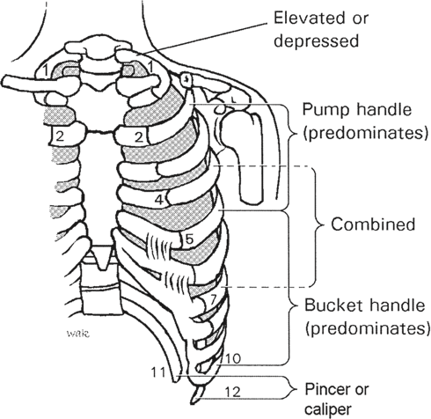
Asthma – Review of Anatomy
Chila, Anthony, et. al.
Foundations of Osteopathic Medicine. Rev 3rd Ed.
2011: 53 - 55, 331 - 334, 528 - 542, 883 - 888, 960 - 965

Slide 36
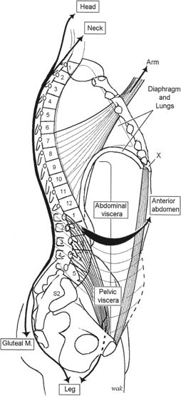
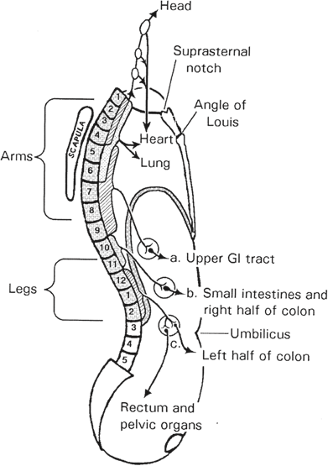
Asthma Review of Anatomy
Chila, Anthony, et. al.
Foundations of Osteopathic Medicine. Rev 3rd Ed.
2011: 53 - 55, 331 - 334, 528 - 542, 883 - 888, 960 - 965

Slide 37
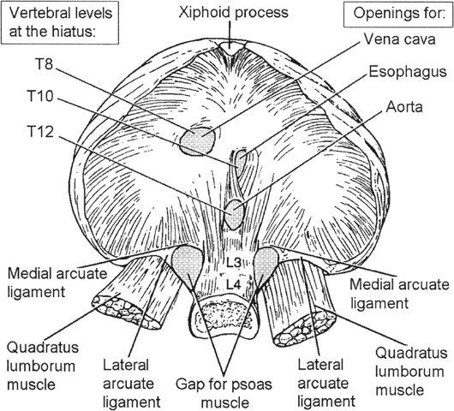
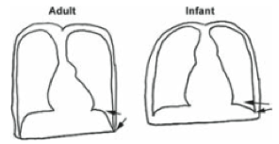
Asthma – Review of Anatomy
Chila, Anthony, et. al.
Foundations of Osteopathic Medicine. Rev 3rd Ed.
2011: 53 - 55, 331 - 334, 528 - 542, 883 - 888, 960 - 965

Slide 38
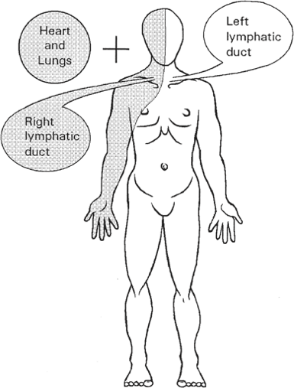
Asthma – Review of Anatomy
Chila, Anthony, et. al.
Foundations of Osteopathic Medicine. Rev 3rd Ed.
2011: 53 - 55, 331 - 334, 528 - 542, 883 - 888, 960 - 965

Slide 39
Phrenic Nerve to diaphragm
Cervical plexus C3 - 5
Treat viscerosomatics
Parasympathetics
Vagus Nerve
Treat OA
Sympathetics T1 – T6
Muscles
Ligaments
Fascia
Joints
Consider neck, thoracics, ribs
STRUCTURAL/
BIOMECHANICAL MODEL
Rib raising
Doming diaphragm
Lymphatic pump
NEUROLOGIC MODEL
RESPIRATORY - CIRCULATORY MODEL
MUSCULOSKELETAL SYSTEM
Consider:
Diet
Sleep
Concomitant illness
Avoid allergen triggers
Visceral function
Consider:
Stress for child and parent
Compliance to treatment
Smoke exposure
School attendance
Socioeconomics
METABOLIC - ENERGETIC MODEL
BEHAVIORAL MODEL

Slide 40
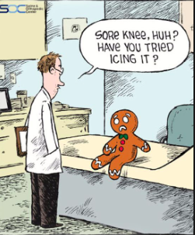
Pediatric OMT

Slide 41
Pediatric OMT
Common Techniques for the problems we have discussed include:
Sinus Effleurage
Galbreath Technique
Ear Pull Technique
Suboccipital Release
Counter – Lateral Traction
Soft Tissue to the Paraspinal Muscles
Rib Raising
Lymphatic Drainage
Thoracoabdominal Diaphragm Release
Thoracic Inlet Myofascial Release

Slide 42
Sinus Effleurage – Why use it?
To effleurage is to move in a stroking massage movement to move lymphatic fluids.
Excessive mucus production and decrease of ciliary motility can be modified using effleurage.
Effleurage will promote lymphatic drainage in both allergic or infective pathology.
Effleurage of the anterior cervical chain towards each lymphatic duct and ultimately the heart will eventually promote health.
American College of Osteopathic Pediatricians Pediatric Sinus Drainage OMT Module
Robert Hostoffer, DO FACOP, FAAP
Eric Hegybeli, DO, FAOCP

Slide 43
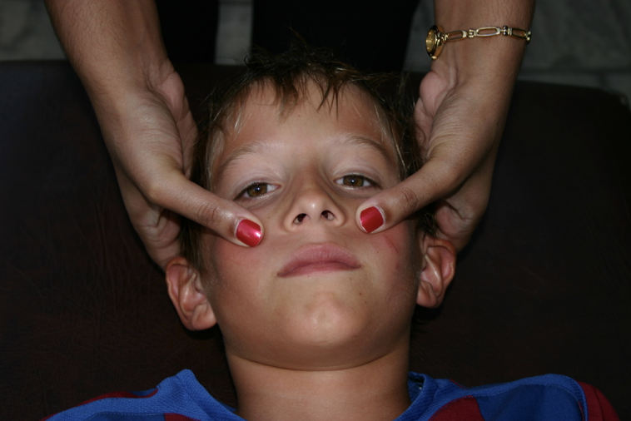
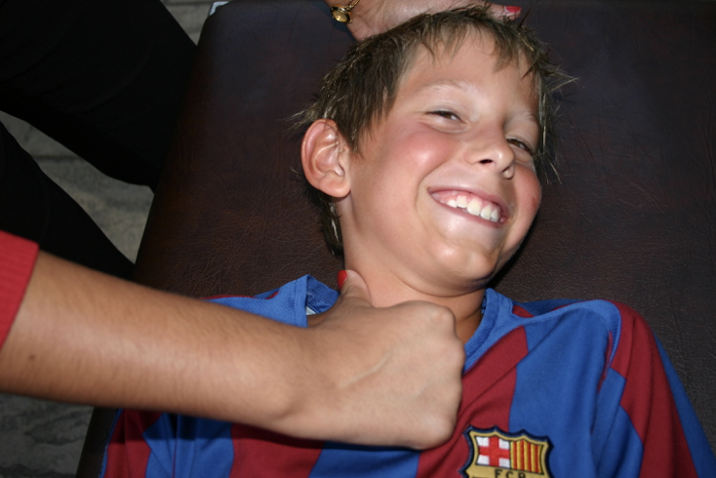
Sinus Effleurage – How to Perform
The patient is supine.
With repetitive strokes, the thumbs are brought across the frontal maxillary sinuses from medial to lateral finishing at a point near the ear lobes.
The thumbs should be used to milk the lymphatic fluid down the anterior aspect of the sternocleidomastoid muscle belly along the anterior cervical lymphatic chain towards the heart.
Repeat this technique for complete drainage.
American College of Osteopathic Pediatricians Pediatric Sinus Drainage OMT Module
Robert Hostoffer, DO FACOP, FAAP
Eric Hegybeli, DO, FAOCP

Slide 44
Galbreath Technique – Why use it?
Passive soft tissue technique is used to induce jaw motion to create increased drainage of middle ear and tonsillar areas via the eustachian tube and lymphatics.
This technique can be used for chronic otitis media.
American College of Osteopathic Pediatricians Pediatric Sinus Drainage OMT Module
Robert Hostoffer, DO FACOP, FAAP
Eric Hegybeli, DO, FAOCP

Slide 45
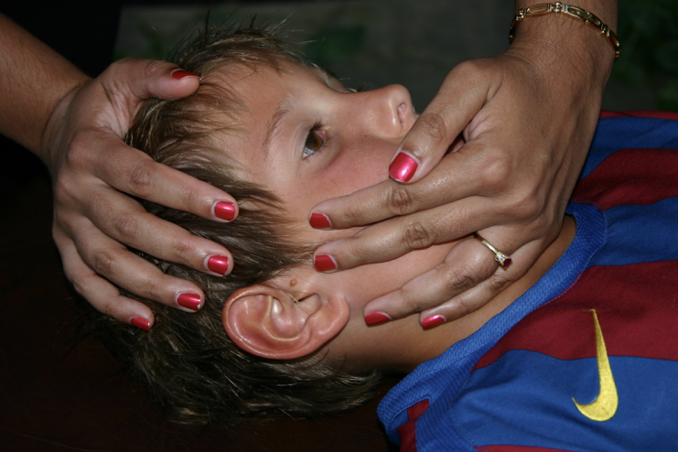
Galbreath Technique – How to Perform
The patient is supine and the doctor is behind patient, while stabilizing the head and placing traction on the mandible. With a “pumping action,” the fascia of the eustachian tube via the mandible is brought anteriorly and medially across the face a short distance, multiple times on each side of the head.
The procedure is done for 30 seconds on each side for up to three times a day.
American College of Osteopathic Pediatricians Pediatric Sinus Drainage OMT Module
Robert Hostoffer, DO FACOP, FAAP
Eric Hegybeli, DO, FAOCP

Slide 46
Ear Pull Technique – Why use it?
A gentle bilateral ear pull will help mobilize the underlying fascia and the temporal bones.
One side may be less mobile and may require longer to feel a release.
The side that is more medial often correlates with an internally rotated temporal bone.

Slide 47
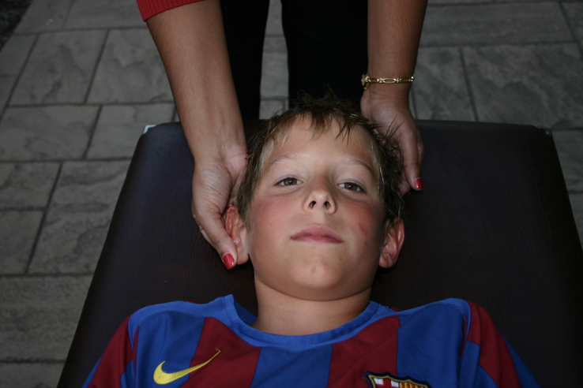
Ear Pull Technique – How to Perform
Positioning:
The patient is supine.
The doctor is behind the patient.
A gentle force is applied to the bilateral pinnae until the pinnae become more mobile.
The ear pull is helpful in infants, but may not be useful in children who are moving around.
American College of Osteopathic Pediatricians Pediatric Sinus Drainage OMT Module
Robert Hostoffer, DO FACOP, FAAP
Eric Hegybeli, DO, FAOCP

Slide 48
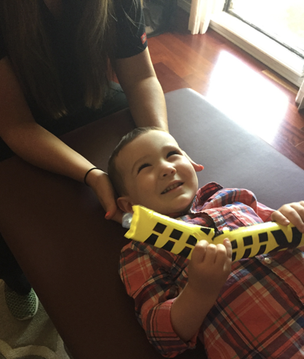
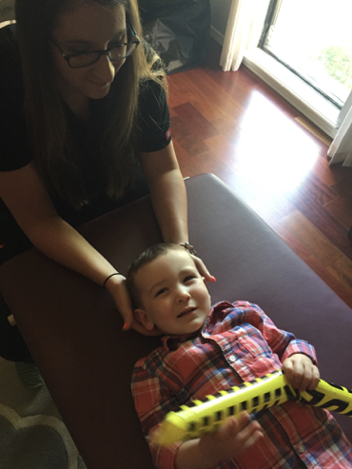
Suboccipital release
Patient is supine with physician at head of bed
Place index and middle fingers in the occipital sulcus on both sides
Apply linear traction until a release is felt (about one minute)

Slide 49
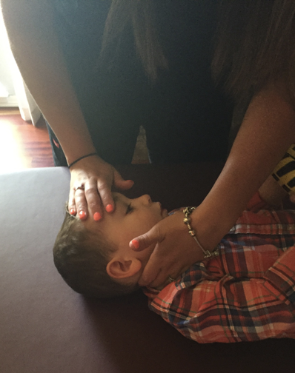
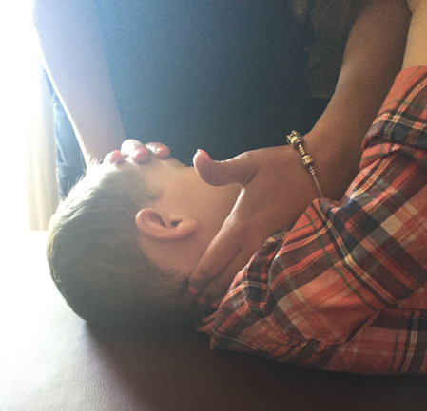
Counter – Lateral Traction
Place one hand on the frontal bone, the other hand on the lateral aspect of the cervical spine along the articular facets.
While applying pressure on the frontal bone away from you, the other hand stretches the muscles of the neck toward you.

Slide 50
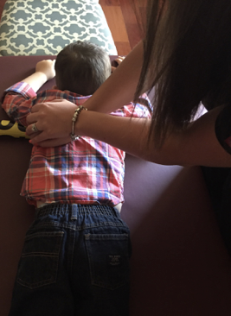
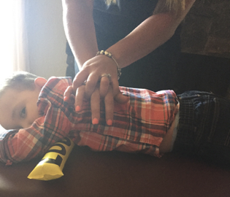
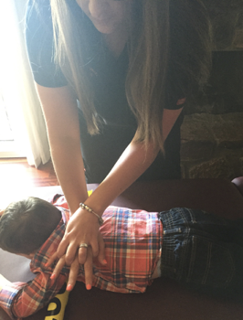
Soft Tissue to the Paraspinal Muscles
Patient is prone
Physician is standing on the opposite side of the patient to which they will treat
Place the thenar and hypothenar eminences of the physician’s dominant hand between the spinous processes and paraspinal muscles on the contralateral side to which you are standing, and are aiming to treat.
The physician places the other hand over the hand above
The physician leans forward applying a lateral force to the paraspinal muscles.

Slide 51
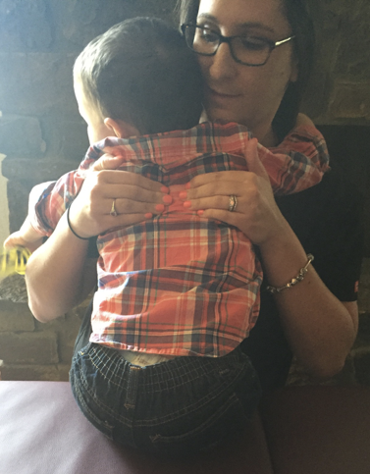
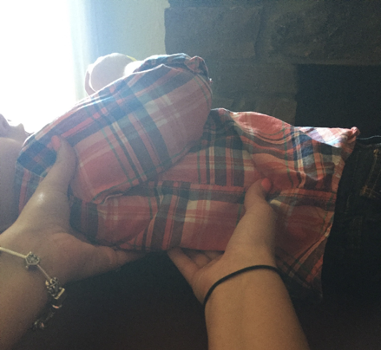
Rib Raising
Patient Supine
Patient Seated
The physician is at the side they are treating
Physician’s hands are under the patient’s back, palms up, with fingers close to the spinous process
The pads of the fingers elevate as the forearms are used as the fulcrum, making a “come here” motion
The physician is standing in front of the patient
The physician reaches around the patient, and contacts the patient’s posterior rib angles on both sides with hands bilaterally
The physician is to lean back applying a gentle traction

Slide 52
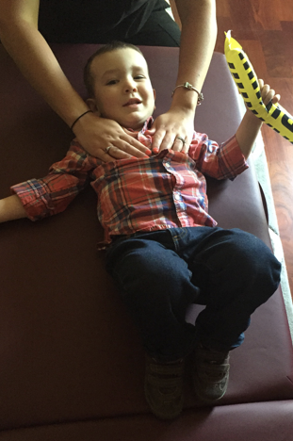
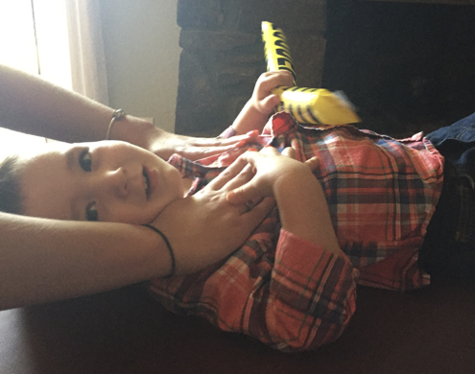
Lymphatic Drainage
The patient is supine with knees flexed, and the physician is at the head of the patient
The physician hands are spread flat over the anterior superior chest wall
Pressure is applied, equally distributed over the entire surface of the anterior superior chest with both hands in downward and caudad rhythmic manner

Slide 53
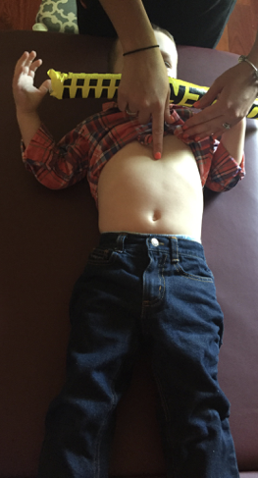
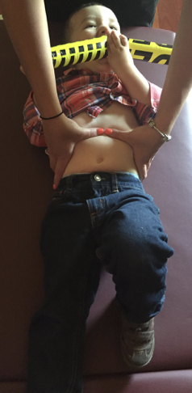
Thoracoabdominal Diaphragm Release
Patient is supine
The physician is standing behind the patient’s head
The physician is to place palms bilaterally over the lower margin of the ribcage, with thumbs lateral to the sternum one inch below the 10th rib
Apply a slow, progressive pressure to the fascia of the anterior abdomen and diaphragm, allowing the thumbs to sink under the ribs. After this is achieved, apply an upward pressure
Hold until a release is felt (approximately one minute)

Slide 54
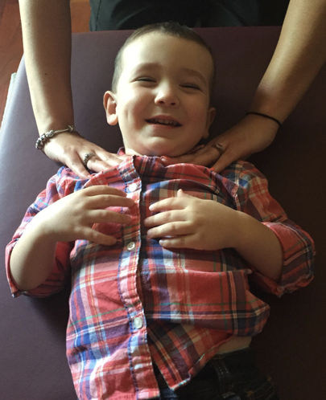
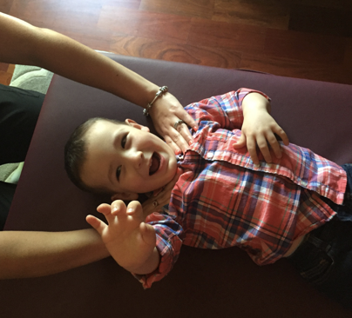
Thoracic Inlet Myofascial Release
The patient is supine
The physician is to be seated at the patient’s head behind the patient
The physician is to place hands with 2nd - 5th digits over the chest wall, over the thoracic inlet at the levels of the first and second ribs. The thumbs of the physician should posterior to the thoracic inlet, at the same level upon the chest anteriorly
With slight pressure over the anterior chest, introduce translation to the left/right, rotation, and/or twisting motion to evaluate for any myofascial restrictions
Hold a point of balance within the above induced motions until a release is felt (about one minute)

Slide 55
Thank you!

Slide 56
References
Allen TW, D’Alonzo GE, Investigating the role of osteopathic manipulation in the treatment of asthma. J Am Osteopath Assoc 1993;93:654–656, 659.
Chila, Anthony, et. al. Foundations of Osteopathic Medicine. Rev 3rd Ed. 2011: 53 - 55, 331 - 334, 528 - 542, 883 - 888, 960 - 965
Hostoffer, Robert and Hegybeli, Eric. Pediatric OMT Chest Module. Powerpoint Presentation. Retrieved from: http://www.acopeds.org/pomt-for-residents-directors/
Kuchera ML, Kuchera WA. Osteopathic Considerations in Systemic Dysfunction. Rev. 2nd Ed. 1994:33–56.
Nelson, Kenneth. Somatic dysfunction in Osteopathic Medicine. Rev 2nd Ed. 2014: pg 285,
Openshaw P, Edwards S, Helms P. Changes in rib cage geometry in childhood. Thorax 1984;39:624.
Sawicki, Gregory, et al. Asthma in Children Younger Than 12 Years Initial Evaluation and Diagnosis. In: UpToDate, Post TW (Ed), UpToDate, Waltham, MA. (Accessed on March 25, 2016.)
Panton J, Barley EA. Family therapy for asthma in children. Cochrane Database Syst Rev 2005:2.

Slide 57
References
Acess Medicine: Current Medical Diagnosis and Treatment: Chapter 8. Ear, Nose, and Throat Disorders. “Acute Otitis Media”
Gunasekera H et al. Management of children with otitis media: a summary of evidence from recent systematic reviews. J Pediatric Child Health. 2009 Oct; 45 (10): 554-62.
JAOA Vol 100. No 10. October 2000. “Galbreath Technique: a manipulative treatment for Otitis Media Revisited” pgs 635-639.
JAOA Vol 106 No 06 June 2006. “Osteopathic Evaluation and Manipulative Treatment in Reducing the Morbidity of Otitis Media: A pilot study.” Degenhardt, Kuchera pgs 327-334
Red Book: 2009 Report of the Committee on Infectious Disease. American Academy of Pediatrics “Otitis Media” page 741.
UpToDate: Acute Otitis Media in Children

