Slide 1
2018 Health Care
Industry Trends
Healthcare Market Survey and Outlook Summary
Rhett Stover, MHA, FACHE | May 18, 2018

Slide 2
I have no relevant financial relationships or affiliations with commercial interests to disclose.
Disclosure

Slide 3
Payment Reform and Reimbursement Trends
Purchaser Behavior
Healthcare Consumerism
Summary

Slide 4
Payment Reform and Reimbursement Trends
Bundled Payments
Revenue Trends
Volume Performance

Slide 5





An Increasingly Attractive Set of Alternative Options
Continuum of Medicare Risk Models
Pay-for-Performance
Bundled Payments
Shared Savings
Shared
Risk
Full
Risk
Hospital VBP Program
Hospital Readmissions Reduction Program
HAC Reduction Program
Merit-Based Incentive Payment System
Bundled Payments
for Care
Improvement
Initiative (BPCI)
Comprehensive Care for Joint Replacement
(CJR) Model
Episode Payment Models
MSSP Track 1
(50% sharing)
MSSP Track 1+¹
MSSP Track 2
(60% sharing)
MSSP Track 3
(up to 75% sharing)
Next Generation
ACO Model
(80-85% shared savings option)
Next Generation
ACO Model
(full risk option)
Medicare
Advantage (provider-sponsored)
Increasing Financial Risk
Anticipated to open for participation in 2018.
Source: Health Care Advisory Board interviews and analysis.
Notes:
MSSP Track 1+ - 2018 start. Alternations focused on benefit of small/rural hospitals and unique challenges of rural health. SNF 3 day rule waiver.
*1,000 ACOs across U.S. 611 of which are Medicare ACOs. Covering 28 MM beneficiaries. 82% are non-risk.
10,000 people become Medicare eligible every day. In 2035, 78MM 65 or older. 76 MM under 18. First time in recorded history.

Slide 6



Future of Bundled Payments in Question
Bundled Payments
CMS Poised to Iterate on Voluntary Programs, Scale Back Mandatory Ones
Cardiac EPMs¹ Cancelled
CJR³ Scaled Back
What’s Next for BPCI⁵?
Mandatory bundling for CABG² and AMI², originally slated to go into effect July 2017
Final rule released on November 30th cancels
both programs
Mandatory bundling for hip and knee replacements, originally in 67 markets
Final rule makes participation in 33 markets voluntary, cancels planned expansion to SHFFT⁴
Optional bundling program; providers may opt into any of 48 different conditions across four risk models
Current Models 2, 3, and 4 extended through September 30th, 2018
CMS Committed to Exploring New Bundled Payment Programs
“We [at CMS] believe the best way to drive health system change while [reducing] burden & maintaining access to care is through developing different bundled payment models & engaging more providers”
Seema Verma, CMS Administrator, November 30th 2017
Episode Payment Models.
Coronary artery bypass graft and acute myocardial infarction; MS-DRGs: 280-282; 246-251; 231-236
Comprehensive Joint Replacement.
Surgical hip/femur fracture treatment; MS-DRGs: 480-482.
Bundled Payments for Care Improvement.
Source: Jankowski, G., “The New “Price” of U.S. Health Care: The Future of Value-based Reimbursement Under President-elect Trump and Tom Price,” JDSUPRA, Jan. 10, 2017; Dickson, V., “Hospitals call on Trump administration to end mandatory bundled pay programs,” Modern Healthcare, April 24, 2017; CMS, “Medicare Program; Cancellation of Advancing Care Coordination through Episode Payment and Cardiac Rehabilitation Incentive Payment Models; Changes to Comprehensive Care for Joint Replacement Payment Model: Extreme and Uncontrollable Circumstances Policy for the Comprehensive Care for Joint Replacement Payment Model,” November 30, 2017; Health Care Advisory Board interviews and analysis.

Slide 7
Finances
Low Growth in National Health Spending
Annual Percent Growth in National Health Expenditures
2010-2017
Altarum’s projected growth rate, as of Q3, is below CMS’s official projected growth rate of 5.4% for 2017.²
¹
¹
1) Projected health spending growth for 2017, as of November, 2017.
2) CMS’s projection was made in 2015.
Source: Altarum, “Health Spending Report,” August, 2017; Altarum “Health Spending Report,” November 2017; CMS, “Table 1:
National Health Expenditures and Selected Economic Indicators, Levels and Annual Percent Change: Calendar Years 2009-2025,” 2015, available at www.cms.gov; Market Innovation Center interviews and analysis.

Slide 8
Margin Deterioration Occurring for Many Providers
Excess Margin¹ Medians of Freestanding Hospitals, Single-State & Multi-State Healthcare Systems, by Broad Rating Category
Aa
Baa
Median
Aa
Baa
Median
Aa
Baa
Median
Aa
Baa
Median
2013
2014
2015
2016
Excess margin= (total operating revenue- total operating expense + non operating revenue)/ (total operating revenue + non-operating revenue) *100.
Operating margin= (total operating revenue- total operating expense)/ total operating revenue*100.
²
Source: Moody’s Investors Service, Preliminary Medians, 2013, 2014, 2015, 2016; Health Care Advisory Board interviews and analysis.

Slide 9









Nine Price and Cost Pressures Squeezing Margins
Downward Pricing Pressure
1
2
3
4
5
Direct
reimbursement
pressure
Federalism and
state-based
coverage reform
Dilution of
commercial
coverage
Deregulation
and the new era
of competition
Shifting
demographics and payer mix evolution
Provider Margins
Upward Cost Pressure
Rising pharmaceutical costs
Uncontrolled
labor spending growth
Increasing
reliance on IT enablement
Growth in purchased
services
6
7
8
9
Source: Health Care Advisory Board interviews and analysis.

Slide 10
Volume Performance Projections Remain Modest
Volume Performance
Inpatient and Hospital Based Outpatient Volume Projections
Inpatient Volume,
CAGR¹
Hospital-Based Outpatient Volume, CAGR
2016-2021
2016-2021
Compound Annual Growth Rate
Source: Advisory Board Market Scenario Planner; Advisory Board research and analysis.

Slide 11
Volumes Continuing to Shift Outpatient
Medicare Volume Growth
All Payer Volume Growth Projections¹
Cumulative Percent Change
2016-2021
(47.4%)
Cardiac Services
Vascular Services
2006
2015
Obstetrics
(19.5%)
Orthopedics
Outpatient services represent entire market regardless of site of service (includes hospital-based settings, ASCs, other freestanding providers and physician offices)
Source: “Report to the Congress: Medicare Payment Policy,” MedPAC, March 2017, available at: www.medpac.gov; Advisory Board Company Market Scenario Planner; Market Innovation Center interviews and analysis.

Slide 12




Inpatient Imaging Utilization Decline Continues
Imaging Centers
Factors Discouraging Inpatient Growth
Total Imaging Procedures
Hospital Inpatient Versus Total Outpatient
Medicare Fee-for-Service, 2011-2015
Length of stay scrutiny
50M
Alternative payment models
40M
Readmissions penalties
30M
Payment transition to DRG¹
Diagnosis-Related Group.
Source: CMS Physician/Supplier Procedure Summary Master File; Neiman Health Policy Institute; Imaging Performance Partnership interviews and analysis.

Slide 13
Modest Outpatient Imaging Opportunities
Imaging Volumes Mostly Outpatient
National Outpatient Radiology Market Projections
Imaging Procedures by Care Setting
Medicare Part B, 2014
Estimated Volumes, 2016-2021
All Imaging Procedures
Modality | Five-Year Projected Growth
US¹ | 20%
PET | 8%
CT | 8%
MRI | 6%
X-Ray | 4%
Mammo | (3%)
Nuc med | (6%)
Overall | 7%
Inpatient
HOPD²
ED³
Office
Advanced Imaging Procedures⁴
Inpatient
HOPD
ED
Office
Ultrasound.
Hospital Outpatient Department.
Emergency Department.
Advanced imaging includes CT, MRI, PET, nuclear medicine.
Source: CMS Physician/Supplier Procedure Summary Master File; Neiman Health Policy Institute; Market Scenario Planner, Advisory Board, 2017; Imaging Performance Partnership interviews and analysis.

Slide 14




Site-Neutral Payments Now Taking Effect
Hospital Sites Meeting Three Criteria…
…Receive 40% of HOPPS¹ payment in 2018
1
Hospital-owned, designated as
“off-campus, provider-based sites”
2
Located more than 250 yards
from hospital’s campus
Reimbursed for all services on site-specific MPFS rate set at 40% of HOPPS¹ payment, down from 50% in 2017
3
Acquired, opened, or built
after November 1, 2015
Further Reductions on the Horizon
1 in 4 Imaging Performance Partnership members own an impacted site
In 2019, claims data from impacted sites will be used to help determine new rates
Ways to Lose Ability to Bill on HOPPS:
Facility relocation²
Site acquisition
Office expansion
CMS exploring a full transition of impacted sites to MPFS claims
Hospital Outpatient Prospective Payment System.
Facilities relocated for extraordinary events, e.g. natural disasters, public safety events, etc. may continue billing on HOPPS.
Source: Centers for Medicare and Medicaid Services, CMS.gov; Imaging Performance Partnership interviews and analysis.

Slide 15
The ASC Build Boom Has Subsided
Ambulatory Surgery Centers
Total Number of Medicare-Certified ASCs
Net percent growth from previous two years
5,464
5,364
5,228
5,064
Source: “Number of ASCs per State,” Advancing Surgical Care, June 2016; “Report to the Congress: Medicare Payment Policy,” MedPAC, March 2015; ASC Association,Beckers, “51 Things to Know About the ASC Industry,” Beckers ASC Review, 2017; Market Innovation Center interviews and analysis.

Slide 16

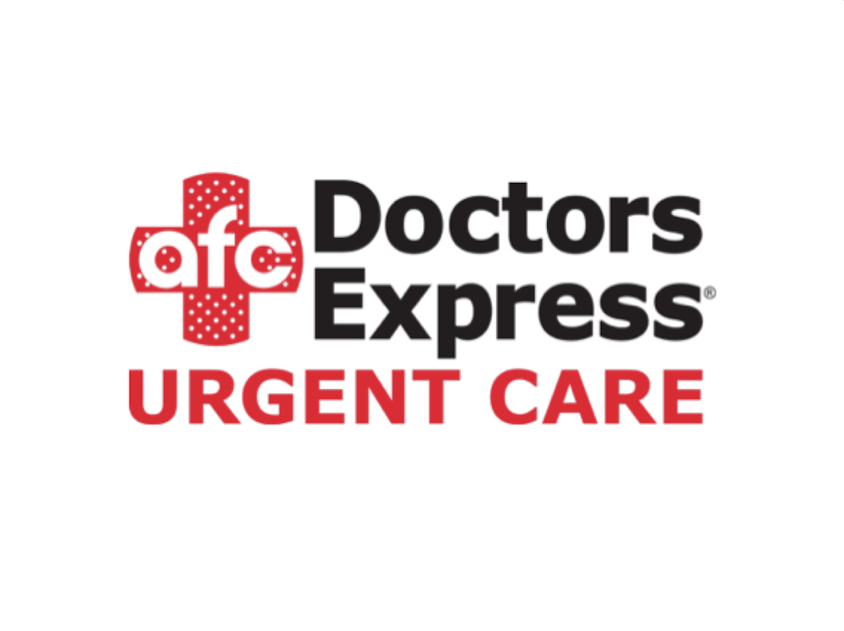

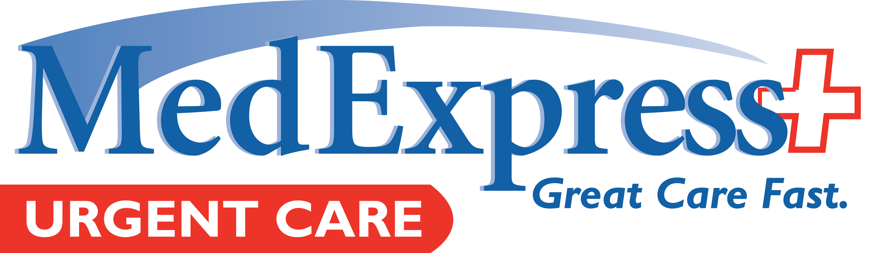
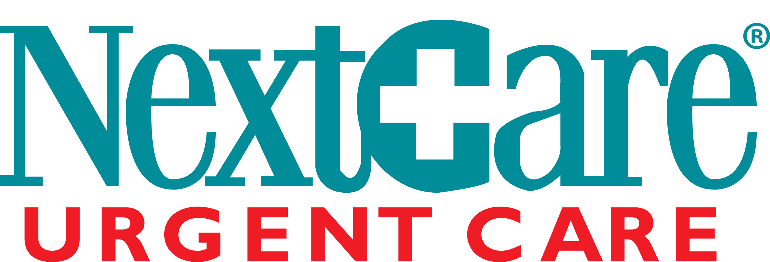

Urgent Care Ripe for Consolidation and Diversification
Urgent Care Beginning to Offer Ongoing Primary Care Services¹
Urgent care and ongoing primary care
7,546
Estimated number of urgent care clinics in operation in the US in 2018
<5%
Exclusively urgent care
Maximum percentage of total industry revenue generated by any of the largest players
Continued growth likely in urgent care centers offering ongoing primary care to bolster referrals, relieve primary care offices, and manage population health
Operator
Operational
Urgent Care Centers²
300+
180
174
163
137
Source: IBISWorld, “IBISWorld Industry Report OD5458: Urgent Care Centers in the US,” February 2017; Merchant Medicine, “The ConvUrgentCare Report,” Vol. 8, No. 7, July 2015; Health Data Management, “30 Top Urgent Care Center Chains,” 2017; UCAOA, “2014 Urgent Care Benchmarking Survey Report”; UCAOA, “Benchmarking Report Summary,” 2016; Market Innovation Center interviews and analysis.
As of January 2016.
As of February 2017.
Notes:
CVS acquired Aetna for $69B. 75% of US population lives within 5 miles of a CVS. Walmart in talks with Humana.

Slide 17
Provider Interest in Telehealth Continues to Grow
Telehealth
Telemedicine as a Strategic Priority
REACH Health, “2017 U.S. Telemedicine Industry Benchmark Survey”
n=436
51%
Respondents identifying telemedicine as a “top” or “high” priority at their organization in 2017
Sources: REACH Health, “2017 U.S. Telemedicine Industry Benchmark Survey,” REACH Health, http://reachhealth.com/wp-content/uploads/2017-US-Telemedicine-Industry-Benchmark-Survey-REACH-Health.pdf, Planning 20/20 research and analysis.

Slide 18
Reimbursement Shows No Sign of Slowing
Year-Over-Year Medicare
Reimbursement for Telehealth Services¹
In millions of dollars
33%
604% Growth
Increase in Medicare telehealth claims from 2015 to 2016
28%
Increase in Medicare telehealth payments between 2015 and 2016
CMS data.
2015 HIS Analytics report.
Sources: Pittman D, “Medicare telemedicine spending jumped 28% last year” Politico Pro, August 9, 2017; Gooch K, “Medicare telehealth spending rose nearly 30% in 2016: 4 things to know” Beckers Hospital Review, August 29, 2017; Service Line Strategy Advisor research and analysis.

Slide 19
Purchaser Behavior
Health Plan Exchanges
Employer Sponsored Health Plans
Medicare & Medicaid

Slide 20
For Providers, a Relatively Limited Impact
Despite Political Significance, Exchanges Only a Small Segment of Market
Approximate Coverage of US Population by Payer Sector
As of March 2016
~11.5M
Individuals with insurance through public exchanges
~153M
Individuals with employer-sponsored insurance
¹
Student, IHS, CH+.
Source: Gaba, C., “Healthcare Coverage Breakout for the Entire U.S. Population in 1 Chart,” ACASignups.net, March 28, 2016, available at: http://acasignups.net/16/04/18/show-your-work-healthcare-coverage-breakout-entire-us-population-1-chart; Health Care Advisory Board interviews and analysis.

Slide 21
Consumers Trade Low Premiums for High Deductibles
Average Deductible for Exchange-Sold
Health Plans
Exchange Enrollment,
by Metal Tier
2015-2017
2016
Gold
Platinum
Bronze
The average premium for a gold plan increased by 22% between 2016-2017, the greatest increase of the metal tiers
Silver
92% of exchange enrollees are in bronze or silver plans
Source: Health Pocket, “Aging Consumers Without Subsidies Hit Hardest by 2017 Obamacare Premium & Deductible Spikes,” October 2016; ”Health Pocket, “2015 Obamacare Deductibles Remain High but Don’t Grow Beyond 2014 Levels,” November 2014; Kaiser Family Foundation, “Marketplace Enrollment by Metal Level,” March 2016; Market Innovation Center interviews and analysis.

Slide 22
Employers Continue to Grow HDHP Offerings
Employers
ESI Average Deductible for Single Coverage¹
Percentage of Firms Offering an High Deductible Health Plans³
By Plan Type, 2007-2017
By Firm Size, 2013-2017
2
Among covered workers with a general annual health plan deductible.
Includes health plans with savings options.
High deductible health plans with a deductible of at least $1,000 for single coverage and $2,000 for family coverage
Source: Kaiser Family Foundation and Health Research & Educational Trust, “Employer Health Benefits 2017 Annual Survey,” 2017; Health Care Advisory Board interviews and analysis.

Slide 23




Price-Exposed Workers Sway the Demand Economy
The Near-Term and Long-Term Impact of Increased Employer Cost-Shifting
Near-Term
Volume Impact
Near-Term
Pricing Impact
Long-Term
Market Share Impact
1
2
3
4
Decreased Demand
Extreme Seasonality
Reduced Collections
Increased Shopping
Large out-of-pocket obligation leading to deferral of care across all services
Delaying high-acuity elective care until out-of-maximum achieved, accentuating volume shifts to the end of the year
Inability to pay out-of-pocket obligation leading to decline in patient collections
Growth of transparency apps facilitating price comparisons, shifting preference to lower-priced providers
Source: Health Care Advisory Board interviews and analysis.

Slide 24
Many Employers Curating Through Network Design
High-Performing Networks Most Prevalent Among Large Employers
Percentage of Firms With Health Plans Offering a Narrow Network, High-Performance Network, or Tiered Network
By Firm Size, 2016
Even More Companies Poised to Join the Trend
46%
Of employers surveyed¹ in Q1 2016 were considering implementing value-based plan designs or high-performance networks in 2017
PwC’s 2016 Health and Well-being Touchstone Survey; includes 1,100 employers from 37 industries across the US.
Source: Murphy, B., “PwC: 46% of employers consider move to high-performance networks,” Beckers, June 21, 2016; Hall, M. et al., “Narrow Provider Networks for Employer Plans,” Employee Benefit Research Institute, Dec. 14, 2016; Health Care Advisory Board interviews and analysis.

Slide 25

Kicking the Legs Out From Under Hospital FFS
Medicare
Medicare Payment Cuts for FFS Models Encourage Migration to Risk
“Productivity” Adjustments and Other Cuts
($32B)
($48B)
($60B)
($71B)
($82B)
($94B)
($103B)
ACA IPPS¹ Update Adjustments
ACA DSH² Payment Cuts
($116B)
MACRA³ IPPS Update Adjustments
($143B)
$14.6B
Cuts to teaching hospitals
and GME payments
$30.8B
Reduction in Medicare
bad debt payments
Source: CBO, “Letter to the Honorable John Boehner Providing an Estimate for H.R. 6079, The Repeal of Obamacare Act,” July 24, 2012; CBO, “Cost Estimate and Supplemental Analyses for H.R. 2, the Medicare Access and CHIP Reauthorization Act of 2015; The Daily Briefing, “How to Understand Last Week’s Big Budget Deal,” November 2, 2015; Budget of the United States Government (Proposed) FY 2016; Pham H, et al., “Medicare’s Vision for Delivery-System Reform – The Role of ACOs,” New England Journal of Medicine, September 10, 2015; Health Care Advisory Board interviews and analysis.
Inpatient Prospective Payment System
Disproportionate Share Hospital
Medicare Access and CHIP Reauthorization Act

Slide 26
Healthcare Consumerism
Behaviors and Features

Slide 27



Consumers
Drivers of Point-of-Care Consumerism
Market Shift
Why Is This Changing?
Effect on Market
Consumers adopt greater financial responsibility
Prevalence of HDHPS increasing
Magnitude of OOP responsibility
continues to grow
Price sensitivity
Shopping behavior
Emergence of meaningful alternatives
New market entrants providing
attractive alternatives
Competition
More (and better) choices for consumers
Greater transparency
Proliferation of third party
transparency vendors continues
Providers’ improved communications on value
More information to make educated decisions about care and providers
Weakening of physician recommendations
Growth of new primary care options, transparency could undermine traditional PCP relationships
Increase in self-referrals
More steerage of provider referrals
Source: Health Care Advisory Board interviews and analysis.

Slide 28





Recommendation Is Top Driver for Specialist
Top Drivers of Consumer Choice
Percentage of Respondents Citing Driver as #1 Influence in Decision for Specialist
60%
of adults turn to family and friends for information or support on health issues
72%
of internet users look online for health information
Friend or relative recommended
Personal or previous relationship
75%
of self-referrers consult at least one source when finding
a specialist
Affiliated with a hospital I like/trust
>80%
Board or subspecialty certification
of Millennials have smartphones, and 25% read online reviews before looking for a provider
Short distance
35%
of adults go online to figure out their medical condition
Source: Fox S and Duggan M, “Health Online 2013,” Pew Research Center, http://www.pewinternet.org/2013/01/15/health-online-2013/; “2016 Report to the Nation,” Healthgrades, October 2015, https://www.healthgrades.com/quality/healthgrades-2016-report-to-the-nation; “What Do Consumers Want from Specialty Care?” Market Innovation Center, 2015; Market Innovation Center interviews and analysis.

Slide 29






Price, Travel Time Are Top Surgical Care Priorities
Average Relative Importance¹ of Six Surgical Care Attributes
Travel time is second most important and about twice as important as the next most important attribute, referrer’s recommendation
Travel Time
to Hospital
Cost of Surgery²
Referrer’s Recommendation
Cost of care is more important than the five other attributes combined; comprises more than half of consumers’ preference
Hospital Affiliation
Location of Follow-Up Visit
Quality of Surgeon
Hospital affiliation matters more than quality of the surgeon
Relative importance depicts how much difference each attribute could make in the total utility of a product. That difference is the range in the attribute’s utility values for the five factors. We calculate percentages from relative ranges, obtaining a set of attribute importance values that add to 100 percent.
Includes cost of care and travel
Source: 2016 Surgical Consumer Preference Survey, Market Innovation Center interviews and analysis.

Slide 30
Most Patients Are Not Loyal to PCP
Percent of Consumers Highly Loyal in Each of Three Loyalty Measures
If your primary care moved to another clinic or practice, how likely are you to follow him/her to another clinic or practice?
How likely are you to stay with your primary care physician over the next 12 months?
How likely are you to recommend your primary care physician to friends or family members?
(On a scale of 0 to 10, with 0 being “definitely would not follow” and 10 being “definitely follow”)
(On a scale of 0 to 10, with 0 being “definitely not staying” and 10 being “definitely staying”)
(On a scale of 0 to 10, with 0 being “not at all likely” and 10 being “extremely likely”)
9%
53%
36%
Source: 2015 Primary Care Physician Consumer Loyalty Survey, Market Innovation Center interviews and analysis.

Slide 31













Expanding Network of Options Available
Primary Care Network
Providers Competing to Draw Patients Upstream
Mobile Apps
Email
In-store Kiosk
Virtual Visits
Remote Monitoring
Ambulatory Care Options
Emergency
Department
High Acuity
Low Acuity
Primary Care Office
Freestanding Emergency Department
Worksite
Clinic
Urgent Care Center
Retail
Clinic
Federally Qualified Health Center.
FQHC¹
Source: Market Innovation Center interviews and analysis.

Slide 32
Millennials v. Boomers v. Gen Xers
Consumers
Generational Shifts in Decision Behavior
1
Far less likely to have a primary care provider: 67% of Millennials have a PCP, vs. 85% Boomers / 78% for Gen Xers.
2
Much more likely to use walk-in clinics: 30% of Millennials have used vs. 14% Boomers / 18% for Gen Xers.
3
Much more interested in telemedicine: 40% of Millennials are interested vs. 19% Boomers / 27% for Gen Xers.
4
Much more likely to research health care options, such as checking quality or rating of MD/hospital: 51% of Millennials vs. 34 percent Gen X / 31% for Boomers.
Source: EBRI March 2018

Slide 33
The Short-term View Ahead
Summary
Market Remains Highly Dynamic
7 Things to Know…
Value Based Care Slowly Increasing Staying Power.
Increased Consumer-Centric Care and Quality Transparency Will Take Hold.
Greater Connectivity and Access to Data will Help Drive Improvements.
As patients take on more healthcare costs, payers and providers can expect patients to continue demanding greater access to data on cost and quality.
By some estimates, mental-health issues alone will account for more than $200 billion in medical spending this year. Behavioral Health solutions will begin making their way to the forefront of medicine.
Employer-sponsored Direct Primary Care Models Progress Through Infancy.
Interest, Experience, and Receptivity to Telehealth Solutions Continues.

