Slide 1
Evaluation of the Dizzy Patient
Tom A. Hamilton, DO
Program Director
Oklahoma State University
Otolaryngology-Head and Neck
Facial Plastic Surgery
Notes:
*

Slide 2
Disclosure
I have no relevant financial relationships or affiliations with commercial interests to disclose.
Notes:
*

Slide 3
Objectives
Define balance system
Define vertigo
Differential Diagnosis
Bedside Tools for Diagnosis
Specialized testing
Notes:
*

Slide 4
How It Works
Balance System
Visual
Proprioceptive
Vestibular
Notes:
*

Slide 5
Fast Facts
5 million office visits per year for dizziness
40% of patients over 65 will fall each year
80% of patients over 65 have experienced dizziness
Most common complaint for patients over 75
Falls are the leading cause of injury for older patients and leading cause of accidental death over age 85
Notes:
*

Slide 6
Dizziness
Vertigo
Disequilibrium
Oscillopsia
Lightheadedness
Physiologic
Multisensory
Notes:
*

Slide 7
True Vertigo
Usually described as spinning, whirling, or turning
Illusion of rotational, linear, or tilting of surroundings
Will not cause syncope
Problem with Brain or Inner Ear
Notes:
*

Slide 8
Dysequilibrium
Sensation of Instability of body positions
Either walking, standing
Feeling of being “off balance or imbalance”
Usually a problem with Proprioception but can be caused by common cold or allergic rhinitis causing eustacian tube dysfunction
Notes:
*

Slide 9
Oscillopsia
Inability to focus on object with movement
Difficulty reading while pushing shopping cart
Difficulty reading sign while walking
Problem with both Inner Ears
Usually from Ototoxic drugs such as chemotherapy or vancomycin
Notes:
*

Slide 10
Lightheadedness
Sense of Impending Faint
Presyncope
Caused by hyperventilation, orthostatic hypotension, vasovagal stimulation, recent changes in medications
Notes:
*

Slide 11
Physiologic
Height Vertigo
Usually seen above 3 meters
Visual cues for body sway correction decreased due to height
Motion Sickness
Rare under 2 years
Vision focused on stationary object with body in motion
Notes:
*

Slide 12
Multisensory
Diabetes
Age related decompensation
Notes:
*

Slide 13
Differential DX
Start with a good history of symptoms
90% of work up
Is there any hearing loss or tinnitus
Medications
History of Trauma
Cardiac symptoms
Anxiety
Aura
Vision change
Focal neurologic symptoms
Notes:
*

Slide 14
Vertigo Symptoms
Peripheral
Severe
Fatigues
Nausea
Hearing loss
Sweating
Worse with eye closure
Nystagmus horizontal or rotary
Ocular fixation reduces nystagmus
Central
Mild
Does not fatigue
More weakness and falling
Symptoms better with eye closure
Nystagmus vertical
Ocular fixation has no effect or makes nystagmus worse
Notes:
*

Slide 15
Peripheral Vertigo
Benign Paroxysmal Positional Vertigo
Meniere’s Disease
Vestibular Neuronitis
Labyrinthitis
Notes:
*

Slide 16
BPPV
Most common cause of true vertigo
Symptoms last for seconds to a minute
Very positional: occurs when sitting up or rolling over. Also when looking up on top shelf
Fatigable
May follow head trauma, joint operation, or bedrest
Notes:
*

Slide 17
BPPV
Diagnosed by history and physical testing
Thought to be caused by loose particles in posterior semicircular canal from otolith organs of inner ear
Dix-Hallpike maneuver
Vestibular suppressants not helpful
Treat with Epley’s maneuver
80+% successful
May repeat
Notes:
*

Slide 18
Dix-Hallpike
Patient sitting on table
Lay patient on back with head hanging 30 degrees and turned to either side
Wait approximately 30 seconds
Rotary nystagmus and vertigo will last for approximately 30 seconds
After symptoms gone, sit patient up and observe for another 30 seconds
Repeat on the other side
The “bad” ear is the one that is pointed to the ground when symptoms are elicited
Notes:
*

Slide 19
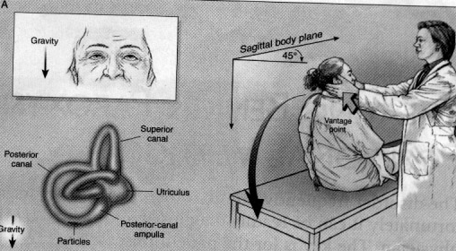
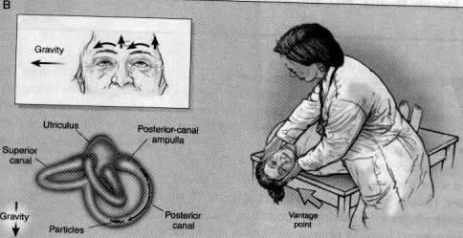
Dix-Hallpike
Notes:
*

Slide 20
Epley’s Maneuver
Lay patient on back with “bad” ear to the ground, head hanging about 45 degrees
SLOWLY rotate head until the “good” ear is toward the ground
SLOWLY rotate patient up on “good” side WHILE KEEPING THE HEAD TILTED 45 DEGREES TO THE GROUND AT ALL TIMES
SLOWLY rotate patient to sitting position
Notes:
*

Slide 21
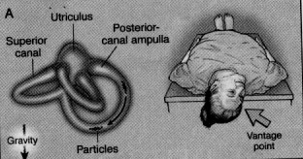
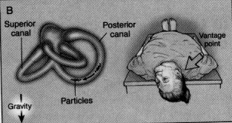
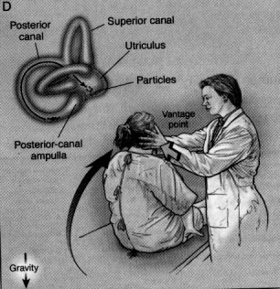
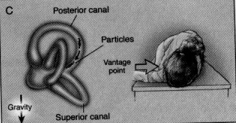
Epley’s Maneuver
Notes:
*

Slide 22
Meniere’s Disease
Fluctuating Sensorineural Hearing Loss
Nystagmus
Intermittent Vertigo: hours to days
Low pitched roaring
Aural fullness
Diagnosis of exclusion
Need at least two audiograms, usually pre and post treatment
Low sodium diet, control allergies, HCTZ, occasionally short course of oral steroids
Rarely surgery or chemoablation
Notes:
*

Slide 23
Vestibular Neuronitis/Labyrinthitis
Usually normal hearing with neuronitis, labyrinthitis usually with hearing loss
Nystagmus
May be after a recent URI or flu like illness
Severe vertigo may last up to one week
Some generalized unsteadiness can persist for up to 6 weeks
Valium useful for severe symptoms, then taper off.
Vestibular rehabilitation can speed recovery
Notes:
*

Slide 24
Metabolic Disorders
Diabetes is the biggest offender
Treat underlying disorder
Patient may need vestibular rehabilitation
Notes:
*

Slide 25
Bedside Testing
Gait test
Preponderance to 1 side
Oculomotor exam
Nystagmus
Rhomberg
Sharpened:heel to toe
Fukuda test
March in place for 30 sec: turn to lesion
Dix-Hallpike
Notes:
*

Slide 26
The Next Step
If no clear etiology proceed with specialized testing
Complete Audiogram
Electronystagmogram
Visually evoked myogenic potentials
Auditory Brainstem Response
Electrocochleography
Posturography
MRI brain with gadolinium or MRA
Notes:
*

Slide 27
Recap
Start with thorough history
Focused neurologic exam
Basic office testing
Treat what you see
If no clear etiology, proceed with more specialized testing
Enhance the normal compensation/healing response
Notes:
*

Slide 28
Questions
Notes:
*

Slide 29
Life is too short for bad music, bad food or bad friends

