Slide 1
James W. (“Jim”) Connor, Jr Medical Malpractice Defense Attorney
30+ years of trial experience defending doctors and other providers
Tried between 75 and 100 jury trials
Twice named Tulsa Best Medical Malpractice Lawyer
Top 50 Lawyers in Oklahoma – Super Lawyers
AV Preeminent Rating from Martindale-Hubble
Fellow of both the American College of Trial Lawyers and The International Academy of Trial Lawyers

Slide 2
Risk Management – Trends in Malpractice and Litigation James W. Connor, Jr.

Slide 3
Disclosures
No conflict(s) of interest in relation to this presentation
Disclaimer
I am not a doctor, I just play one on TV.
I have no expertise in asset protection or estate planning.

Slide 4
“We have a public health crisis on our hands”
“Medical malpractice / medical errors rank as the 3rd leading cause of death in the U.S.”
“The fact is that medical malpractice is under litigated”

Slide 5
Medical Malpractice Lawsuits in the 1980’s
My resources were a Taber’s Medical Dictionary and a very old set of Netter’s
One-third or more of the cases I defended were truly “frivolous”
Plaintiff lawyers relied exclusively on their experts for the medicine
The general public was much more deferential to their doctors
Plaintiffs had trouble getting credible experts

Slide 6
Medical Malpractice Lawsuits Today
Complete “Living Body” 3D anatomy, UpToDate, and internet on my phone
Patients have all of these things, including recorders, on their phones
Very few truly “frivolous” cases filed - too expensive for Plaintiffs
Most of cases filed have potential of 7-figure damages awards
Greater physician concern for potential excess verdicts

Slide 7
The Medicolegal Climate . . .
Negative effects of being sued
Feeling helpless; accused; practice disruption; being judged by others ignorant about medicine; self-doubt; paranoia; depression; exposure and humiliation; negative effect on marriage, family and self
Can’t be over-emphasized

Slide 8
How to Manage Medicolegal Risk
Obtain an amount of malpractice insurance which is usual and customary in your region
$1M/$3M in Oklahoma and many other states
Avoids the costs and risks of too much or too little coverage
Get separate policy with separate limits for your group for NPDB and excess issues
+
Understand malpractice and its nuances
Understand and engage risk management strategies
Practice good medicine and put your patients’ interests first
Be knowledgeable of state laws, SOC, Guidelines and algorithms

Slide 9
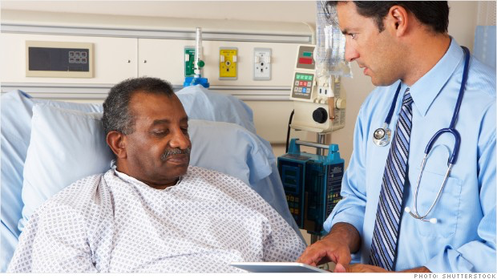
Comprehensive Risk Management Principles
COMPASSION
COMMUNICATION
COMPETENCE
CHARTING
CONSENT

Slide 10
14.1 OUJI Instruction Standard of Care - NonSpecialist
In diagnosing/treating/operating upon a patient, a physician must use his or her best judgment and apply with ordinary care and diligence the knowledge and skill that is possessed and used by members of his or her profession in good standing engaged in the same field of practice at the time. A physician’s standard of care is measured by national standards. A physician does not guarantee a cure and is not responsible for the lack of success, unless that lack results from his or her failure to exercise ordinary care or from his or her lack of that degree of knowledge and skill possessed by physicians in the same field of practice.

Slide 11
14.3 OUJI Instruction Alternative Methods of Treatment
Where there is more than one medically accepted method of diagnosis or treatment, a physician has the right to use his or her best judgment in the selection of the diagnosis or treatment, after securing the informed consent of the patient, even though another medically accepted method of diagnosis or treatment might have been more effective.

Slide 12
14.14 OUJI Instruction Informed Consent – Physician’s Duty
It is the duty of the physician to disclose to his or her patient all relevant information to enable that patient to make an informed decision on whether to consent to or reject the physician’s proposed treatment or surgery. This duty of disclosure includes advising a patient, when a proposed treatment or surgery involves a known risk of death or serious bodily harm, of the possibility of such outcome and explain in understandable terms the complications that might occur. The disclosure shall include any alternatives to the proposed treatment or surgery and the risks of each, including the risk in foregoing all treatment or surgery.

Slide 13
14.16 OUJI Instruction Informed Consent - Causation
Before a physician may be held liable for a breach of his or her duty to disclose, the patient must establish that he or she would have chosen no treatment or surgery or a different course of treatment of surgery had the alternatives and material risks of each been made know to him or her. In addition, the patient must have been injured by the undisclosed risk as a result of submitting to the treatment or surgery.

Slide 14
Informed Consent Additional Considerations
Doing it right does not guarantee you will win
Failure to do it will guarantee you will lose
Consider NOT using a dictation template in isolation (or at all)
Do not rely solely on hospital consent forms – nondelegable duty
Consider using technology
MedPro.com has an excellent section on Informed Consent and many other practice and risk management guidelines and strategies – educate yourselves
Shari Moore at PLICO/MedPro is also an excellent resource.

Slide 15
How to Manage Medicolegal Risk?
Participate in continuing education (like all of you)
Obtain an amount of malpractice insurance which is usual and customary in your region
$1M / $3M in many states
Avoids the substantial costs and risks of too much or too little insurance
Understand malpractice and its nuances
Understand and engage risk management
Practice good medicine
Be knowledgeable of state laws, standards of care, recommended treatment guidelines and algorithms
+

Slide 16
The “Treating Physician” in Medmal or Product Liability cases
If just personal injury, car wreck, comp, etc., no lawyer needed
If malpractice case, recommend you call your carrier for lawyer
”I don’t want to take your time with a deposition...if I could just have 15 minutes…”
Unrepresented treating physicians in medmal depositions
Your proprietary right to your expert opinions as a treater
Being compensated for your time as a treating physician
Surreptitious recordings by patients or others

Slide 17
Being an Expert Witness
Much easier than testifying in your own defense
We want experts who practice medicine for a living…
Sharpens your skills and knowledge
Contributes to quality of medicine in cases
Be aware of expert guidelines
Fees
Approach

Slide 18
Know What Goes into Your Charts
Not Peer Review or QA response letters
Not privileged emails or letters from your lawyer
Not any phone messages or anything about your lawyer
Medical record requests I prefer in separate place
Educate all staff about these things and confirm

Slide 19
Source - MedPro Group at medpro.com

Slide 20
https://www.diederichhealthcare.com/the-standard/2018-medical-malpractice-payout-analysis/.
.

Slide 21
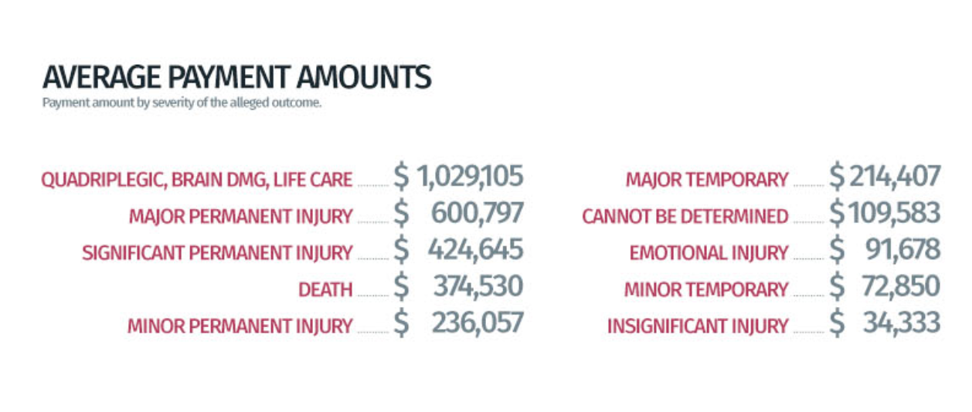
https://www.diederichhealthcare.com/the-standard/2018-medical-malpractice-payout-analysis/.

Slide 22
Source - MedPro Group at medpro.com

Slide 23
Oklahoma (former) cap on noneconomic damages Beason v I.E. Miller Servs., 2019 OK 28, ___P.3d___(April 23, 2019)
Supreme Court held that noneconomic cap of $350K was an unconstitutional special law in 14 page opinion
Court found statute unfairly distinguished between those who die and those who don’t
Close decision, 5-4; 3 Justices recused; 2 of 3 replacements voted with majority; and Justice Winchester wrote a 67 page dissenting opinion
In 2017, Court struck affidavit of merit requirement for the third time as denying or unfairly impeding Plaintiffs’ access to the courts (Chicoine v SFH)

Slide 24
Final Considerations
Medicolegal liability is unfortunately a part of practicing medicine
Understand and engage in risk management efforts
Protect yourself with the right coverage and use it when necessary
Educate yourself on your state’s standards by which your care will be judged in a courtroom
Be that physician every day that would make a juror say: “that is the type of physician that I want taking care of my family members”

Slide 25
Thank you! Go Pokes!

