Slide 1
Non-Hormonal Therapies for Dyspareunia: Risks, Reviews, and Revelations
Corey R. Babb, D.O., FACOOG, IF, NCMP
Clinical Assistant Professor of Obstetrics and gynecology
Oklahoma State University college of osteopathic medicine

Slide 2
Conflict of Interests Disclosure
Speaker’s Bureau: AMAG Pharmaceuticals
Consumer Advisory Board: AMAG Pharmaceuticals

Slide 3
Outline
Why is this Important?
Review Potential Causes of Dyspareunia
Discuss Current Non-Hormonal Treatment Options
Evaluate Potential Risk Factors Associated with Therapies

Slide 4
Dyspareunia
dys· pa· reu· ni· a
(dis'pa-rū'nē-ă), Occurrence of pain during sexual intercourse.
[dys- + G. pareunos, lying beside, fr. para, beside, + eunē, a bed]

Slide 5
Dyspareunia – Why is this Important?

Slide 6
Dyspareunia is a Common Problem
More than 200,000 new cases annually in the United States
Retrospective studies list 1.5% - 70% prevalence rate
Due to differing definitions, reporting, etc…
Current statistics are 8% - 20%
Symptom prevalence increases with age
Progressive in nature
Seems to peak at six years following menopause

Slide 7
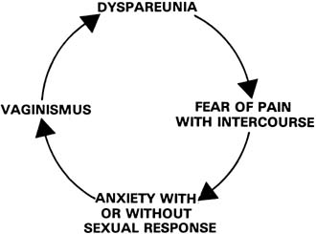
Dyspareunia Affects Relationships
Common cause of relationship stress
Feelings of inadequacy, fear, etc
Associated with loss of libido
Why do something that hurts?
May lead to obligatory intercourse
Which in turn leads to more pain!

Slide 8
Dyspareunia Affects Self-Image
“Am I broken?”
“Why can’t I just work correctly?”
“It’s not supposed to hurt all the time, right?”
“[dyspareunia causes]…decreased sexual desire, feelings of guilt, shame, failure, and a sense of being incomplete. Women will frequently describe their genital area as a "dead" part of the body”
Pazmany, E., et al, “Body image and genital self-image in pre-menopausal women with dyspareunia.” Arch Sex Behav. 2013 Aug;42(6):999-1010. doi: 10.1007/s10508-013-0102-4. Epub 2013 Apr 19.

Slide 9
Dyspareunia is Multifactorial
Often multiple comorbidities
GYN disease, GI disease, Psych Disease, etc…
Therapies are often multimodal as well
Medication, counseling, PT, etc..
NO ONE TREATMENT IS RIGHT FOR EVERYONE

Slide 10
Dyspareunia- What Causes it?

Slide 11
Common Etiologies
Hormonal Causes
GSM/VVA
Hormonal Vestibulitis
Medication (OCPs)
Non-Hormonal Causes
Anatomic issues
Vaginismus
Vulvar Vestibulitis
Vulvar Dermatoses
Interstitial Cystitis
Pelvic floor Dz
GI Disease
Cancer
Psychogenic
STI’s
The list goes on…
N94.10 - Unspecified dyspareunia
N94.11 - Superficial (introital) dyspareunia
N94.12 - Deep dyspareunia
N94.19 - Other specified dyspareunia
ICD-10 Coding

Slide 12
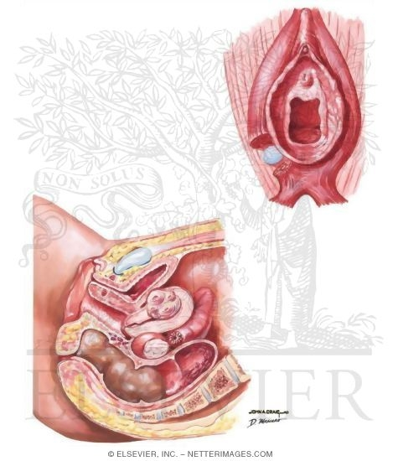
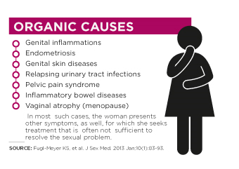
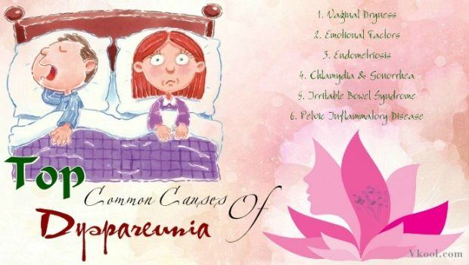
According to Google…

Slide 13
Case Study
Ms. Smythe-Jones is a 34 y/o G2P2002 who presents complaining of pelvic pain and dyspareunia. She reports that these symptoms have been increasing over the past two years, and are significant enough to affect her marriage. She notes that the symptoms began after the birth of her last child in 2017. She states that she recently stopped nursing, and has noticed some leakage of urine with laughing and coughing. She also admits to some changes in her menses, reporting an increase in flow. She denies any other medical problems, surgeries.
PE: hypertonic pelvic floor, tenderness to palpation in deep pelvic floor, mimics pain with dyspareunia, Grade II cystocele. Normal rugation in vagina
How would you proceed?

Slide 14
Two Resident Responses
PGY1
Pelvic Ultrasound to check for masses
OCPs to control menses/?endometriosis
?Surgery for incontinence
Physical Exam Findings:
Look for endometriosis
Bladder tenderness
PGY4
Better history
Stressors, marriage, PMH
US for masses
OCPs for pain/?endometriosis
Only if PE revealed it
Physical Exam:
Look for Uterosacral nodularity, enlarged ovaries, CMT

Slide 15
Case Study #2
Ms. Jones-Smythe is a 57 y/o G2P2002 who presents complaining of increasing dyspareunia. Her last period was six years ago. She reports that the pain is mostly with initial penetration, and admits that penetrative intercourse feels like “broken glass in my vagina.” She admits to significant vaginal dryness, as well as low libido. She is currently receiving chemotherapy for E/P receptor positive breast cancer. She would like to discuss options to help her sex life, as she feels “like a broken woman.”
PE: Introital stenosis, vaginal pallor, loss of rugae, atrophic labia
How do you proceed?

Slide 16
Two Resident Response
PGY4
PGY3 (on GYN oncology)
Laser therapy?
Can you inject a steroid?
PRP?
Moisturizers
Lubricants
Counseling
Dilators

Slide 17
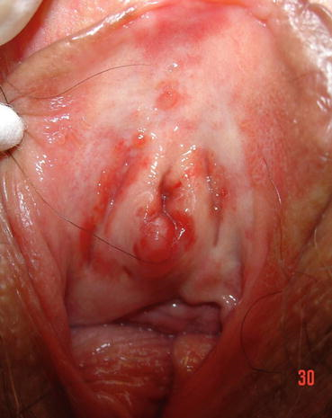
Physical Exam
External
Hormonal changes
Discharge
Lesions
Internal
Hormonal changes
Discharge
Lesions
Muscle spasms

Slide 18
Non-Hormonal Therapies for Dyspareunia

Slide 19
Two Main Types of Therapy
Non-Invasive
Invasive
Self-Based
Lubricants
Moisturizers
Dilators
Provider-Based
Physiotherapy
Counseling
Medication
Therapeutic Injections
Energy-Based Therapies
Platelt-Rich Plasma (PRP)

Slide 20
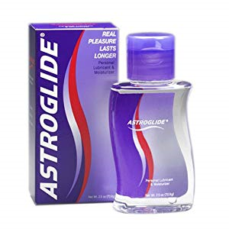
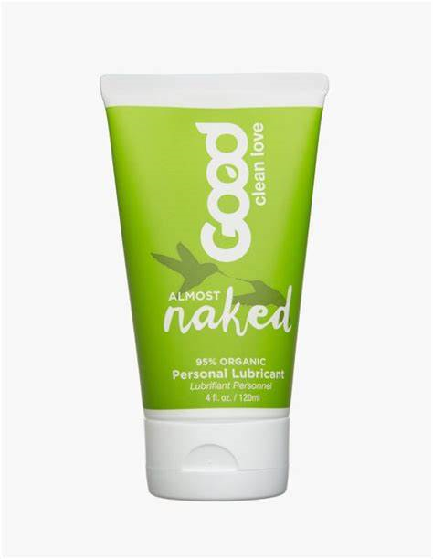
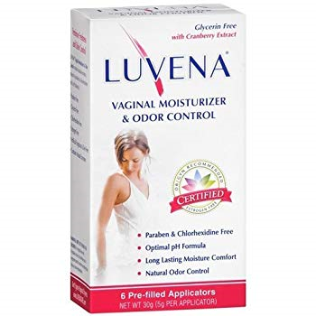
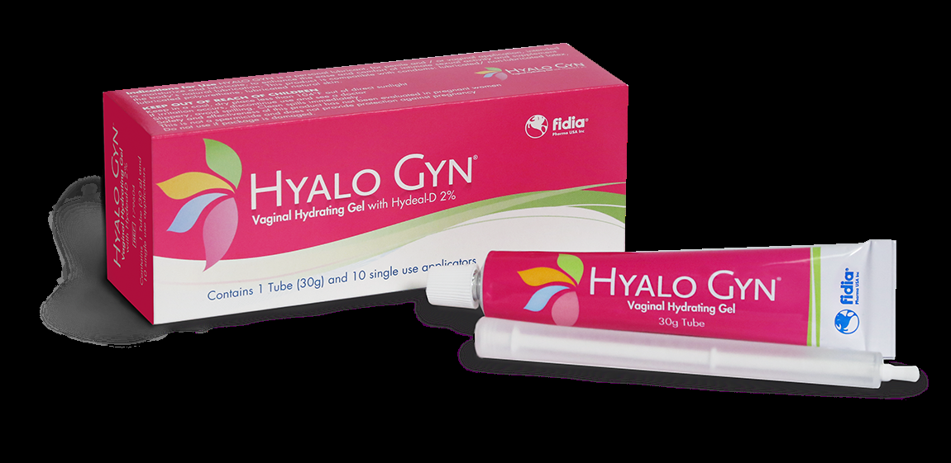
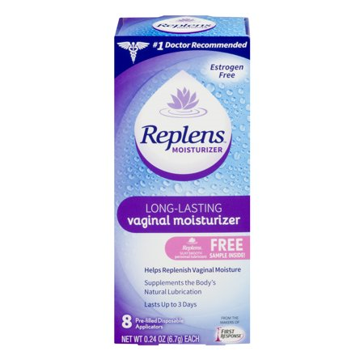
Lubricants and Moisturizers
Lubricants = with sexual activity
Moisturizers = regardless of sexual activity
Take into account pH and Osmolality

Slide 21
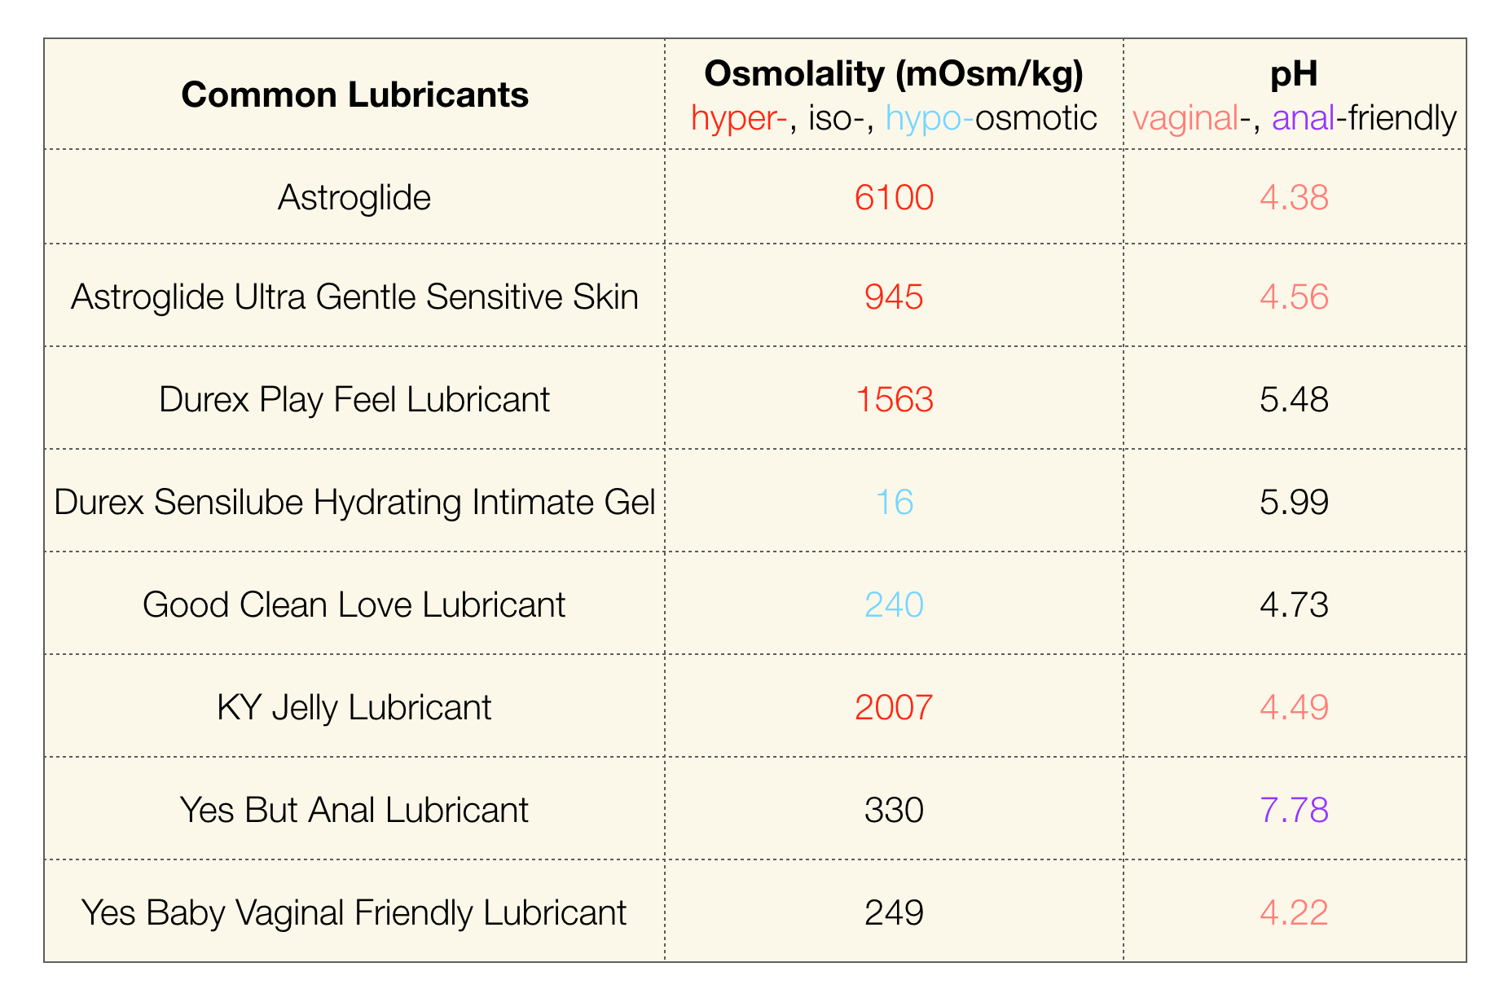
pH and Osmolality Comparison - Lubricants

Slide 22
pH and Osmolality – THE Comparison
Edwards, D., & Panay, N. (2015). Treating vulvovaginal atrophy/genitourinary syndrome of menopause: how important is vaginal lubricant and moisturizer composition?. Climacteric : the journal of the International Menopause Society, 19(2), 151–161. doi:10.3109/13697137.2015.1124259

Slide 23
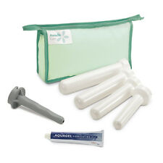
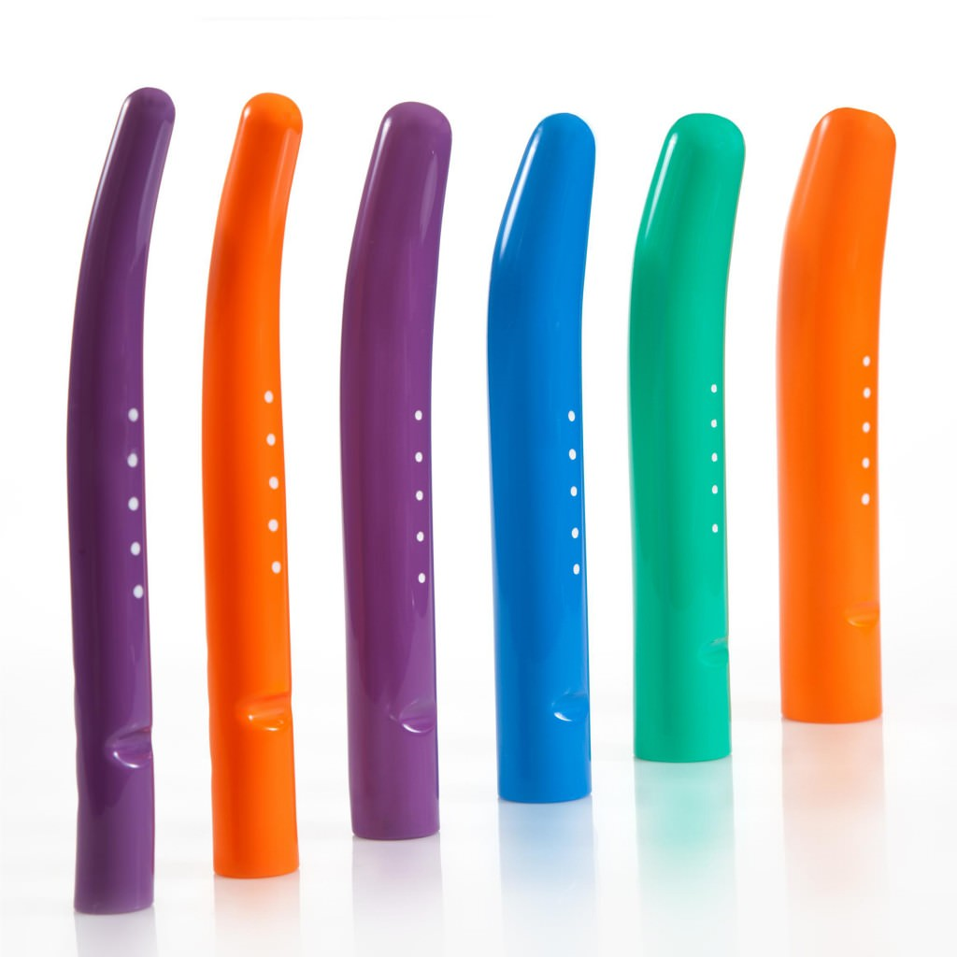
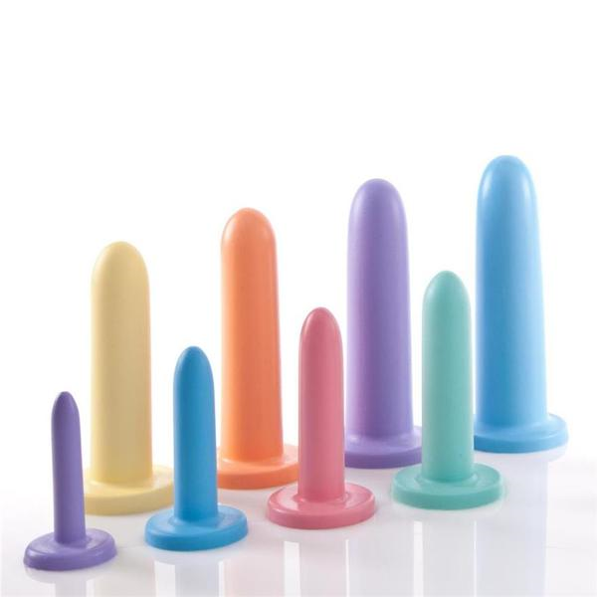
Dilators
Multiple sizes and textures
Most are graded – start small and increase in diameter
Goal is to approximate partner’s erection or diameter of desired object

Slide 24
Dilation Pearls
Insert like a tampon
Dilate prior to sexual activity, gyn visit, PT
Apply lubrication to dilator prior to insertion
Twist to “break seal” with removal

Slide 25
Provider-Based Therapies
Physiotherapy
Counseling
Specialized Pelvic-Floor physical therapists
Perform both external and internal techniques
Strengthen poor pelvic floor tone
Relax hypertonic musculature
https://pelvicrehab.com
Insurance Covers
AASECT-certified Sex Therapists
Works with individual and couples
Multiple avenues of effective treatment
CBT, EMDR, Mindfulness, etc…
https://www.aasect.org
Insurance MAY cover

Slide 26
Medications
Oral
Topical
Antidepressants
Amitriptyline, Paroxitene
Neuromodulators
Gabapentin/Pregabalin
Compounded versions of the same…
Topical anesthetic agents
May cause burning sensation
BLT Therapy
Benzocaine, lidocaine, tetracaine

Slide 27
Invasive Therapies

Slide 28
Therapeutic Injections
Localized Steroid/anesthetic injections
Long-acting anesthetic may provide significant relief
Relief time varies
Diagnostic and Therapeutic
Steroid addition has synergistic effect
Especially beneficial in neuroproliferative Vestibulitis
Shanthanna, Harsha et al. “Local anesthetic injections with or without steroid for chronic non-cancer pain: a protocol for a systematic review and meta-analysis of randomized controlled trials.” Systematic reviews vol. 5 18. 1 Feb. 2016, doi:10.1186/s13643-016-0190-z

Slide 29
Energy-Based Therapies
What is it?
From Cleveland Clinic, “…nonsurgical procedures that use heat. The treatments are done with a device that focuses the energy and heats the tissue. Energy-based devices are used for skin treatments, and more recently, for vaginal rejuvenation. When used in the vagina, the goal is to enhance collagen, blood vessels, tightness and lubrication
Why do we have it?
“…Thus, for both cosmetic and medical reasons, women seek to revitalize and strengthen the elasticity of the vaginal wall and hydration of the vaginal mucosa.”
International Journal of Women's Dermatology Volume 2, Issue 3, September 2016, Pages 85-88

Slide 30
Vaginal Rejuvenation?
Vaginal rejuvenation has been adopted as an umbrella term and marketing tool with promises to reverse the expected changes seen in menopause, including vaginal laxity, dryness, dyspareunia, and improve sexual experiences.

Slide 31
Different Types
CO2 or ER:YAG Laser
eg…MonaLisa Touch, Femilift
Radiofrequency Laser
eg…ThermiVa, ReVive

Slide 32
But How Does it Work?
Laser-Based
RF Based
“…laser therapy has gained acceptance as a safe, precise, and efficient method for skin resurfacing and restoration, especially in the field of plastic surgery and dermatology”
“…have recently been applied to the vaginal tissues a for the treatment of symptomatic vulvar and vaginal atrophy”
“…focused electromagnetic waves generating heat upon meeting tissue impedance…thermal energy denatures the dermal collagen, inducing remodeling and tissue tightening and subsequent reduction of redundant skin in the area”
International Journal of Women's Dermatology Volume 2, Issue 3, September 2016, Pages 85-88

Slide 33
But What about Dyspareunia?
Research is…lacking…
Small studies, short length of follow up, and subjective results
“in July of 2018, the Food and Drug Administration released a statement cautioning women against vaginal rejuvenation devices and highlighted the paucity of long-term clinical research in this field…”
In the one multinational trial on RF safety…
“There were only a few mild and moderate adverse events, although the study was not powered to detect a difference in adverse outcomes, and no follow-up evaluation was conducted past 6 months”
American Journal of Obstetrics and Gynecology Volume 220, Issue 3, March 2019, Pages 246.e1-246.e4

Slide 34
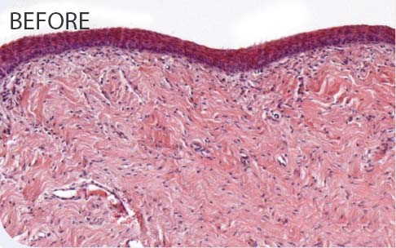
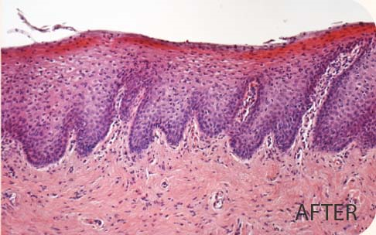
Promising Results

Slide 35
Official Statements
AUGS - https://www.augs.org/energy-based-devices-and-vaginal-rejuvenation/
“…the FDA is aware of the use of devices such as a CO2 laser for a variety of surgical applications, it has not approved their use for any specific gynecologic indication.”
ACOG - https://www.acog.org/Clinical-Guidance-and-Publications/Position-Statements/Fractional-Laser-Treatment-of-Vulvovaginal-Atrophy-and-US-Food-and-Drug-Administration-Clearance
“…Position Statement is to advise obstetrician–gynecologists and patients that this technology is, in fact, neither approved nor cleared by the FDA for the specific indication of treating vulvovaginal atrophy.”

Slide 36
Platelet-Rich Plasma
What is it?
Basically, a concentrate of platelet-rich plasma protein derived from whole blood, centrifuged to remove red blood cells
Usage begin in 1980’s in CV surgery
Now in multiple disciplines
Orthopedics, urology, plastic surgery, oral surgery
For Dyspareunia…
PRP injections exist – trademark “O-Shot”

Slide 37
O-Shot
From the O-Shot Website… “Another study of the treatment of the dyspareunia and other symptoms of vaginal lichen sclerosus with PRP (as in the O-Shot procedure) showed a statistical improvement in symptoms and two blinded dermatopathologists reported decreased inflammation in post treatment biopsies of the injected areas”
Developed by Charles Runels, MD
Autologous injection of RPR into clitoris, vulva, vestibule
Possible benefit for GSM, Vestibulitis, Pelvic floor muscle spasms
A co-author of this study later went on to state in a different study that “In conclusion, the negative results of this study show that autologous PRP does not adequately treat vulvar LS.”

Slide 38
But Where’s the Data?
Significant research paucity in efficacy of PRP for dyspareunia
Most studies listed Runels as author or co-author
Providers must buy the “rights” to use O-shot, and go through training
No FDA-approval of PRP for dyspareunia
Anecdotal evidence for success
Highly publicized by Hollywood

Slide 39
So What Now?

Slide 40
Conclusions
Dyspareunia is a common, unreported, complaint amongst women
Multiple non-hormonal therapies exist for the treatment of dyspareunia
Some are well studied, others not so much
Consider non-invasive therapies first
Don’t be afraid to refer
Efficacy and safety should dictate treatment
If using non-FDA approved methods, patients should know

Slide 41
Questions?
Feel free to call or email any time!
918-586-4500
Corey.Babb@okstate.edu

