Slide 1
Pain Management and Opioid Therapy 2019:
A Responsibility to Protect
C. Scott Anthony, D.O.
Pain Management of Tulsa

Slide 2
Disclosure
I have no relevant financial relationships or affiliations with commercial interests to disclose.

Slide 3
Recent Actions
Presidents Commission on Combating Drug Addiction and the Opioid Crisis 2018
HHS Pain Management Best Practices Draft Report 2019
CDC Guidelines for Opioid Prescribing 2016
SB 1446
All agree there is a role for opioids in carefully selected and monitored patients
All agree on identifying abuse and addiction

Slide 4
Consensus
Much emphasis placed on addiction and abuse
Emphasis on training physicians and providers
Focus on alternatives to opioids
Risk reduction
The need for further research
Attempts to decrease acute pain episodes leading to chronic opioid therapy

Slide 5
Opioid Deaths
Major reason for CDC, national and state legislative involvement
47,600 deaths involving all opioids in 2017
Significant escalation in illicit opioids
Diversion: most deaths are from “non-prescribed” opioids
Lethal combinations especially with benzodiazepines
Illegal opioids outpacing prescribed opioids
We are now in the midst of a fentanyl crisis

Slide 6
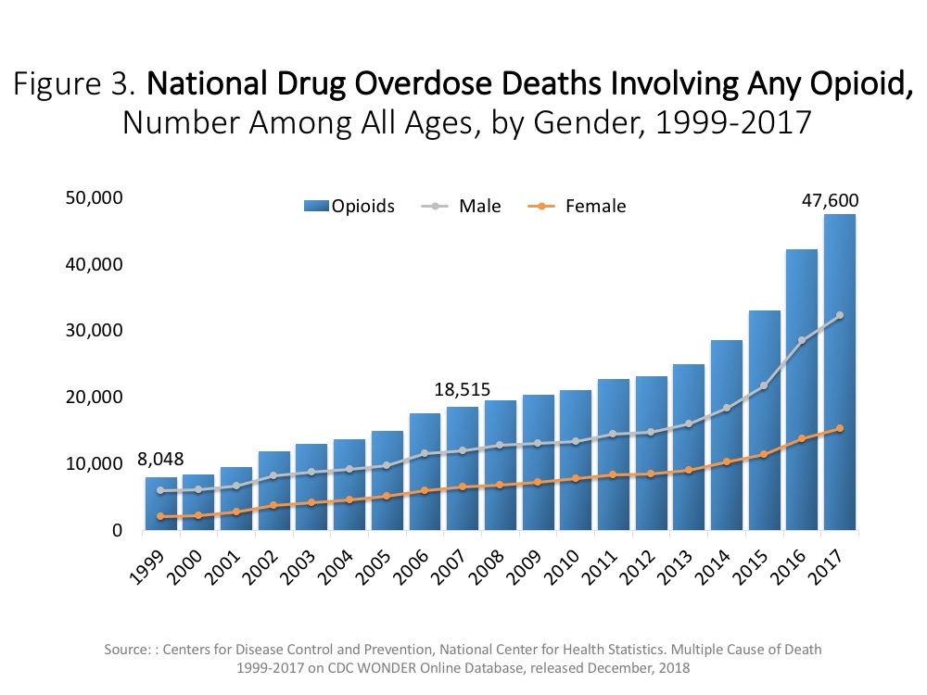

Slide 7
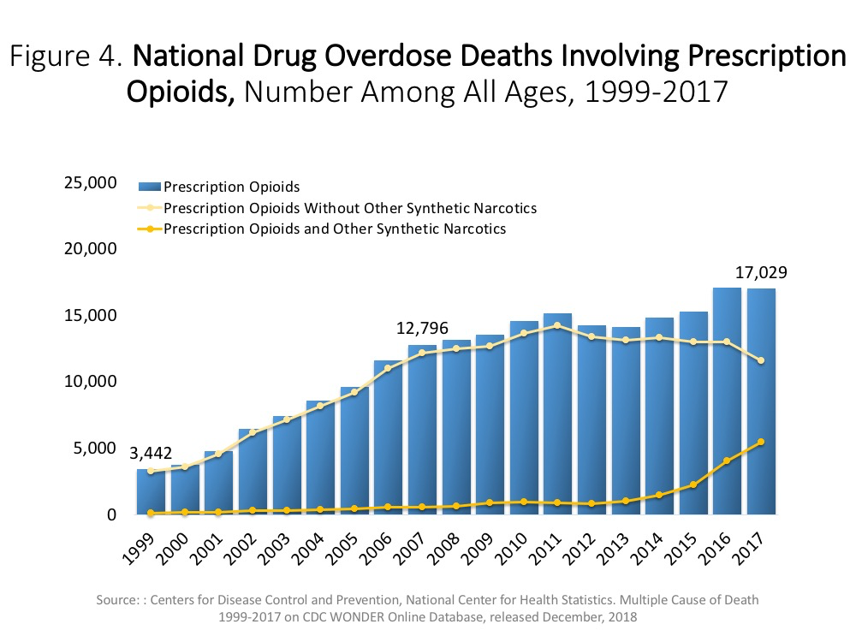

Slide 8
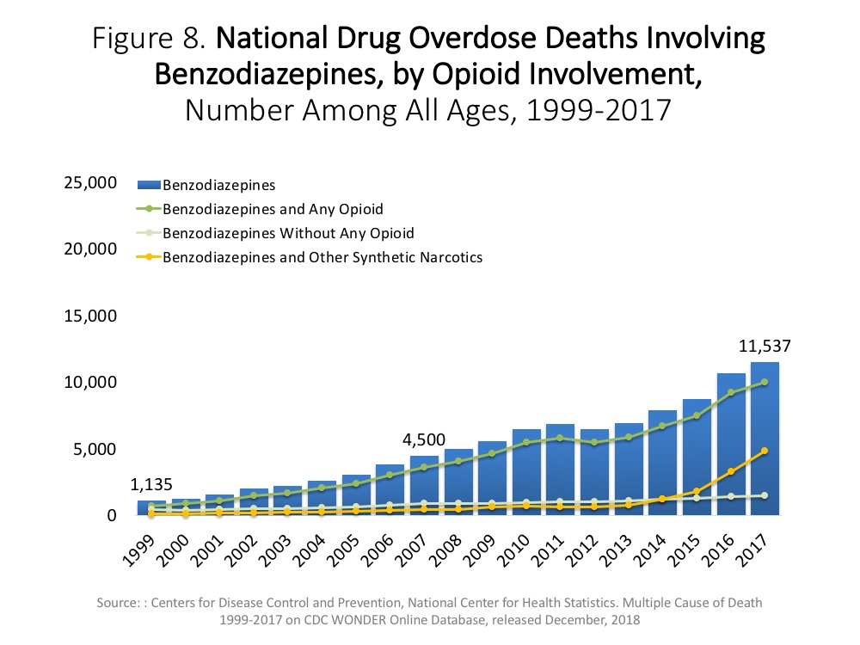

Slide 9
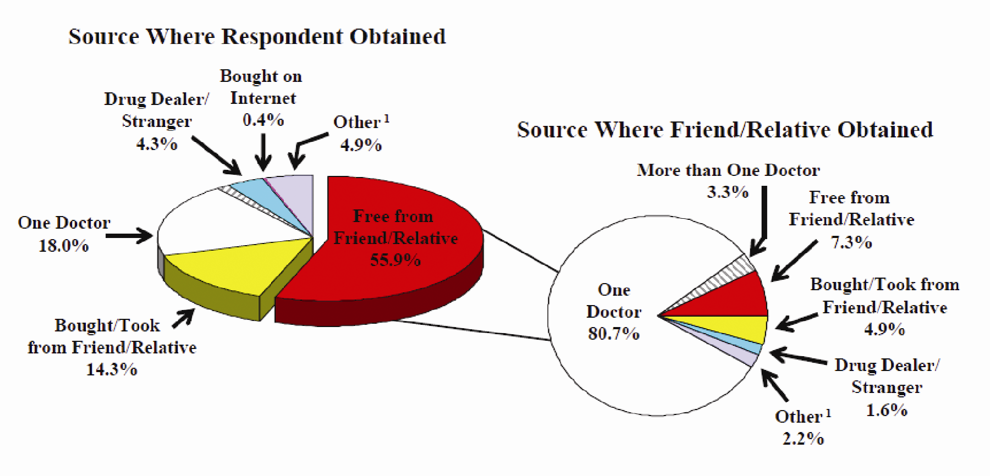

Slide 10
CDC Enhanced Opioid Overdose Surveillance 2017
11 states participated including Oklahoma
59% of deaths due to illicit opioids
18.5% combined prescription and illicit opioids
18% positive for only prescription opioids
  50% of these deaths also positive for benzodiazepine
  “Findings indicate that illicit opioids were a major driver of deaths… and were detected in approximately three of four deaths”

Slide 11
The Origin of the Crisis
NEJM article 1980
Big pharma and opioid sales
Provider education
Patient education
5th vital sign
Pain scores
Pill mills
FDA inaction

Slide 12
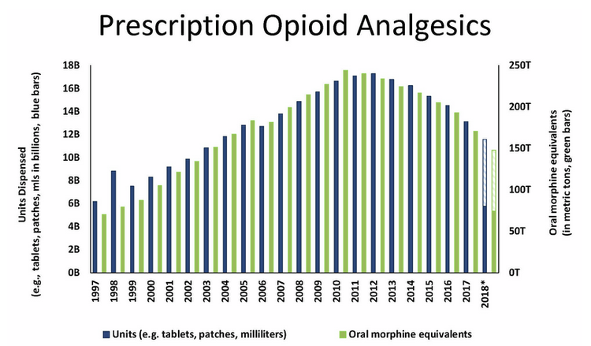
Prescription Opioid Reduction

Slide 13
Contributing Factors to Opioid Reduction
Awareness and education
Regulatory oversight
Fear
Increased vigilance
Targeting of misuse
Better awareness of misuse and addiction
Tightening of availability of opioids

Slide 14
Competing Views
“The ongoing opioid crisis lies at the intersection of two substantial public health challenges… reducing the burden of suffering from pain and containing the rising toll of the harms that can result from the use of opioid medications.” HHS 2019
We are faced with two separate populations of patients who are vulnerable and suffering
“Life saving therapy” or “legalized heroin”

Slide 15
Unintended Consequences
Forced opioid tapering
FDA warning: “Serious harm”
Patient abandonment
Increase in “over” referrals
Reduction in physicians willing to prescribe
Stigma associated with opioids
  Patient and physician
Suffering, suicide and disability

Slide 16
“Forced” Dose Reductions
There is really no evidence for this approach
A vulnerable population of patients
Does this lead to more harm?
Rupture of patient-physician relationship
Increased disability, suffering and suicide
Risk of illicit drug use
Potential Oregon initiative

Slide 17
CDC Letter: April 2019
CDC committed to addressing needs of patients
Does not endorse mandated or abrupt dose reduction
Taper or reduce only when harm outweighs benefit
The recommendation of high dose opioids focuses on initiation
Different recommendations for patients on higher doses of opioids
Emphasizes patient collaboration

Slide 18
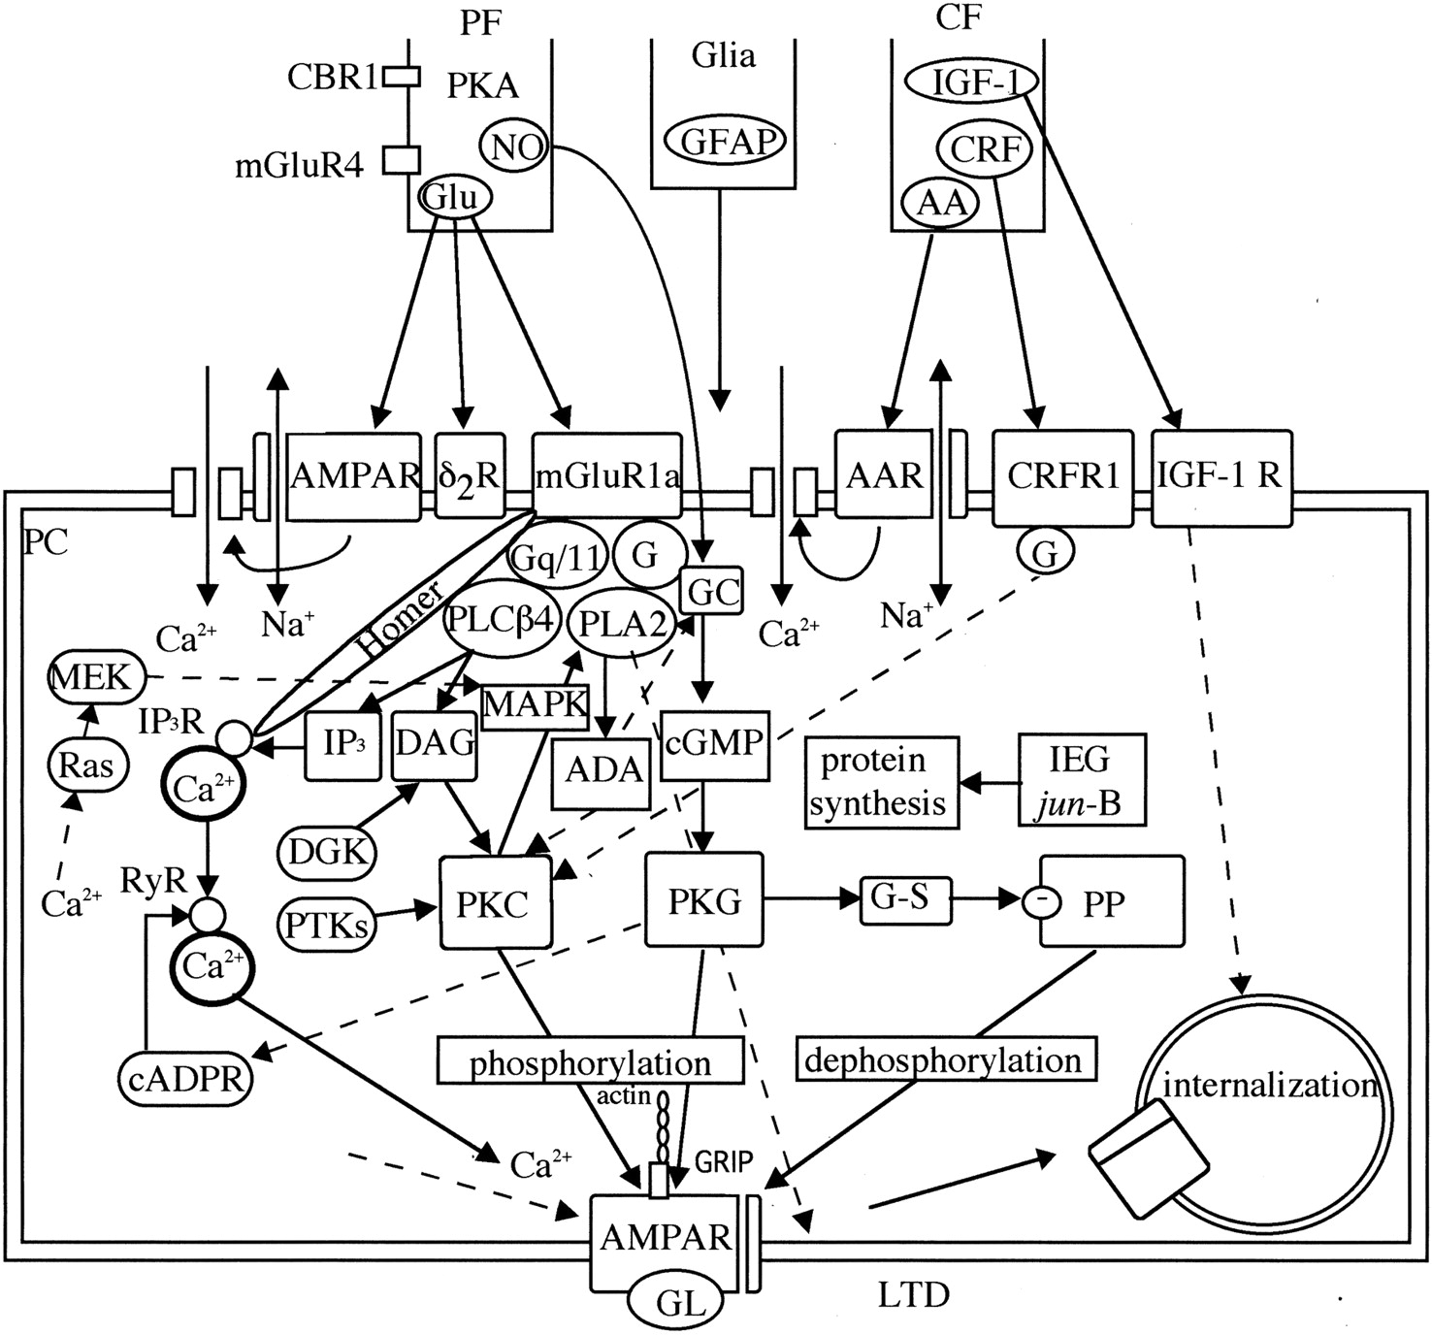

Slide 19
Opioid Prescribing:
Chronic pain is highly complex
Opioids alone are often inadequate
  25-50% improvement in pain scales
Opioid therapy can be beneficial in select patients who demonstrate compliance and function
Often the only remaining option for some patients
Best outcomes are in a multi-model setting

Slide 20
Contributing Factors to Inadequate Treatment and Prescribing
Physician lack of knowledge in best clinical practice
Inadequate research
Poor understanding of risk mitigation
Poor utilization of PMP and UDS
Lack of multi-model treatment
Physician misunderstanding of dependence/addiction
Complete relief may not be an attainable goal

Slide 21
Are Opioids Efficacious for Chronic Pain?
Long term outcome studies are lacking but also lacking for most all pain therapies
Insight based on available evidence
  Opioid use may be the most important factor impeding recovery of function
  Opioids may not consistently and reliably relieve pain and can decrease quality of life
  The routine use of opioids cannot be recommended
Appropriate only for selected patients with moderate-severe pain that significantly affects quality of life

Slide 22
CDC Summary Comments
Recommendations are based on the best available evidence
The scientific evidence is low in quality
Much left to be learned about opioid therapy
Need research leading to safer and more effective care
Strong evidence for many pain therapies is lacking
Does the potential benefits outweigh the risks

Slide 23
Future Research is Needed
A good example… “are opioids effective in musculoskeletal pain?”
There is absence of data on long term opioid effectiveness which has been interpreted as lack of evidence
Research on the risks of long term opioids and addiction
Updating CDC guidelines with ongoing research
Recent FDA comments on the need for more research regarding opioid therapy

Slide 24
We Lack Knowledge
Support studies to determine the long-term efficacy of opioids in the treatment of chronic pain
  Supported by CDC and HHS
Conduct clinical trials on specific disease entities
Research that takes into account patient variability and co-morbidities
Research conducted in the real world setting of multi-modal treatment
Research on outcomes of opioid reduction

Slide 25
High Dose Opioids
SB1446: Key issue
Providers should prescribe lowest possible dose
Additional precautions at > 50 MME’s
Should avoid > 90 MED’s
Risks of fatal and non-fatal overdoses increase
Demands documented increase in function and no adverse side effects
Recommend consultation over 90 MME’s
  Closer follow-up and assessment of other risk factors

Slide 26
High Dose Opioid Therapy
Data is proving more reliable
Defined typically as >90 MME’s
Strong evidence linked with poor outcome
Higher risk of OUD
Overdose risk doubles at >50 MME
9x increase in deaths with 100mg or higher MME
Remember, existence of persisting pain does NOT constitute evidence of undertreatment

Slide 27
First Line Approach
Important issue in SB1446
Non-pharmacological approach
Non-opioid approach
Emphasis on
  Behavioral therapies
  Functional therapies
  Adjunctive medications
  Interventional therapies

Slide 28
Patient Selection and Risk Stratification
History, physical examination and diagnostic testing
Psychosocial risk assessment
Expectations: physician and patient
Risk assessment is an underdeveloped skill for most clinicians
SB1446 requires vigilant monitoring of abuse and addiction
SB1446 emphasizes documentation of the progress of the patient to the treatment objectives

Slide 29
Chronic Opioid Therapy (COT)
Consensus agreement that it can be useful in carefully selected patients with moderate to severe pain
Absolutely demands:
  Compliance: As with any medical problem
  Documentation
  Vigilant monitoring for SUD and OUD
  Assessment of opioid related side effects
  Understanding of opioid use in chronic pain

Slide 30
Appropriate Initiation of COT
Informed consent and discussion of risk vs. benefit
Therapeutic trial of 4-6 weeks
Exhaustion of other modalities
Insufficient data on starting dose
  Start low-go slow
Ongoing monitoring and assessment of benefit vs. risk, expectations and alternative modalities
Consider a taper or wean even in functional patients

Slide 31
Opioid Prescribing Caveats:
IR vs. ER/LA opioid therapies
Lowest effective dose
Shortest possible time
Benzodiazepine use with opioids
  Significant increase in deaths and ER visits
Acute pain leading to chronic therapy
Combine with other modalities
Offering naloxone to patients at risk (50 MME’s)
Ongoing assessment of psychological risks

Slide 32
Characteristics of Ideal Patient
Well defined pathology
Good insight and desire to improve
Willing to “work hard” to improve
Interested in other modalities and work-up
Not focused on opioids but desire to improve
Good understanding that opioids will provide “some” relief to help them improve
Examples

Slide 33
The Worrisome Patient
Diffuse and poorly localized pain
No interest in work-up or other modalities
Focus is on opioids alone
Poor insight and unrealistic expectations
Poorly motivated with no desire to “work hard”
Poor functionality
Examples

Slide 34
Patients at Risk
Psychosocial issues
History of Substance Use Disorder (SUD)
Adverse Childhood Experience (ACE)
  Abuse, neglect, household dysfunction and traumatic stressors
Poor motivation and lack of insight
No firm cause of pain delineated
Disability, Medicaid and even prior criminal activity
Prior overdose

Slide 35
Substance Use Disorder (SUD)
“The catalyst of the opioid crisis was a denial of the addictive potential of prescription opioids”
History of alcohol, nicotine, THC, sedatives
SUD increases risk of developing OUD
Screening helps identify and reduce risk
Screening tools for SUD should be incorporated prior to and during opioid therapy
Beware: flashing light for potential OUD

Slide 36
Opioid Use Disorder
3-26% incidence
Significant impairment or distress
Poor insight and social support
Inability to reduce opioids
Inability to control use
Often of younger age
Social function reduced
Failure to fulfill work, home or school obligations
Commonly referred to as “abuse” in the literature

Slide 37
Common Pathways to OUD
Poor pain control (often opioids alone)
Prior history of SUD
Initial exposure to opioids at a younger age
Ongoing emotional distress
Higher opioid doses
Long term use of opioids
Type of opioid
Misuse of opioids for psychoactive purposes and for unrelieved pain

Slide 38
Medication Assisted Treatment
Emphasized with patients who display OUD
Buprenorphine: Partial agonist
Methadone
Behavioral therapies
  Help maintain retention
  Help reduce relapse rate
Consensus concerns:
  Availability
  Cost

Slide 39
Opioid Induced Hyperalgesia
Increased sensitivity to noxious or non-noxious stimuli
Sensitization of pro-nociceptive mechanisms
Glial cell inflammation at the mu-receptor
Hypersensitivity and allodynia
Confused with tolerance
Caused with rapid escalation and high dose therapy?
Activity at the NMDA receptor in dorsal horn
Novel medications now and future

Slide 40
Future Novel Agents
NKTR-181: slow entry to CNS reduces high, addiction
VX-150: peripheral acting sodium channel blocker
AT-121: binds mu-receptor and blocks FQ peptide
Tanezumab: monoclonal antibody/blocks NGF
Blue 181: synthetic opioid only acts on spinal receptor
Low dose naltrexone: action on glial inflammation

Slide 41
Common Errors
Continued escalation of opioids despite no evidence of improvement in pain or function
Opioids used in pain syndromes know to be poorly responsive
Failure to document (emphasized in SB1446)
Not addressing psychosocial issues and OUD
Not using medication assisted treatment options
Lenient with abuse behaviors
Failure to use monitoring systems

Slide 42
Addressing Worsening Pain
Evaluate prior to dose increase for OUD
Common scenarios patient request for opioids or opioid increase
  Progression of disease
  New painful diagnosis
  Psychological issues
  Poor understanding of pain and opioids
  Failure to use adjunctives or other therapies
  OUD or diversion

Slide 43
Risk Mitigation
Pay attention to a pattern of activity that suggests abuse and address
Monitor closely through follow up and documentation
Use available tools:
  PMP database
  UDS and pill counts
  Opioid risk tools
Obligated to protect yourself, your patient and society from opioid abuse and diversion

Slide 44
Prescription Monitoring Program
Powerful tool
Mandated in Oklahoma first prescription and every 90 days
Physician and staff friendly
Crosses state lines
Helpful to determine other scheduled drugs like benzodiazepines
Good “teaching moment” with the patient
Unfortunately a high percentage of overdoses are from non-prescribed opioids

Slide 45
Enhancements to the PMP
Required utilization in the ER
Adding medical marijuana
Naloxone administration
Overdose information
Coding the prescriptions should be mandatory
  Chronic pain
  Acute pain
  Palliative care
  Cancer pain

Slide 46
SB1446: Major Points of Emphasis
Addiction and abuse
Dose reduction and cessation
Emphasis on lower MME’s
Alternative therapies
Strong focus decreasing the risks of acute pain leading to chronic opioid therapy
Strong language for assessing, documenting and specifying your care of the opioid patient

Slide 47
Prior to Issuing an Initial or Chronic Prescription
Practitioner shall discuss and document with a note in medical record of the risks not limited to
  Risks of addiction and overdose and risks of combining alcohol and or benzodiazepines
  The reasons why the prescription is necessary
  Alternative treatments that may be available
  Risks associated with the drug being prescribed such as physical and psychological dependence, that “opioids are highly addictive” and overutilization can lead to death

Slide 48
Patient-Provider Agreement
Provides informed consent
Essentially an opioid “contract”
Needed before the 3rd prescription and for chronic pain treatment
Needed at initial prescription for under 18 and pregnancy
The Boards will provide an approved agreement for use

Slide 49
Patient-Provider Agreement
Explain the possible risks
Document the understanding of patient and physician
Establish the rights and obligations of the patient
Storage of opioids
Establish specific medications and other treatments
Specify the measures used by the physician to monitor the patient
Delineate the process for termination of agreement
Compliance shall constitute valid informed consent

Slide 50
Chronic Utilization of Opioids
Review at a minimum every 3 months
  The course of treatment
  Any new information about the etiology of the pain
  Progress of the patient toward treatment objectives
  Monitor the compliance with the pain management agreement and any recommendations that the patient seek a referral
  Check PMP
  Document the results

Slide 51
Chronic Utilization of Opioids
Periodically make reasonable efforts, unless clinically contraindicated, to
  Stop use of controlled substance
  Decrease the dosage
  Try other medications and treatment modalities in an effort to reduce the potential for abuse or development of physical or psychological dependence
  DOCUMENT and SPECIFY the efforts undertaken

Slide 52
Qualifying Opioid Therapy Patient
A patient requiring opioid treatment for more than 3 months
  Does not matter if low dose or high dose
A patient who is prescribed a benzodiazepine and opioid together
  What about different doctors prescribing each?
  Psychiatrist and PCP
A patient prescribed a dose of opioids over 100 MME’s

Slide 53
Conclusions
Carefully weigh the benefits vs. the harms of opioid therapy
Ongoing risk assessment is mandatory
Ongoing balance of opioids with adjunctive therapy
The real need for further research in this field
Stakeholders need to work together for the protection of the patients with chronic pain and/or addiction

Slide 54

Talk Sponsored by

