Slide 1

ADJUNCT FACULTY ENHANCED REIMBURSEMENT PROGRAM
Eric Polak
V.P. for Administration & Finance
OSU Center for Health Sciences

Slide 2

PROGRAM ROOTS
In order to encourage broad participation in the medical education programs of OSU and OU, the Oklahoma Health Care Authority negotiated with CMS for a Medicaid state plan amendment to provide additional compensation to physicians participating in the education programs of the universities
Physicians employed by or contracted with the university are eligible for participation
Participation in the program is first driven by the academic needs of the institution and then the level of enhanced reimbursement is commensurate with the level of participation of that individual physician

Slide 3
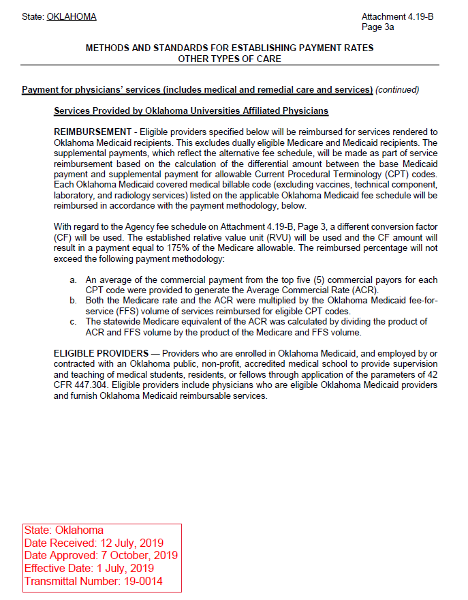
MEDICAID STATE PLAN

Slide 4
OSU PROGRAM SPECIFICS
Base Rate – established annually dependent on the normal Medicaid rate and the Federal Medical Assistance Percentage
  Appointment as an adjunct faculty member by a clinical department of OSU-COM or the Physician Assistant program
  A minimum of 6 months’ availability to accept placement of medical students, physician assistant students, and/or residents for rotations
  Submission of claims for physician services through the OSU Medicine claims portal

Slide 5
OSU PROGRAM SPECIFICS
Optional reimbursement amounts are available as compensation in addition to the Base Rate of enhanced reimbursement through participation in the following programs
  Execute agreement to participate in the OSU Health Access Network
  Execute agreement to participate in the OSU Rural Oklahoma Network (ROK-Net)
  Delivery of medication assisted treatment (MAT) to needed patients
  Participation in 12 or more OSU-CHS Project Extension for Community Health Care Outcomes (ECHO) sessions annually
Bundling these services can drive additional rate increases

Slide 6
MEDICAID MANAGED CARE IMPACT
Will need to contract with MCO’s through the University
Payment process is projected to convert to a quarterly supplemental payment based on claims activity
OHCA is working with CMS to finalize the specifics of the supplemental payment, but the state plan authorization remains intact

Slide 7

THANK YOU
Eric Polak
V.P. Administration & Finance
OSU Center for Health Sciences
E | eric.polak@okstate.edu
medicine.okstate.edu

