Slide 1
Physician Advocacy and its Impact on Health Policy
Sean Neal
Vice President, Advocacy and Political Affairs
American Osteopathic Association

Slide 2
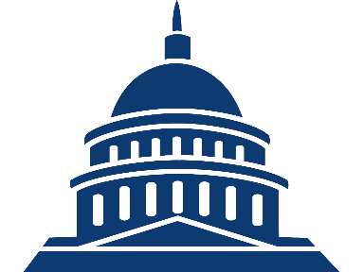


How Does Advocacy Work?
Show support
Ask for change
Tell stories
Share ideas
Provide info
Congress and the White House create laws and regulations to govern citizens
Citizens influence governing behavior by participating in advocacy efforts

Slide 3




Primary Levels of Government
Federal
Federal legislators
Regulatory bodies
State
State legislators
Regulatory bodies
Local
City councils
School boards

Slide 4
Members of Congress Want to Hear from You
If your member/senator has not already arrived at a firm decision on an issue, how much influence might the following advocacy strategies directed to the Washington office have on his/her decision?*
*Asked of senior managers and mail staffers

Slide 5
Progress Takes Time
Bills and resolutions by status
Only 5-6% of bills make it to the House or Senate floor

Slide 6
Structure of a Congressional Office
Sample organizational structure of a congressional office
Member of Congress
Chief of Staff
Policy Staff*
Communications Staff*
Office Staff
District Staff
Legislative Director
Communications Director
Personal Assistant/ Scheduler
District Director
Legislative Assistant/Aide
Press Secretary/Assistant
Staff Assistant
District Caseworkers
Legislative Correspondent
Members of Congress have busy schedules – staffers often have more time to devote to Hill meetings and are more capable of affecting any takeaway
*Some offices may have “Senior Counsel/Counsel” roles among Policy staff, others may include a “Social Media Director” or “New Media Director” among Communications staff.

Slide 7

House of Representatives
Senate
Introduction
A representative or senator introduces a bill by filing it with the House/Senate clerk
Committee consideration
Bills are referred to committees for debate, analysis, and amendments
Simple majorities are needed to pass committees in both the House and Senate
Bills are often sent to subcommittees for extra analysis, especially on niche issues
Floor debate
House
Bill is debated and amended
Simple majority needed to pass
Senate
Bill is debated and amended
3/5 majority needed to end debate
Simple majority needed to pass
Final votes/
conference
committee
If both chambers pass an identical bill, it is sent directly to the president
If they pass different bills, a conference committee is formed of representatives and senators who try and find a compromise
Bills that pass conference committee must then pass both the House and Senate
President’s
signature
or veto
A bill becomes law after a president signs it or after 10 days if they take no action
The president can reject a bill with a veto
Congress can override the veto by with a 2/3 majority vote in each chamber

Slide 8
The Legislative Process: Reconciling House and Senate Differences
Rare Common
Scenario 1
Scenario 2
Scenario 3
Similar bills are introduced at the same time in the House and Senate
The chamber that finishes their bill first (usually the House) sends its completed measure to the second chamber for consideration
One chamber passes a bill and sends it to the second chamber
The bill’s sponsors seek parallel consideration of the legislation in both chambers
The second chamber debates and amends the bill and then passes it
The second chamber takes up its own bill but passes it as a grand substitute amendment to the first chamber’s bill
Both chambers pass similar bills with differing text

Slide 9







Bills Face Numerous Obstacles to Passage in Congress
Bill is ignored by full committee
Bill fails passage in subcommittee vote
Bill fails passage in full committee vote
Introduced in House/Senate
Sent to committee
Sent to subcommittee
Full committee vote
Process repeats
in other chamber
Full House/Senate vote
Amended
Floor debate
Placed on legislative calendar
Bill fails final vote in full chamber
“Poison pill” amendments can sabotage final passage
In the Senate, bills can be filibustered during debate
Senate majority leader/
House speaker declines to put bill on calendar
Note
The Senate relies on unanimous consent to operate efficiently; therefore, individual senators have the power to delay or prevent a bill’s passage by creating additional procedural hurdles, including filibusters

Slide 10

Bills Continue to Face Hurdles After Passage
The Courts
Federal judges can prevent the enforcement of laws by issuing injunctions and can also strike down laws as unconstitutional
Executive interpretation
Passes Congress
Signed by president
Enacted
A president can write executive orders or signing statements that prevent a law from being enforced as originally intended
President vetoes a bill;
Congress can override veto with a 2/3 vote in each chamber
Note
A bill may pass both the House and Senate but still face enormous challenges, either before or after it is formally enacted.

Slide 11
Keep Momentum Going
Advocacy Activity Level Over Time (Illustrative)
Ideal continuous engagement
Advocate activity level
Loss of engagement
Start of campaign
End of campaign

Slide 12
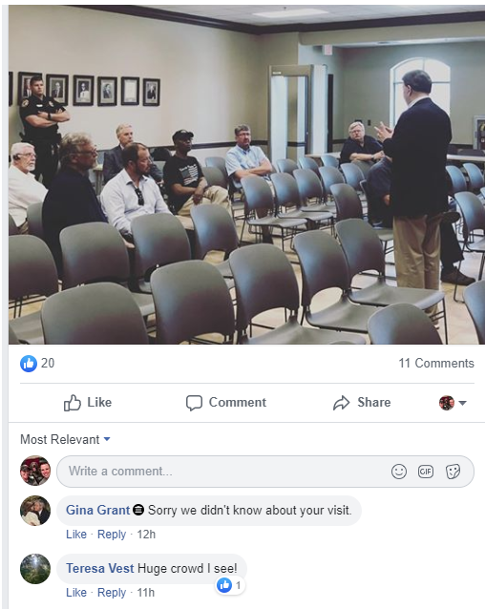
Lack of Engagement?
An opportunity for osteopathic physicians and medical students to engage where others are not.
Notes:
But a lot of the noise that we see on TV is often just electronic communications or social media. I know everyone has heard the quote ,”90% of success is just showing up” and I think this picture illustrates that quite nicely. This is an actual town hall with a member of Congress. We see, what, six people here? Imagine the impact we can have if we have osteopathic physicians and students in those seats.

Slide 13



Osteopathic Advocacy Network

Slide 14
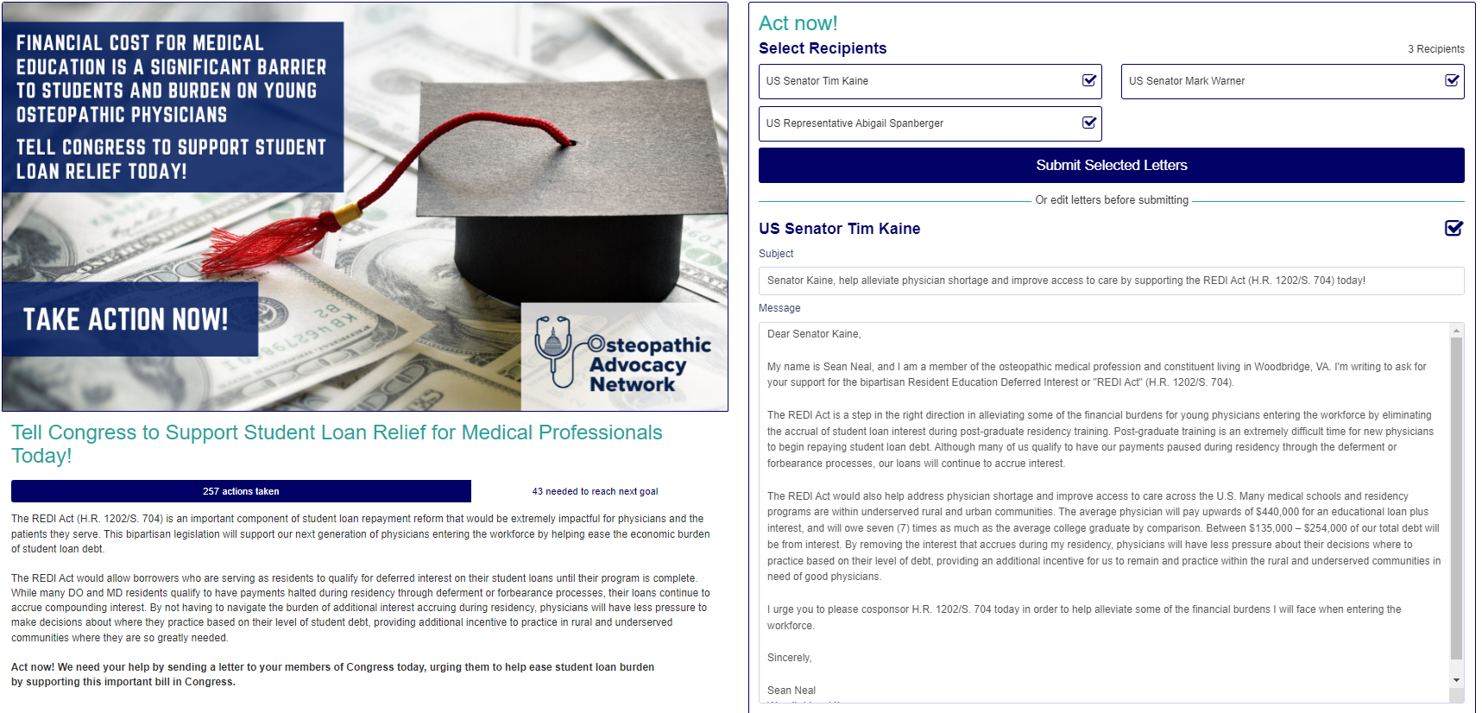
Grassroots Advocacy
Notes:
But a lot of the noise that we see on TV is often just electronic communications or social media. I know everyone has heard the quote ,”90% of success is just showing up” and I think this picture illustrates that quite nicely. This is an actual town hall with a member of Congress. We see, what, six people here? Imagine the impact we can have if we have osteopathic physicians and students in those seats.

Slide 15
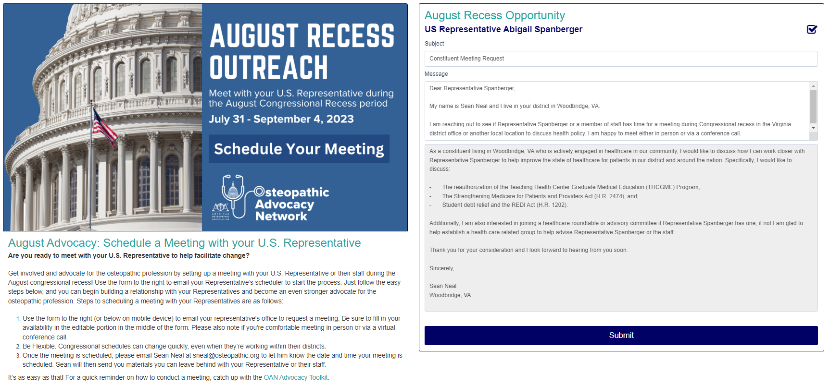
August Recess
Notes:
But a lot of the noise that we see on TV is often just electronic communications or social media. I know everyone has heard the quote ,”90% of success is just showing up” and I think this picture illustrates that quite nicely. This is an actual town hall with a member of Congress. We see, what, six people here? Imagine the impact we can have if we have osteopathic physicians and students in those seats.

Slide 16
Case Study
Notes:
And now I want to turn to how we can use these methods of advocacy to build momentum and support for a bill to help get it passed into law. And so for this case study, we will be discussing the Substance Use Disorder Workforce Loan Repayment Act.

Slide 17
The Issue
Identifying problems that impact physicians and patients
Physician Shortages
Opioid Crisis
Crushing Student Debt
A shortage of 85,000 physicians in 2020
40% of all U.S. opioid overdose deaths involve a prescription opioid
Opioid deaths now higher than motor vehicle accidents
Potential impact on primary care
Impact on economy
Shortages impact rural communities more dramatically
Notes:
In 2018, we received a lot of feedback from physicians, residents and students on issues that impact them. Here were the top three.
#1 – physician shortages, especially in rural areas
#2 – The opioid crisis. Deaths from opioids are now higher than motor vehicle accidents
#3 – Crushing student debt. It potentially has an impact on primary care and the economy.

Slide 18
Introducing Legislation
The Substance Use Disorder Workforce Loan Repayment Act of 2018
  Creates a loan repayment program for individuals who serve in a substance use disorder treatment job in a mental health professional shortage area, or an area of the country where the drug overdose death rate is higher than the national average.
Student Debt
Opioid Crisis
Physician Shortages
Notes:
So now that we understood the issues that were directly impacting our members, it was time to get to work by implementing some of our advocacy strategies that I mentioned earlier. But first, we needed a bill. So, we worked with our advocates and leaders of the osteopathic profession to draft a bill. Fortunately, we were also able to find a member of Congress that was also willing to introduce this legislation. So to summarize, this bill would:
helps address student debt by creating a loan repayment program
For individuals who serve in a substance use disorder treatment job, so taking measures to fight back against the opioid epidemic
Then finally, help grow the physician workforce in in areas of need, so think rural and underserved.

Slide 19
Advocacy Timeline – SUDs Act
October, 2017
AOA collaborates with osteopathic profession to draft SUDs Act
Feb, 2018
SUDs Act introduced in the House of Representatives
March, 2018
SUDs Act introduced in the Senate
June 4, 2018
Action Alert sent to osteopathic advocates to encourage lawmakers to cosponsor SUDs Act
June 11, 2018
House moves to vote on SUDs Act, Action Alert sent to advocates to encourage House to vote yes
August 17, 2018
Bill moves to Senate, Action Alert sent to advocates to request the Senate keep the SUDs Act alive
Sept., 2018
Senate passes watered down version, Action Alert sent to keep House version
Sept., 2018
AOA leads coalition letter to Congress featuring over 40 state and national health organization to advocate for inclusion of AOA endorsed SUDs Act
Sept., 2018
Congress keeps AOA endorsed version of SUDs Act after committee conference
October, 2018
Signed by President and is now law
The AOA Public Policy team and osteopathic advocates conducted more than 225 meetings with Members of Congress and their staff on the SUDs Act
Notes:
The path was not easy. As we saw earlier, under 5% of bills actually go on to become law.
And so what you see in front of you are some of the steps we took to help pass this bill.
So, as I mentioned, we worked with our leaders and advocates to draft a bill that addressed the three issues. This bill was named the “Substance Use Disorder Workforce Loan Repayment Act”
To start, the bill was introduced to the House of Representatives and shortly after the Senate. We then encourages our advocates to send letters to their lawmakers to make them aware of the bill and support.
The bill moves to the Senate, we again encourage our advocates to stay engaged and write their Senators; however, the Senate passed a watered down version of the bill. Because of the differences between the bills, we sent yet another advocacy alert encouraging them to adopt the House version and not the Senate version.
We worked on building a coalition with our osteopathic affiliates and leaned on lawmakers to keep the House version. Ultimately, our advocacy action payed off and Congress kept the AOA endorsed version of the SUDs act. President then signed the bill into law.
and while this was all going on we had more than 225 meetings with lawmakers on this issue alone.
And so the Substance Use Disorder Workforce Loan Repayment Act is just one example of how we can come together to help pass meaningful legislation.
I will also say that we didn’t act alone. We had 13,586 of our closest osteopathic friends help us. From 2019 to today, more than 13,500 osteopathic physicians, residents and students sent just under 43,000 social media posts, phone calls, emails and other actions to Capitol HIll to inform their lawmakers on issues that impact them and the patients they serve.

Slide 20
Other Areas of Success
Physician Workforce
Surprise Medical Billing
Physician Payment Cuts
Reauthorization of the Teaching Health Center Graduate Medical Education Program (THCGME)
Telehealth Expansion and Payment Parity
COVID-19 Efforts
The Coronavirus Preparedness and Response Supplemental Appropriations Act (H.R. 6074)
Families First Coronavirus Response Act (H.R. 6201)
The Coronavirus Aid, Relief and Economic Security Act (CARES Act, H.R. 748)
The Paycheck Protection Program and Healthcare Enhancement Act (H.R. 266)
The American Rescue Plan Act (H.R. 1319)
Removed barriers for emergency medical care services
Remove geographic restrictions
Expand originating sites to include the home and other appropriate sites
Medicare Sequester COVID Moratorium Act (H.R. 315)
The practice of surprise medical billing was banned in an end-of-year package

Slide 21
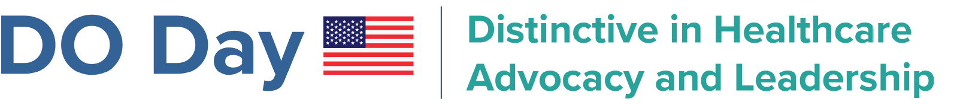
DO Day 2023 – In Conjunction with NOM Week!

Slide 22

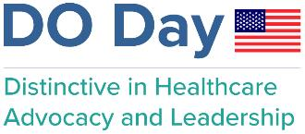
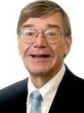
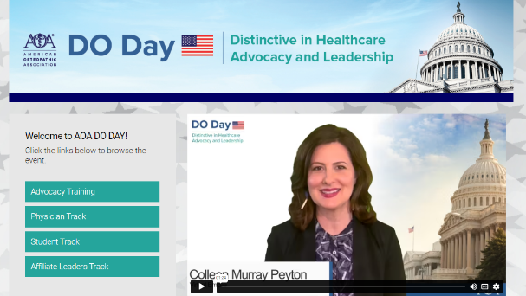
DO Day 2023 Program
Keynote speakers with live Q&A
Separate tracks for physicians, students, and affiliate leaders
Advocacy awards in individual and organizational public policy
Smaller Congressional meeting groups
  285 scheduled
    199 House and 86 Senate

Slide 23
DO Day Issues
Protecting patient access to care and physician practices by advocating for positive updates to Medicare physician payment.
Expanding graduate medical education and the Teaching Health Center Graduate Medical Education (THCGME) program.
Advocating for student loan reform by encouraging Congress to support the REDI Act (S.704/H.R.1202).

Slide 24
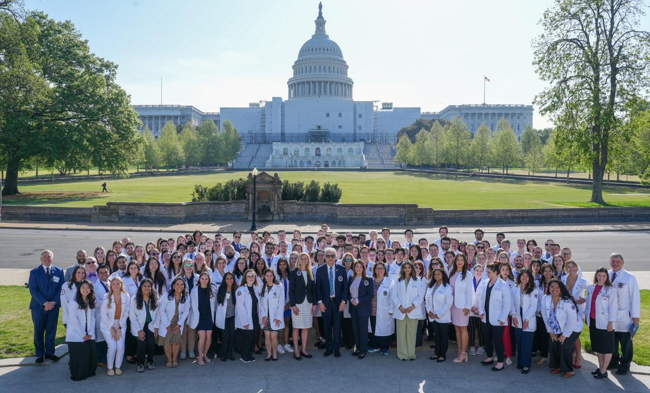
Group Photo – U.S. Capitol

Slide 25
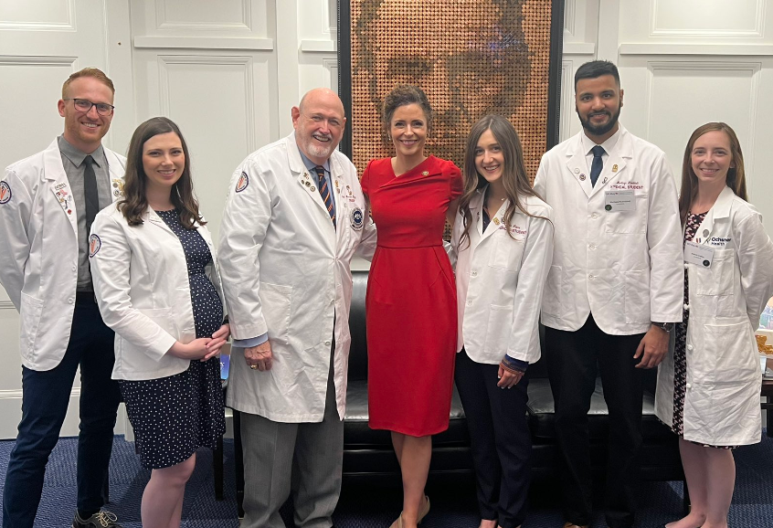

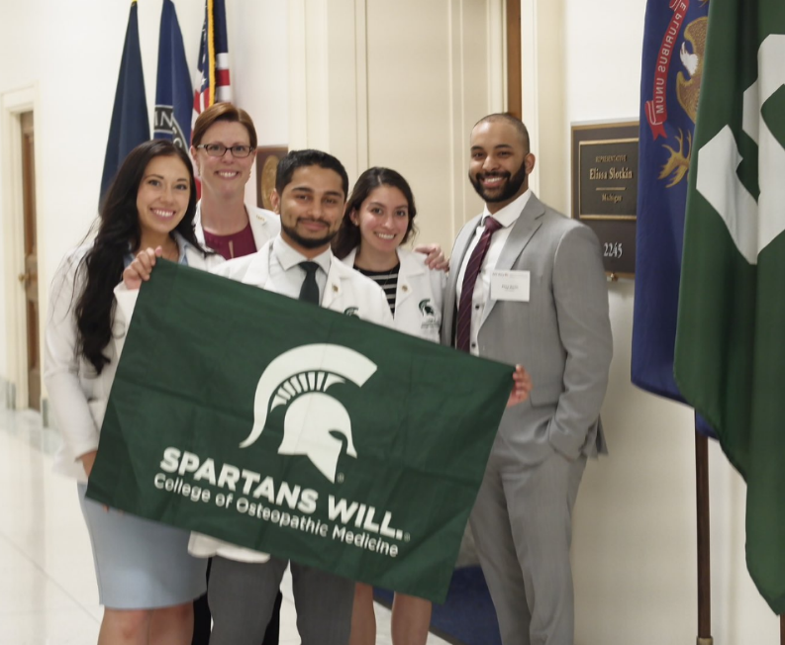
DO Day Advocates on Capitol Hill

Slide 26
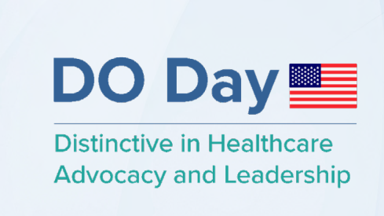
Save the Date – DO Day on Capitol Hill 2024
April 13-14, 2024 | Virtual Conference
April 17-18, 2024 | In-person Congressional Meetings

Slide 27
Political Involvement

Slide 28
Different Types of PACs
Political committees
Super PACs
  Candidate committees
  Automatically created when a candidate declares an intention to run
  Money donated goes directly to the candidate’s campaign and must be disclosed to the FEC
  Cannot directly donate to federal candidates or parties
Candidate-aligned
Party committees
Fundraise each election cycle in the same way that candidates do
Parties may only raise "hard money," which is given by individuals and political action committees and is subject to federal contribution limits
Party-aligned
Issue-aligned
Political Action Committees (PACs)
Non-profits
501(c)(3) groups cannot contribute monetarily to campaigns, nor can they endorse candidates or parties. 501(c)(3) groups can engage in nonpartisan activities that encourage political engagement
Issue groups often have a non-profit 501(c)(4) arm. They can engage in some political activity, as long as such activities do not constitute the group’s main purpose. Reporting requirements are more relaxed
Notes:
Sources:
“Upcoming Congressional Fiscal Policy Deadlines,” Committee for a Responsible Federal Budget, July 6, 2021, http://www.crfb.org/blogs/upcoming-congressional-fiscal-policy-deadlines
“Chairman Yarmuth on House Adoption of 2022 Budget Resolution” House Appropriations Committee, August 24, 2021
https://budget.house.gov/news/press-releases/chairman-yarmuth-house-adoption-2022-budget-resolution
“Chairman Yarmuth, House Budget Committee Release Report Outlining 2022 Budget Resolution and Reconciliation: How We Will Build Back Better” House Appropriations Committee, August 18, 2021
https://budget.house.gov/news/press-releases/chairman-yarmuth-house-budget-committee-release-report-outlining-2022-budget
David Lawder and Susan Heavey. “Yellen says U.S. may exhaust cash by Oct 18 barring debt ceiling rise” Reuters, September 28, 2021
https://www.reuters.com/business/finance/yellen-says-delta-slowing-recovery-urges-congress-raise-us-debt-limit-testimony-2021-09-28/
Tony Romm. “Biden signs government funding bill hours before midnight deadline to avert shutdown” Washington Post, September 30, 2021
https://www.washingtonpost.com/us-policy/2021/09/30/house-senate-shutdown-vote/

Slide 29







Differences Between PACs and Super PACs
PACs
Political Action Committees pool donations from people with similar views or goals to then spend on election activities. PACs are regulated by the FEC, which limits contributions to and from each PAC
Super PACs
Super PACs similarly pool money from like-minded individuals and are regulated by the FEC. Super PACs do not have contribution or donation limits, but unlike regular PACs, they cannot donate directly to a candidate
PAC
Individual
Union
Issue group
Business
Individual
Max contribution
$5,000
Super PAC
X
PAC
Individual
campaign
Individual
campaign
Max contribution
$5,000
National party
committee
Max contribution
$15,000
Other PACs
Max contribution
$5,000
Campaign/
advocacy spending
Max contribution
No limit
Super PAC
Max contribution
No limit
Campaign/advocacy spending
Max contribution
No limit
Notes:
Sources:
“Upcoming Congressional Fiscal Policy Deadlines,” Committee for a Responsible Federal Budget, July 6, 2021, http://www.crfb.org/blogs/upcoming-congressional-fiscal-policy-deadlines
“Chairman Yarmuth on House Adoption of 2022 Budget Resolution” House Appropriations Committee, August 24, 2021
https://budget.house.gov/news/press-releases/chairman-yarmuth-house-adoption-2022-budget-resolution
“Chairman Yarmuth, House Budget Committee Release Report Outlining 2022 Budget Resolution and Reconciliation: How We Will Build Back Better” House Appropriations Committee, August 18, 2021
https://budget.house.gov/news/press-releases/chairman-yarmuth-house-budget-committee-release-report-outlining-2022-budget
David Lawder and Susan Heavey. “Yellen says U.S. may exhaust cash by Oct 18 barring debt ceiling rise” Reuters, September 28, 2021
https://www.reuters.com/business/finance/yellen-says-delta-slowing-recovery-urges-congress-raise-us-debt-limit-testimony-2021-09-28/
Tony Romm. “Biden signs government funding bill hours before midnight deadline to avert shutdown” Washington Post, September 30, 2021
https://www.washingtonpost.com/us-policy/2021/09/30/house-senate-shutdown-vote/

Slide 30
Different Types of Groups and Their Regulations
 | Contribution limit | Must disclose donors? | Can coordinate with candidate? | Can be primarily political? | Can expressly tell voters who to vote for? | Regulator
Traditional PACs | $5,000 per year |  |  |  |  | FEC
Super PAC | Unlimited |  |  |  |  | FEC
501(c)(4) Non-profit | Unlimited |  |  |  |  | IRS
527 Non-profit | Unlimited |  |  |  |  | IRS
YES
YES
YES
YES
YES
NO
YES
YES
NO
NO
NO
NO
YES
NO
YES
YES
Notes:
Sources:
“Upcoming Congressional Fiscal Policy Deadlines,” Committee for a Responsible Federal Budget, July 6, 2021, http://www.crfb.org/blogs/upcoming-congressional-fiscal-policy-deadlines
“Chairman Yarmuth on House Adoption of 2022 Budget Resolution” House Appropriations Committee, August 24, 2021
https://budget.house.gov/news/press-releases/chairman-yarmuth-house-adoption-2022-budget-resolution
“Chairman Yarmuth, House Budget Committee Release Report Outlining 2022 Budget Resolution and Reconciliation: How We Will Build Back Better” House Appropriations Committee, August 18, 2021
https://budget.house.gov/news/press-releases/chairman-yarmuth-house-budget-committee-release-report-outlining-2022-budget
David Lawder and Susan Heavey. “Yellen says U.S. may exhaust cash by Oct 18 barring debt ceiling rise” Reuters, September 28, 2021
https://www.reuters.com/business/finance/yellen-says-delta-slowing-recovery-urges-congress-raise-us-debt-limit-testimony-2021-09-28/
Tony Romm. “Biden signs government funding bill hours before midnight deadline to avert shutdown” Washington Post, September 30, 2021
https://www.washingtonpost.com/us-policy/2021/09/30/house-senate-shutdown-vote/

Slide 31
The Cost of Federal Elections - Timeline
IN BILLIONS USD
113%
jump in total election costs from 2016 to 2020
Notes:
Sources:
“Upcoming Congressional Fiscal Policy Deadlines,” Committee for a Responsible Federal Budget, July 6, 2021, http://www.crfb.org/blogs/upcoming-congressional-fiscal-policy-deadlines
“Chairman Yarmuth on House Adoption of 2022 Budget Resolution” House Appropriations Committee, August 24, 2021
https://budget.house.gov/news/press-releases/chairman-yarmuth-house-adoption-2022-budget-resolution
“Chairman Yarmuth, House Budget Committee Release Report Outlining 2022 Budget Resolution and Reconciliation: How We Will Build Back Better” House Appropriations Committee, August 18, 2021
https://budget.house.gov/news/press-releases/chairman-yarmuth-house-budget-committee-release-report-outlining-2022-budget
David Lawder and Susan Heavey. “Yellen says U.S. may exhaust cash by Oct 18 barring debt ceiling rise” Reuters, September 28, 2021
https://www.reuters.com/business/finance/yellen-says-delta-slowing-recovery-urges-congress-raise-us-debt-limit-testimony-2021-09-28/
Tony Romm. “Biden signs government funding bill hours before midnight deadline to avert shutdown” Washington Post, September 30, 2021
https://www.washingtonpost.com/us-policy/2021/09/30/house-senate-shutdown-vote/

Slide 32
Winning Candidates are Usually the Top Spenders
SPENDING IN MILLIONS USD
■ Spending by candidates ■ Percent of races won by the top spending candidates
House races
Senate races
Notes:
Sources:
“Upcoming Congressional Fiscal Policy Deadlines,” Committee for a Responsible Federal Budget, July 6, 2021, http://www.crfb.org/blogs/upcoming-congressional-fiscal-policy-deadlines
“Chairman Yarmuth on House Adoption of 2022 Budget Resolution” House Appropriations Committee, August 24, 2021
https://budget.house.gov/news/press-releases/chairman-yarmuth-house-adoption-2022-budget-resolution
“Chairman Yarmuth, House Budget Committee Release Report Outlining 2022 Budget Resolution and Reconciliation: How We Will Build Back Better” House Appropriations Committee, August 18, 2021
https://budget.house.gov/news/press-releases/chairman-yarmuth-house-budget-committee-release-report-outlining-2022-budget
David Lawder and Susan Heavey. “Yellen says U.S. may exhaust cash by Oct 18 barring debt ceiling rise” Reuters, September 28, 2021
https://www.reuters.com/business/finance/yellen-says-delta-slowing-recovery-urges-congress-raise-us-debt-limit-testimony-2021-09-28/
Tony Romm. “Biden signs government funding bill hours before midnight deadline to avert shutdown” Washington Post, September 30, 2021
https://www.washingtonpost.com/us-policy/2021/09/30/house-senate-shutdown-vote/

Slide 33

The Osteopathic Political Action Committee
Notes:
Sources:
“Upcoming Congressional Fiscal Policy Deadlines,” Committee for a Responsible Federal Budget, July 6, 2021, http://www.crfb.org/blogs/upcoming-congressional-fiscal-policy-deadlines
“Chairman Yarmuth on House Adoption of 2022 Budget Resolution” House Appropriations Committee, August 24, 2021
https://budget.house.gov/news/press-releases/chairman-yarmuth-house-adoption-2022-budget-resolution
“Chairman Yarmuth, House Budget Committee Release Report Outlining 2022 Budget Resolution and Reconciliation: How We Will Build Back Better” House Appropriations Committee, August 18, 2021
https://budget.house.gov/news/press-releases/chairman-yarmuth-house-budget-committee-release-report-outlining-2022-budget
David Lawder and Susan Heavey. “Yellen says U.S. may exhaust cash by Oct 18 barring debt ceiling rise” Reuters, September 28, 2021
https://www.reuters.com/business/finance/yellen-says-delta-slowing-recovery-urges-congress-raise-us-debt-limit-testimony-2021-09-28/
Tony Romm. “Biden signs government funding bill hours before midnight deadline to avert shutdown” Washington Post, September 30, 2021
https://www.washingtonpost.com/us-policy/2021/09/30/house-senate-shutdown-vote/

Slide 34

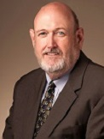
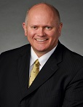
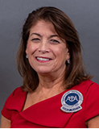


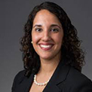

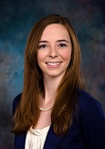

2024 Cycle Board Members
Ronnie Martin, DO
Chair
Ray Morrison, DO
Vice Chair
Richard Thacker, DO
Treasurer
Teresa Hubka, DO
Assistant Treasurer
Jeffrey Grove, DO
Secretary
Kris Nicholoff, JD
Affiliate Member
Sonbol Shahid-Salles, DO
Member at Large
Jantzen Faulkner, OMS
Student Member
Alexis Cates, DO
Coalitions Officer
Vacant
Academic Member
Notes:
Sources:
“Upcoming Congressional Fiscal Policy Deadlines,” Committee for a Responsible Federal Budget, July 6, 2021, http://www.crfb.org/blogs/upcoming-congressional-fiscal-policy-deadlines
“Chairman Yarmuth on House Adoption of 2022 Budget Resolution” House Appropriations Committee, August 24, 2021
https://budget.house.gov/news/press-releases/chairman-yarmuth-house-adoption-2022-budget-resolution
“Chairman Yarmuth, House Budget Committee Release Report Outlining 2022 Budget Resolution and Reconciliation: How We Will Build Back Better” House Appropriations Committee, August 18, 2021
https://budget.house.gov/news/press-releases/chairman-yarmuth-house-budget-committee-release-report-outlining-2022-budget
David Lawder and Susan Heavey. “Yellen says U.S. may exhaust cash by Oct 18 barring debt ceiling rise” Reuters, September 28, 2021
https://www.reuters.com/business/finance/yellen-says-delta-slowing-recovery-urges-congress-raise-us-debt-limit-testimony-2021-09-28/
Tony Romm. “Biden signs government funding bill hours before midnight deadline to avert shutdown” Washington Post, September 30, 2021
https://www.washingtonpost.com/us-policy/2021/09/30/house-senate-shutdown-vote/

Slide 35
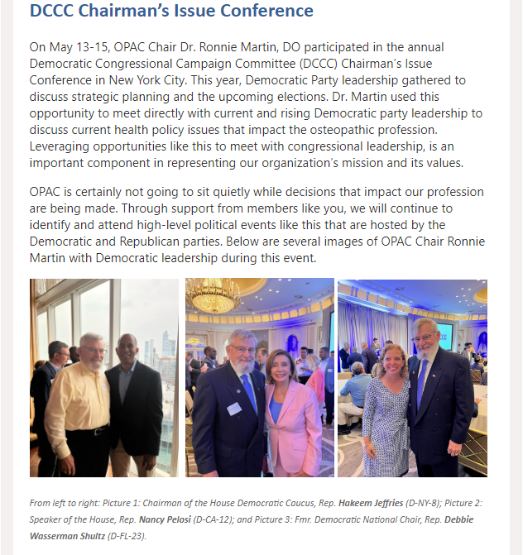
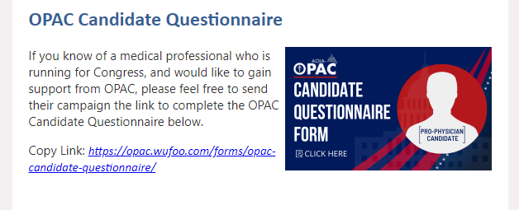
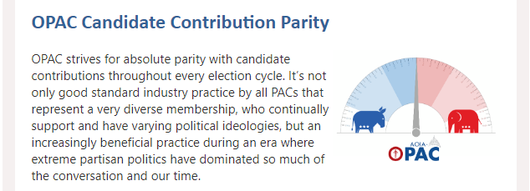
Communications
Notes:
We partnered to defeat optometrist scope expansion in WA but unfortunately our efforts in VA were unsuccessful.
AZ grad transitional training permit. So far, few are making use of the permits, which first became available in November. While 99 permits had been issued as of May 12, only 12 permittees were practicing under a supervising physician, according to data from the Arizona Medical Board. enate Bill 1271, signed by Gov. Doug Ducey on May 4, 2021, created a one-year transitional training permit for medical school graduates who have successfully completed Step 1 and 2 of the United States Medical Licensing Examination or equivalent exams but haven’t gone through residency,

Slide 36
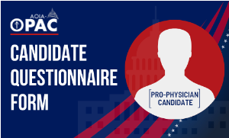
Candidate Questionnaire
Introductory Questions
Has your campaign conducted polling?
Do other healthcare PACs support you?
What are your top priorities?
What are the challenges that physicians and patients face in your district?
By Issue
Do you support expanding funding for GME?
Do you support student debt relief or forgiveness programs?
Do you support expanding telehealth services?
Do you support legislation to expand the scope of practice for non-physician clinicians?
Do you support medical liability reform?
Notes:
Payment Parity requires that health care providers are reimbursed the same amount for telehealth visits as in-person visits. During the COVID-19 pandemic, many states implemented temporary payment parity through the end of the public health emergency. Now, many states are implementing payment parity on a permanent basis. As portrayed in Figure 1, as of June 2022, 21 states have implemented policies requiring payment parity, 5 states have payment parity in place with caveats, and 24 states have no payment parity.
These updates are highlighted below because in many states, temporary telehealth flexibilities are tied to the status of state of emergency declarations.
Illinois passed House Bill No. 4797, which allows appropriately licensed non-residents to provide social services via telehealth to another non-resident of the state for up to 5 days in one month and 15 days in one year. These limits to not apply when providing social services via telehealth to the recipient of telehealth social services is currently attending an in-state university or college.
Illinois passed Executive Order 22-13, extending various Executive Orders, including ones related to telehealth, through June 25, 2022.
New Hampshire passed Senate Bill No. 320, which:
Requires providers delivering telehealth services to be licensed, certified, or registered in New Hampshire if the patient is located in the state at the time of service.
Requires the Office of Professional Licensure and Certification to seek reciprocity agreements with states that have similar licensing requirements as New Hampshire, and to approve telehealth licenses for providers with a license in good standing in another state that participates in such agreements.

Slide 37
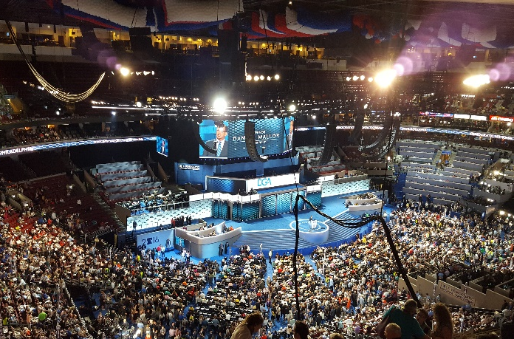
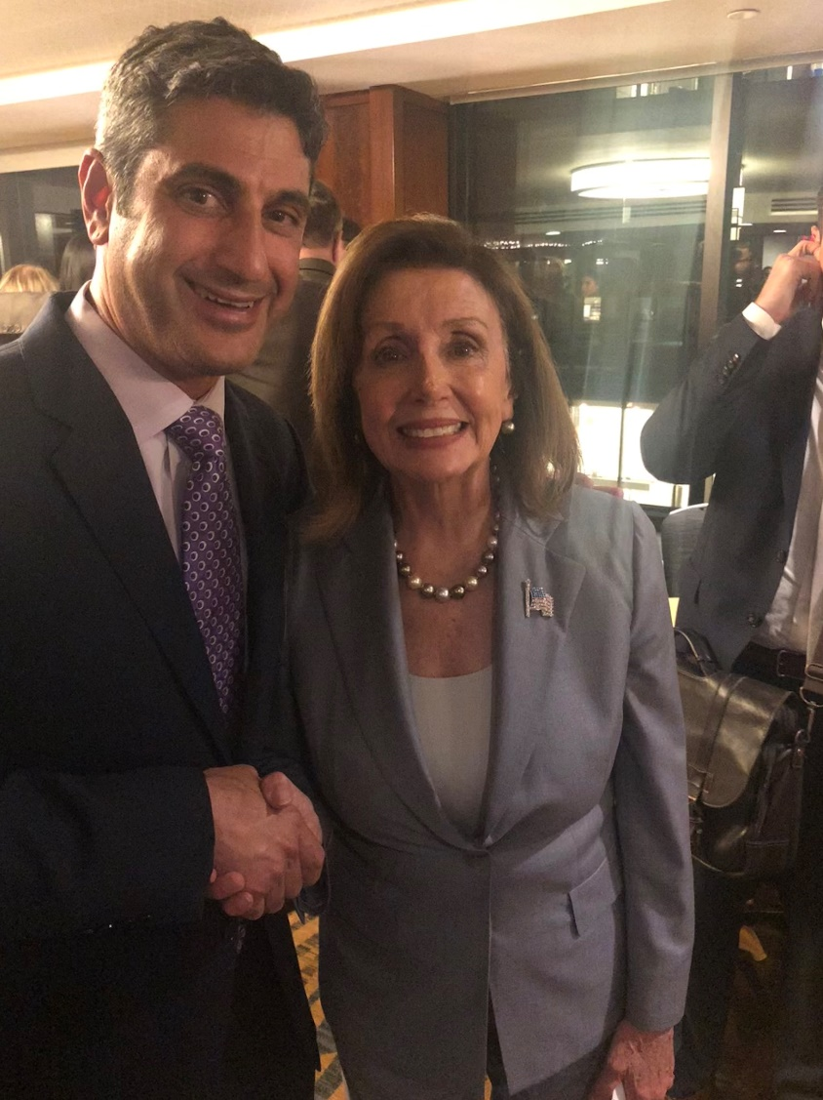
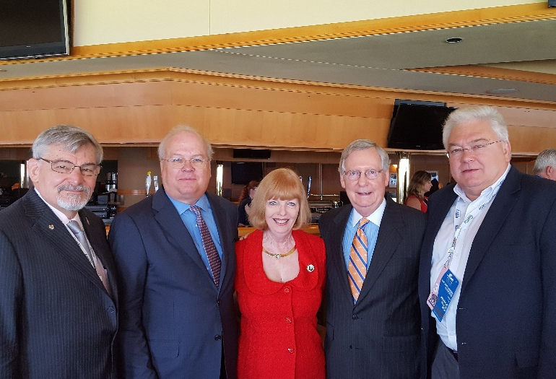
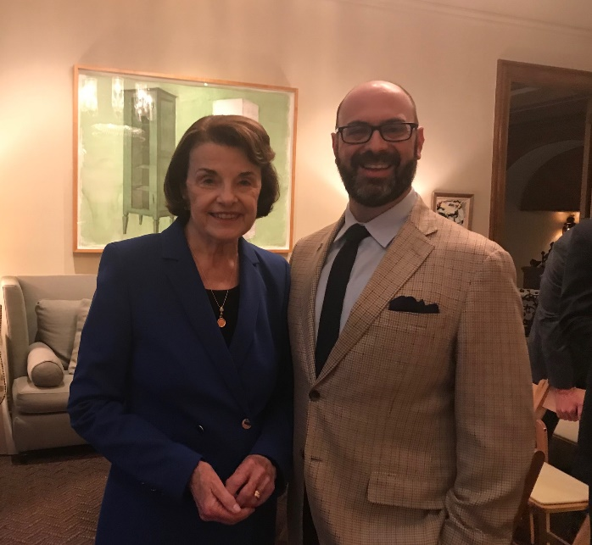
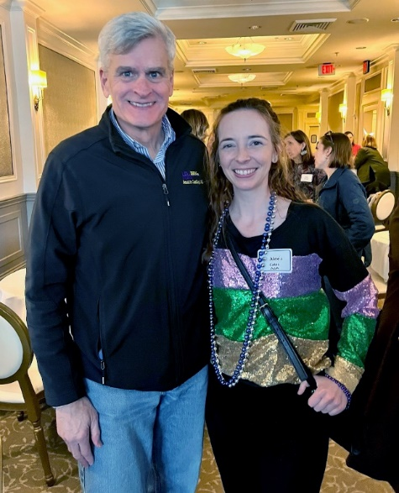
A Seat at the Table
Notes:
Sources:
“Upcoming Congressional Fiscal Policy Deadlines,” Committee for a Responsible Federal Budget, July 6, 2021, http://www.crfb.org/blogs/upcoming-congressional-fiscal-policy-deadlines
“Chairman Yarmuth on House Adoption of 2022 Budget Resolution” House Appropriations Committee, August 24, 2021
https://budget.house.gov/news/press-releases/chairman-yarmuth-house-adoption-2022-budget-resolution
“Chairman Yarmuth, House Budget Committee Release Report Outlining 2022 Budget Resolution and Reconciliation: How We Will Build Back Better” House Appropriations Committee, August 18, 2021
https://budget.house.gov/news/press-releases/chairman-yarmuth-house-budget-committee-release-report-outlining-2022-budget
David Lawder and Susan Heavey. “Yellen says U.S. may exhaust cash by Oct 18 barring debt ceiling rise” Reuters, September 28, 2021
https://www.reuters.com/business/finance/yellen-says-delta-slowing-recovery-urges-congress-raise-us-debt-limit-testimony-2021-09-28/
Tony Romm. “Biden signs government funding bill hours before midnight deadline to avert shutdown” Washington Post, September 30, 2021
https://www.washingtonpost.com/us-policy/2021/09/30/house-senate-shutdown-vote/

Slide 38
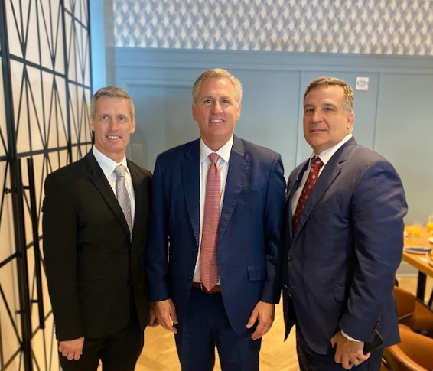
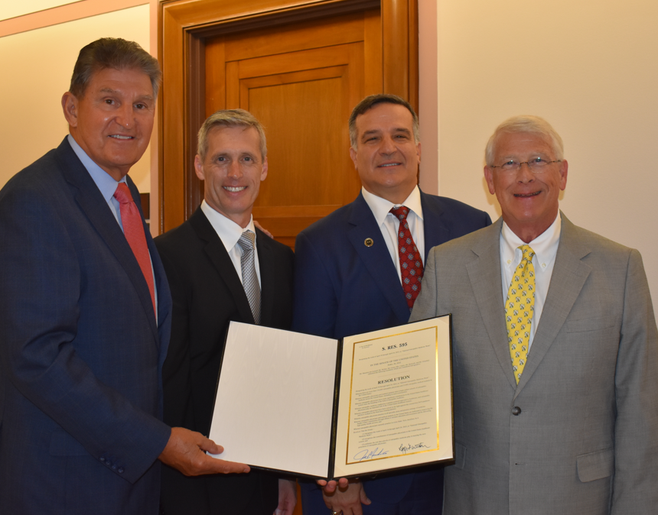
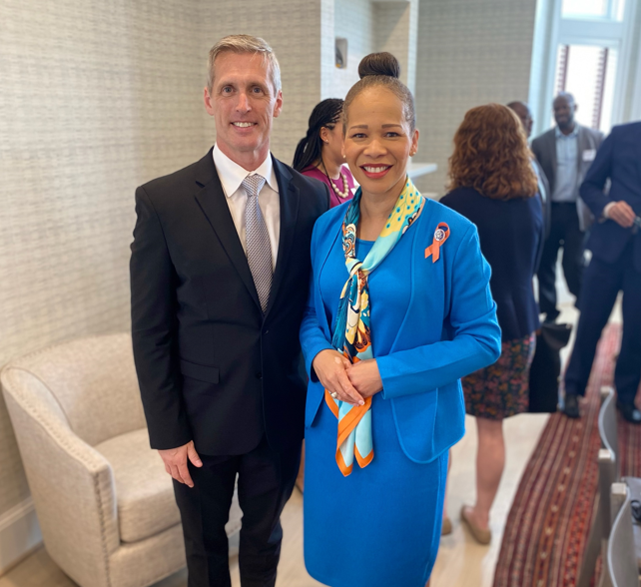
House Call on the Mall
Kevin Klauer, DO, Minority Leader Kevin McCarthy (R-CA-23), Joe Giaimo, DO
Sen. Joe Manchin (D-WV), Kevin Klauer, DO, Joe Giaimo, DO, Sen. Roger Wicker (R-MS)
Kevin Klauer, DO, Rep. Lisa Blunt Rochester (D-DE-AL)

Slide 39
Thank you!
Sean Neal
Vice President, Advocacy & Political Affairs
sneal@osteopathic.org

