Slide 1
Do Not Resuscitate Policy
How to ensure compliance with the Oklahoma Do-Not-Resuscitate Act
Notes:
The Oklahoma Do-Not-Resuscitate Act—the Hospital is obligated to comply with this Act; this is also a CMS patient right requirement

Slide 2
Compliance
The hospital is obligated to comply with the Oklahoma Do-Not-Resuscitate Act
CMS—Patient has a right to decide end-of-life care

Slide 3
Oklahoma Law
It is assumed that all individuals want to be resuscitated in the event that the heart stops or breathing ceases
Oklahoma law allows for an individual to decide if they want heroic measures taken in this instance
The individual will need to formally state this desire and sign a DNR Consent

Slide 4
DNR Does Not Mean Do Not Treat
DNR only applies to the specific condition that the patient’s heart stops or breathing ceases
Up until that point, the patient will continue to receive medical treatment

Slide 5
Required Paperwork for DNR Status
Do-Not-Resuscitate Consent Form
DNR Compliance Form
DNR Physician Certification Form

Slide 6
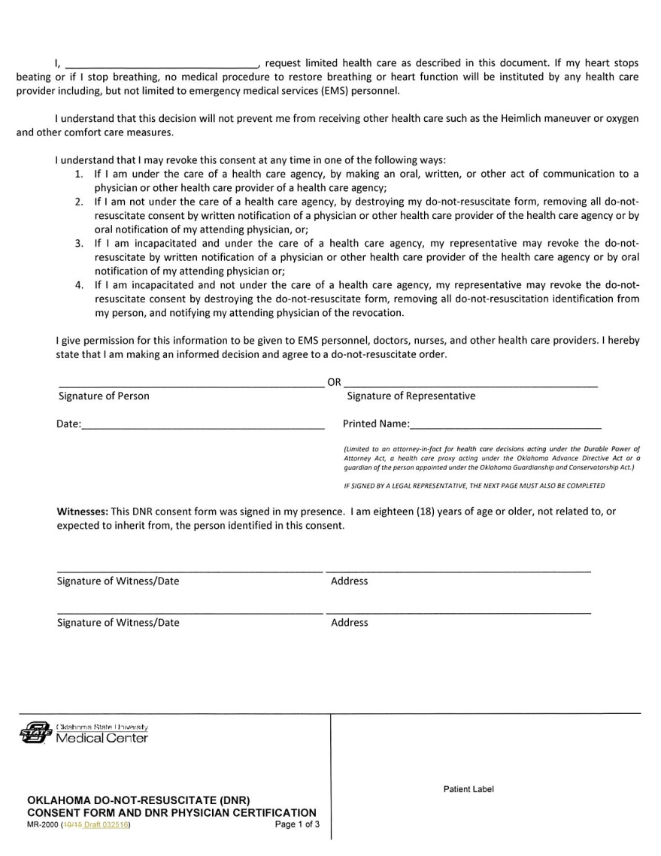
Oklahoma DNR Consent Form 1/3
Notes:
This is the Oklahoma DNR Consent form; this form is signed by the patient with decision-making capacity or by the patient’s legal representative (Durable Power of Attorney for Medical Decisions, Health Care Proxy under an Advance directive, or Court Appointed Guardian)

Slide 7
Page 1/3
This form is signed by
The patient with decision-making capacity
OR
The legal representative of an incapacitated patient
Durable power of Attorney for Medical Decisions that is executed prior to November 1, 2021.
Health Care Proxy under an Advance Directive
Court Appointed Guardian
Notes:
DNR form is 3 pag
You must have paperwork before allowing legal representative to sign paperwork

Slide 8
Verify with Request for Legal Document
Request a copy of the legal document that identifies the individual as the legal representative for the patient
Do not take at face value that an individual is the legal representative—must verify this information with the actual legal document
The legal document will become part of the medical record

Slide 9
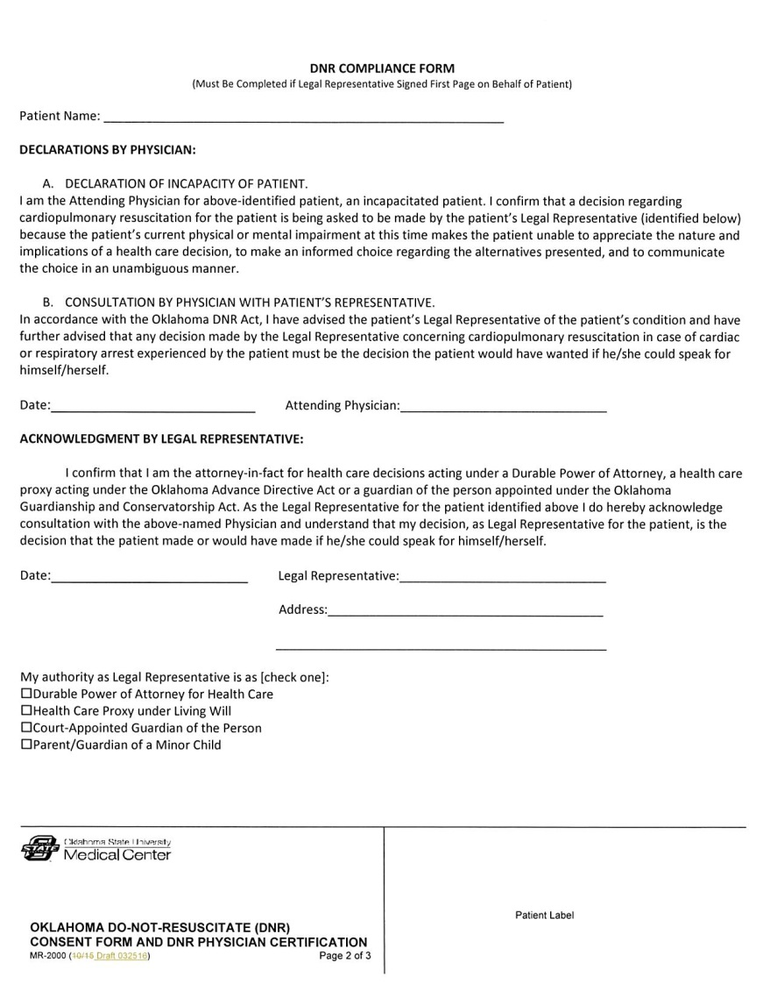
DNR Compliance Form 2/3
Notes:
For patients who do not have decision-making capacity and have a Legal Representative, this document is signed by the Physician and the Legal Representative verifying this relationship for DNR considerations for the patient.

Slide 10
DNR Compliance Form
For a patient who does not have decision-making capacity but does have a Legal Representative
Durable Power of Attorney for Health Care that is executed before November 1, 2021 is valid
Health Care Proxy
Court Appointed Guardian
Document is signed by the Physician and the Legal Representative verifying this relationship for DNR considerations for the patient

Slide 11
DNR Compliance Form
Must be completed if Legal Representative signed DNR Consent Form on Behalf of Patient
Declarations by Physician
Patient is incapacitated
Consultation by Physician with Patient’s Legal Representative that CPR decision must be what the patient would have wanted
Acknowledgment by Legal Representative
Confirmation of status of Legal Representative for Patient
Acknowledges Consultation of patient’s Physician with this person acting as Legal Representative for CPR decisions

Slide 12
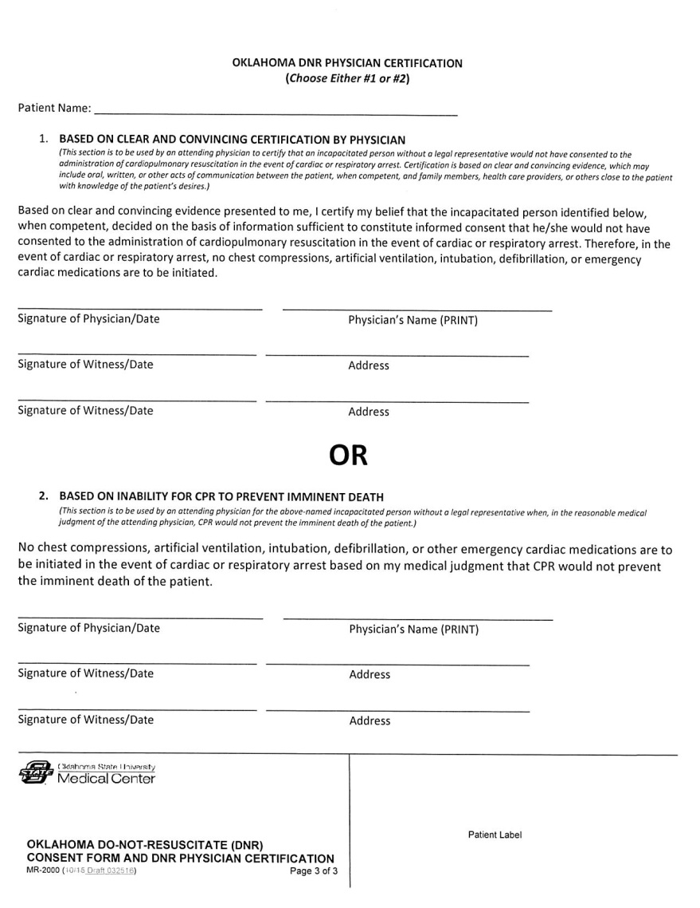
Physician Certification 3/3
Notes:
When the patient does not have decision-making capacity and does not have a legal representative, then the Physician uses this form to 1) Certify that there is clear and convincing evidence that the patient would not want CPR; OR 2) that CPR would not prevent the imminent death of the patient
Either choice requires a Physician Signature and the signature of 2 Witnesses

Slide 13
Conditions for Physician Certification
The patient does not have decision-making capacity
AND
The patient does not have a legal representative

Slide 14
Physician Certification
The Physician enters an order for DNR status
Because there is clear and convincing evidence that the patient would not want CPR
OR
CPR would not prevent the imminent death of a patient
Either choice requires a Physician Signature and the signature of 2 Witnesses
Notes:
Must be a PGY2 or higher ( a licensed physician)

Slide 15
Signatures Required: DNR Consent Form
Patient or
Legal Representative
No DNR Consent by Patient
No Legal Representative
Patient has signed a DNR Consent Form
Legal Representative signs DNR Consent Form
Durable Power of Attorney for Medical Decisions executed prior to Nov. 1 , 2021
Health Care Proxy under an Advance Directive
Court-appointed Guardian
Declaration by Physician
Clear and Convincing Evidence or
Inability for CPR to prevent imminent death
Notes:
SUMMARY SLIDE: This slide shows the pathway to follow for a patient with decision-making capacity and/or a patient who has a Legal Representative (LEFT); the pathway to obtain DNR Status when the patient does not have decision-making capacity and no Legal Representative (RIGHT)

Slide 16
Family Members and DNR Consent
Family Members cannot sign the DNR Consent Form
(Unless they are the legal representative)
Because the family member may benefit from the death of the patient
Family members may sign consents for surgery or procedures
However, family members cannot sign a DNR Consent

Slide 17
Family Members and Consents
Oklahoma Law allows for family members to consent to surgery/procedures in this order of priority:
Spouse
Adult son or daughter
Either parent
Adult brother or sister
Relative by blood or marriage

Slide 18
DNR Witness
A witness must be 18 years of age or older
A witness cannot be related to the person identified in the consent
A witness cannot be expected to inherit at the time of death of this person
Notes:
Direct caregivers are discouraged from witnessing DNR Consent forms. This could be considered a conflict of interest.
Non-direct caregivers are the recommended witnesses for DNR Consent forms.

Slide 19
DNR Witness continued…
A Witness is verifying the signature of the patient
A witness is not verifying the content of discussion of DNR status between the physician and the patient
Notes:
Please document the conversation in either the H&P or a Care Plan note

Slide 20
Physician Order for DNR Required
Physician conversation with the patient or patient representative has taken place
DNR Consent form signed
Physician enters order in EMR for DNR status

Slide 21
Who Discusses DNR Status With The Patient?
The consent process is a conversation(s) between the physician and the patient/legal representative
The consent conversation involves a licensed physician so a PGY1 resident cannot be the physician on record for obtaining DNR consent
A PGY1 resident may be involved in presenting this information to the patient/legal representative
The “attending” physician is the physician at the bedside; NOT “attending” vs. “resident” for GME
Cannot delegate this conversation to the chaplain

Slide 22
Oklahoma Do-Not-Resuscitate (DNR) Consent Form Goldenrod Form
OK Statutes 63-3131 Do-Not-Resuscitate Act
Goldenrod form from Oklahoma Human Services is taken directly from the OK Statute 63-3131.5
Community DNR form that individuals may complete and have available should EMSA be summoned to the home

Slide 23
Goldenrod Form vs. OSU Medical Center DNR Consent Form
Both documents have the same content
The Goldenrod form is honored regarding the wishes of the patient
However, DNR Consent form for OSU Medical Center must be completed

Slide 24
Limited Code Options
Hospital policy allows for limited Code options
Intubation
Chest Compressions
Antiarrhythmic medications
Cardioversion
Notes:
The Oklahoma DNR Consent form is only for DNR status and not for limited Code options

Slide 25
Requirements for Limited Resuscitation Order
The same process/paperwork is followed for a Limited Resuscitation Order as the DNR process/paperwork
There are three documents that are included in the Limited Resuscitation Order
Consent for Limited Resuscitation Order
Limited Resuscitation Compliance Form
Limited Resuscitation Physician Certification
The physician will enter an order into the patient’s medical record for Limited Resuscitation with the options identified by the patient/patient representative

Slide 26
Consent for Limited Resuscitation

Slide 27
Limited Resuscitation Compliance Form

Slide 28
Limited Resuscitation Physician Certification

Slide 29
Physician Order for Limited Resuscitation Required
Physician conversation with the patient or patient representative has taken place
Limited Resuscitation Consent form signed
Physician enters order in EMR for limited resuscitation options

Slide 30
Questions
Kathy Cook, D.O.
CLER Quality Co-chair
Kathy.cook@okstate.edu
Chaplain
Office 918-599-1733
Pager 918-621-9111
Special Thanks to Kris Schueren
Sharing her slides
Our previous risk manager

