Slide 1

THE GME AND C-SUITE RELATIONSHIP;
PEARLS AND PITFALLS
MO SOM, D.O. MS
JUNE 7, 2023

Slide 2

HISTORICAL PERSPECTIVE

Slide 3

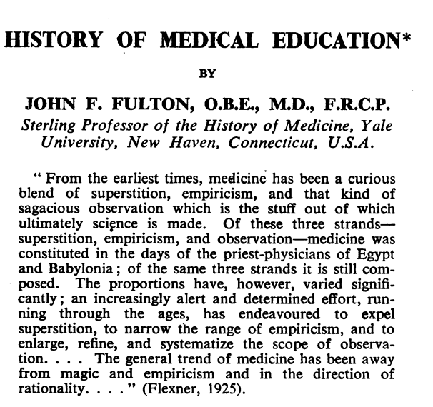
There are many in this era who lament the fact that the personal tie between teacher and pupil no longer plays so vital a part in medical education, and they would urge a return to the earlier mode of teaching.
—John Fulton

Slide 4
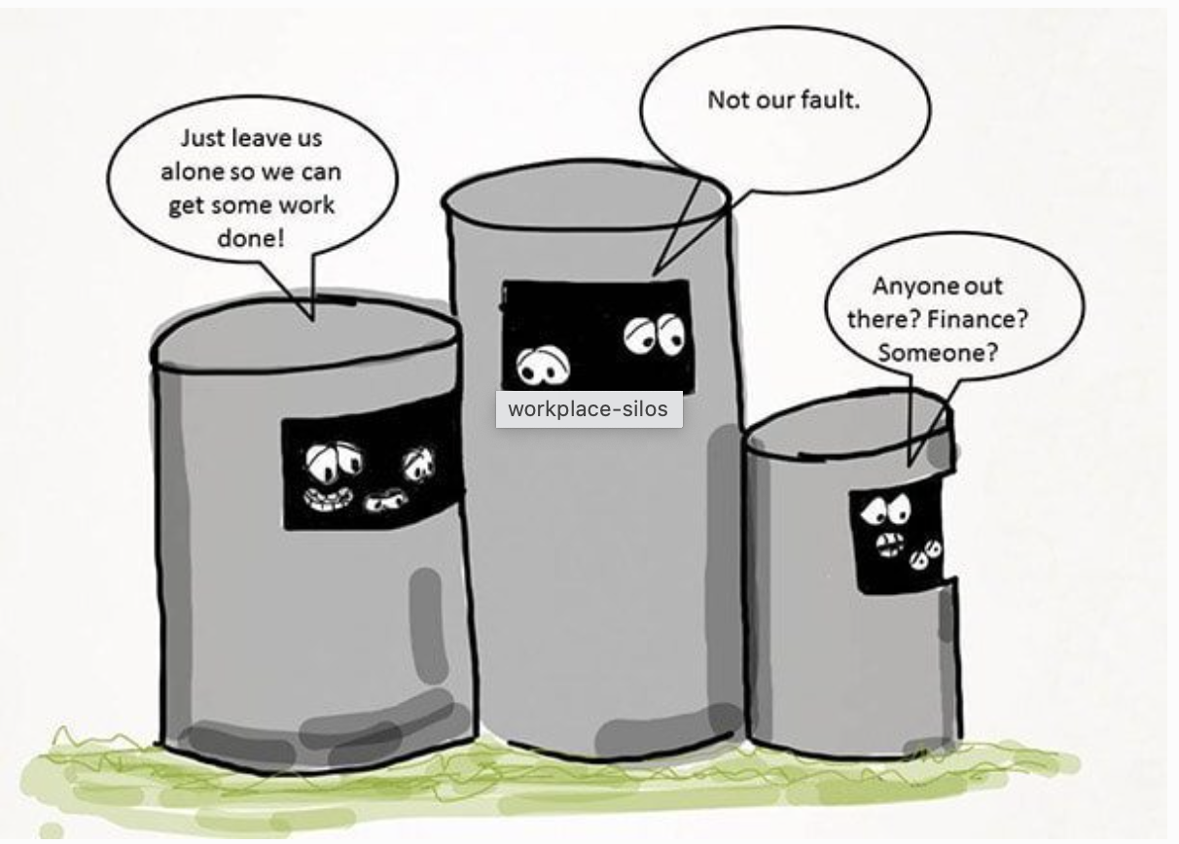
https://focusu.com/blog/how-to-break-silos-within-an-organisation/

Slide 5
DATA SOURCES
GME and the C-Suite
ACGME Surveys
Financial Reports
Patient Satisfaction
Sponsoring Institution Surveys
CLER
ACGME accreditation decisions
Safety Reports
Patient Volumes and other external factors
Internal Surveys (Exit and Post Graduate)
NRMP Match Data

Slide 6
AGGREGATE DATA IN COHESIVE DECISION-MAKING
Multiple Data Sources
GME and
C-Suite Dashboard
Collaborative Decision Making

Slide 7
Key Measures | Program A | Program B | Program C | Program D | Program E | Program F
Resident Overall Satisfaction | 95% | 43%
NRMP Match Rate | 100% | 25%
Retention of Graduates in State of Oklahoma
Program on Special Review | N/A

Slide 8
USE THIS TOOL TO ASSIST IN FILLING IN NEEDS
Focus on educational quality of programs
Alignment with hospital mission/strategic plans
Interval growth in teaching faculty, specialty institutes and departments that offer educational opportunities
Long term plans for departmental growth
Program specific growth in ambulatory and inpatient volume (historical and projected)
Workforce needs

Slide 9
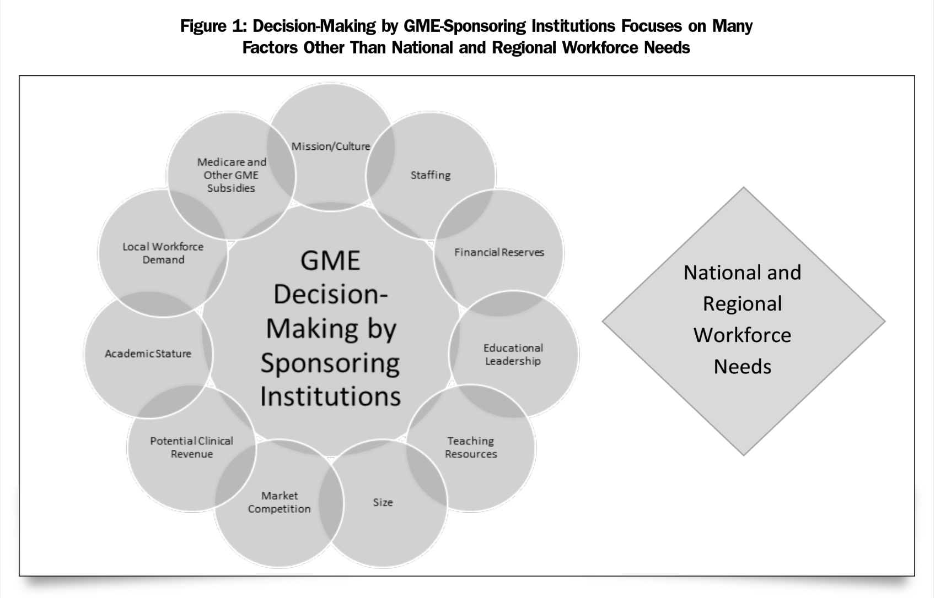
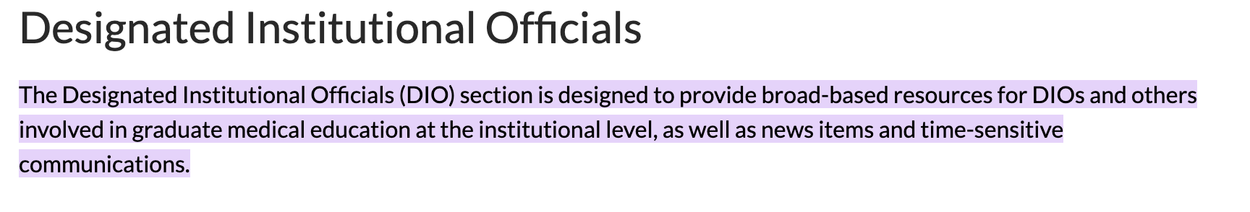
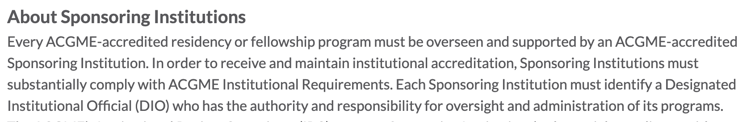
WHO IS THE SPONSORING INSTITUTION,
AND WHAT IS THEIR ROLE?

Slide 10
THE PITFALLS OF GME

Slide 11
DISCIPLINARY ACTION
Non-Reviewable/Informal Actions are any additional training, supervision, or assistance above what is typical for training in the specialty
Reviewable/Formal Actions are based on a decision that the performance or conduct of a learner falls short of program requirements
Designated Institutional Official (DIO) notification should occur in all cases of formal remediation and may be advisable with informal remediation in some cases.

Slide 12
WHY HR SHOULD NOT BE THE SOLE RESPONSIBILITY PARTY IN GME DISCIPLINARY ISSUES
Residents and fellows are in a unique position as they are hospital employees and learners simultaneously
The ACGME Common Program Requirements charge the program director with ensuring compliance with mandates for trainees to raise a grievance and have the benefit of due process.
The ACGME institutional requirements specify that sponsoring institutions must have a policy that provides residents and fellows with due process upon suspension, nonrenewal, non-promotion, or dismissal

Slide 13
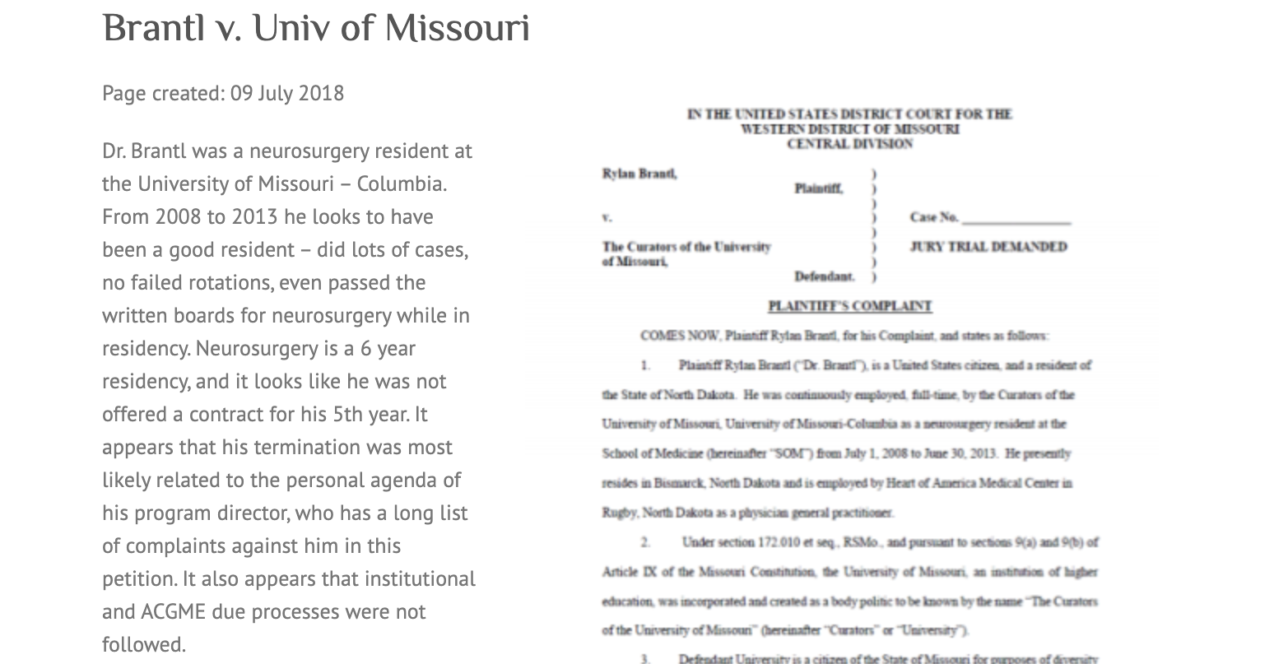

THE GRADUATE MEDICAL EDUCATION
COMPLIANCE PROJECT
“…it appears that his termination was most likely related to the personal agenda of his program director, who has a long list of complaints against him in this petition. It also appears that institutional and ACGME due processes were not followed.”

Slide 14
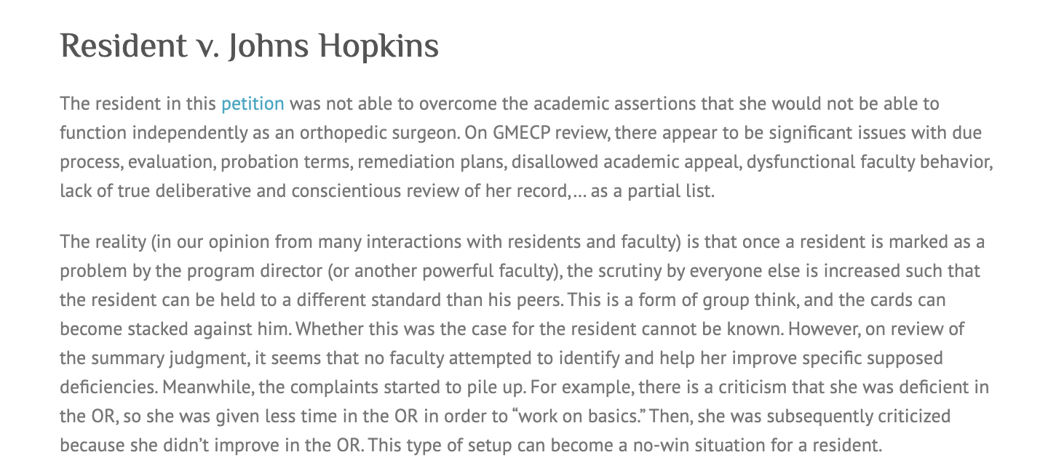

THE GRADUATE MEDICAL EDUCATION
COMPLIANCE PROJECT
“…it seems that no faculty attempted to identify and help her improve specific supposed deficiencies. Meanwhile, the complaints started to pile up. For example, there is a criticism that she was deficient in the OR, so she was given less time in the OR in order to ‘work on the basics’.”

Slide 15
CAN I DISCLOSE NEGATIVE PERFORMANCE
MEASURES INTERNALLY?
Case law supports educators' critical evaluation of a trainee's performance and abilities
Kraft v William decision upholds the dissemination of this information within an educational institution

Slide 16
CAN I DISCLOSE NEGATIVE PERFORMANCE
MEASURES EXTERNALLY?
Educators are bound by an ethical obligation and professional duty to truthfully report formal remediation and/or probation (when solicited)
Legal action could potentially be sought by the trainee if he or she believes the probation status was unwarranted and/or inaccurate, or the disclosure of his or her status was improper

Slide 17
WHAT ABOUT THE LEGAL IMPLICATIONS FOR
DISMISSING A RESIDENT?
While unsuccessful remediation resulting in dismissal poses possible liability, institutions are generally on solid legal ground

Slide 18

WHAT HAPPENS WHEN A DISABILITY IS DISCOVERED?
When a disability is discovered during training, programs should protect the resident by collaborating with institutional officials familiar with the Americans with Disabilities Act.

Slide 19
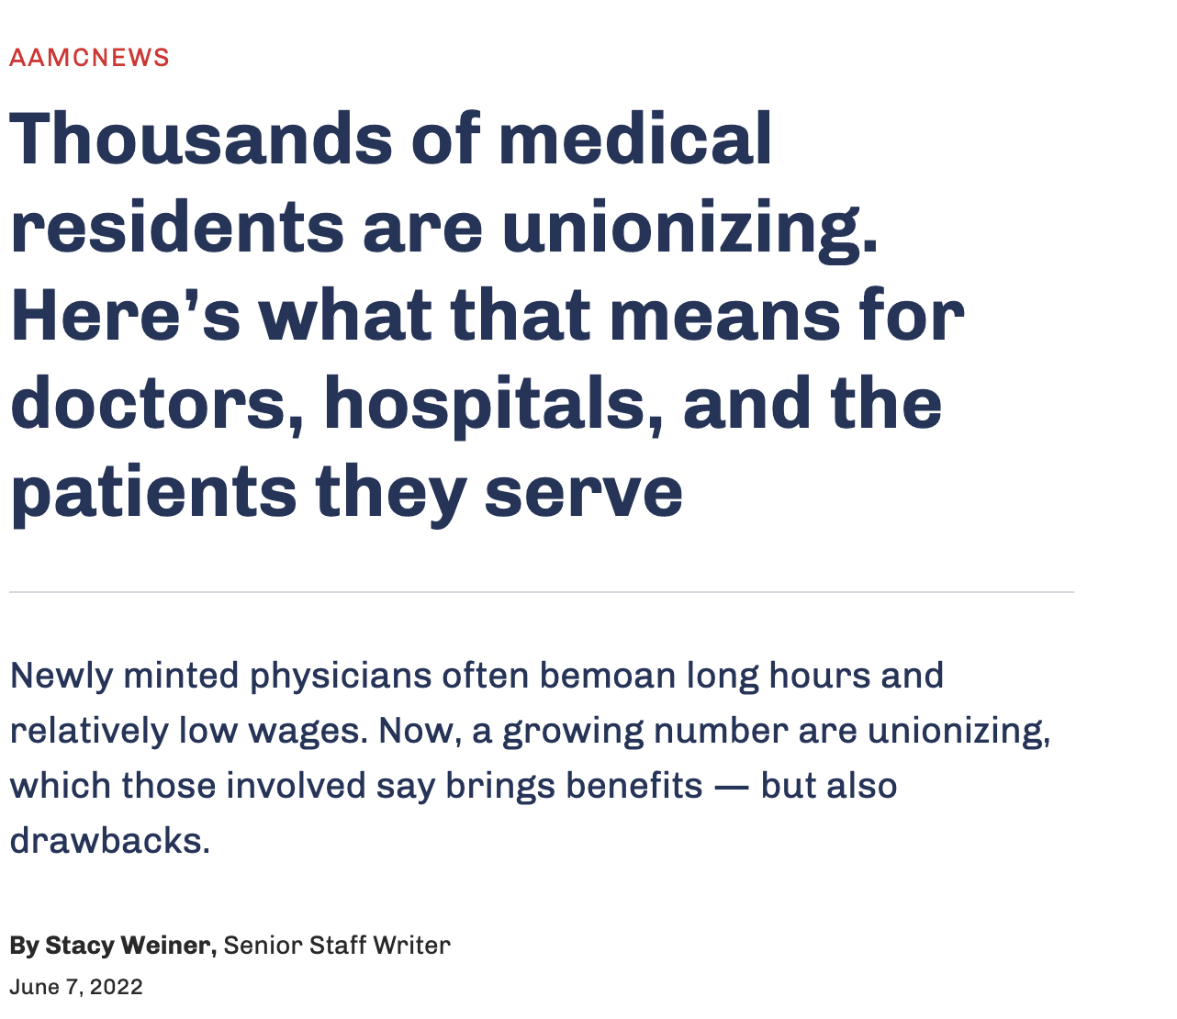
RESIDENCY UNIONIZATION

Slide 20
THE PEARLS

Slide 21
CLINICAL LEARNING ENVIRONMENT REVIEW
Provides leaders of hospitals, medical centers, and other clinical settings with formative feedback through site visits that explore six Focus Areas: Patient Safety; Health Care Quality; Supervision; Teaming; Well-Being; and Professionalism
Only accreditation link is that a SI must complete a CLER site visit if contacted
  Egregious findings may prompt further evaluations

Slide 22

SOCIAL DETERMINANTS OF HEALTH
GME programs are required to focus on patient safety and social determinants of health (SDOH), which encourages health systems to increase their focus on these areas.
https://edhub.ama-assn.org/steps-forward/module/2702762

Slide 23
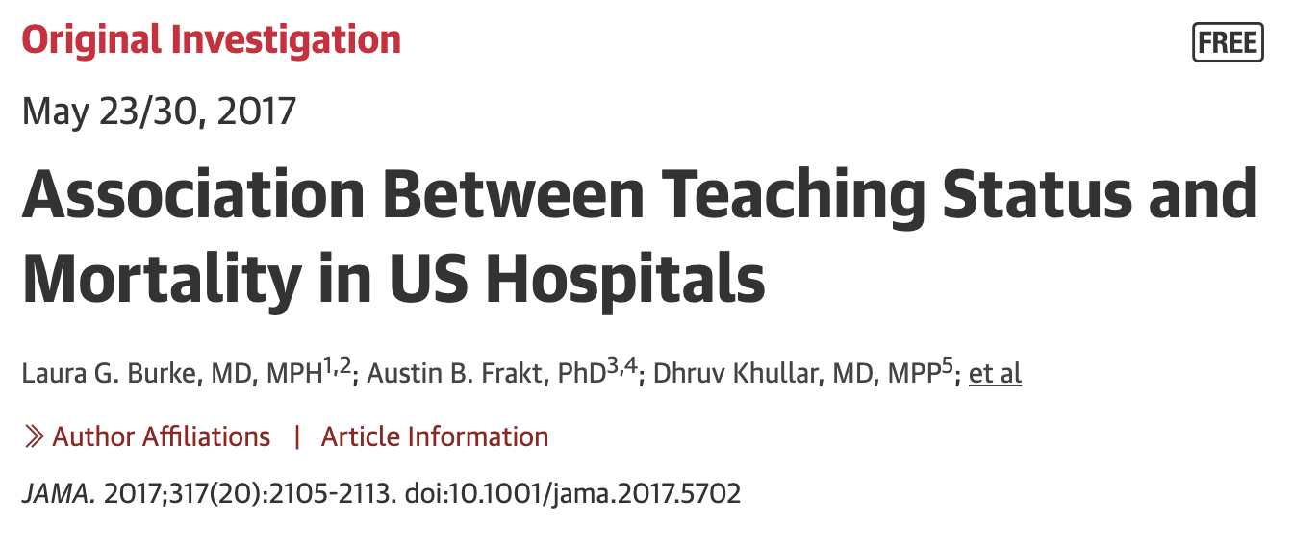

Slide 24
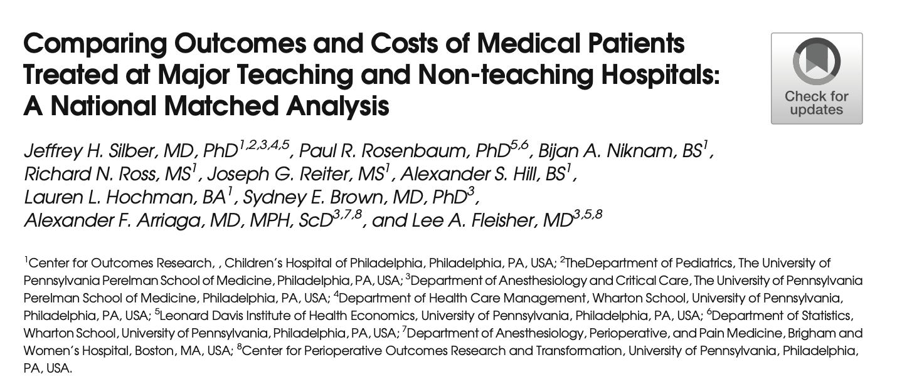

Slide 25
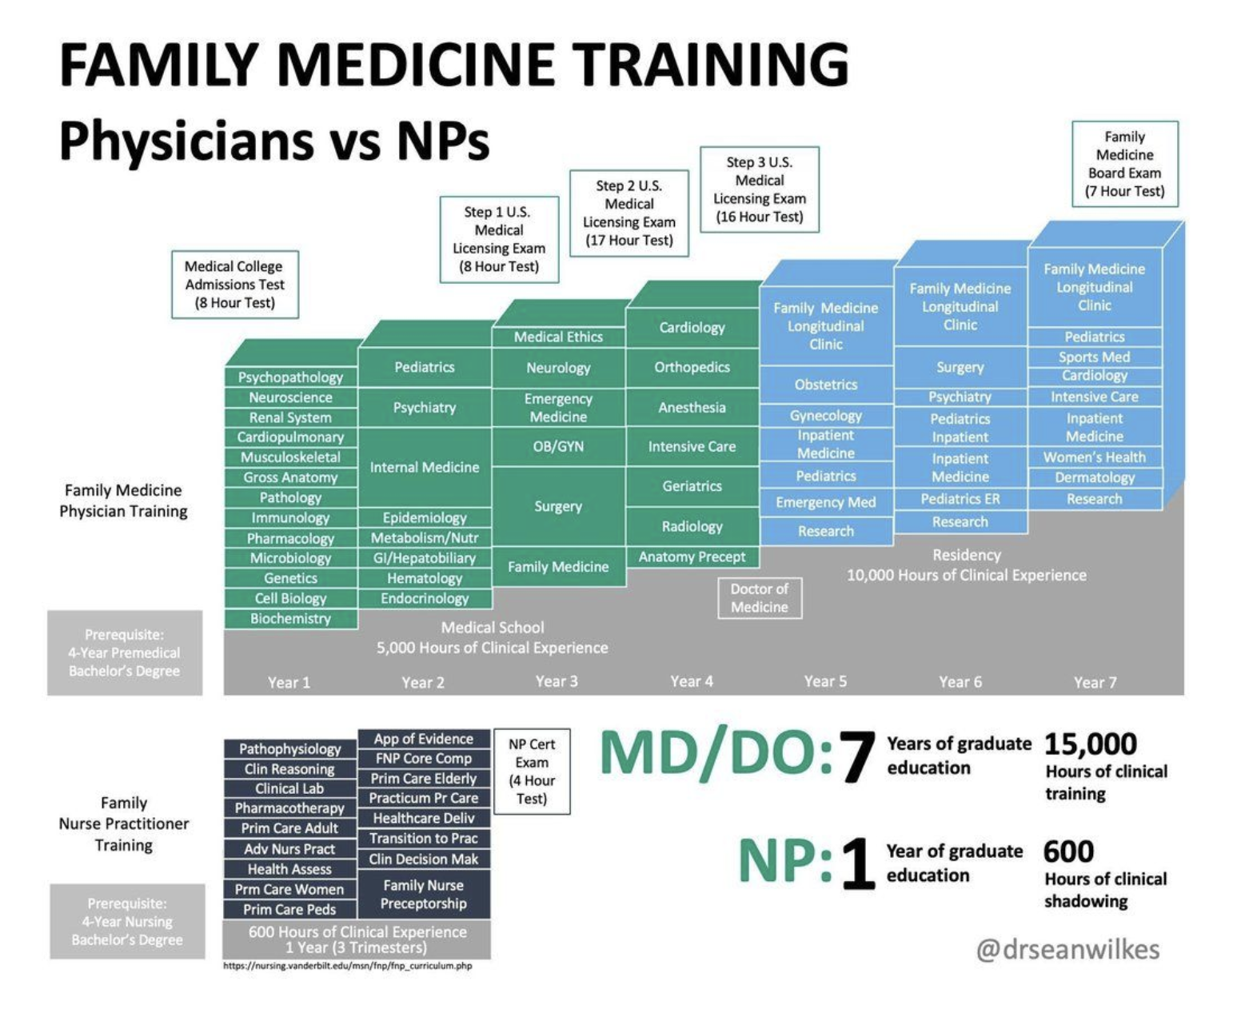
NP vs RESIDENCY TRAINING?
Replacing residents with advanced practice providers increases cost to an institution with no change in patient outcomes, resulting in net financial loss.

Slide 26
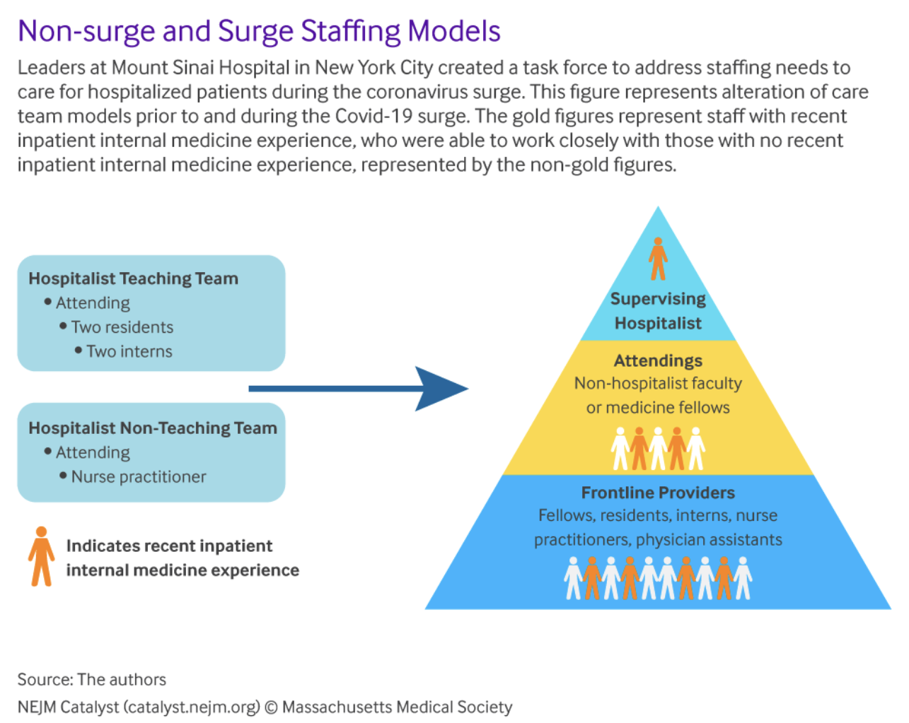
PUBLIC HEALTH EMERGENCIES
Trainees serve as a ready pool of re-deployable healthcare providers if public health emergencies arise.

Slide 27
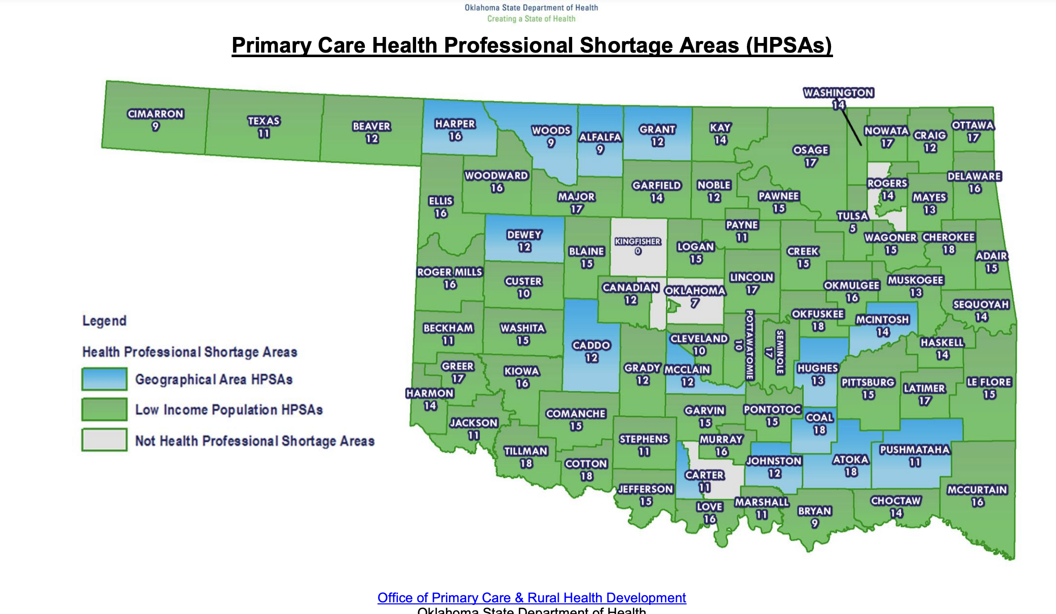
PRIMARY CARE HEALTH PROFESSIONAL SHORTAGE AREAS (HPSAs)

Slide 28
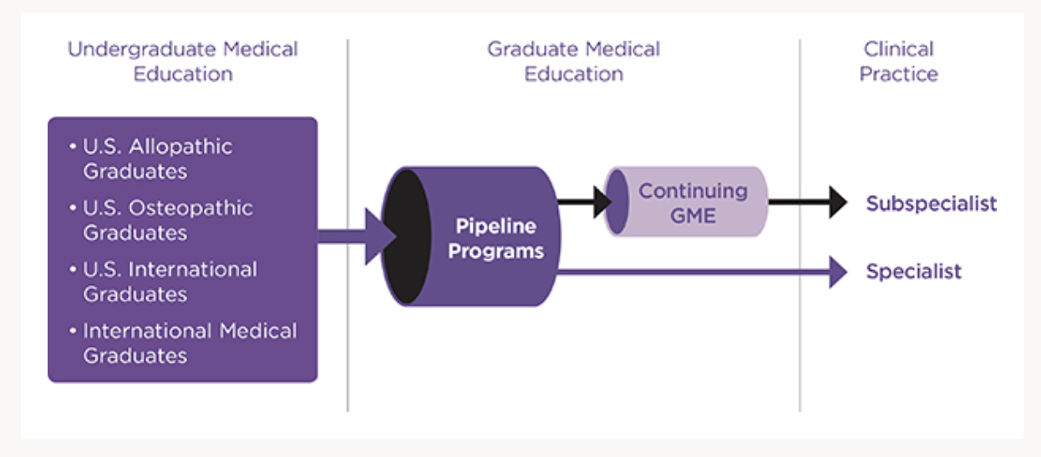

Slide 29
REFERENCES
https://www.ncbi.nlm.nih.gov/pmc/articles/PMC8462840/
https://www.ncbi.nlm.nih.gov/pmc/articles/PMC8782116/
https://med.stanford.edu/content/dam/sm/gme/gme_community/ACGME_conference/2019/SES059%20-%20Beyond%20Collaboration-Real-Time%20Integration%20with%20the%20C-Suite%20Using%20CLER%20ACGME%20and%20GME%20Data_FINAL.pdf
https://www.ncbi.nlm.nih.gov/pmc/articles/PMC6008017/
https://www.jabfm.org/content/36/1/190
https://n.neurology.org/content/98/23/973
https://www.tandfonline.com/doi/full/10.1080/20009666.2021.1961381

