Slide 1
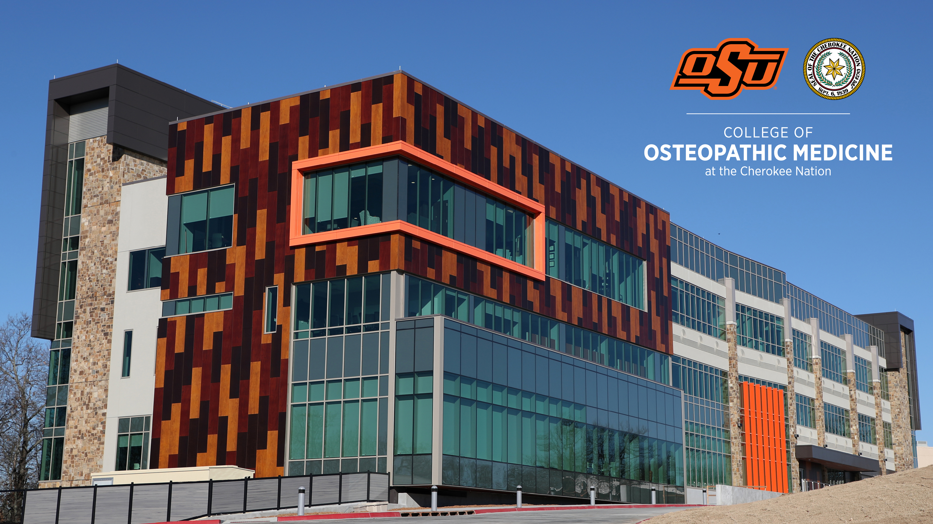
Osu-com at the Cherokee nation

Slide 2

CHALLENGES OF RURAL & FRONTIER
20% of the Population / 9% of the Physician Workforce
Significantly Worse Health
Health and Healthcare Disparities have Increased
Some Examples
  Shorter Life Expectancy
  Increased Mortality (Heart, Respiratory, Cancer, Stroke, Trauma)
  Increased Maternal & Infant Mortality
  Increased Opioid Use Disorder / Overdose
  Higher Rates of Mental Illness & Death by Suicide

Slide 3
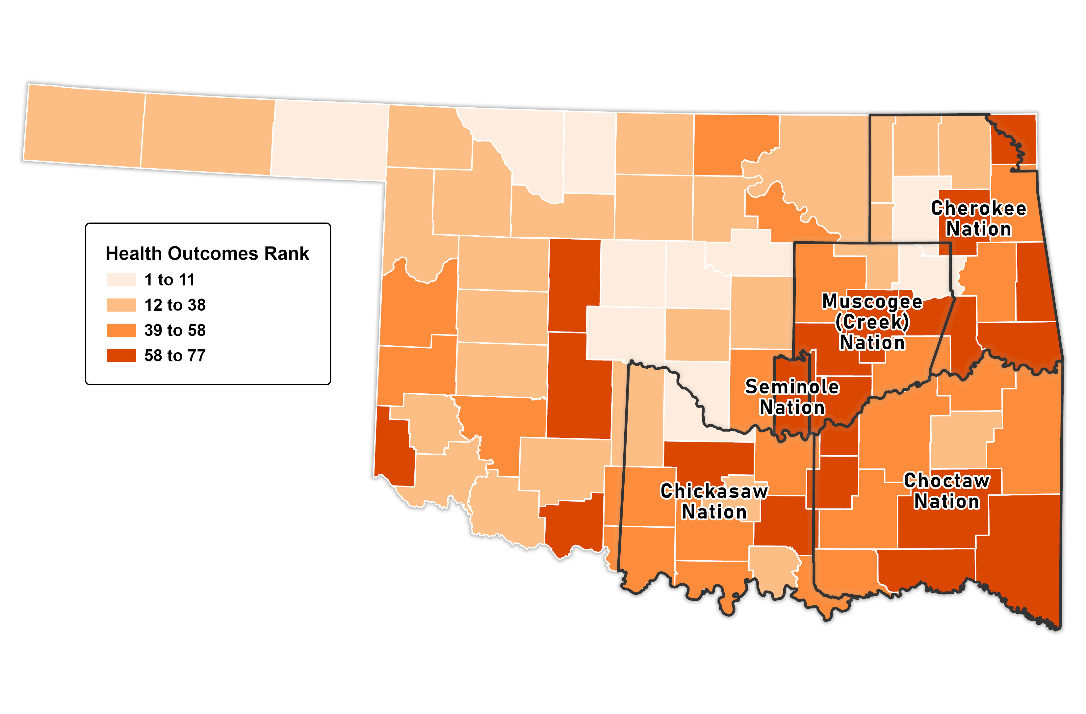
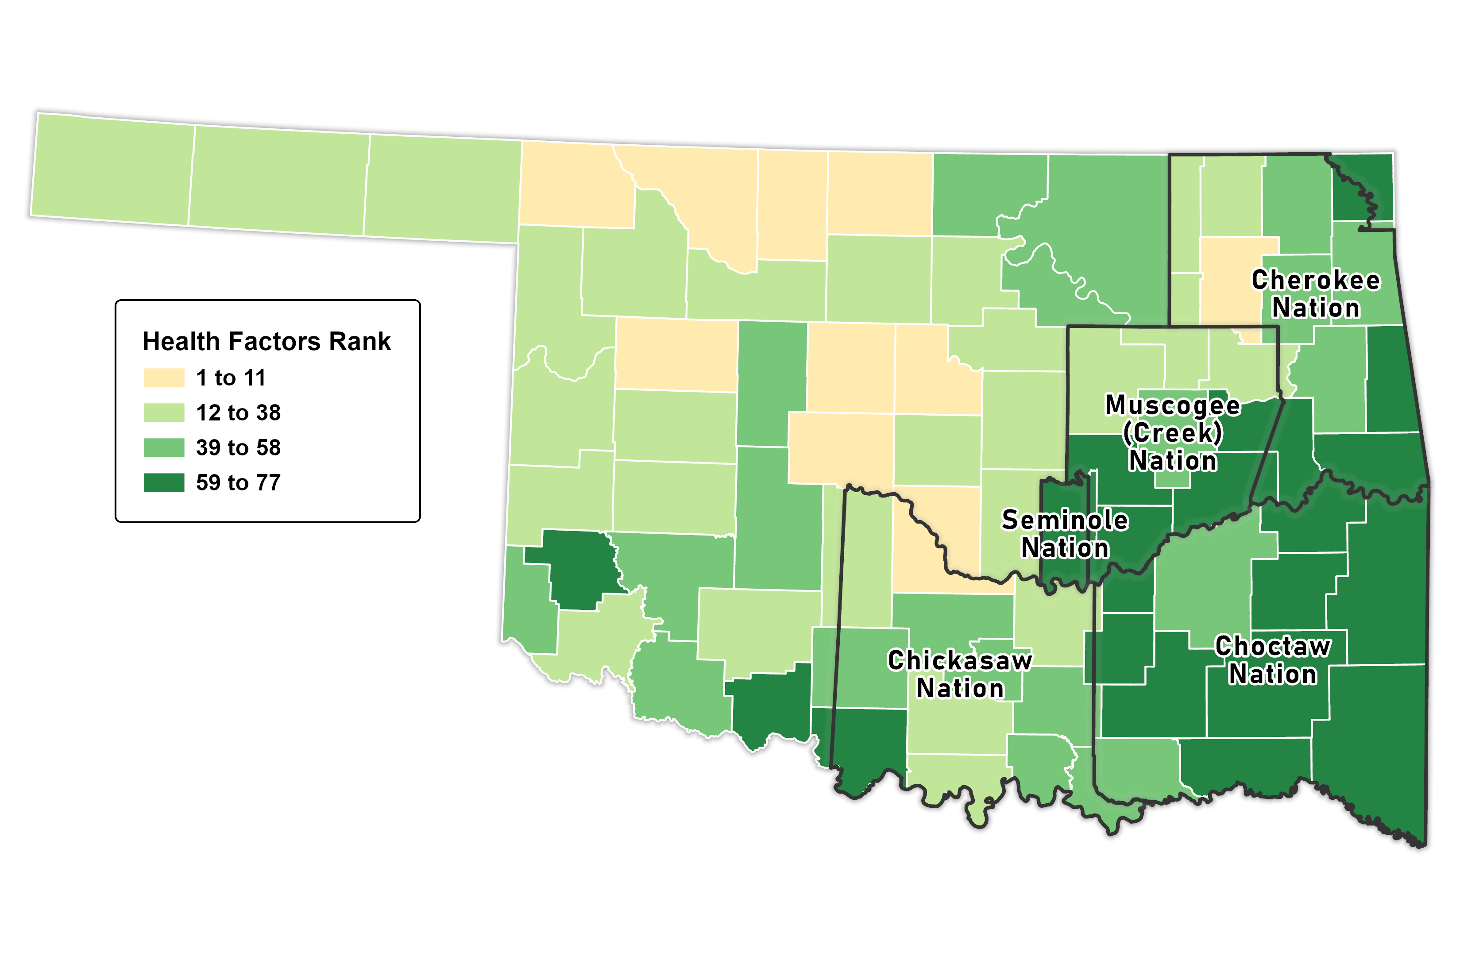
CONCENTRATED POOR HEALTH OUTCOMES/FACTORS
2022 County Health Rankings
2022 County Health Rankings
Notes:
Oklahoma compared to nation
2022 America’s Health Ranking report – Oklahoma is ranked 45th overall. Up 4 points since reaching a low of #49 in 2009.
Between 1999 and 2019, Oklahoma had the smallest decrease in cancer death rates in the nation: -16% vs. -27% for the US. Significant increase in obesity (ranked 48th) and suicide rates from 2012. Cardiovascular death rate is increasing (compared to 2015). Significant increase in frequent mental distress from 2016.
Ranked 33rd in occupational fatalities
Ranked 49th in percent of the population uninsured (13.8%)
Ranked 50th in health system performance
Ranked 49th in premature deaths from treatable causes
Ranked 47th in premature deaths from preventable causes

Slide 4
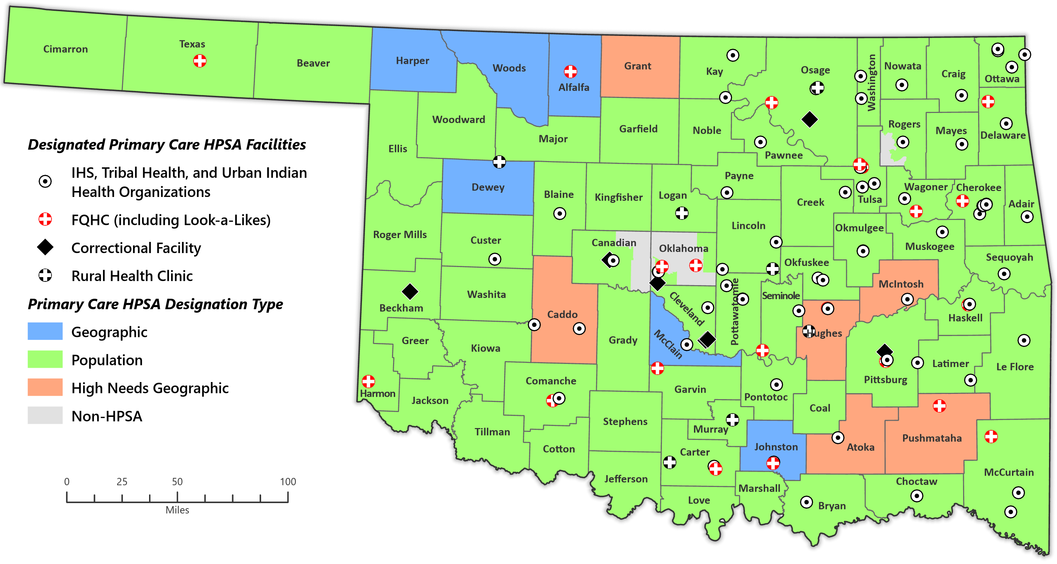
WIDESPREAD PRIMARY CARE SHORTAGES
77 HPSA Counties
3 counties with 1 PCP
6 counties with no PCPs
74.2 active PCPs per 100,000 population
Notes:
Compounding the poor health factors and outcomes for Oklahomans is a severe and persistent physician shortage that adds additional stress to tribal health systems. OK ranked 47th in both active patient care physicians & primary care physicians per capita.

Slide 5
CHALLENGES OF RURAL & FRONTIER
Despite 20% of Americans living in rural and frontier locations
Only 1% of residents train in rural areas
Only 4% of family medicine and 5% of internal medicine training sites are in community-based health clinics
Only 6% of family medicine, 1% of internal medicine, and 2% of general surgery sites are in rural settings

Slide 6
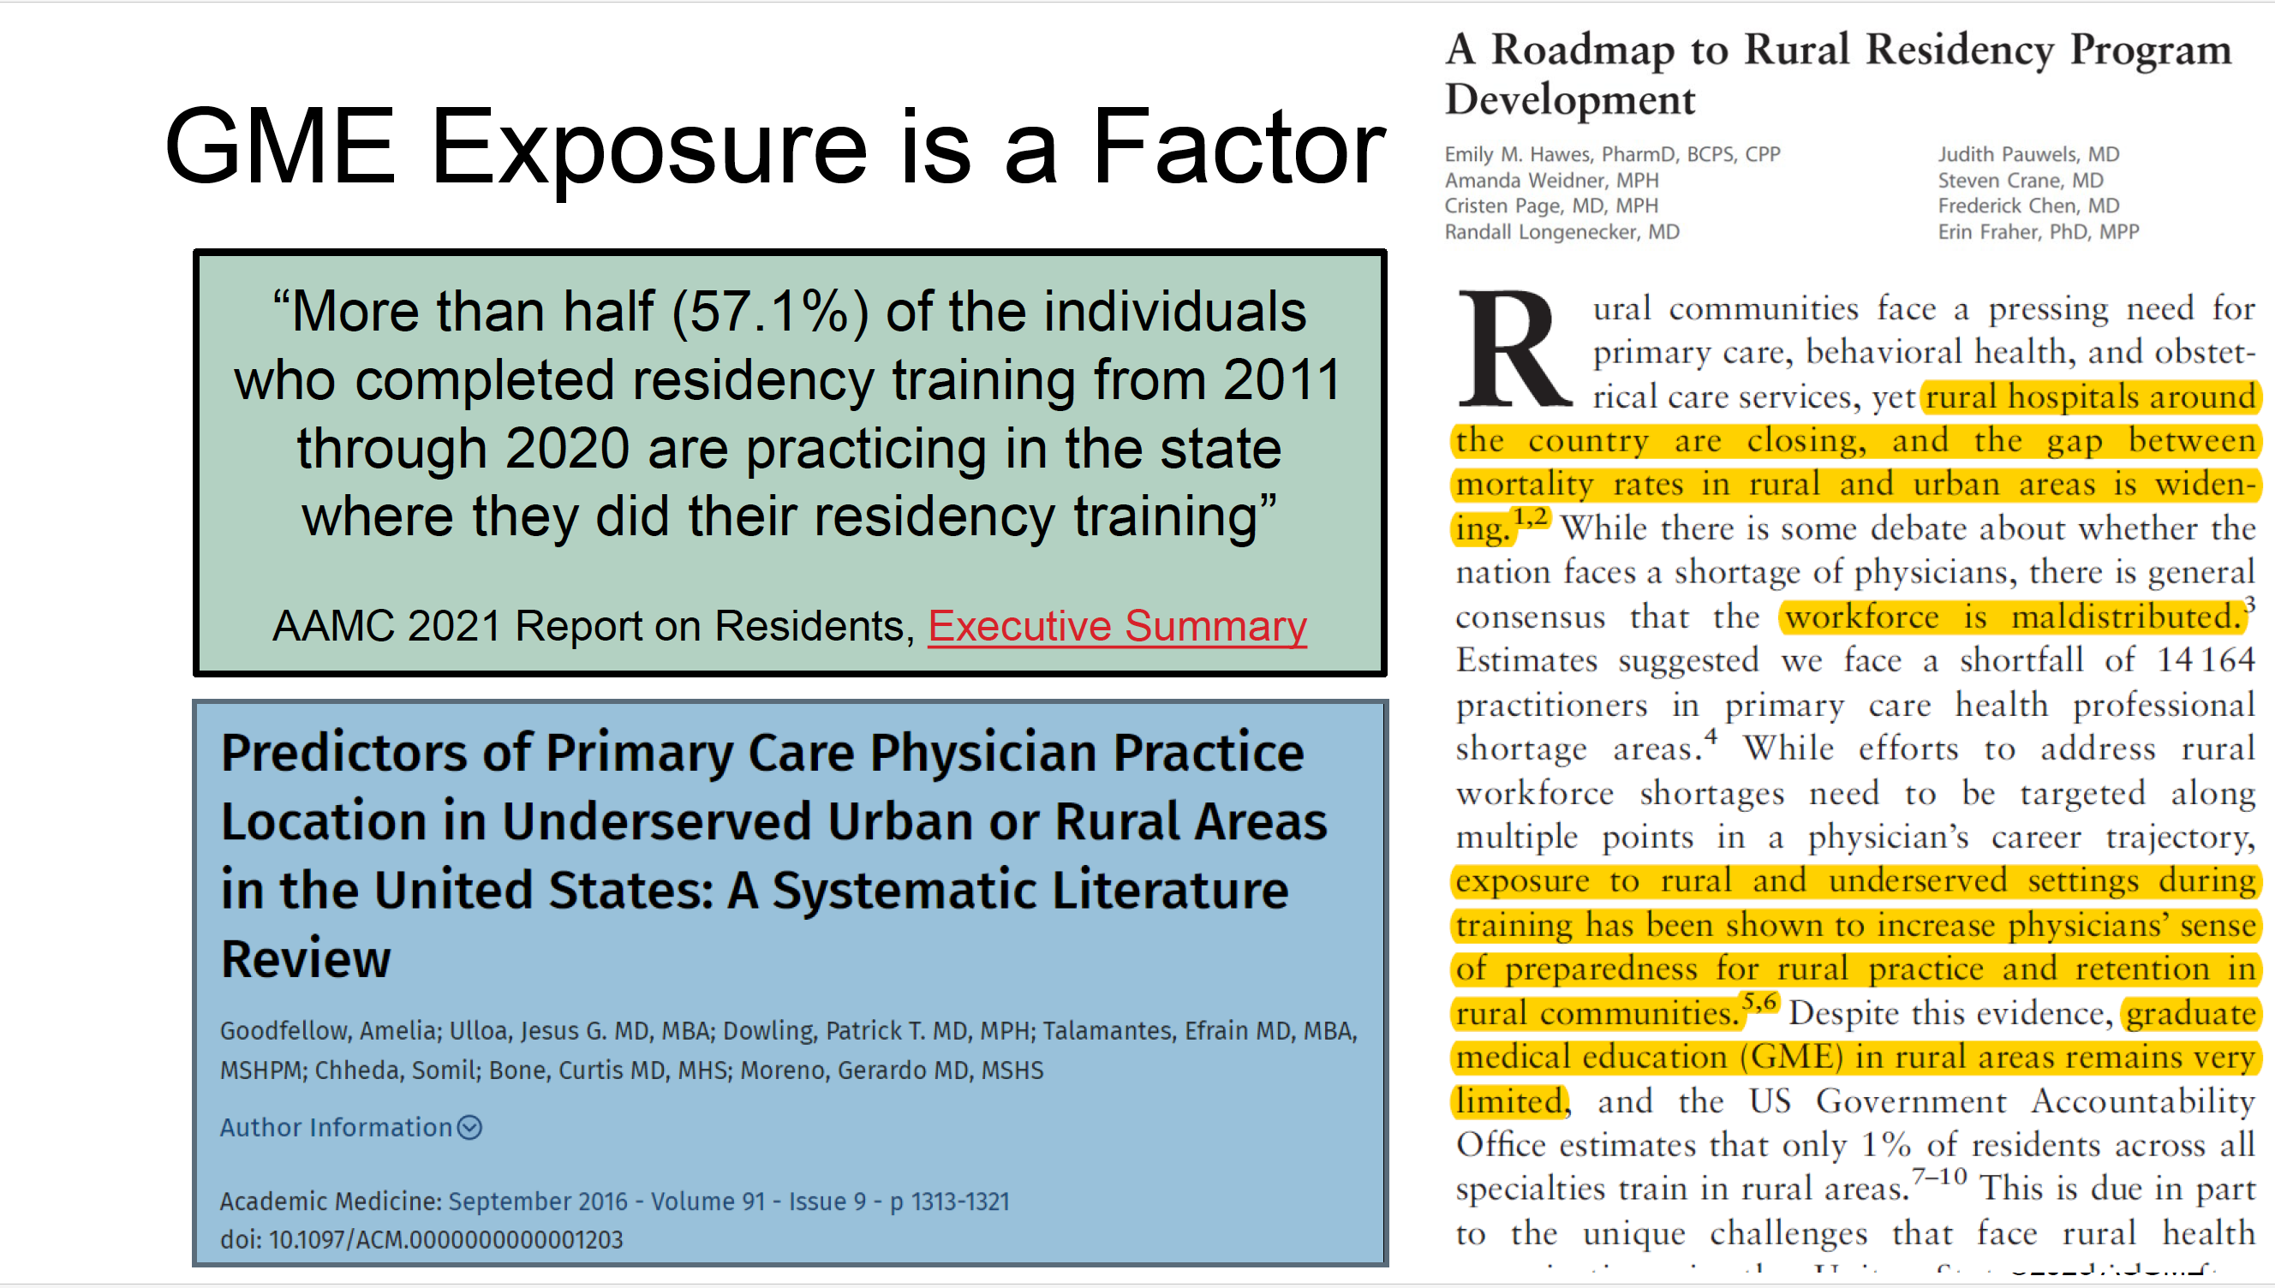
GME EXPOSURE IS A FACTOR

Slide 7
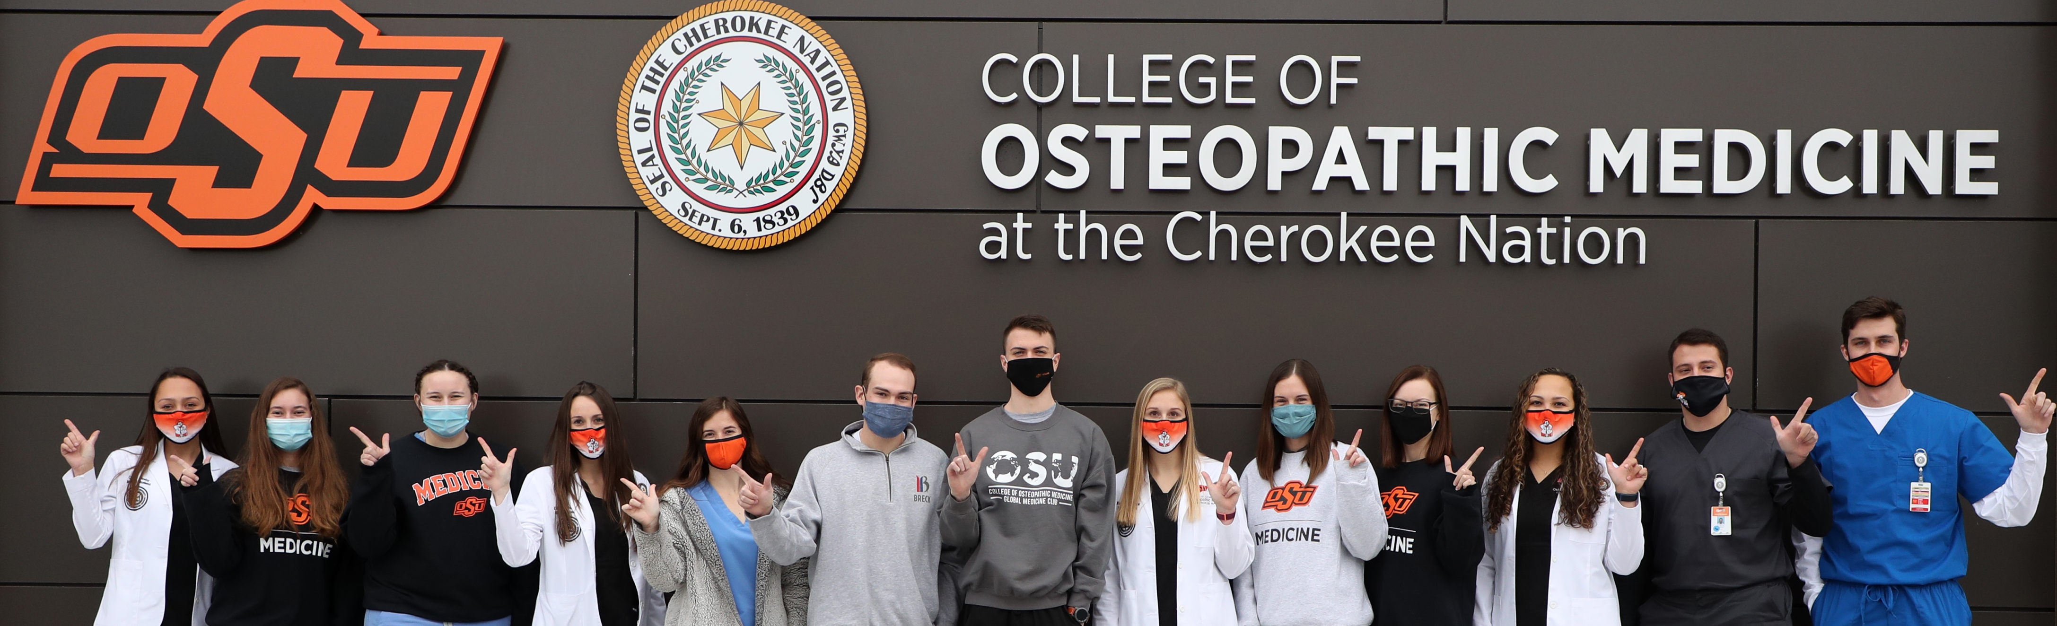
CULMINATION OF RURAL PHYSICIAN PATHWAY STRATEGY
R³
At OSU-COM, we will recruit RURAL students, educate them in a RURAL environment, and place them in RURAL-based residencies.

Slide 8


STORIES OF SUCCESS
Dr. Dustin Beck
Dr. Ashton Clayborn
Hometown: Wagoner (population 7,846)
Undergraduate: Northeastern State University
Medical School: Oklahoma State University College of Osteopathic Medicine (2011)
  IHS Scholarship (4 years)
Residency: OMECO/ NHS - Cherokee Nation Family Medicine (2014)
Current Job: Program Director – Cherokee Nation Family Medicine (since 2022)
Hometown: Porum (population 607)
Undergraduate: Northeastern State University
Medical School: Oklahoma State University College of Osteopathic Medicine (2014)
  Rural Health Option and Rural Medical Track
Residency: Choctaw Nation Family Medicine (2017)
Current Job: Program Director – Choctaw Nation Family Medicine (since 2022)

Slide 9
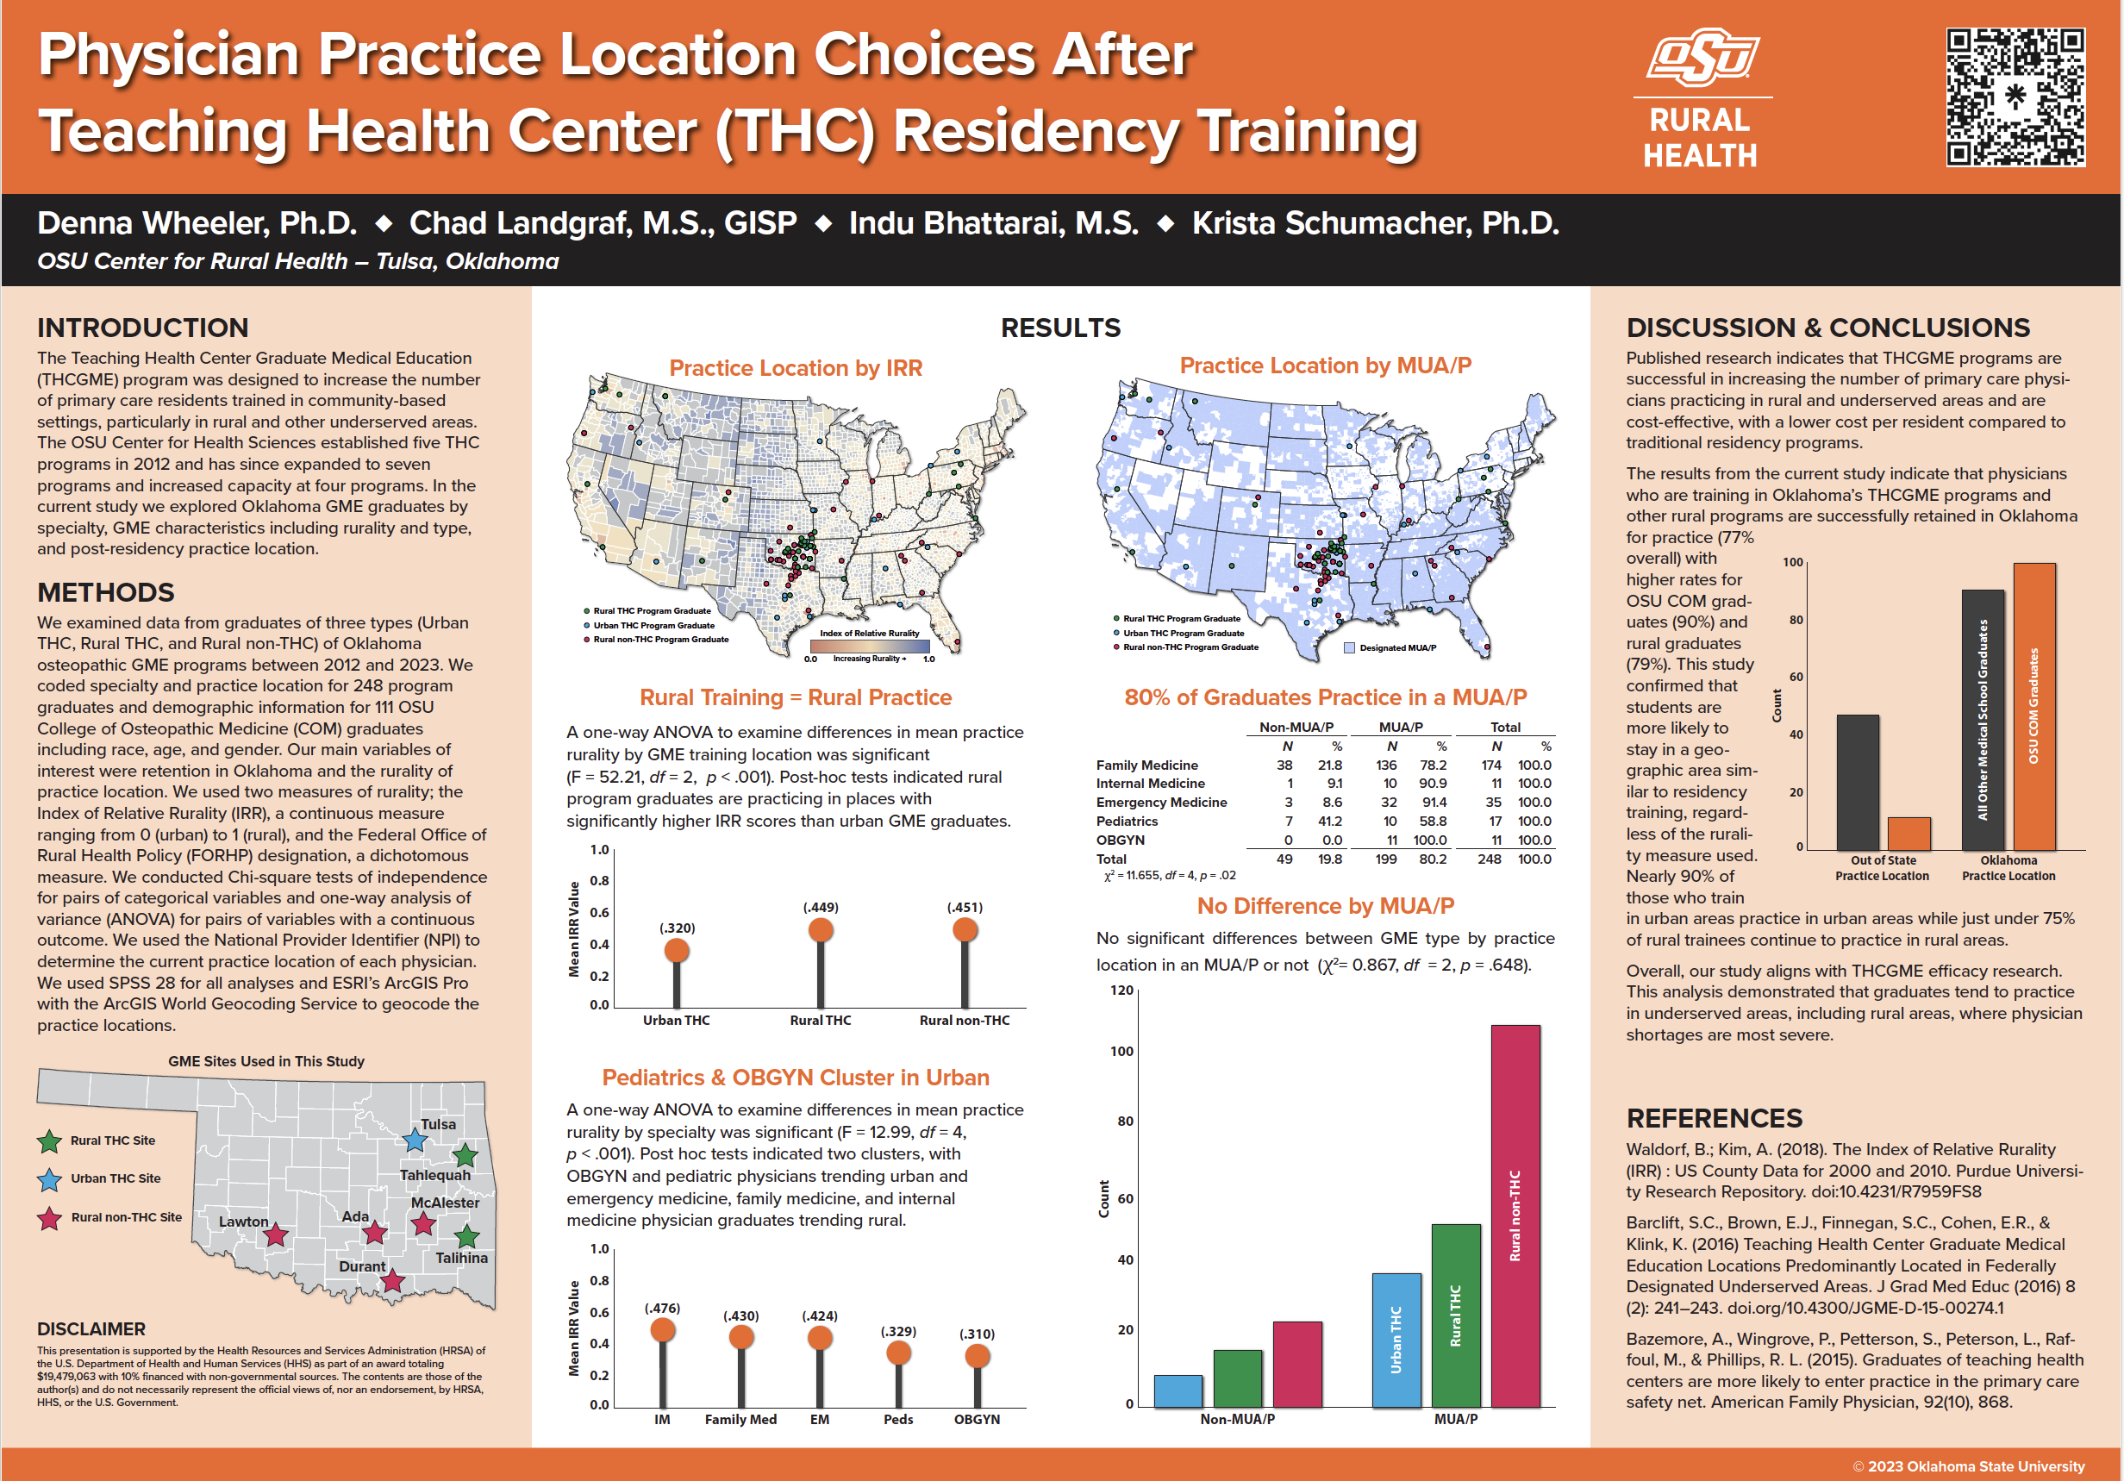

Slide 10
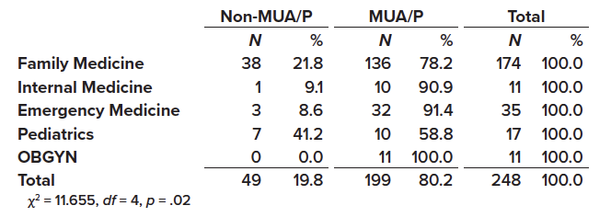
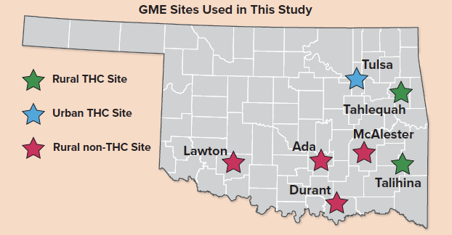
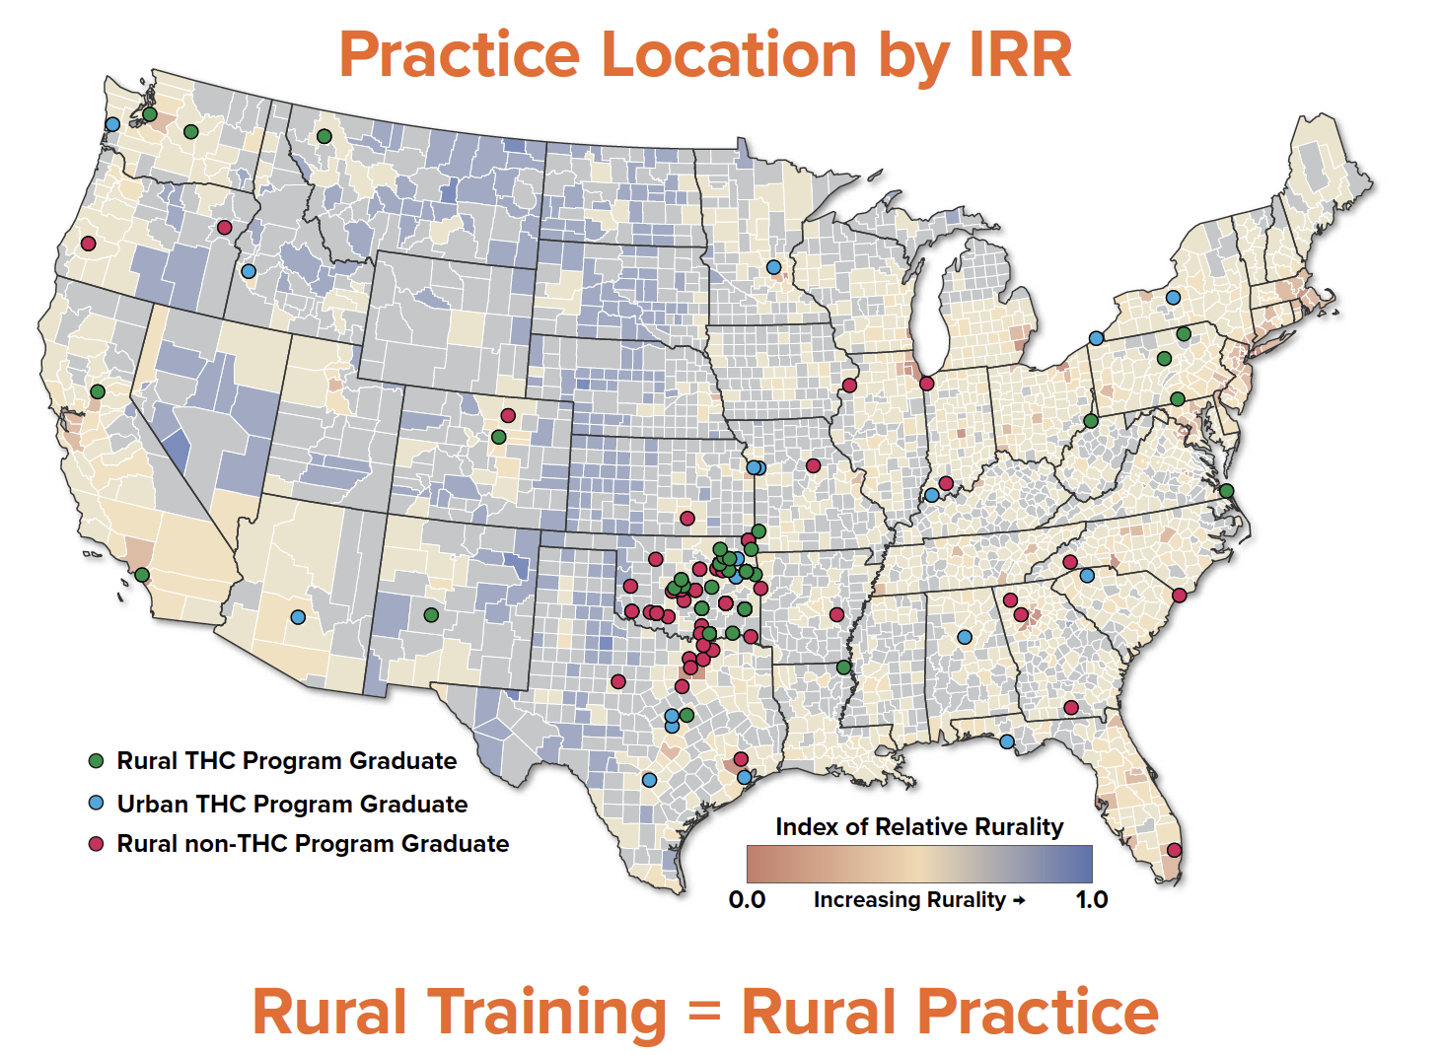
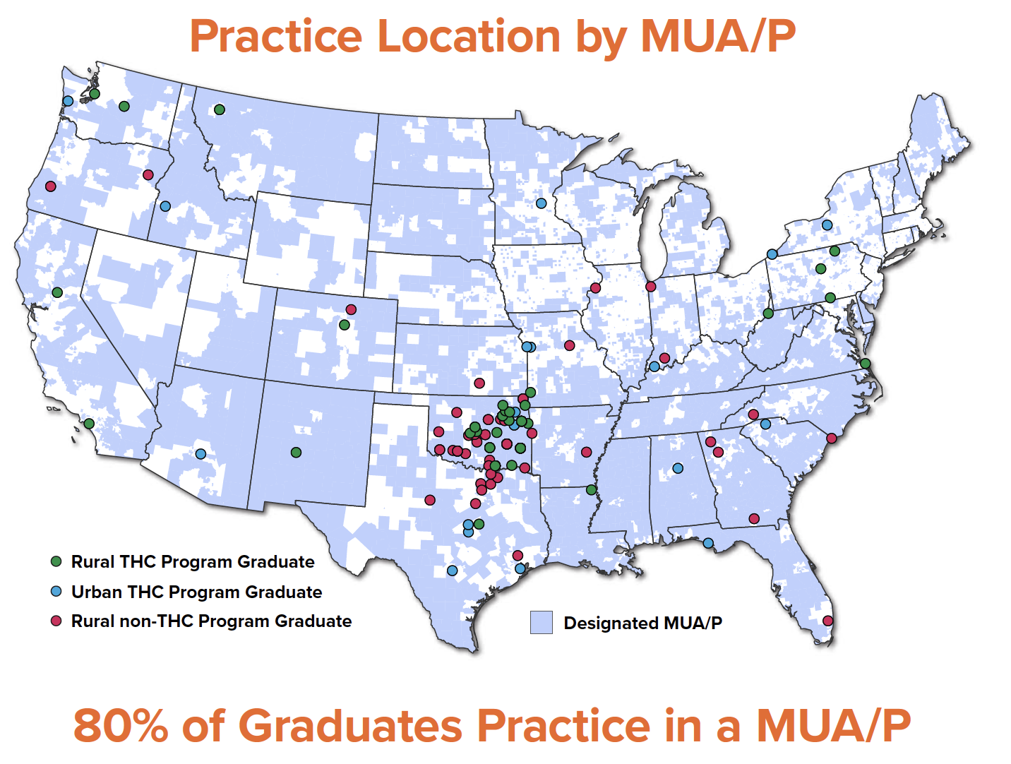
PHYSICIAN PRACTICE LOCATION CHOICES AFTER TEACHING HEALTH CENTER RESIDENCY TRAINING
Oklahoma’s Rural Residency Programs:
77% Retained in Oklahoma
(↑ 90% for OSUCOM Graduates)
Notes:
Urban THC
Rural THC
Rural non-THC
Oklahoma GME from 2012 – 2023
248 Program Graduates (111 OSUCOM graduates)
Index of Relative Rurality (IRR) – a continuous measure raging from 0 (urban) to 1 (rural)
Federal Office of Rural Health Policy (FORHP) designation, a dichotomous measure.

Slide 11
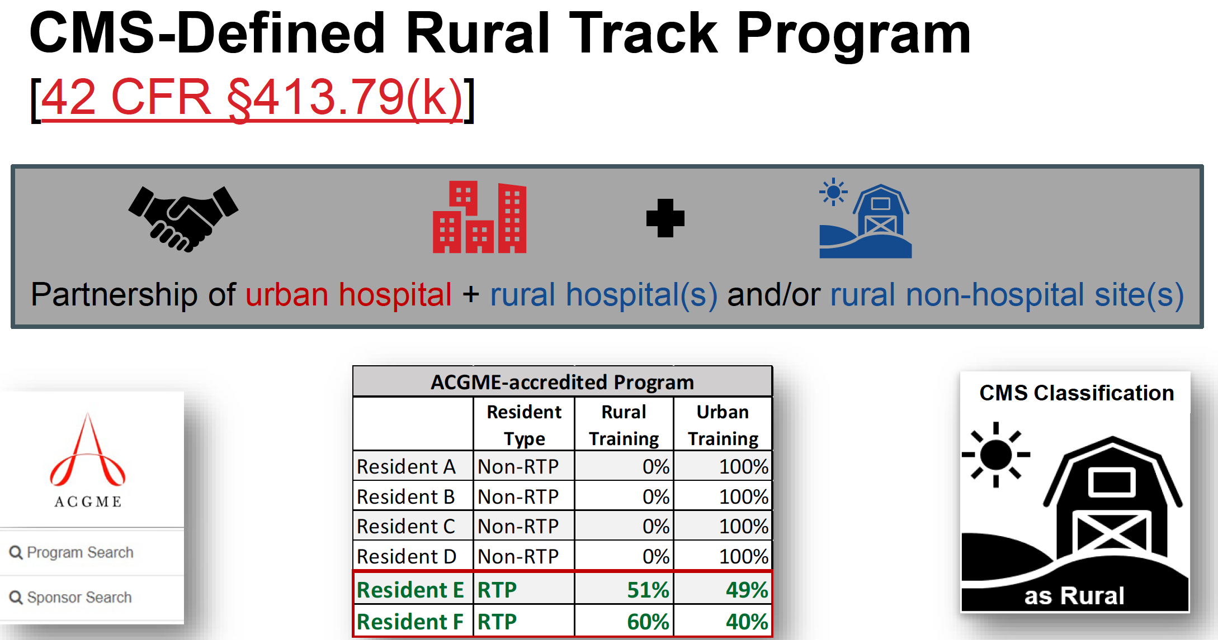
RURAL RESIDENCY PROGRAMS
Accredited Residency Program
More than 50% of training for each (or some) residents in “Rural” Location
Rural location(s) meet CMS classification of “rural”
Notes:
PGY1: 4+4+4+4+6+7+6+4 = 33 PGY1 positions
OSU Total 110 PGY 1 positions

Slide 12
ACGME RURAL TRACK PROGRAM (RTP)
An ACGME-accredited program in which all or some residents/fellows gain both urban and rural experience with more than half of the education and training for the applicable residents(s)/fellow(s) taking place in a rural area (any area outside of an urban CORE-Based Statistical Area (CBSA)).
A classification provided by the ACGME that identifies Rural Track Programs either with the approval of a permanent complement increase request and the addition of at least one new rural participating site or at the time of application for accreditation.
Notes:
PGY1: 4+4+4+4+6+7+6+4 = 33 PGY1 positions
OSU Total 110 PGY 1 positions

Slide 13
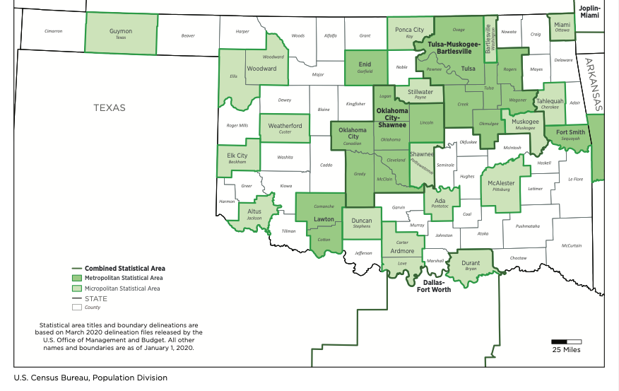
OKLAHOMA CORE-BASED STATISTICAL AREAS
Notes:
PGY1: 4+4+4+4+6+7+6+4 = 33 PGY1 positions
OSU Total 110 PGY 1 positions

Slide 14
ACGME TRAINING DURATION THRESHOLD
ACGME RTP Rotation Information Form* and rotation months per year listed in ADS must show:
  More than 50% in rural sites
  Some required GME in non-rural sites
*An ACGME RTP Rotation Information Form must be uploaded (separate from and in addition to the program’s block diagram) for designation consideration. The template can be found on the ACGME Rural Track Program designation web page.
RTP Rotation Information Form: https://www.acgme.org/link/e0b33937799549ff96edf3a27cdfeb31.aspx
Total Rural | Total Non-Rural | ACGME RTP Designation Criteria?
49% | 51% | X
50% | 50% | X
51% | 49% | ✓
75% | 25% | ✓
100% | 0% | X

Slide 15
ACGME DESIGNATION PROCESSES SUMMARY
RTP – New Program
  DIO initiates at program application
  Criteria include:
    Greater than 50% GME in rural PPS hospital and/or non-provider site (s)
    Rural area = county outside of an urban CBSA
    Some required non-rural GME
  Required Forms:
    RTP Rotation Information Form
    Specialty-specific RTP Questionnaire
RTP – Track within Existing Program
  Program director initiates using sidebar option within ADS
  Criteria include:
    All of the new program criteria; and,
    New rural site(s) (not required for current program residents/fellows)
    Faculty members at the new rural site(s) are not supported by a current rural participating site
Two Approval Steps:
ACGME MUA/P and GME review of designation information
ACGME Review Committee review* of permanent complement increase request and site changes (track within existing program) or program application (new program)
Notes:
PPS – Rural Prospective Payment System (PPS) hospitals or non-provider site
New Rural Site Criterion (RTP within existing program)
A participating site is considered new for ACGME RTP designation
Not currently used as a required participating site for the program’s residents/fellows
Faculty members are supported by a rural PPS hospital that is not a current participating site.

Slide 16
ACGME REVIEW COMMITTEE CONSIDERATIONS
Distant Sites
  Resources provided (e.g. travel costs, lodging, etc.)
  Separate match/resident awareness
  Residents from other institutions rotating at the site
  Peer-to-peer interaction
  Is site director over more than one site?
  Local support systems
Notes:
PGY1: 4+4+4+4+6+7+6+4 = 33 PGY1 positions
OSU Total 110 PGY 1 positions

Slide 17

SUMMARY

Slide 18
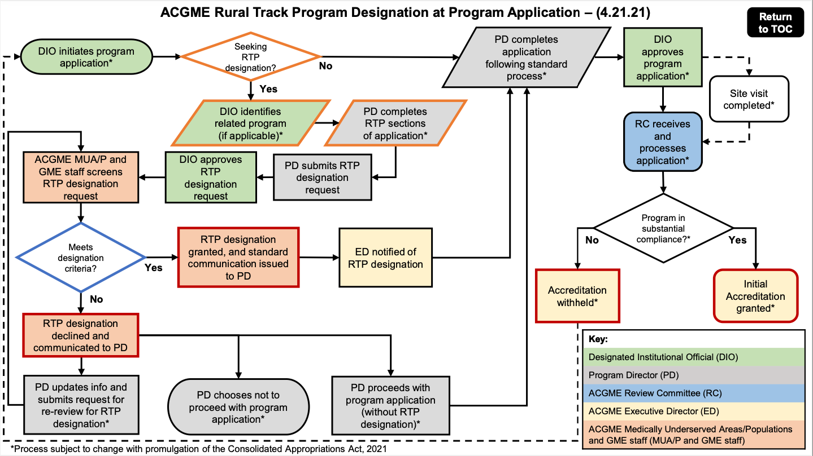

Slide 19
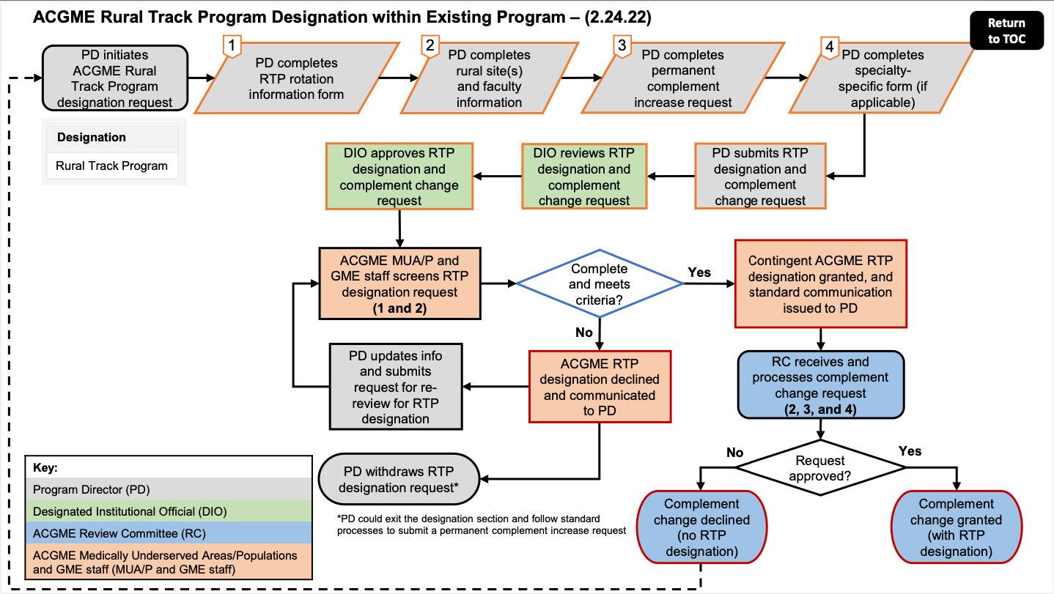

Slide 20
THANK YOU
QUESTIONS?

Slide 21
RESOURCES
ACGME Rural Track Programs
  MUA/P: https://www.acgme.org/What-We-Do/Accreditation/Medically-Underserved-Areas-and-Populations
  RTP: https://www.acgme.org/initiatives/medically-underserved-areas-and-populations/rural-tracks/
  Instruction for Requesting ACGME Rural Track Program (RTP) Designation: https://www.acgme.org/globalassets/pdfs/acgme-rural-track-program-designation-request-instructions_web.pdf
  ACGME RTP Designation Process Toolkit: https://www.acgme.org/globalassets/pdfs/acgme-rtp-designation-toolkit_web.pdf
  RTP Rotation Information Form: https://www.acgme.org/link/e0b33937799549ff96edf3a27cdfeb31.aspx
  Specialty-Specific RTP Questionnaires
    Family Medicine: https://www.acgme.org/globalassets/pdfs/acgme-rtp-questionnaire_familymedicine_web.docx
    Internal Medicine: https://www.acgme.org/globalassets/pdfs/acgme-rtp-questionnaire_internalmedicine_web.docx
    Pediatrics: https://www.acgme.org/globalassets/pfassets/programresources/acgme-rtp-questionnaire_peds_web.docx
    Physical Medicine & Rehabilitation: https://www.acgme.org/globalassets/pfassets/programresources/acgme-rtp-questionnaire_pmr_web.docx
    Psychiatry: https://www.acgme.org/globalassets/pdfs/acgme-rtp-questionnaire_psychiatry_web.docx
Centers for Medicare and Medicaid Services (CMS) Rural Track Designation
  https://www.ecfr.gov/current/title-42/chapter-IV/subchapter-B/part-413/subpart-F/section-413.79
  FY2022 IPPS Final Rule: https://www.cms.gov/medicare/acute-inpatient-pps/fy-2022-ipps-final-rule-home-page
  Acute Inpatient PPS: https://www.cms.gov/Medicare/Medicare-Fee-for-Service-Payment/AcuteInpatientPPS
Notes:
PPS – Rural Prospective Payment System (PPS) hospitals or non-provider site

