Slide 1
The Impact of Soft Skills on the Prevention of Medical Malpractice

Slide 2
Speaker bio
Christine M. Hoskin, EdD, RN, CPHRM, NPD-BC, Assistant Vice President, Risk Solutions- Education Leader, MedPro Group (Christine.Hoskin@medpro.com)
Christine has been involved in risk and quality management throughout her career, providing oversight of clinical education, epidemiology, safety, accreditation, risk management, quality improvement, and nursing.
She has experience in a range of care settings — including both inpatient and outpatient facilities, primary care, specialty care, dental care, and rehabilitation — and with various patient populations. These opportunities have enabled Christine to develop a strong understanding of the challenges and opportunities facing healthcare providers and organizations.
In her role at MedPro, Christine leads the development of new continuing education for all lines of business, including physicians, dentists, nurses, healthcare professionals, facilities, hospitals, and senior care. She collaborates with the Risk Solutions team, division leadership, continuing education committee members, and other key individuals within the organization to facilitate the delivery of high-quality educational programs.
Christine is a registered nurse and certified professional in healthcare risk management and nursing professional development. She earned her bachelor of science in nursing degree, master’s degree, and doctoral degree in education and healthcare leadership from Nebraska Methodist College.

Slide 3
Objectives
At the conclusion of this program, participants should be able to:
Define and provide examples of soft skills
Describe the physician selection and training processes and how they have evolved in recent years
Understand the role of communication as a contributing factor in medical malpractice cases
Discuss the impact of disruptive behavior on workplace culture and quality of care
Explain the effects of burnout and empathy on staff retention and culture of safety
Identify strategies for improving communication, teamwork, and behavior

Slide 4
Definition of soft skills
Soft skills are personal traits or attributes that characterize an individual’s relationships with other people.
Soft skills are considered to be a complement to hard skills (knowledge and occupational skills).
In healthcare, hard skills refer to technical skills and medical decision-making skills.
Sociologists use the term soft skills to describe a person's emotional intelligence quotient (EQ).
Examples of soft skills
Empathy | Humility
Active listening | Communication
Honesty | Integrity
Leadership | Respect
Kenton, W. (2021). What are soft skills? Investopedia. Retrieved from www.investopedia.com/terms/s/soft-skills.asp

Slide 5
Physician selection and training
Historically, medical schools have selected students who are high achievers, excel at exams, and are assertive and competitive.
Residency and fellowship training is rigorous, with long hours spent on learning the hard skills necessary to achieve technical excellence and medical decision-making.
Over the past decade, these processes have evolved.
The Medical College Admission Test® was updated in 2015 to include questions related to psychology, sociology, and reasoning.
The Accreditation Council for Graduate Medical Education has incorporated interpersonal skills, communication, and professionalism into its six core competencies and supporting specialty-specific milestones.
These criteria are now a requirement for completing residency training and obtaining medical licensure.
“A path to better outcomes and patient experience can be traced by how much attention physicians pay to cultivating these ‘soft’ yet crucial skills.”
Javelin Learning Solutions. (2017). Soft skills, hard outcomes: How physicians’ interpersonal skills have a real impact on healthcare. Retrieved from https://javelinlearningsolutions.com/avoiding-the-thorny-issues-two/

Slide 6
Communication

Slide 7
The importance of communication
Communication is a critical contributing factor in 46% of malpractice cases.
Inadequate or poor communication can occur among various members of the care team or between clinicians and patients.
Active listening, having patience, and being aware of communication barriers (e.g., health literacy issues and cultural differences) are helpful techniques for improving patient comprehension.
It takes patient about 60 seconds to tell their stories; but clinicians will interrupt or redirect patients within the first 11–23 seconds of telling their stories.
Establishing rapport with patients is essential to gaining their trust and developing good doctor-patient relationships.
MedPro Group. (2023). Claims data snapshot: A ten year overview of medical cases. Retrieved from https://www.medpro.com/documents/10502/5086245/Ten+Year+Overview_Data+Insight_2023.pdf ; Phillips, K. A., Ospina, N. S., & Montori, V. M. (2019). Physicians interrupting patients. Journal of General Internal Medicine, 34(10), 1,965. https://doi.org/10.1007/s11606-019-05247-5; Phillips, K. A., & Ospina, N. S. (2017). Physicians interrupting patients. Journal of the American Medical Association, 318(1):93–94. doi:10.1001/jama.2017.6493

Slide 8
Most common contributing factors* across all cases
Cases involving insufficient documentation and/or failure to follow administrative policies/procedures close with indemnity payments most often.
Defense is made more difficult when documentation of events/care provided is sub-par, and it is difficult to defend a failure to follow established policies/procedures.
MedPro Group + MLMIC cases opened 2012-2021 (N=22,625); More than one factor per case, therefore totals >100%; *Environmental contributing factor (overall just 1% of cases reflect an Environmental factor, which also includes building and weather-related safety/security issues). Retrieved from: https://www.medpro.com/documents/10502/5086245/Ten+Year+Overview_Data+Insight_2023.pdf

Slide 9
Provider–provider and provider–patient communication issues
Informed consent: communication breakdown
CRICO Strategies. (2015). Malpractice risks in communication failures: 2015 annual benchmarking report. Retrieved from www.rmf.harvard.edu/Malpractice-Data/Annual-Benchmark-Reports

Slide 10
Issues with communication
Poor communication with staff involved in patient care
Inadequate communication of pertinent clinical findings to radiologists and other providers
Lack of or delayed reporting of critical values
Physician/staff distractions or lack of teamwork
Care across multiple locations/providers
Health literacy issues
To help align expectations, it is critical that surgeons:
Establish trust with their patients
Take the time to clearly explain the risks and benefits
Address patients’ questions and concerns before and after the procedure
Acknowledge the challenges of health literacy, communication barriers, and cultural perspectives
Candello Solutions by CRICO. (2022, March 1). Known complications of surgery. Retrieved from https://cbscommunity.rmfstrategies.com/content_items/known-complications-of-surgery

Slide 11
Behavior

Slide 12
Definitions
Inappropriate behavior
“Any conduct that is unwarranted and is reasonably interpreted to be demeaning or offensive . . . Persistent, repeated inappropriate behavior can become a form of harassment and thereby rise to the level of disruptive behavior.”
Disruptive behavior
“Any abusive conduct, including sexual or other forms of harassment, or other forms of verbal or nonverbal conduct that harms or intimidates others to the extent that quality of care or patient safety could be compromised.”
American Medical Association. (2009). AMA Opinion 9.045 - Physicians with disruptive behavior. Retrieved from www.ama-assn.org/sites/ama-assn.org/files/corp/media-browser/public/about-ama/councils/Council%20Reports/council-on-ethics-and-judicial-affairs/i09-ceja-physicians-disruptive-behavior.pdf

Slide 13
Behaviors
Appropriate
Encourages clear communication
Inappropriate
Belittles or berates others
Disruptive
Threats of violence or retribution
Is part of team problem-solving
Offers respectful and constructive criticism
Makes inappropriate comments to staff
Refuses to communicate
Physical contact that is threatening or intimidating
Sexual harassment
American Medical Association. (2009). AMA Opinion 9.045 - Physicians with disruptive behavior. Retrieved from www.ama-assn.org/sites/ama-assn.org/files/corp/media-browser/public/about-ama/councils/Council%20Reports/council-on-ethics-and-judicial-affairs/i09-ceja-physicians-disruptive-behavior.pdf

Slide 14
Inappropriate and disruptive behaviors
Passive
Passive aggressive
Excessive sarcasm
Aggressive
Incomplete charting
Avoidance
Failure to answer calls
Frequent absences
Chronic tardiness
Getting behind
Refusing to help
Implied threats
Inappropriate jokes
Refusal to complete tasks
Condescending language/tone
Angry outbursts
Raised voice
Demeaning
Intimidation
Public criticism
Physical aggression
Physical violence
Disrespect is the most common disruptive behavior.
American Medical Association. (2009). AMA Opinion 9.045 - Physicians with disruptive behavior. Retrieved from www.ama-assn.org/sites/ama-assn.org/files/corp/media-browser/public/about-ama/councils/Council%20Reports/council-on-ethics-and-judicial-affairs/i09-ceja-physicians-disruptive-behavior.pdf

Slide 15
Prevalence and magnitude
American College of Physician Executives and QuantiaMD® survey results (>840 physician and physician leader participants)
70% indicated physician disruptive behavior occurs monthly in their organizations
59% encountered degrading comments or insults
55% encountered failure to follow established protocols
54% encountered refusal to cooperate
26% engaged in disruptive behavior at least one time; two most common contributors were workload and learned behaviors
50% have seen patients change physicians or leave the practice
90% believe disruptive behavior affects patient care (always, sometimes)
Identified needs
Confronting disruptive physicians
Enacting strategies for disciplining disruptive physicians
Improving culture and communication
MacDonald, O. (2011, May 15). Disruptive physician behavior. QuantiaMD. Retrieved from https://www.kff.org/wp-content/uploads/sites/2/2013/03/quantiamd_whitepaper_acpe_15may2011.pdf

Slide 16
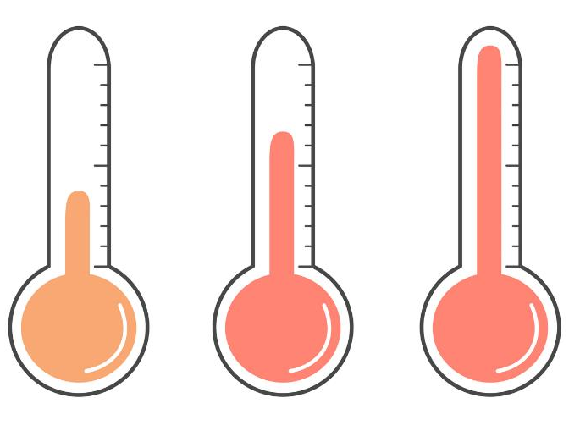
Prevalence and magnitude (continued)
The best estimate is 3%–5% of physicians present with disruptive behavior.
In a physician executive survey:
70% stated these disruptive behaviors are from the same physicians.
These behaviors are most common between a nurse or allied healthcare staff member and the physician.
80% stated disruptive behavior is underreported due to fear of retaliation.
The perception of physicians versus nurses.
Inconsistency in resolving behavior.
Reynolds, N. (2012). Disruptive physician behavior: Use and misuse of the label. Journal of Medical Regulation, 98(1).

Slide 17
Potential indicators of disruptive behavior
Frequent job changes
Employed in jobs inappropriate for their qualifications
Reluctant to provide references or permission to contact
History of voluntary or involuntary relinquishment of licensure or medical staff membership
History of limitation, reduction, or loss of clinical privileges
Excessive claims resulting in final judgments against them
History of investigations or disciplinary actions
Poor performance evaluations
Cascella, L. M. (2021). Red flags for disruptive behavior in healthcare professionals. MedPro Group. Retrieved from www.medpro.com/disruptive-behavior-red-flags-healthcare-professionals

Slide 18
Contributing factors to disruptive behavior
Psychiatric conditions
Depression
Bipolar disorders
Personality disorders
Narcissism
Paranoia
Passive-aggressive personality disorder
Borderline/mixed personality disorder
Occasional incident
Substance abuse
Reynolds, N. (2012). Disruptive physician behavior: Use and misuse of the label. Journal of Medical Regulation, 98(1).

Slide 19
Triggers contributing to disruptive behavior
Intrapersonal (affects job performance)
Lack of competency or fatigue
Lack of leadership
Questioning providers about patient care
Staff diversity
Interpersonal (affects relationships)
Organizational (inhibits interactions at work)
Systems
Processes
Culture
Bae, S.H., Dang, D., Karlowicz, K.A., & Kim, M.T. (2020). Triggers contributing to health care clinicians’ disruptive behaviors. Journal of Patient Safety, 16(3), 1. https://doi.org/10.1097/PTS.0000000000000288

Slide 20
Impact of disruptive behavior
According to The Joint Commission, disruptive behavior:
Fosters medical errors
Decreases patient satisfaction
Increases preventable adverse events
Increases the cost of care
Drives away clinicians and others on the healthcare team
Rehder, K. J., et al. (2020). Associations between a new disruptive behaviors scale and teamwork, patient safety, work-life balance, burnout, and depression. The Joint Commission Journal on Quality and Patient Safety, 46(1), 18-26. https://doi.org/10.1016/j.jcjq.2019.09.004

Slide 21
Medical errors
More mistakes in diagnosis
42%
Performance reduced when exposed to disruptive behavior
11% - 14%
Higher risk of surgical and medical complications
If more than four behavioral reports, had higher complication risk
31.7%
Hicks, S., & Stavropoulou, C. (2020). The effect of health care professional disruptive behavior on patient care. Journal of Patient Safety. Epub Jan 5; Schmidt, H.G., et al. (2016). Do patients’ disruptive behaviors influence the accuracy of a doctor’s diagnosis? A randomized experiment. BMJ Quality & Safety, 26(1), 19-23. https://doi.org/10.1136/bmjqs-2015-004109

Slide 22
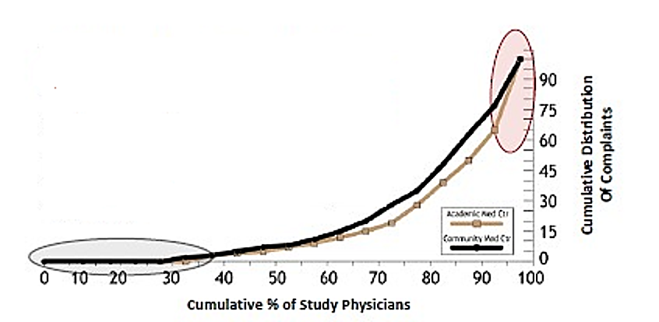
Decrease in patient satisfaction
Predicted risk category | # (%) of physicians | Relative expense | % of total expense | Score (range)
5 (high) | 51 (8) | 73 | 50% | > 50
4 | 52 (8) | 42 | 29% | 41-50
3 | 76 (12) | 4 | 4% | 21-40
2 | 147 (23) | 6 | 13% | 1-20
1 (low) | 318 (49) | 1 | 4% | 0
Total | 644 (100) |  | 100%
Hickson, G.B., et al. (2007). Patient complaints and malpractice risk in a regional healthcare center. Southern Medical Journal, 100(8), 791-796. https://doi.org/10.1097/SMJ.0b013e318063bd75; Moore, I., Pichert, J., Hickson, G., & Federspiel, C. (2006). Rethinking peer review: Detecting and addressing medical malpractice claims risk. Vanderbilt Law Review, 59(4), 1,175−1,206; Hickson, G.B., et al. (2002) . Patient complaints and malpractice risk. JAMA, 287(22), 2,951-2,957.

Slide 23
Increase in malpractice claims
About 8% of physicians are sued annually.
Odds of being sued at least once in one’s career based on behavior:
Does not consider suggestions — 5.99.
Snaps at others when frustrated — 5.92.
Does not pay attention — 4.97.
Does not inform others of treatment plan — 4.86.
Talks down to others — 4.28.
Lagoo, J., et al. (2019). Multisource evaluation of surgeon behavior is associated with malpractice claims. Annals of Surgery, 270(1), 84-90. https://doi.org/10.1097/SLA.0000000000002742

Slide 24
Discouraging disruptive behavior
Vanderbilt Center for Patient and Professional Advocacy (www.vumc.org/patient-professional-advocacy/vumc-cppa-home)

Slide 25
Empowering to report
Peer messengers share behavior reports directly with recipients:
Vanderbilt: Coworker observation reporting system (CORS) to report unsafe conduct and behaviors known to undermine teams
3% of medical staff (physicians and advanced practice professionals [APPs]) had pattern of CORS reports
71% of recipients with CORS patterns following peer messenger feedback were not named in any subsequent CORS reports (1-year follow-up period)
Peer messenger feedback is helpful in encouraging behavior self-regulation.
Webb, L. E., et al.(2016). Using coworker observations to promote accountability for disrespectful and unsafe behaviors by physicians and advanced practice professionals. The Joint Commission Journal on Quality and Patient Safety, 42(4):149-164. https://doi.org/10.1016/s1553-7250(16)42019-2

Slide 26
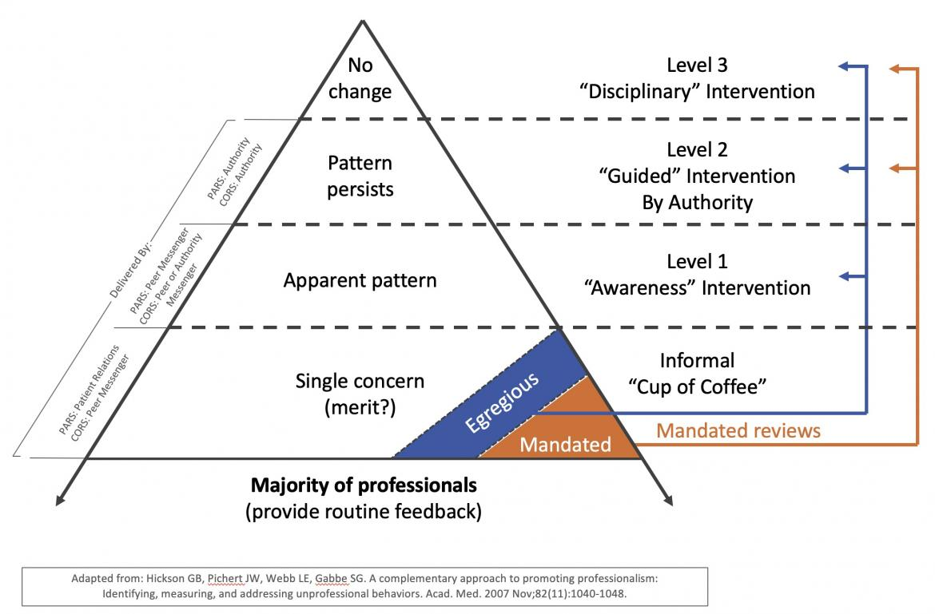
Promoting professionalism pyramid
Hickson, G. B., Pichert, J. W., Webb, L. E., & Gabbe, S. G. (2007). A complementary approach to promoting professionalism: Identifying, measuring, and addressing unprofessional behaviors. Academic Medicine, 82(11), 1,040-1,048. https://doi.org/10.1097/acm.0b013e31815761ee; Pichert, J. W., et al. (2017). Planning and implementing the Patient Advocacy Reporting System in the Sanford Health System. Agency for Healthcare Research and Quality. Retrieved from https://www.ahrq.gov/patient-safety/resources/liability/pichert.html

Slide 27
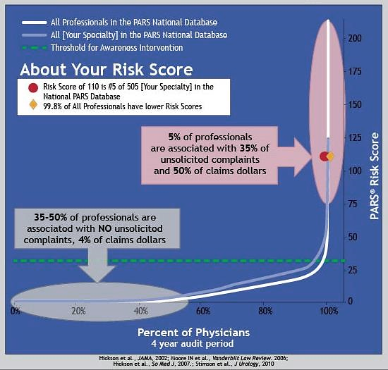
Patient Advocacy Reporting System® (PARS®) national data sample
Hickson, G.B., et al. (2007). Patient complaints and malpractice risk in a regional healthcare center. Southern Medical Journal, 100(8), 791-796. https://doi.org/10.1097/SMJ.0b013e318063bd75; Moore, I., Pichert, J., Hickson, G., & Federspiel, C. (2006). Rethinking peer review: Detecting and addressing medical malpractice claims risk. Vanderbilt Law Review, 59(4), 1,175−1,206. Retrieved from https://scholarship.law.vanderbilt.edu/vlr/vol59/iss4/6/; Hickson, G.B., et al. (2002). Patient complaints and malpractice risk. JAMA, 287(22), 2,951-2,957; Vanderbilt Center for Patient and Professional Advocacy. The Patient Advocacy Reporting System® (PARS®) Program. Retrieved from www.vumc.org/patient-professional-advocacy/pars-program

Slide 28
Burnout & empathy

Slide 29
Burnout
Burnout affects interpersonal skills, job performance, career satisfaction, psychological health, and communication.
Burnout, workload, and COVID-19-related stresses were associated with intent to reduce hours or leave.
Approximately 1 in 3 physicians, APPs, and nurses surveyed intend to reduce work hours.
1 in 5 physicians and 2 in 5 nurses intend to leave their practice altogether.
Burnout also contributes to medical errors and poor communication, both of which increase the risk of malpractice.
Reducing burnout and improving a sense of feeling valued may allow healthcare organizations to better maintain their workforces after the pandemic.
Soft skills training has been shown to help prevent burnout syndrome.
Healthcare organizations also need early recognition programs aimed at raising awareness and coping with burnout symptoms through stress management and resilience enhancement trainings.
Sinsky, C. A., Brown, R. L., Stillman, M. J., & Linzer, M. (2021). COVID-related stress and work intentions in a sample of US health care workers. Mayo Clinic Proceedings Innovations, Quality & Outcomes, 5(6), 1,165–1,173. https://doi.org/10.1016/j.mayocpiqo.2021.08.007; Leal-Costa, C., Díaz-Agea, J. L., Tirado-González, S., Rodríguez-Marín, J., & van-der Hofstadt, C. J. (2015). Communication skills: A preventive factor in Burnout syndrome in health professionals. Anales del sistema sanitario de Navarra, 38(2), 213–223. https://doi.org/10.23938/ASSN.0070

Slide 30
Burnout (continued)
Sinsky, C. A., Brown, R. L., Stillman, M. J., & Linzer, M. (2021). COVID-related stress and work intentions in a sample of US health care workers. Mayo Clinic Proceedings Innovations, Quality & Outcomes, 5(6), 1,165–1,173. https://doi.org/10.1016/j.mayocpiqo.2021.08.007

Slide 31
COVID effect
Sinsky, C. A., Brown, R. L., Stillman, M. J., & Linzer, M. (2021). COVID-related stress and work intentions in a sample of US health care workers. Mayo Clinic Proceedings Innovations, Quality & Outcomes, 5(6), 1,165–1,173. https://doi.org/10.1016/j.mayocpiqo.2021.08.007

Slide 32
Solutions

Slide 33
Empathy
Empathy has been shown to decrease during medical education and training.
Empathy training has been shown to improve active listening, enhance communication, and decrease burnout.
Empathy training has been found to not only improve patient outcomes but also to decrease malpractice risk and improve physician and patient satisfaction.
“I had to re-learn to like patients after my residency program.”
“After empathy training, I feel that I like my work again, and instead of resenting all the demands, I'm remembering why I chose this profession in the first place.”
Medical Professional Liability Association. (2021). Empathy training tied to improved patient satisfaction, lower MPL risk. Inside Medical Liability. Retrieved from www.mplassociation.org/Web/Publications/ Inside_Medical_Liability/Issues/2021/Q3/articles/Empathy_Training_Patient_Satisfaction.aspx; Reiss, H. (2021, September 25). More empathy means better care, less medical liability. MedPage Today. Retrieved from www.medpagetoday.com/opinion/kevinmd/94699

Slide 34
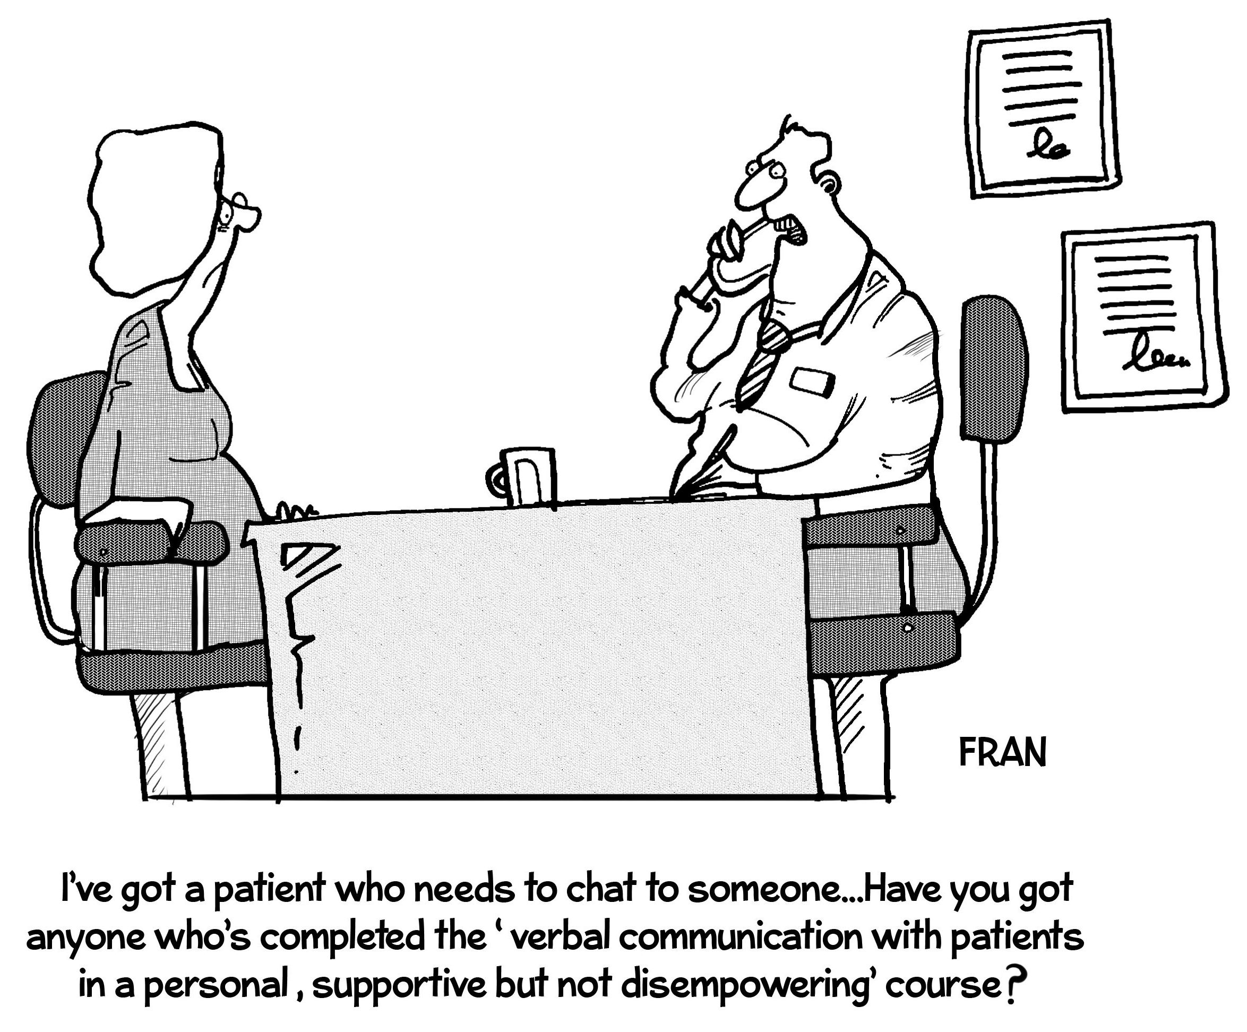
Communication strategies with patients
Knock before entering exam rooms.
Greet patients and introduce yourself (if needed).
Sit when you can and maintain eye contact when talking to patients.
Be aware of nonverbal communication and cues.
Ask patients about their goals for the visit.
Don’t interrupt while patients are talking.
Ask open-ended questions.

Slide 35
Communication strategies with patients (continued)
Use layman’s language and visual aids to ensure comprehension.
Provide plain-language follow-up instructions and educational materials.
Use the teach-back technique to ensure comprehension.
Encourage patients to voice questions and concerns.
Consider patients’ personal and cultural preferences and values.
Use satisfaction surveys to gauge patient perceptions.

Slide 36
Risk strategies for surgical teams
Communication
Clearly describe possible known complications of the surgery to the patient/family, including symptoms to watch out for during recovery.
Discuss and document any proposed changes with the patient/family before a planned surgery, and explain unexpected outcomes or findings afterward.
Verify patient/family understanding of written postoperative instructions, pain control, symptoms to monitor, bandage changes, use of supportive devices like crutches, and 24/7 contact information.
Arrange close postoperative follow-up, and investigate atypical symptoms.
“The importance of clear, two-way communication about possible risks and complications, before and after surgery, cannot be overstated.”
Informed consent
Explain and document the relevant risks (i.e., known complications), benefits, probability of success, and risk of not undergoing the procedure.
Amend boilerplate documentation to include patient-specific and procedure-specific information in layman’s terms.
Candello Solutions by CRICO. (2022, March 1). Known complications of surgery. Retrieved from https://cbscommunity.rmfstrategies.com/content_items/known-complications-of-surgery

Slide 37
Risk strategies for surgical teams
Surgery management
Establish guidelines for providers to understand their patients’ medical histories as completely as possible, including reviewing the medical record and consulting about rare conditions.
Ensure that surgical teams take a safety pause to confirm the patient, procedure, and anatomical site and laterality before the procedure begins. Also confirm that the planned procedure is the one to which the patient consented.
Use a standardized preoperative checklist to identify patients with potential risk factors for surgical complications (e.g., the Strong for Surgery preoperative checklists).
Expand clinical training opportunities (e.g., simulation to practice surgical techniques and coaching on technical, safety, and teamwork skills).
Candello Solutions by CRICO. (2022, March 1). Known complications of surgery. Retrieved from https://cbscommunity.rmfstrategies.com/content_items/known-complications-of-surgery

Slide 38
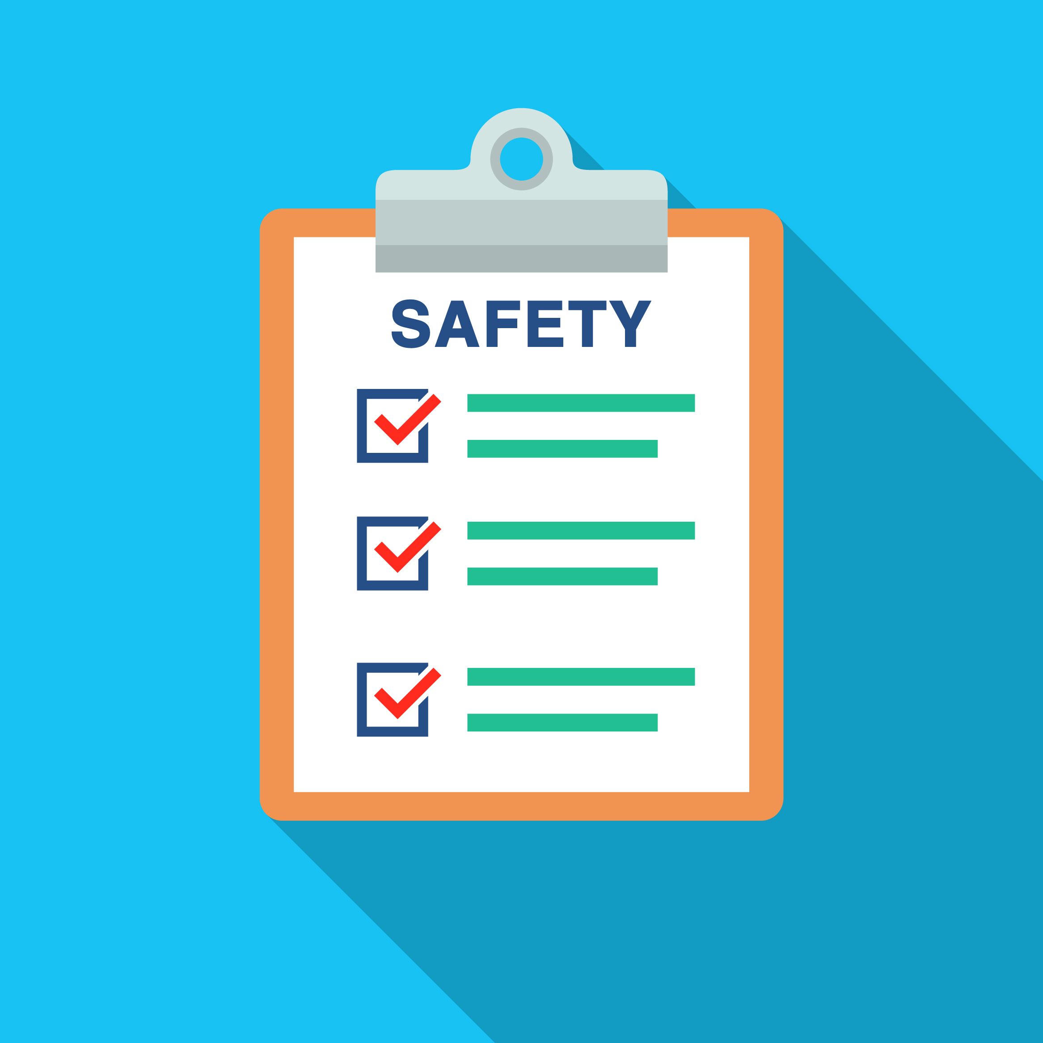
Risk strategies for all healthcare teams
Communication
Effective Communication Between Doctors and Advanced Practice Providers
Communication in the Diagnostic Process
Culture of Safety resource list (includes TeamSTEPPS)
Hospitalist Communication
Addressing Disruptive Behaviors Among Healthcare Professionals
Collaborating with Healthcare Staff to Improve Patient Safety, Adherence, and Satisfaction
Culture of safety
Maintain an environment in which all members of the team feel empowered to speak up when they see something that appears unsafe or have concerns
Candello Solutions by CRICO. (2022, March 1). Known complications of surgery. Retrieved from https://cbscommunity.rmfstrategies.com/content_items/known-complications-of-surgery

Slide 39
Organizational risk strategies
Policies and procedures (code of conduct)
Medical executive committee and leadership support
Early intervention and monitoring
Staff education and team training
Handoff procedures, e.g., situation, background, assessment, recommendation (SBAR)
Culture of safety surveys

Slide 40
Risk strategies for physicians and other providers
Staff and physician education: policy and procedures
Compliance: policy and procedures
Compliance: partnership agreement (financial incentives)
Physician performance: monthly review meetings
Physician: cancel appointments until charts complete
Chain of command/referral

Slide 41
Summary
In healthcare, soft skills allow individuals to communicate effectively, build relationships, solve problems, and maintain professionalism.
Physician education and training programs are increasingly recognizing the value of soft skills and incorporating them into curricula and requirements.
Communication, a critical soft skill, is a contributing factor in 46% of malpractice cases. Communication failures can occur among members of the healthcare team or between clinicians and patients.
Behavior is another factor that contributes to malpractice risk. Disruptive behaviors can lead to medical errors, decrease patient satisfaction, increase costs, and affect the overall quality of care provided.
Burnout and lack of empathy are other issues that plague healthcare and can result in toxic work environments, staff absenteeism and turnover, and increased professional liability exposure.
Strategies to enhance soft skills and address pervasive problems in healthcare can benefit physicians by cultivating better doctor–patient relationships, alleviating burnout, improving teamwork, reinforcing safety culture, and reducing medical errors.

Slide 42
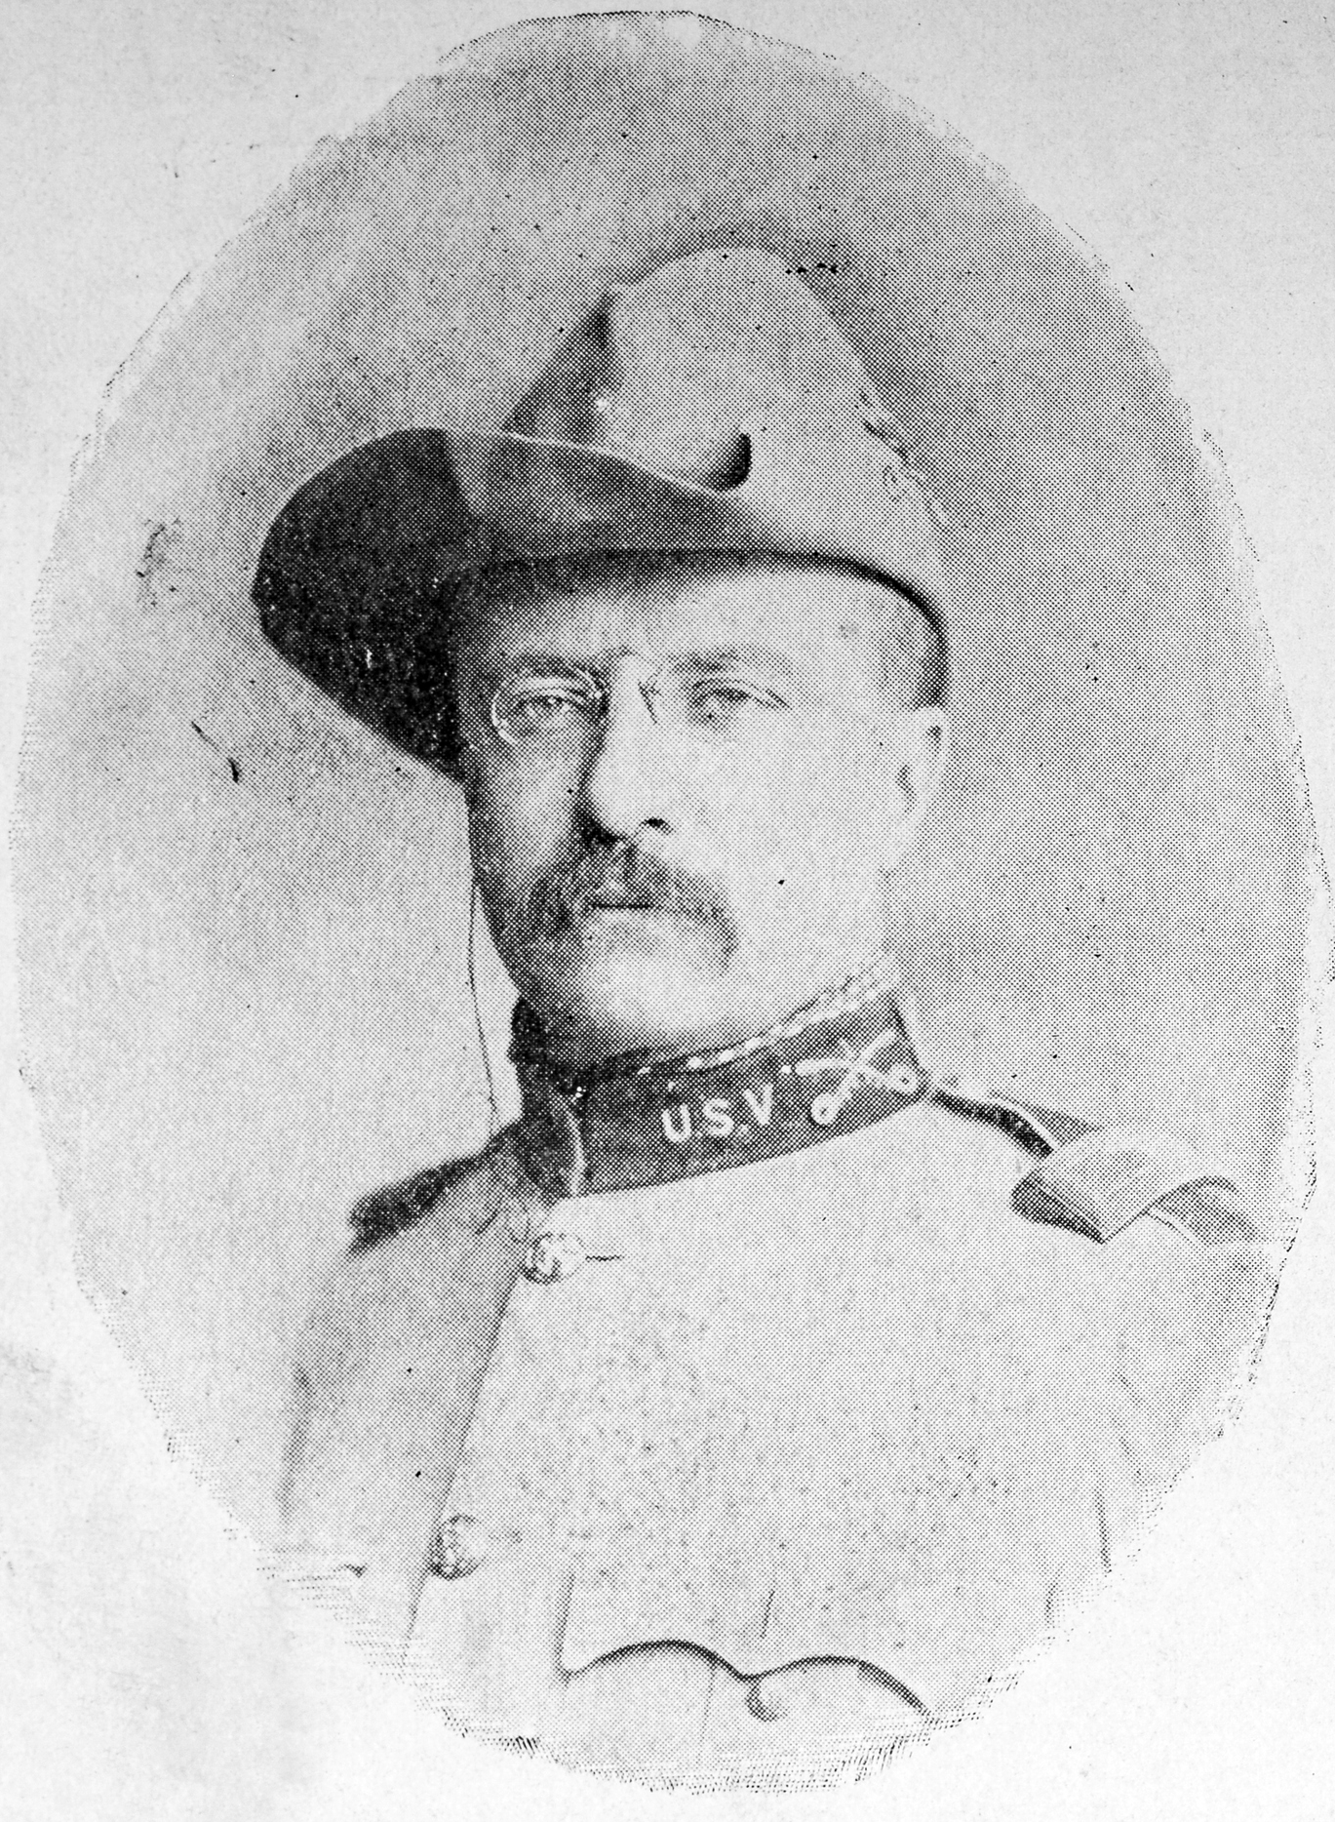
Wisdom
“Nobody cares how much you know, until they know how much you care.”
⎯ Theodore Roosevelt

