Slide 1
Transitions of Care
Clinical Learning Environment Review

Slide 3
The I-PASS Mnemonic

Slide 4
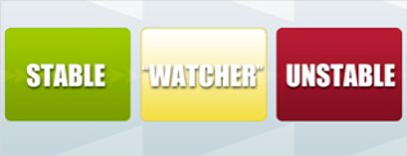
I = Illness Severity

Slide 5
A = Action List

Slide 6
P = Patient Summary

Slide 7
S = Situational Awareness and Contingency Planning

Slide 8
S = Situation Awareness and Contingency Planning

Slide 9
S = Synthesis by Receiver

