Slide 1

How To Log Work Hours

Slide 2
Background
Work Hour Logging is a requirement of ACGME as well as the Institution and must be completed EACH month.
  Not logging your work hours in a timely manner reflects poorly upon your professionalism, which is a core competency of ACGME.
Work Hour Logs are how the hospital reports resident working hours to Medicare/CMS, which is how the hospital, and in turn you, are paid.
Work Hours must be logged no later than the 3rd day of each month, for the month prior.
Ask your Program Coordinator for program specific work hour logging requirements, for example, your program may require that you log hours on a weekly basis.

Slide 3
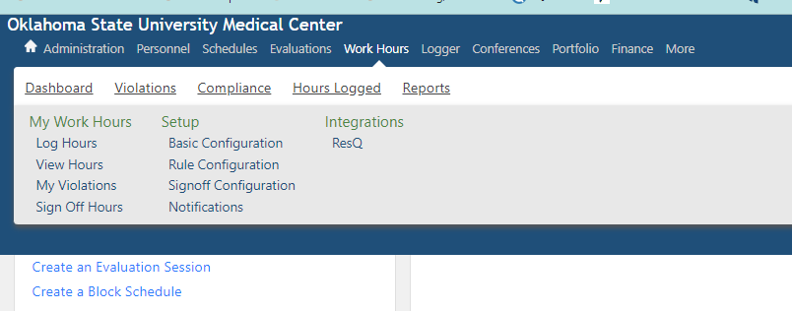
How To Log:
Log into New Innovations; on the toolbar, choose WORK HOURS; under My Work Hours, choose LOG HOURS.

Slide 4
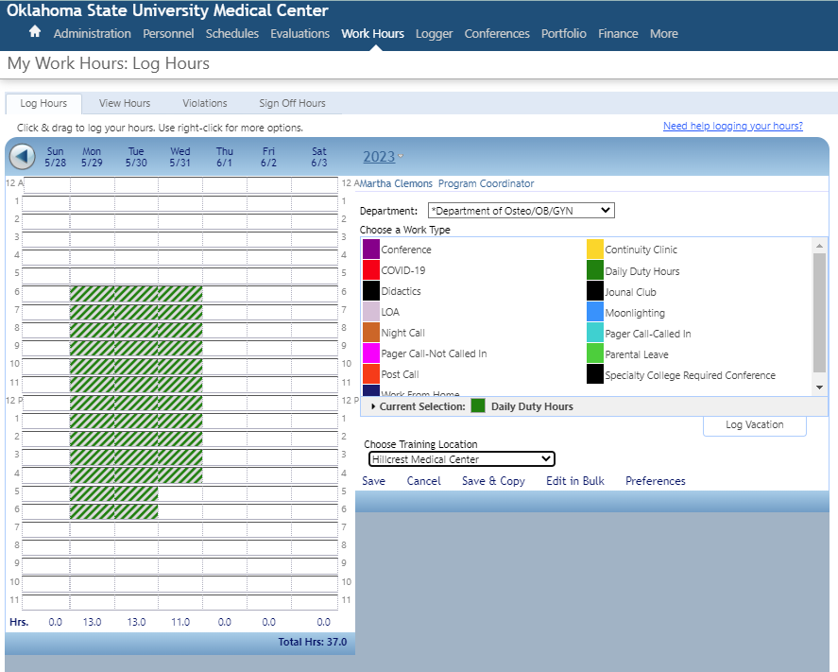
First, CHOOSE TRAINING LOCATION.
  If you do not choose training location first, the logs will not save.
  If you do not see your training location listed, let your coordinator know, and they will have it added.

Slide 5
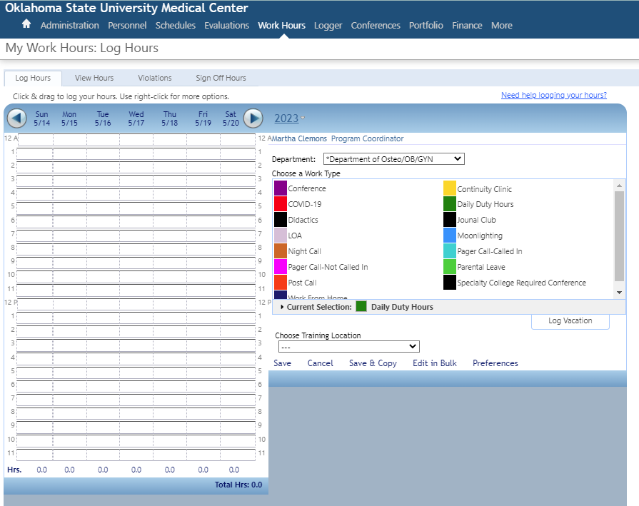
Next, choose WORK TYPE

Slide 6
When deciding which WORK TYPE to choose, consider the following:
Daily Work Hours – This is the work type that will be used most frequently
Continuity Clinic – To be used when working at a resident/fellow continuity clinic
Educational Event – To be used when attending conferences, journal club, didactics, grand rounds, scholarly activity/QI projects, etc., including Boards and ITEs.
Moonlighting – To be used when Moonlighting, either internally or externally
Home Call, NOT called in – these hours do NOT count toward the 80-hour work week
Home Call, called in – these hours DO count toward the 80-hour work week
Time Off – To be used anytime a resident/fellow has time off (vacation, illness, bereavement, Parental Leave, interviews, etc.)
Break – to be used for short breaks throughout the day, to be used to fill in gaps between working hours, such as one or two hours between shifts such as clinic or didactics, and scheduled work hours.) Using this work type will prevent short break violations when moving between assignments.

Slide 7
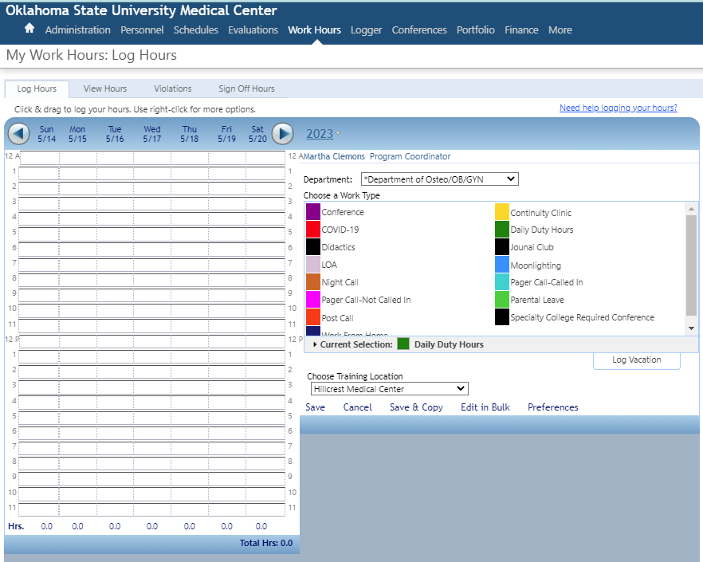
Then, click and hold to drag your mouse over the hours you worked with that work type, then click SAVE.
DO NOT use Save & Copy!

Slide 8
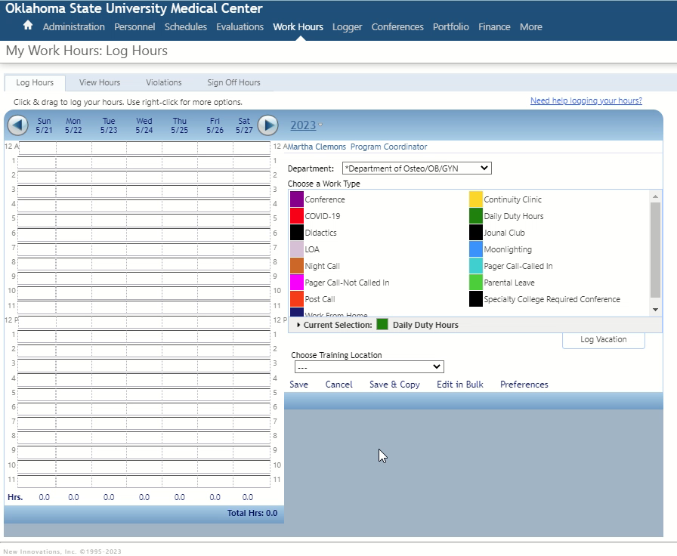
Press Play to see it in action!

Slide 9
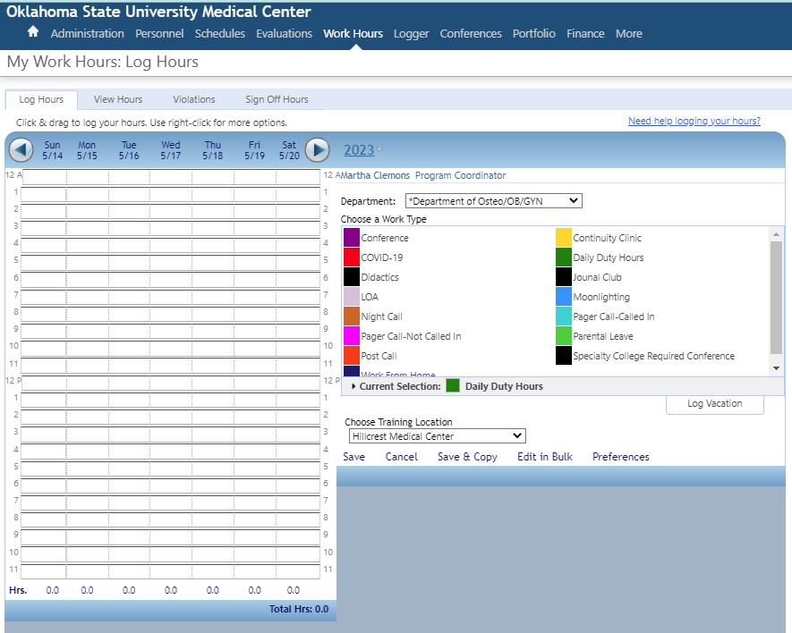
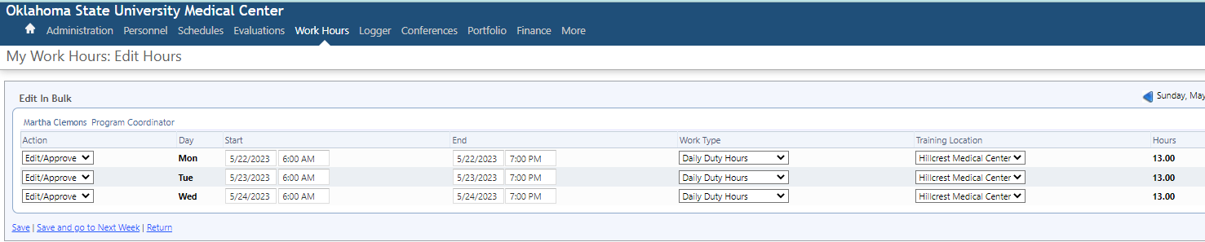
If needed, you can change your work logs easily using Edit in Bulk (you will automatically be directed to a new screen).
Don’t forget to save your edits!

Slide 10
You MUST log Didactics/Conference and Continuity Clinic in your work hour logging.
Only use Save & Copy if your weeks are absolutely identical.
GME should be able to account for every hour and location worked based on work hour logs.
You MUST log Moonlighting! Moonlighting is included in your 80-hour work-week limit. Moonlighting must have prior approval by the Program Director.
Check with your Program Coordinator to see if there are any additional program-specific types of work hours to be logged.

Slide 11
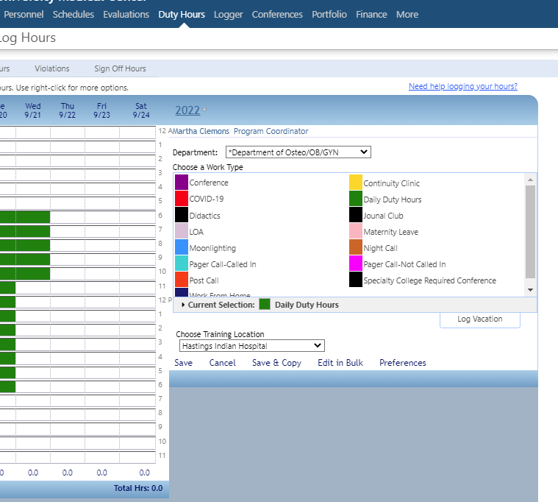
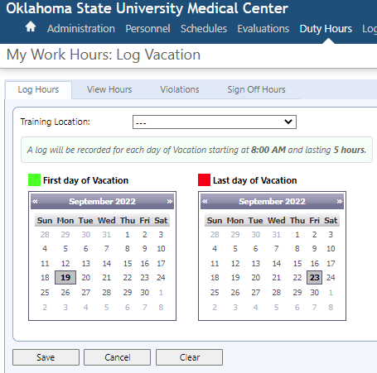
To log vacation, click LOG VACATION; a new window will open. Choose the FIRST and LAST day of your vacation, then SAVE. No training location is required when logging vacation.

Slide 12
Thank you!

