Slide 1

How To Log Work Hours

Slide 2
Background
Work Hour Logging is a requirement of ACGME as well as the Institution and must be completed EACH month.
  Not logging your work hours in a timely manner reflects poorly upon your professionalism, which is a core competency of ACGME.
Work Hour Logs are how the hospital reports resident working hours to Medicare/CMS, which is how the hospital, and in turn you, are paid.
Work Hours must be logged no later than the 5th of each month, for the month prior.
Ask your Program Coordinator for program specific work hour logging requirements, for example, your program may require that you log hours on a weekly basis.

Slide 3
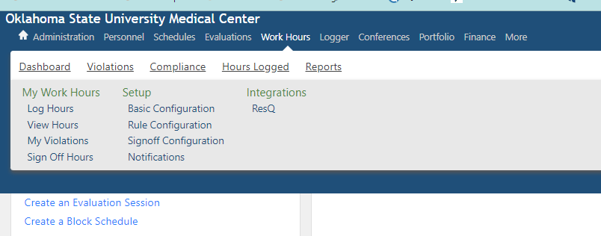
How To Log:
Log into New Innovations; on the toolbar, choose WORK HOURS; under My Work Hours, choose LOG HOURS.

Slide 4
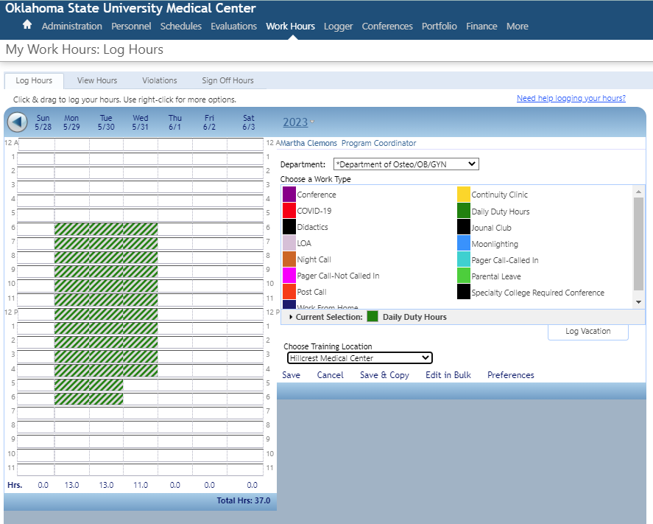
First, CHOOSE TRAINING LOCATION.
  If you do not choose training location first, it will not save.

Slide 5
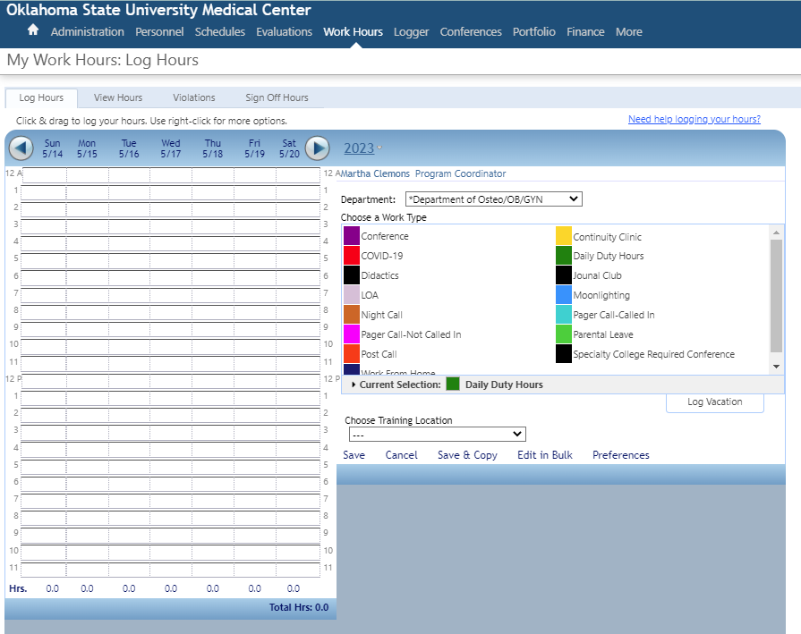
Next, choose WORK TYPE

Slide 6
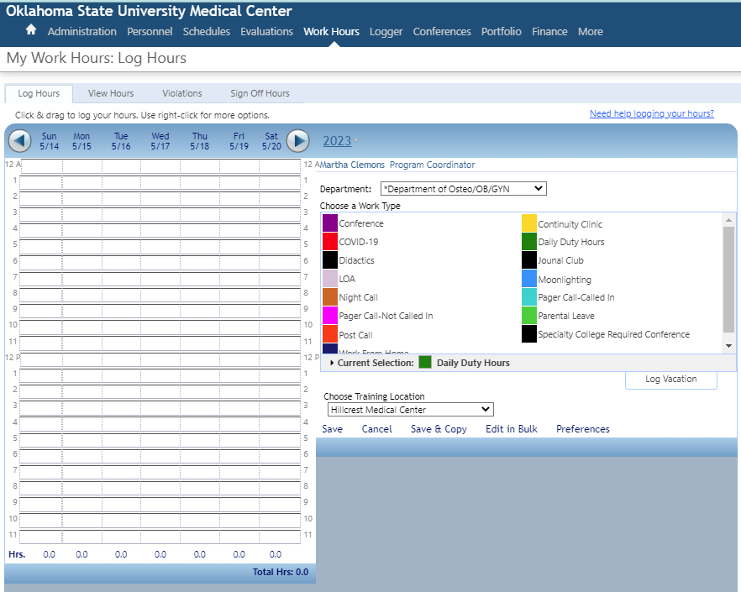
Then, click and hold to drag your mouse over the hours you worked with that work type, then click SAVE.
DO NOT use Save & Copy!

Slide 7
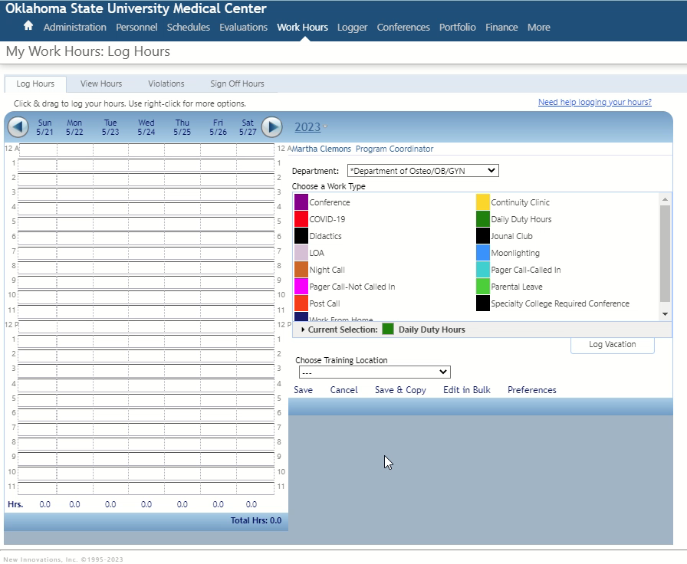
Press Play to see it in action!

Slide 8
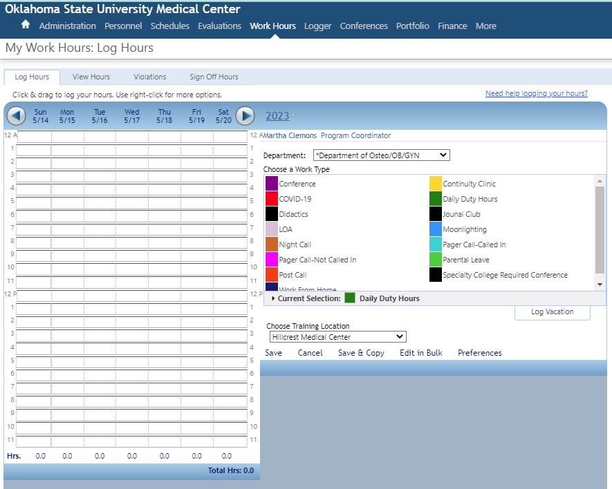
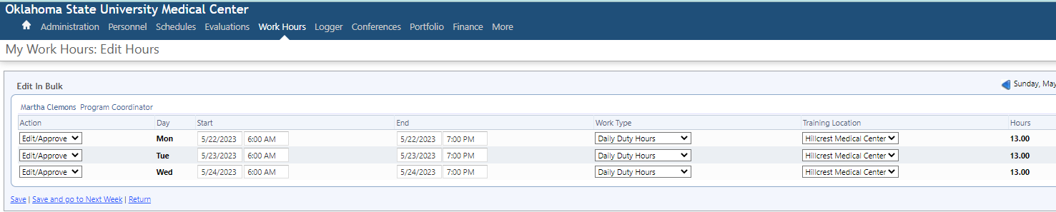
If needed, you can change your work logs easily using Edit in Bulk (you will automatically be directed to a new screen).
Don’t forget to save your edits!

Slide 9
You MUST include Didactics/Conference and Continuity Clinic in your work hour logging.
We should be able to account for every hour and location you work based on your work hour logs.
You MUST log Moonlighting! Moonlighting is included in your 80-hour work-week limit.
Check with your Program Coordinator to see if there are any additional program-specific types of work hours to be logged.

Slide 10
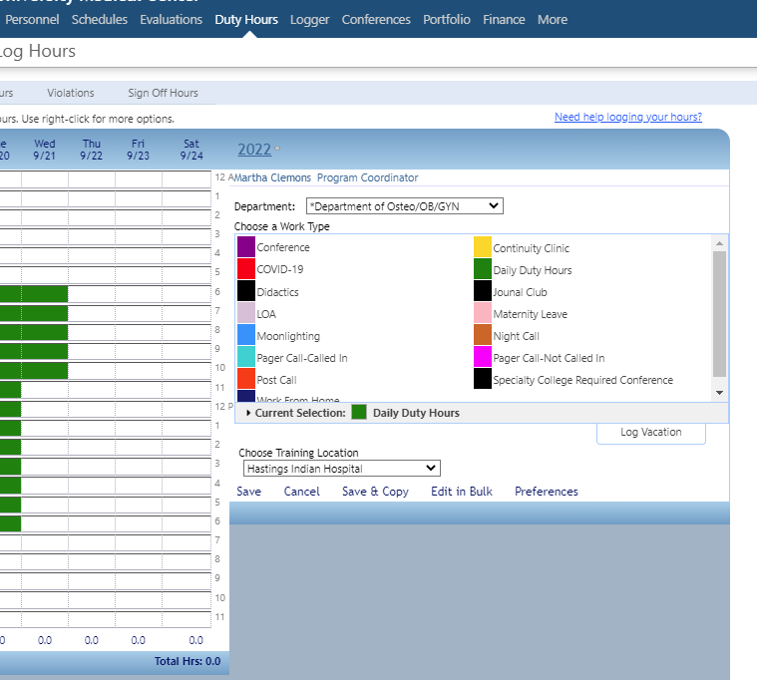
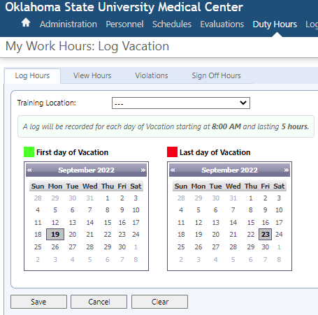
To log vacation, click LOG VACATION; a new window will open. Choose the FIRST and LAST day of your vacation, then SAVE. No training location is required when logging vacation.

Slide 11
Thank you!

