Slide 1

Advocacy Update
Sean Neal
Vice President, Advocacy & Political Affairs

Slide 2
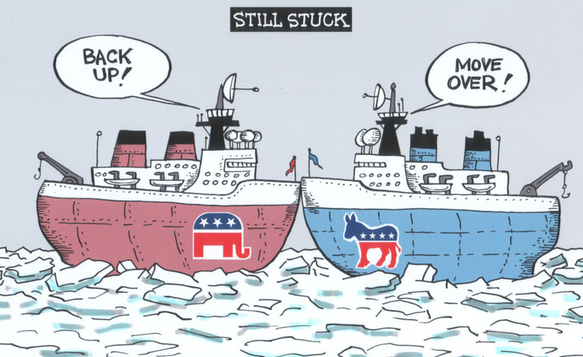
Collaborating with the 119th Congress

Slide 3




Primary Levels of Government
Federal
Federal legislators
Regulatory bodies
State
State legislators
Regulatory bodies
Local
City councils
School boards

Slide 4
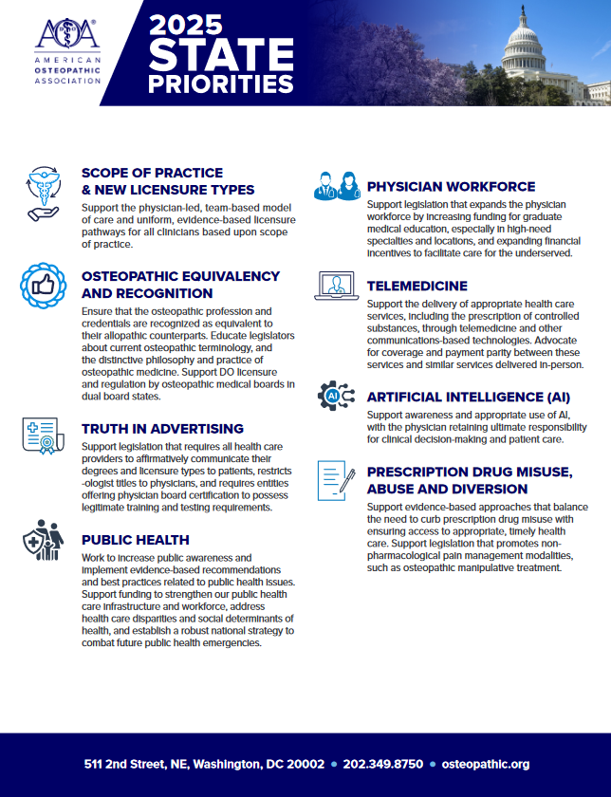
State Priorities
Scope of practice & new licensure types
Osteopathic equivalency and recognition
Truth in advertising
Public health
Physician workforce
Telemedicine
AI
Prescription drug misuse, abuse and diversion

Slide 5
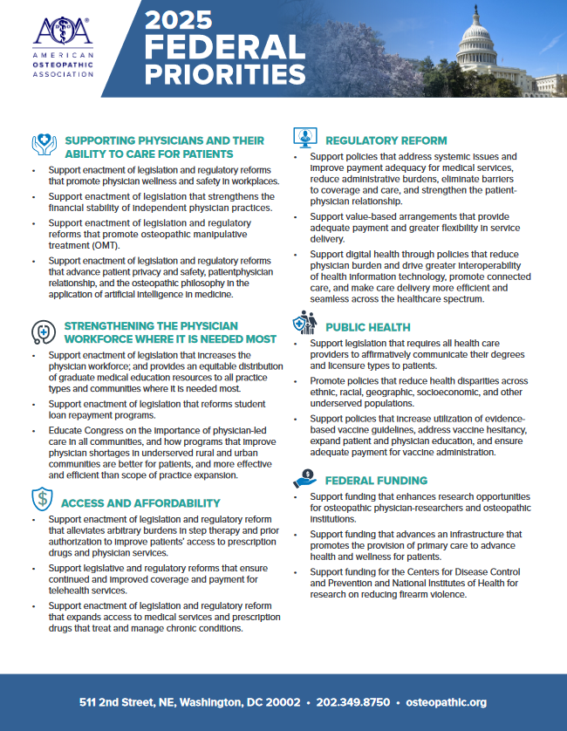
Federal Priorities
Supporting physicians and their ability to care for patients
Strengthening the physician workforce where it is needed most
Access and affordability
Regulatory reform
Public health
Federal funding

Slide 6




Reconciliation Bills – What Are They?
Budget reconciliation is a congressional procedure that allows for expedited consideration of certain tax, mandatory spending, and debt limit legislation
Typical reconciliation process
The president typically submits a budget request to Congress in February before House and Senate committees begin to markup a budget resolution, imposing instructions for reconciliation bills
PRESIDENTIAL BUDGET REQUEST
The House and Senate convene to pass a joint budget resolution, broadly outlining federal revenue, spending, and debt over a specified time frame; these budget resolutions are not subject to presidential sign-off
BUDGET RESOLUTION
BUDGET RECONCILIATION
The budget resolution includes instructions that mandate committees to create policies matching the budget; these bills can pass with a simple majority and have a 20-hour debate limit in the Senate
Reconciliation measures are usually combined into one omnibus bill and sent to the president for approval; if vetoed, Congress must pass a new budget resolution to start over
APPROVAL

Slide 7










Policy Through Reconciliation – 119th
POSSIBLE PROVISIONS IN UPCOMING RECONCILIATION LEGISLATION
Extend 2017 tax cuts and ban collecting taxes on tipped wages
Fund border security enhancements such as detention facility upgrades
Raise the national debt ceiling
Institute per capita limits on Medicaid funding
Link Medicaid eligibility to work requirements
Offer equal Medicaid funding for children, working adults, and disabled adults
Restrict eligibility to ACA health plans to US citizens
Establish site-neutral Medicare payments for outpatient care
Cut grants and tax credits for green energy in the Inflation Reduction Act
Allow increased mining, oil, and gas drilling operations

Slide 8
Data Backs Advocacy
INFLUENCE OF ADVOCACY STRATEGIES DIRECTED AT A MEMBER’S WASHINGTON OFFICE
■ A lot of positive influence ■ Some positive influence

Slide 9
Success Takes Time
BILLS AND RESOLUTIONS BY STATUS
■ 116th Congress ■ 117th Congress ■ 118th Congress
Historically, only about 5%-6% of bills make it to the House or Senate floor for a vote

Slide 10
Structure of a Congressional Office
Sample organizational structure of a congressional office
Member of Congress
Chief of Staff
Policy Staff*
Communications Staff*
Office Staff
District Staff
Legislative Director
Communications Director
Personal Assistant/ Scheduler
District Director
Legislative Assistant/Aide
Press Secretary/Assistant
Staff Assistant
District Caseworkers
Legislative Correspondent
Members of Congress have busy schedules – staffers often have more time to devote to Hill meetings and are more capable of affecting any takeaway
*Some offices may have “Senior Counsel/Counsel” roles among Policy staff, others may include a “Social Media Director” or “New Media Director” among Communications staff.

Slide 11

House of Representatives
Senate
Introduction
A representative or senator introduces a bill by filing it with the House/Senate clerk
Committee consideration
Bills are referred to committees for debate, analysis, and amendments
Simple majorities are needed to pass committees in both the House and Senate
Bills are often sent to subcommittees for extra analysis, especially on niche issues
Floor debate
House
Bill is debated and amended
Simple majority needed to pass
Senate
Bill is debated and amended
3/5 majority needed to end debate
Simple majority needed to pass
Final votes/
conference
committee
If both chambers pass an identical bill, it is sent directly to the president
If they pass different bills, a conference committee is formed of representatives and senators who try and find a compromise
Bills that pass conference committee must then pass both the House and Senate
President’s
signature
or veto
A bill becomes law after a president signs it or after 10 days if they take no action
The president can reject a bill with a veto
Congress can override the veto by with a 2/3 majority vote in each chamber

Slide 12







Bills Face Numerous Obstacles to Passage in Congress
Bill is ignored by full committee
Bill fails passage in subcommittee vote
Bill fails passage in full committee vote
Introduced in House/Senate
Sent to committee
Sent to subcommittee
Full committee vote
Process repeats
in other chamber
Full House/Senate vote
Amended
Floor debate
Placed on legislative calendar
Bill fails final vote in full chamber
“Poison pill” amendments can sabotage final passage
In the Senate, bills can be filibustered during debate
Senate majority leader/
House speaker declines to put bill on calendar
Note
The Senate relies on unanimous consent to operate efficiently; therefore, individual senators have the power to delay or prevent a bill’s passage by creating additional procedural hurdles, including filibusters

Slide 13



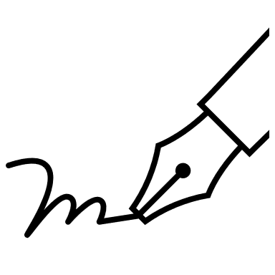
How to Influence
Keep it Simple: Policy issues can often be very complex and members of Congress need to be able to convey to their constituents why the issue you’re advocating for is important as well.
Make it Concrete: Policy discussions can get theoretical, referencing direct policy or a bill will make it easier for the lawmaker to see how it impacts their constituents.
Stress Credibility: Explain how your background and profession relates to the policy issue at hand.
Use Stories: Don’t be afraid to tell an emotional story. A story will make you stick out.

Slide 14


Stories Stick. Literally.
Researcher and cognitive psychologist Jerome Bruner conducted a study that demonstrated people are 22 times more likely to remember a fact when it’s delivered through a story rather than just presented on its own.
When someone tells a story, something called neural coupling happens. That means the listener’s brain activity starts to mirror the speaker’s.

Slide 15
Keep Momentum Going
Advocacy Activity Level Over Time (Illustrative)
Ideal continuous engagement
Advocate activity level
Loss of engagement
Start of campaign
End of campaign

Slide 16
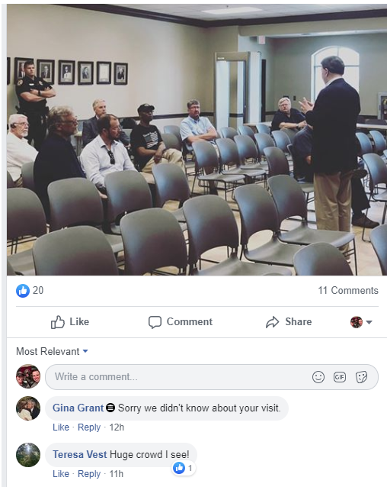
Lack of Engagement?
An opportunity for osteopathic physicians and medical students to engage where others are not.

Slide 17


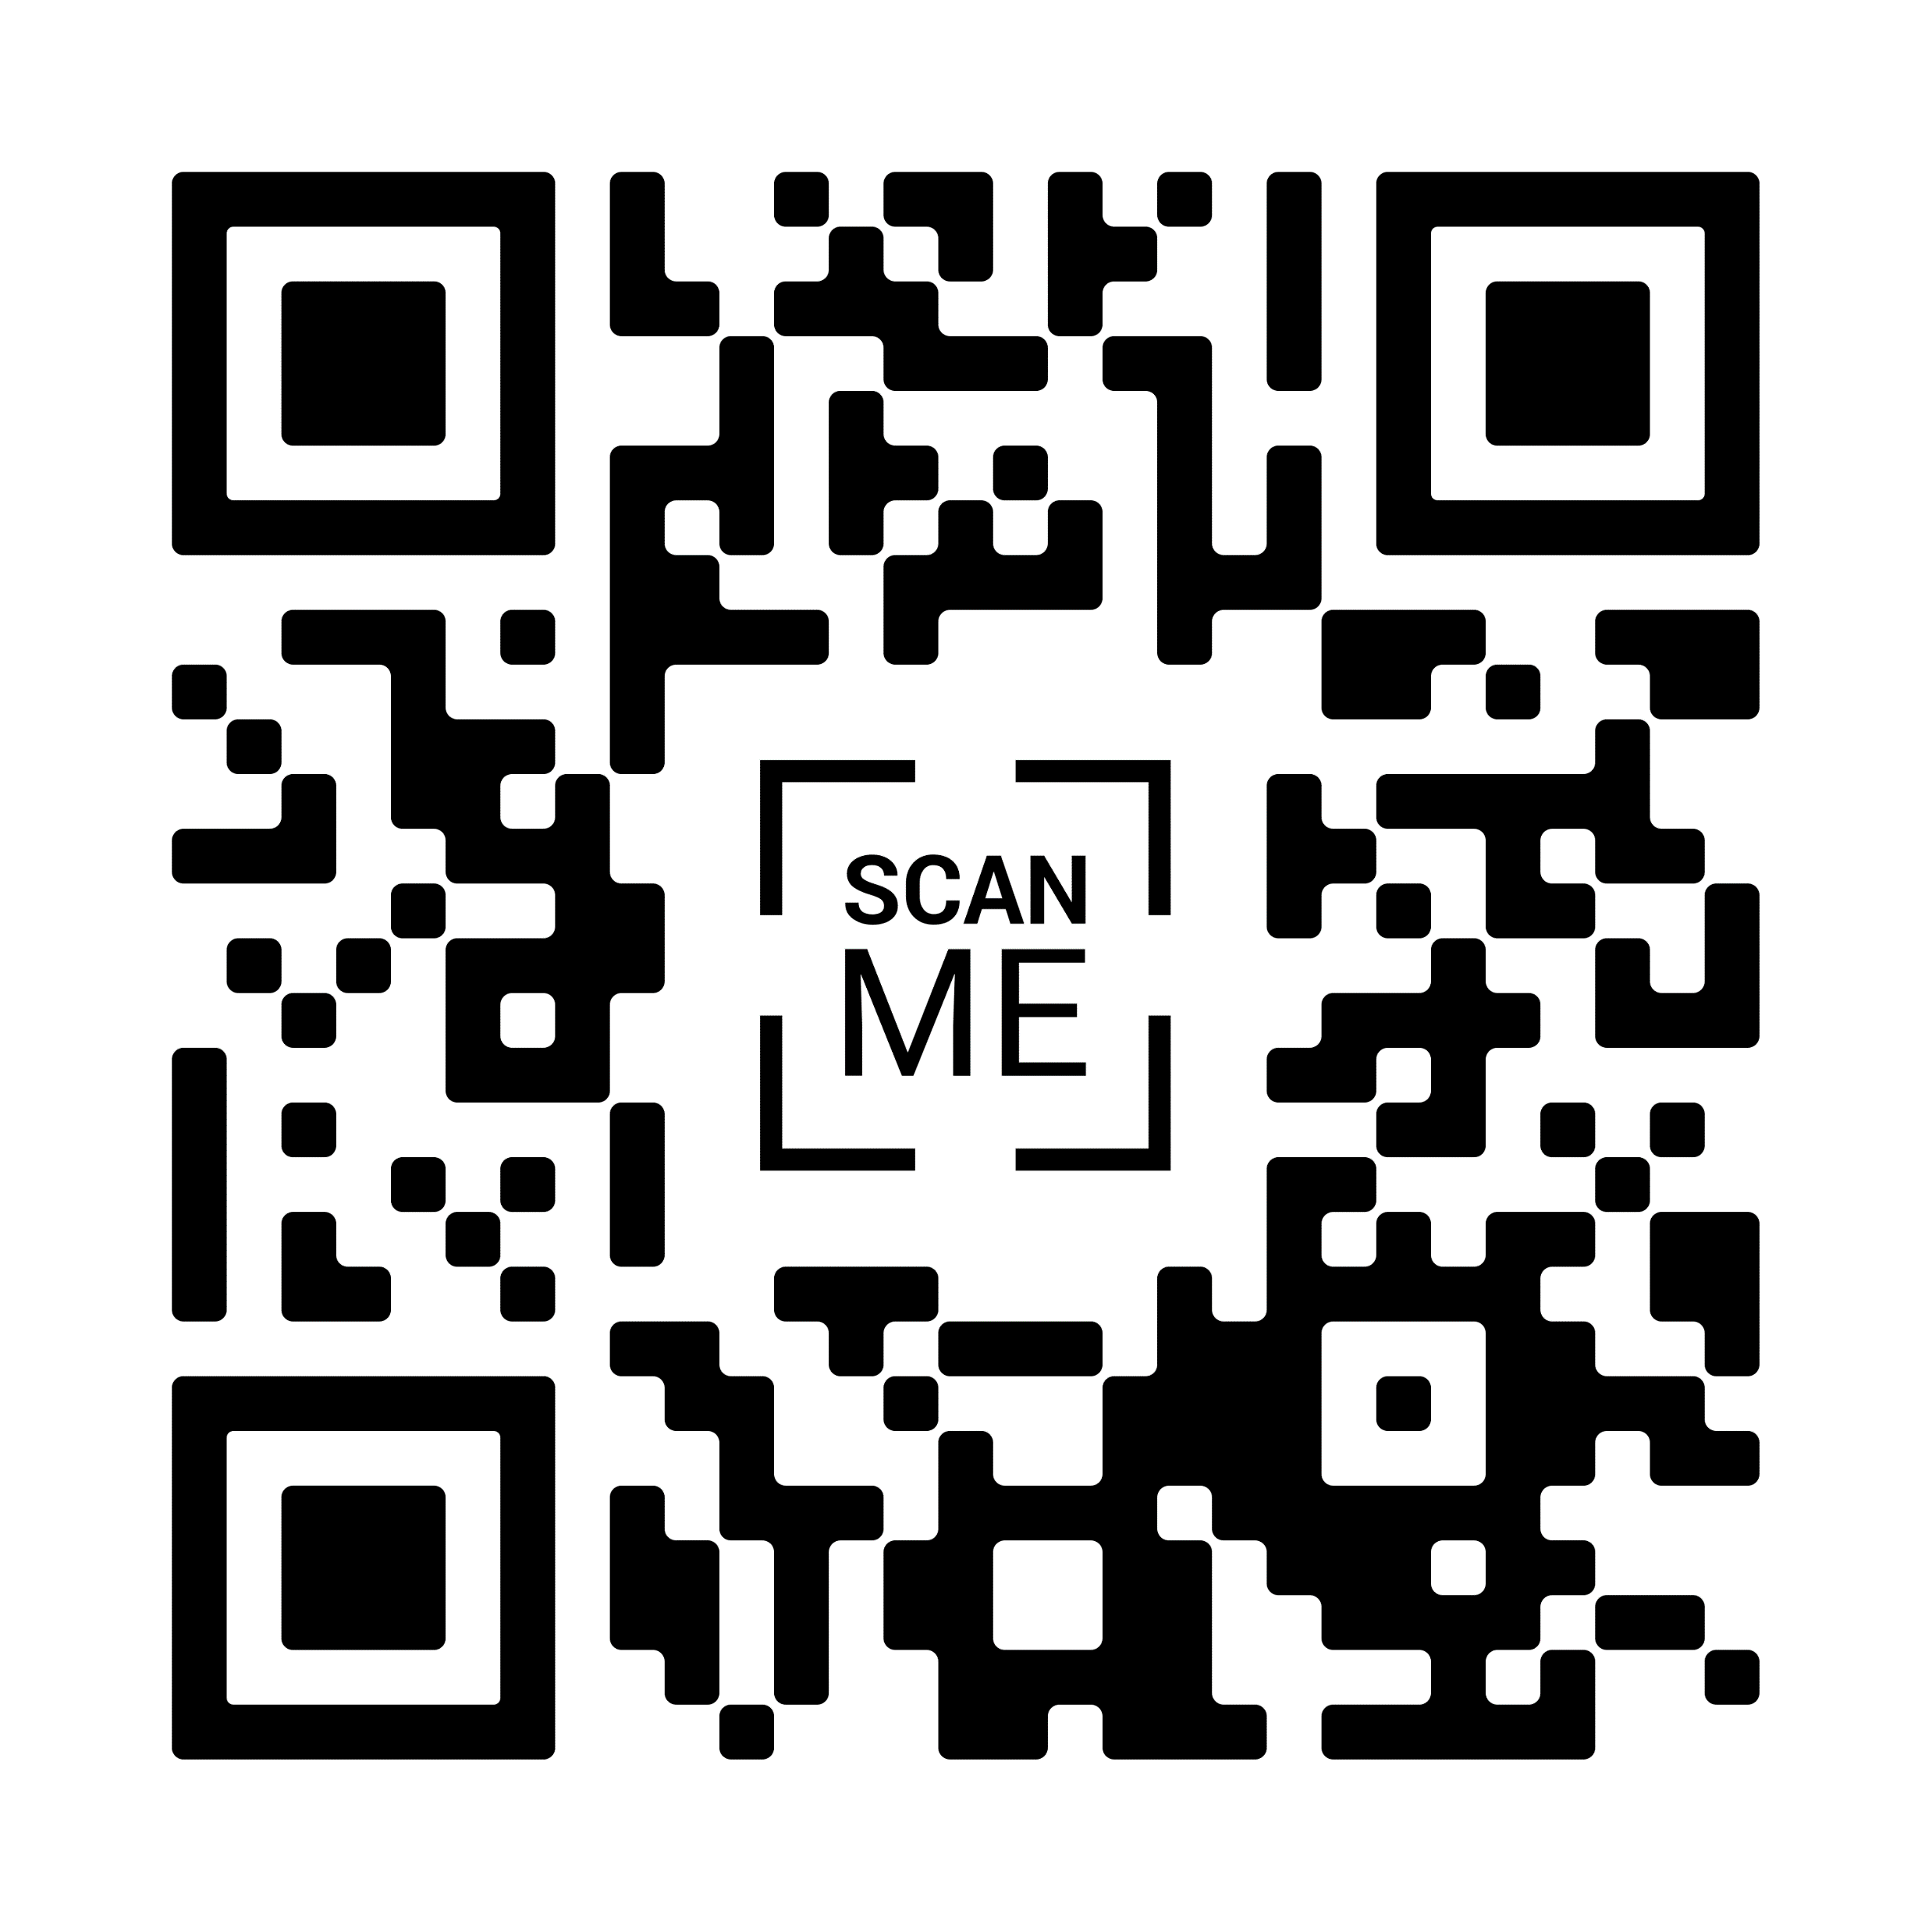


Osteopathic Advocacy Network
Join Today!

Slide 18
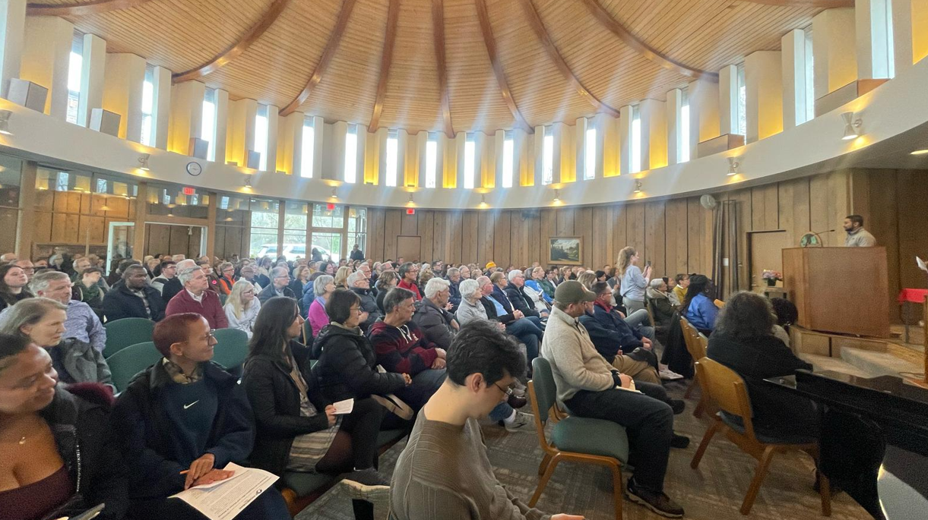
Osteopathic Advocacy - Townhall

Slide 19
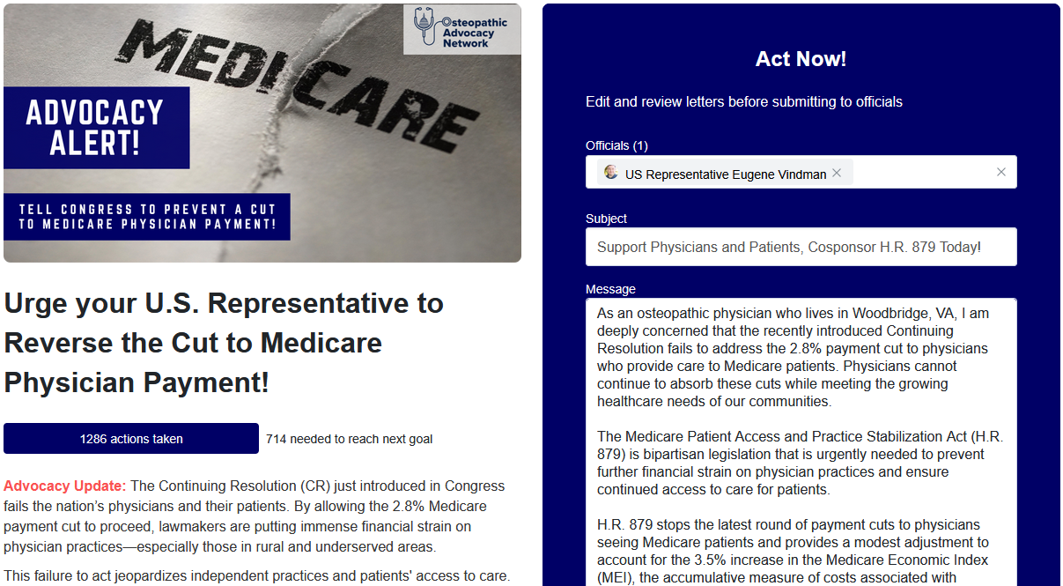
Advocacy Roadmap

Slide 20
Advocacy Roadmap
Winter
Policy briefing and introduction to the osteopathic profession
OAN membership drives
Spring
DO Day on Capitol Hill
Affiliate conferences
Summer
House of Delegates
August recess campaign
Fall
OMED
Election activities
Affiliate conferences
State advocacy
State advocacy
Presidential inauguration

Slide 21
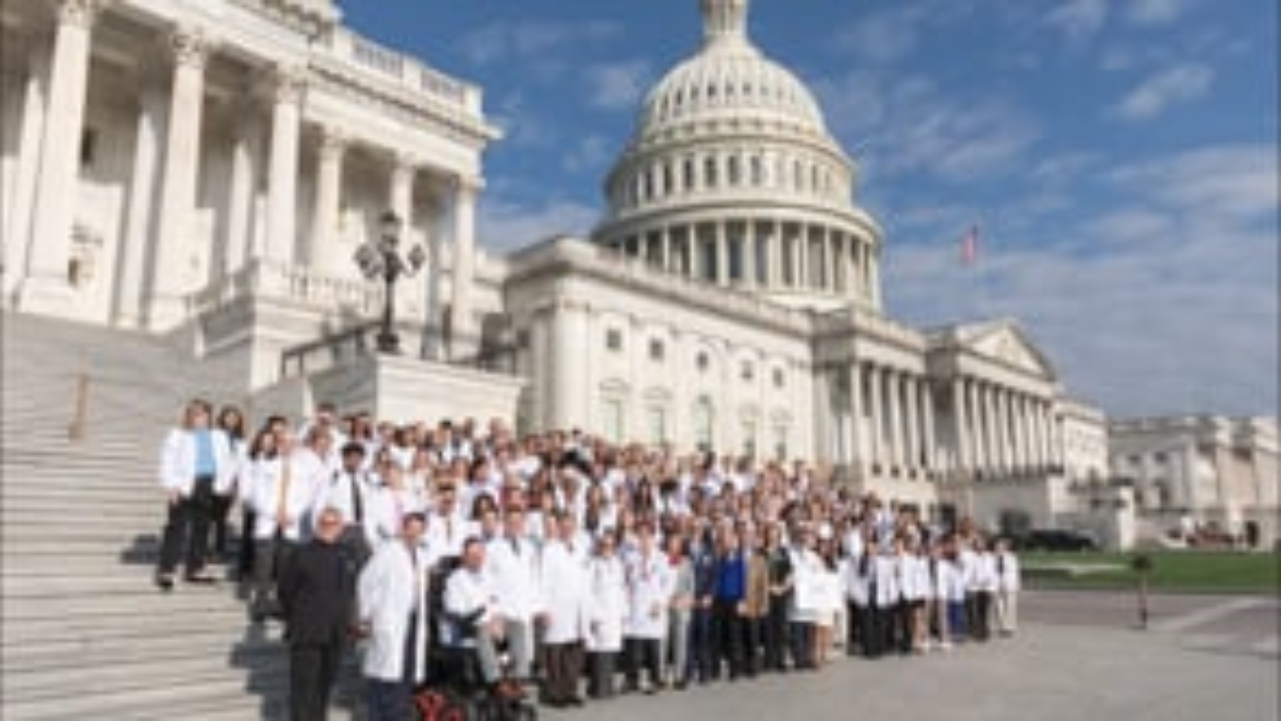

Slide 22

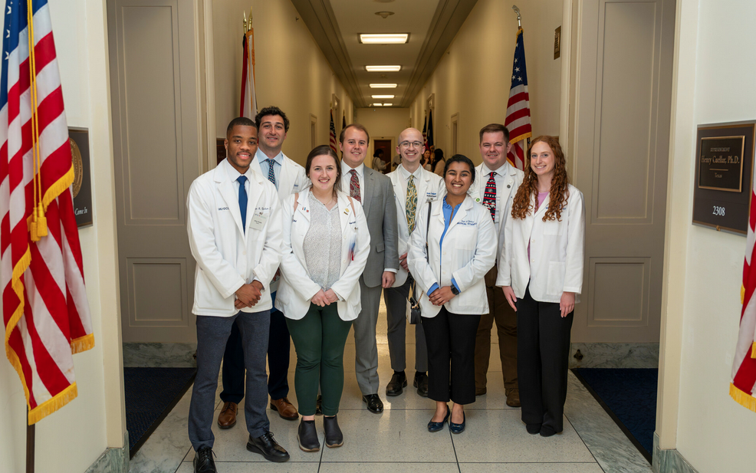
Operational Recap
Virtual Conference 3/22 – 3/23
New Learning Management System (LMS) Utilized
Exceptional Content
    Keynote Speaker: Leana Wen
    Physician track
    Early Learners track
    Affiliate leader track

Slide 23
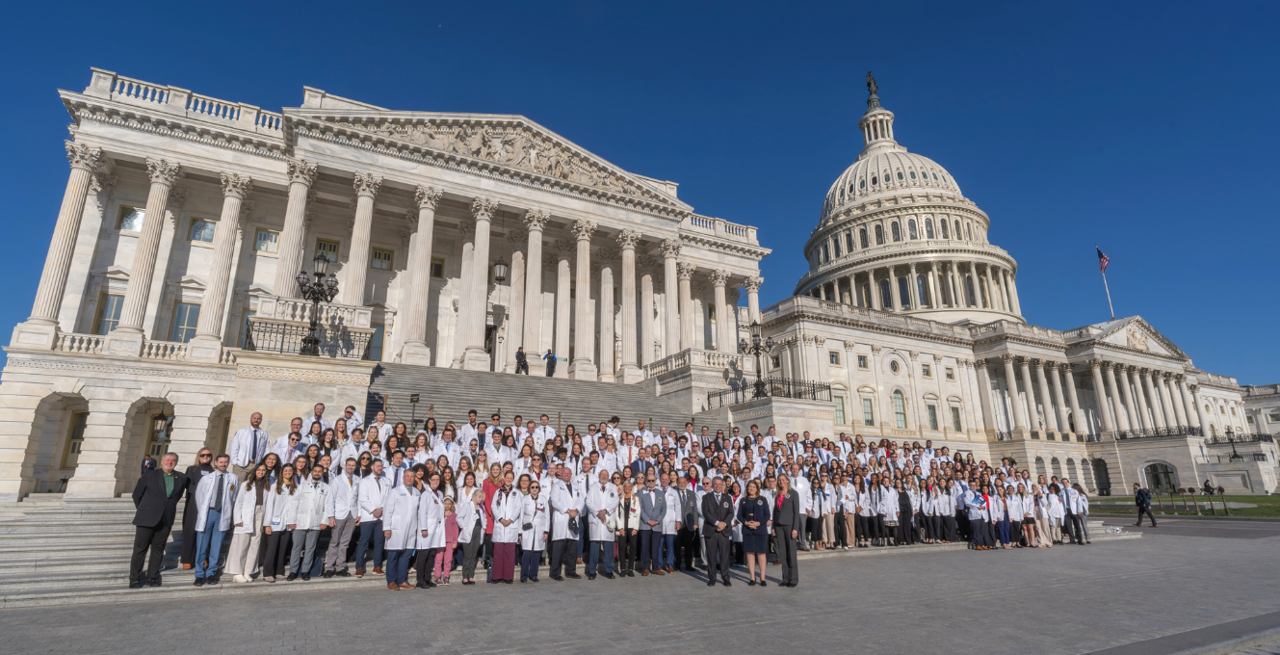
Congressional Meetings
Number | Category
407 | Total Participants
40 | States Represented
283 | Total Meetings
203 | U.S. House Meetings
80 | U.S. Senate Meetings
Notes:
Sean

Slide 24
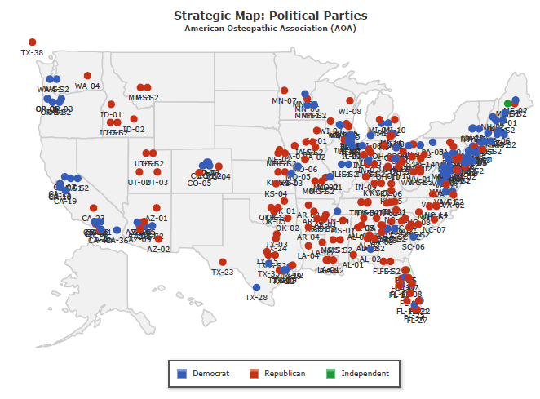
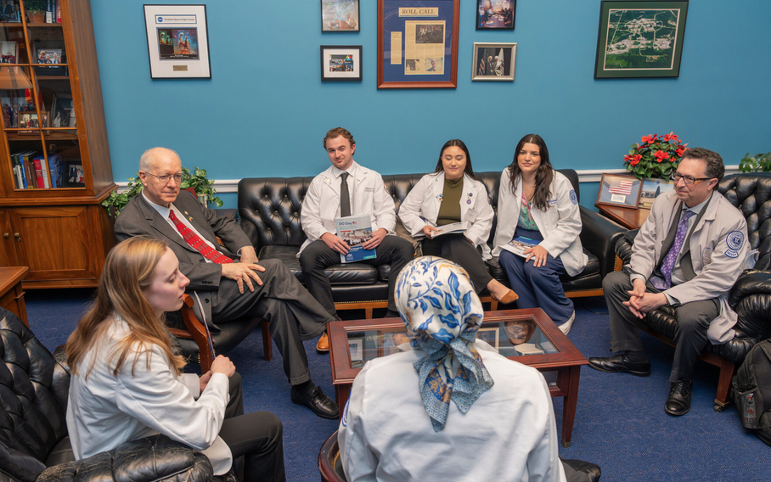
Congressional Meetings
Notes:
Sean

Slide 25
Issues - Medicare
Year | Medicare Conversion Factor | Adjusted for Inflation
1995 | $36.38 | -
2025 | $32.34 | $70.30
Protecting Physician Practices and Medicare Access: Advocate for the Medicare Patient Access and Practice Stabilization Act (H.R. 879), which prevents further cuts to Medicare physician payments.
CUMULATIVE
CHANGE SINCE 2001
PRACTICE COST INFLATION (MEI)
Roughly 54% decrease in physician payment since 1995, when adjusted for inflation
PHYSICIAN PAYMENT

Slide 26






Issues – Medicaid/Telehealth
Addressing Barriers to Care: Advocate for policies that maintain access to both Medicaid and telehealth services.
Medicaid is in danger of being cut due to the coming budget resolution; this would negatively impact access to care for the most vulnerable of our patients
Covers 39% of children
Covers 50% of youth with special health care needs
Funds 41% of births
Funds 1/4 of
all mental health and substance use treatment
Covers 1/3 of working-age adults with disabilities
Funds 61% of long-term care

Slide 27
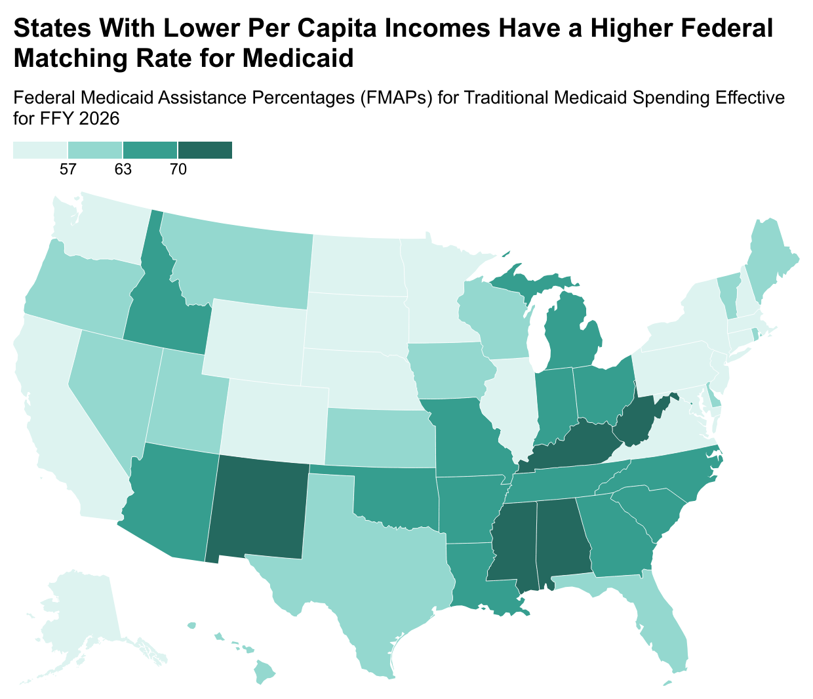
Issues - Medicaid
States With Lower Per Capita Incomes Have a Higher Federal Matching Rate for Medicaid
Federal Medicaid Assistance Percentages (FMAPs) for Traditional Medicaid Spending Effective for FFY 2026

Slide 28
Issues - THCGME
Invest in the Future Physician Workforce: The Teaching Health Center Graduate Medical Education (THCGME) program plays a key role in training primary care physicians in underserved areas. Without reauthorization, we risk losing a crucial pipeline of physicians serving patients in need.
There are 82 Teaching Health Center programs in nearly 30 states with nearly 1,200 medical residents handling more than an estimated one million patient visits annually.
82 percent of THC graduates remain in primary care practice, compared to 23 percent of traditional GME graduates. Additionally, 55 percent of THC graduates practice in underserved communities, compared to 26 percent of traditional GME graduates.

Slide 29
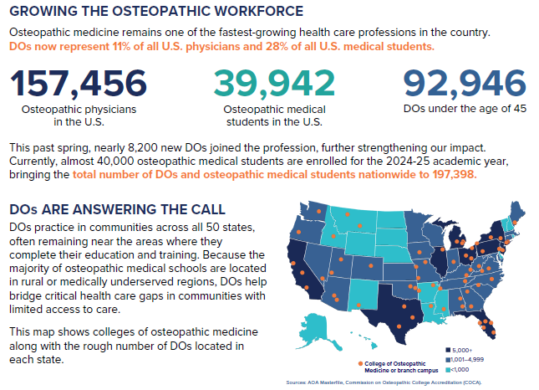
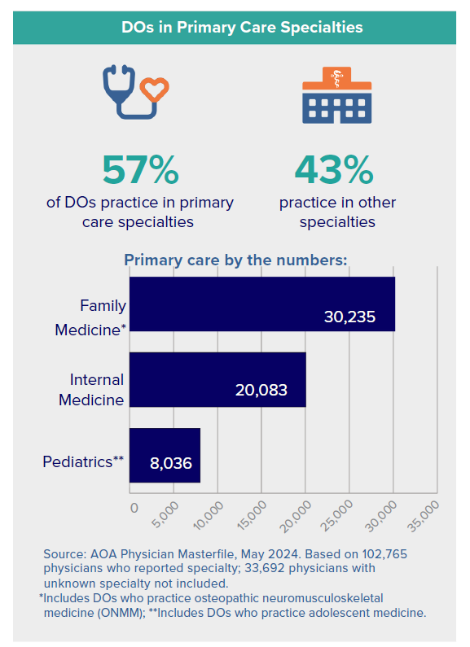
About the AOA

Slide 30
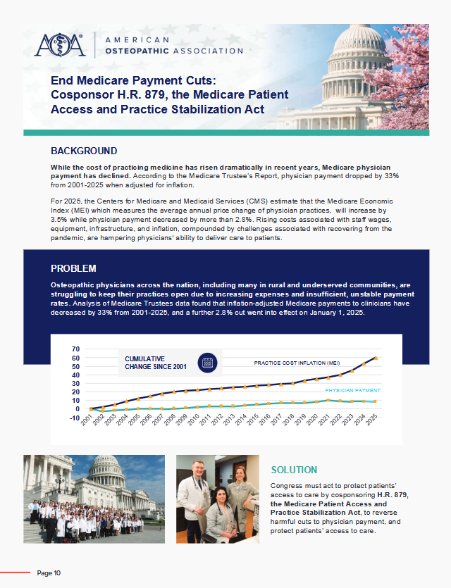
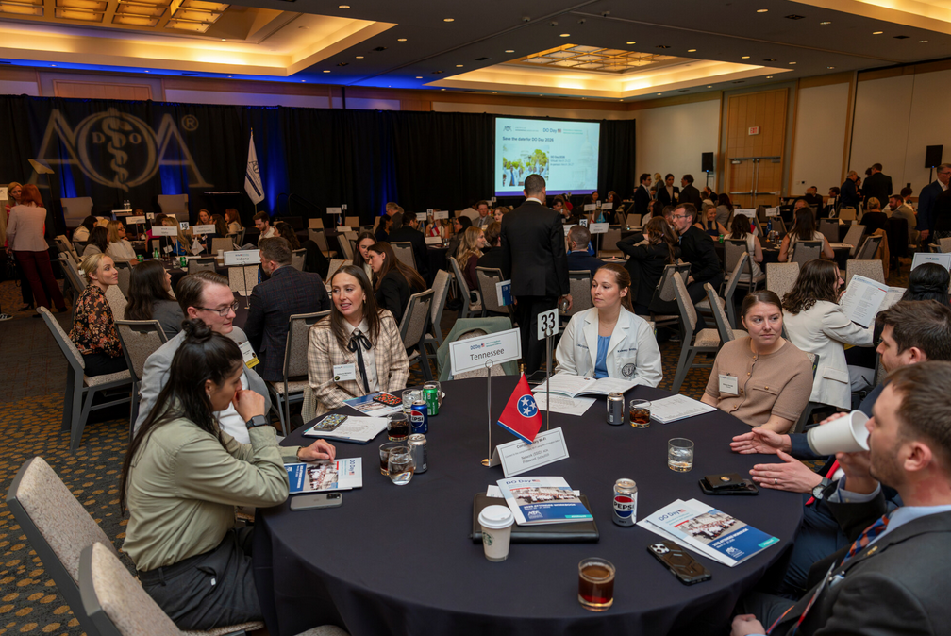
Training

Slide 31
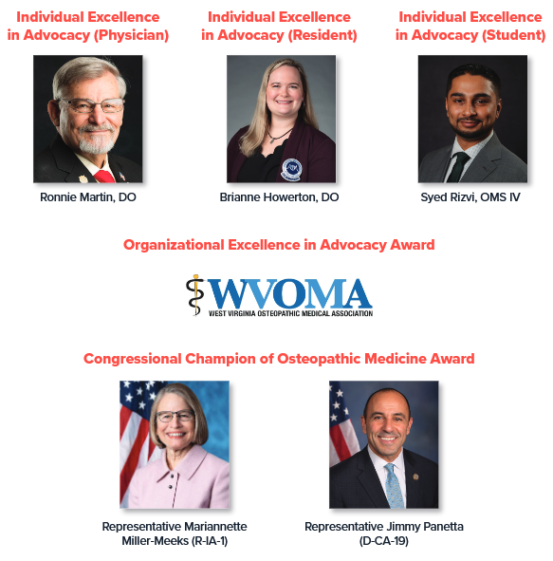

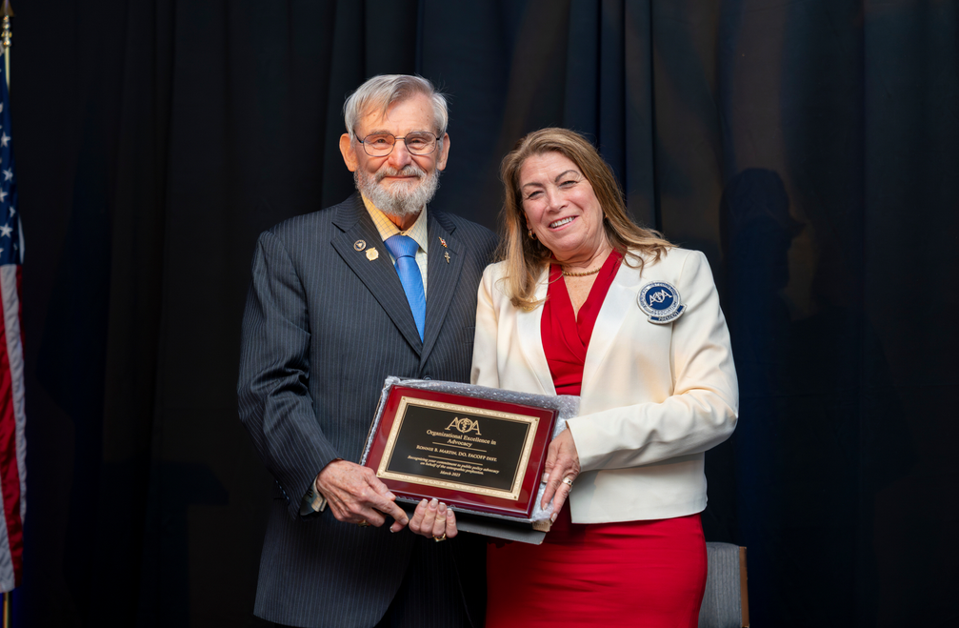
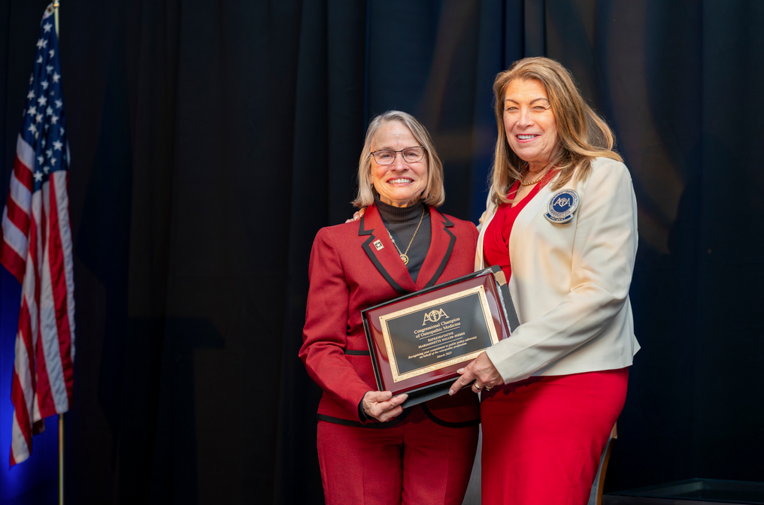
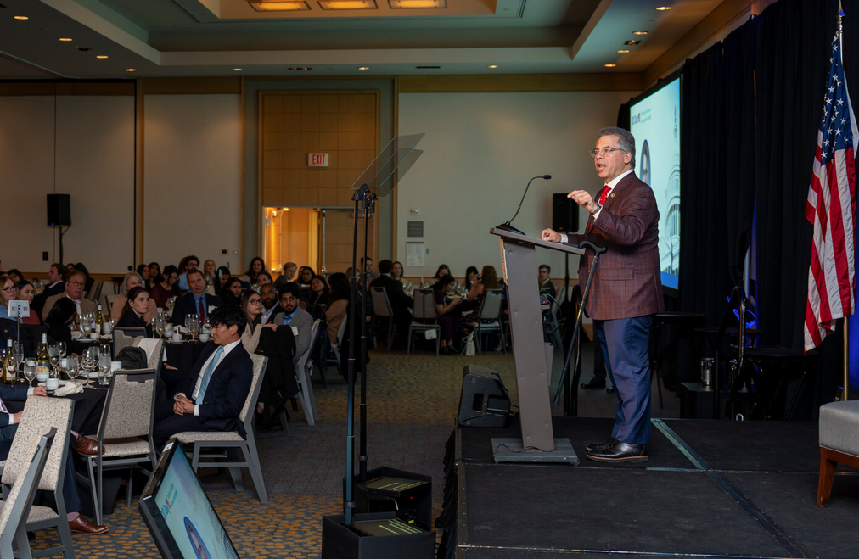
Advocacy Awards
Notes:
Sean

Slide 32
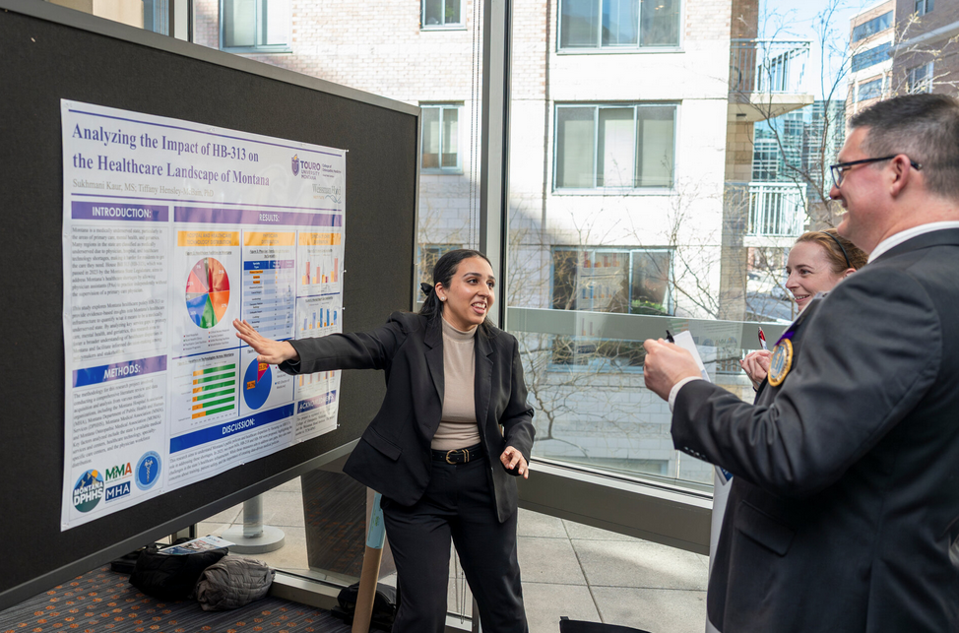
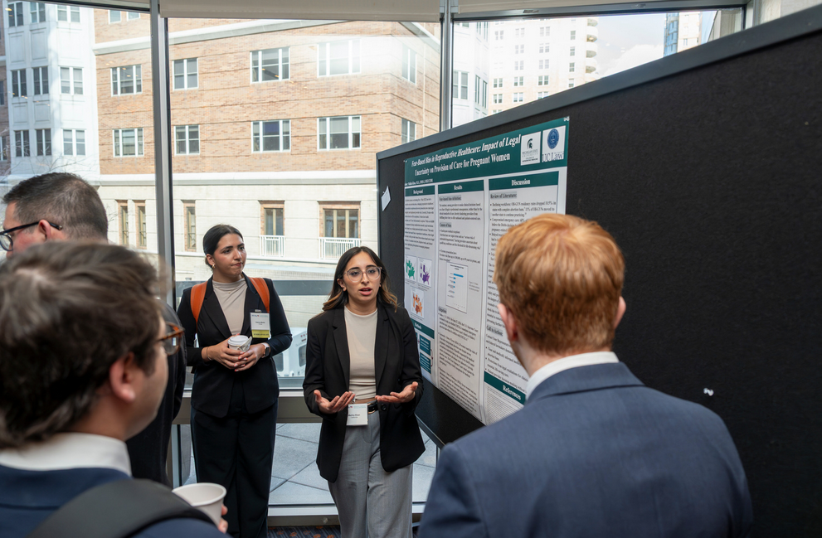
Poster Competition
Notes:
Sean

Slide 33

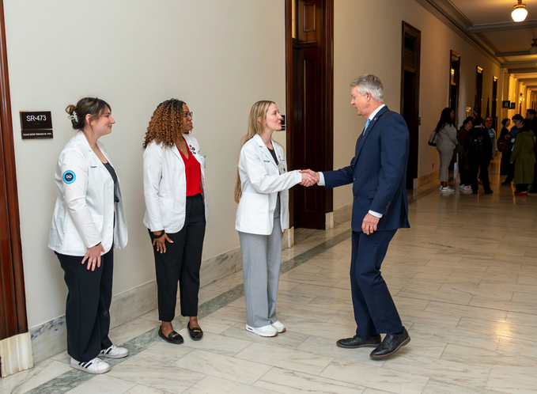
Affiliate Sponsorship
Number | Category
26 | Total Affiliates
7 | Specialty Affiliates
19 | State and Student
Notes:
Sean

Slide 34
The Cost of Federal Elections - Timeline
IN BILLIONS USD
113%
jump in total election costs from 2016 to 2020

Slide 35
Winning Candidates are Usually the Top Spenders
SPENDING IN MILLIONS USD
■ Spending by candidates ■ Percent of races won by the top spending candidates
House races
Senate races

Slide 36

The Osteopathic Political Action Committee

Slide 37

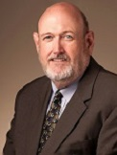
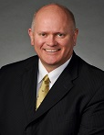
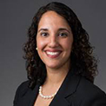



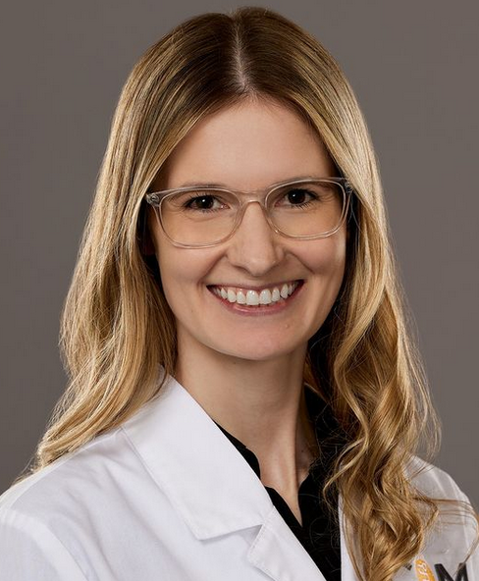
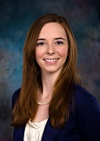
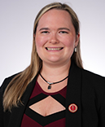
2026 Cycle Members
Ronnie Martin, DO
Chair
Ray Morrison, DO
Vice Chair
Richard Thacker, DO
Treasurer
Sonbol Shahid-Salles, DO
Assistant Treasurer
Jeffrey Grove, DO
Secretary
Kris Nicholoff, JD
Affiliate Member
Jodi Benett, DO
Member at Large
Annie Hoffman, OMS
Student Member
Alexis Cates, DO
Coalitions Officer
Brianne Howerton, DO
Academic Member

Slide 38
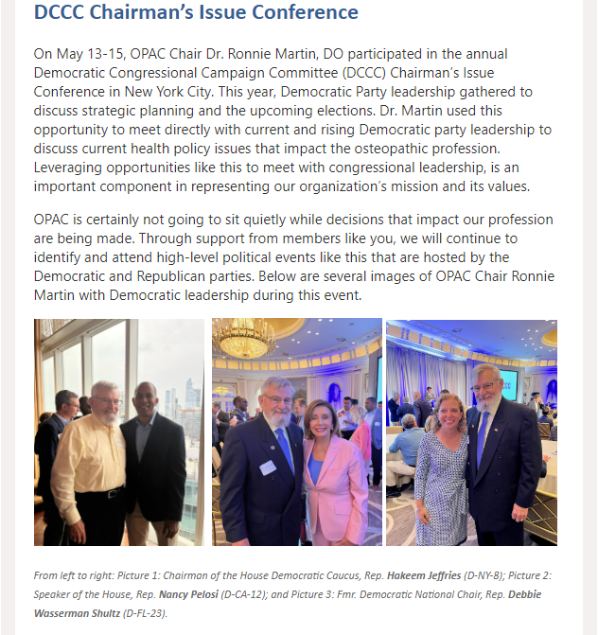
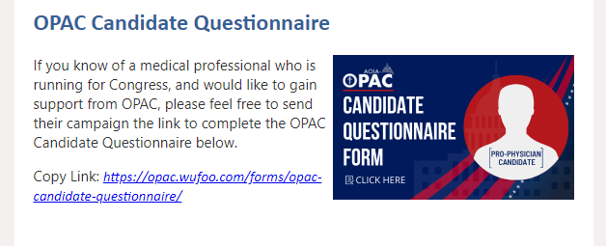
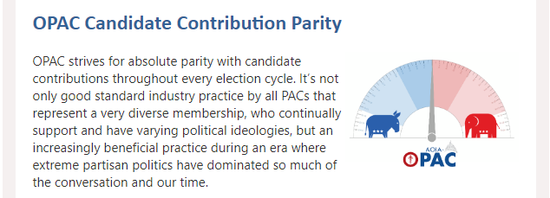
Communications

Slide 39
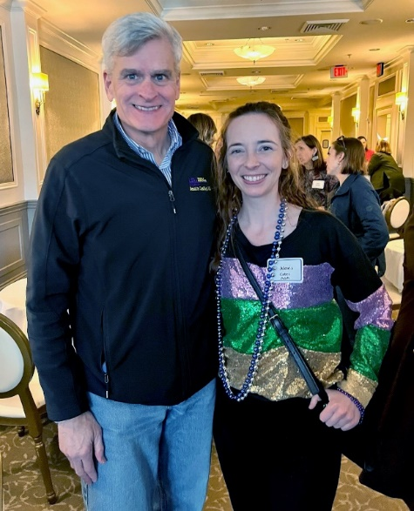
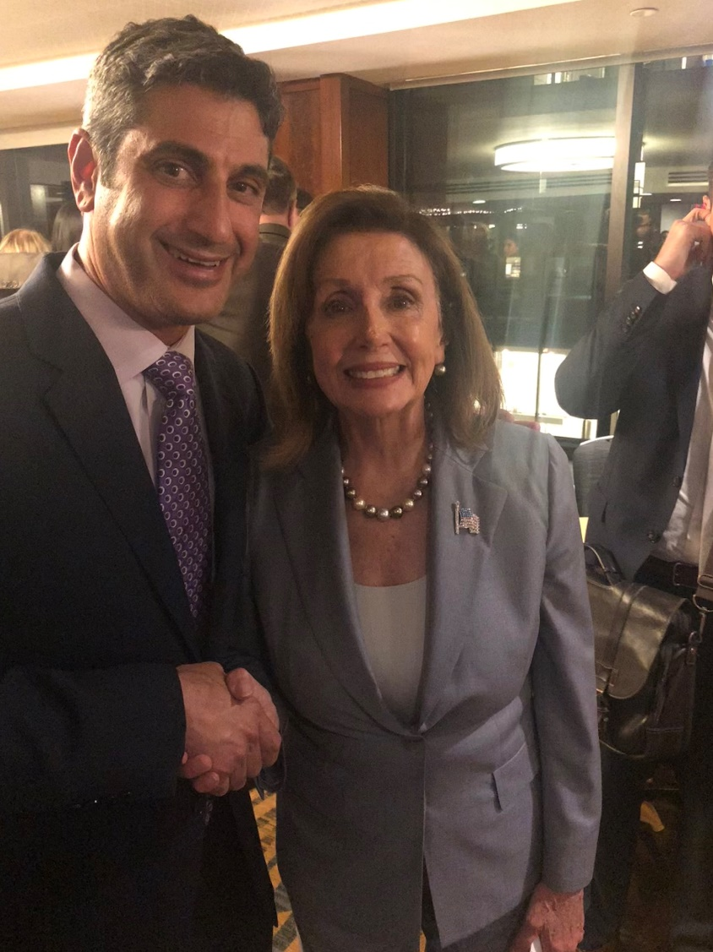
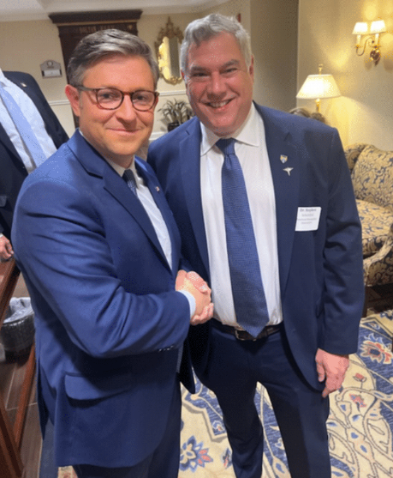
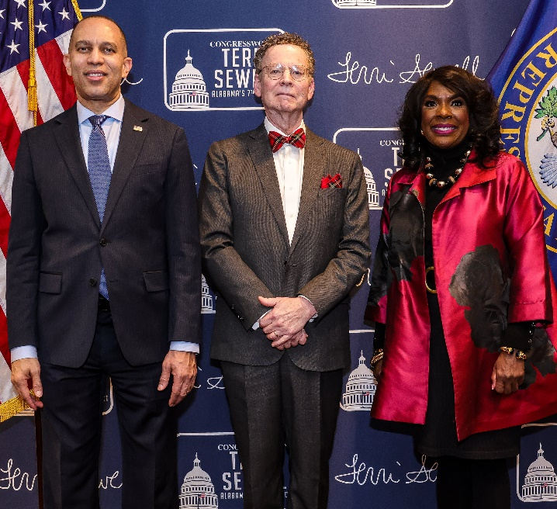
A Seat at the Table

Slide 40
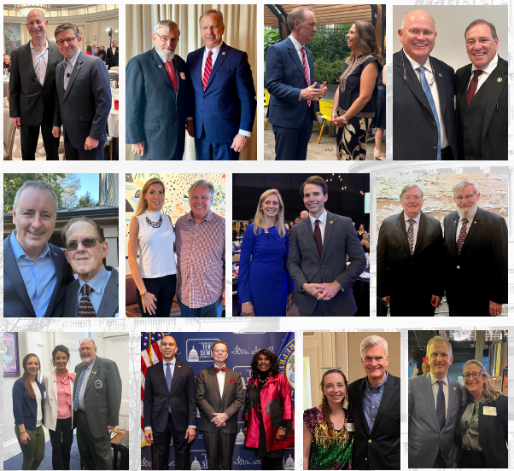

Slide 41
Thank you!

