Slide 1

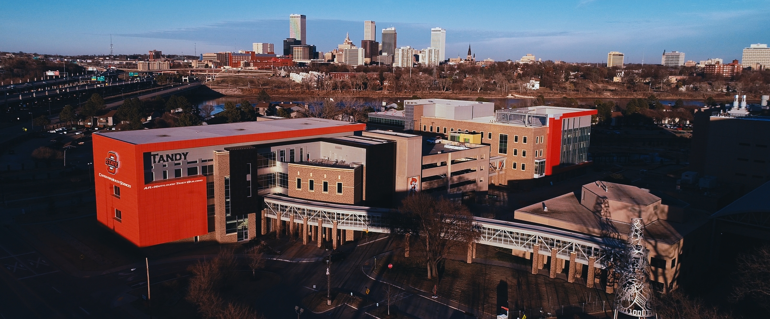
WELCOME
DR. JOHNNY STEPHENS
PRESIDENT

Slide 2
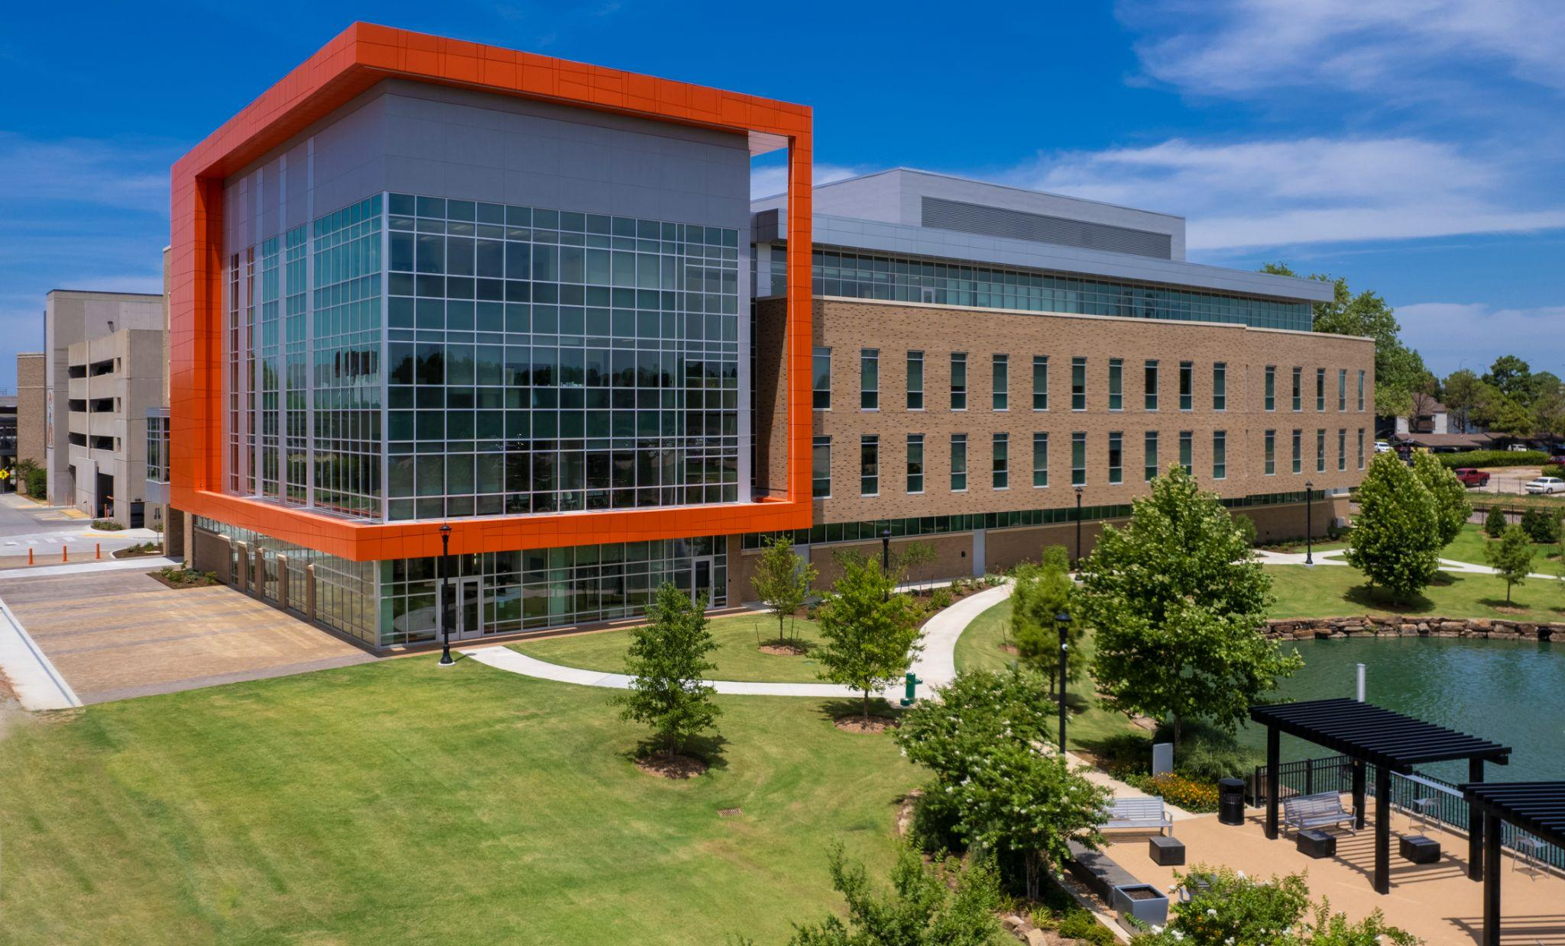
CAMPUS IMPROVEMENTS - NORTH HALL

Slide 3
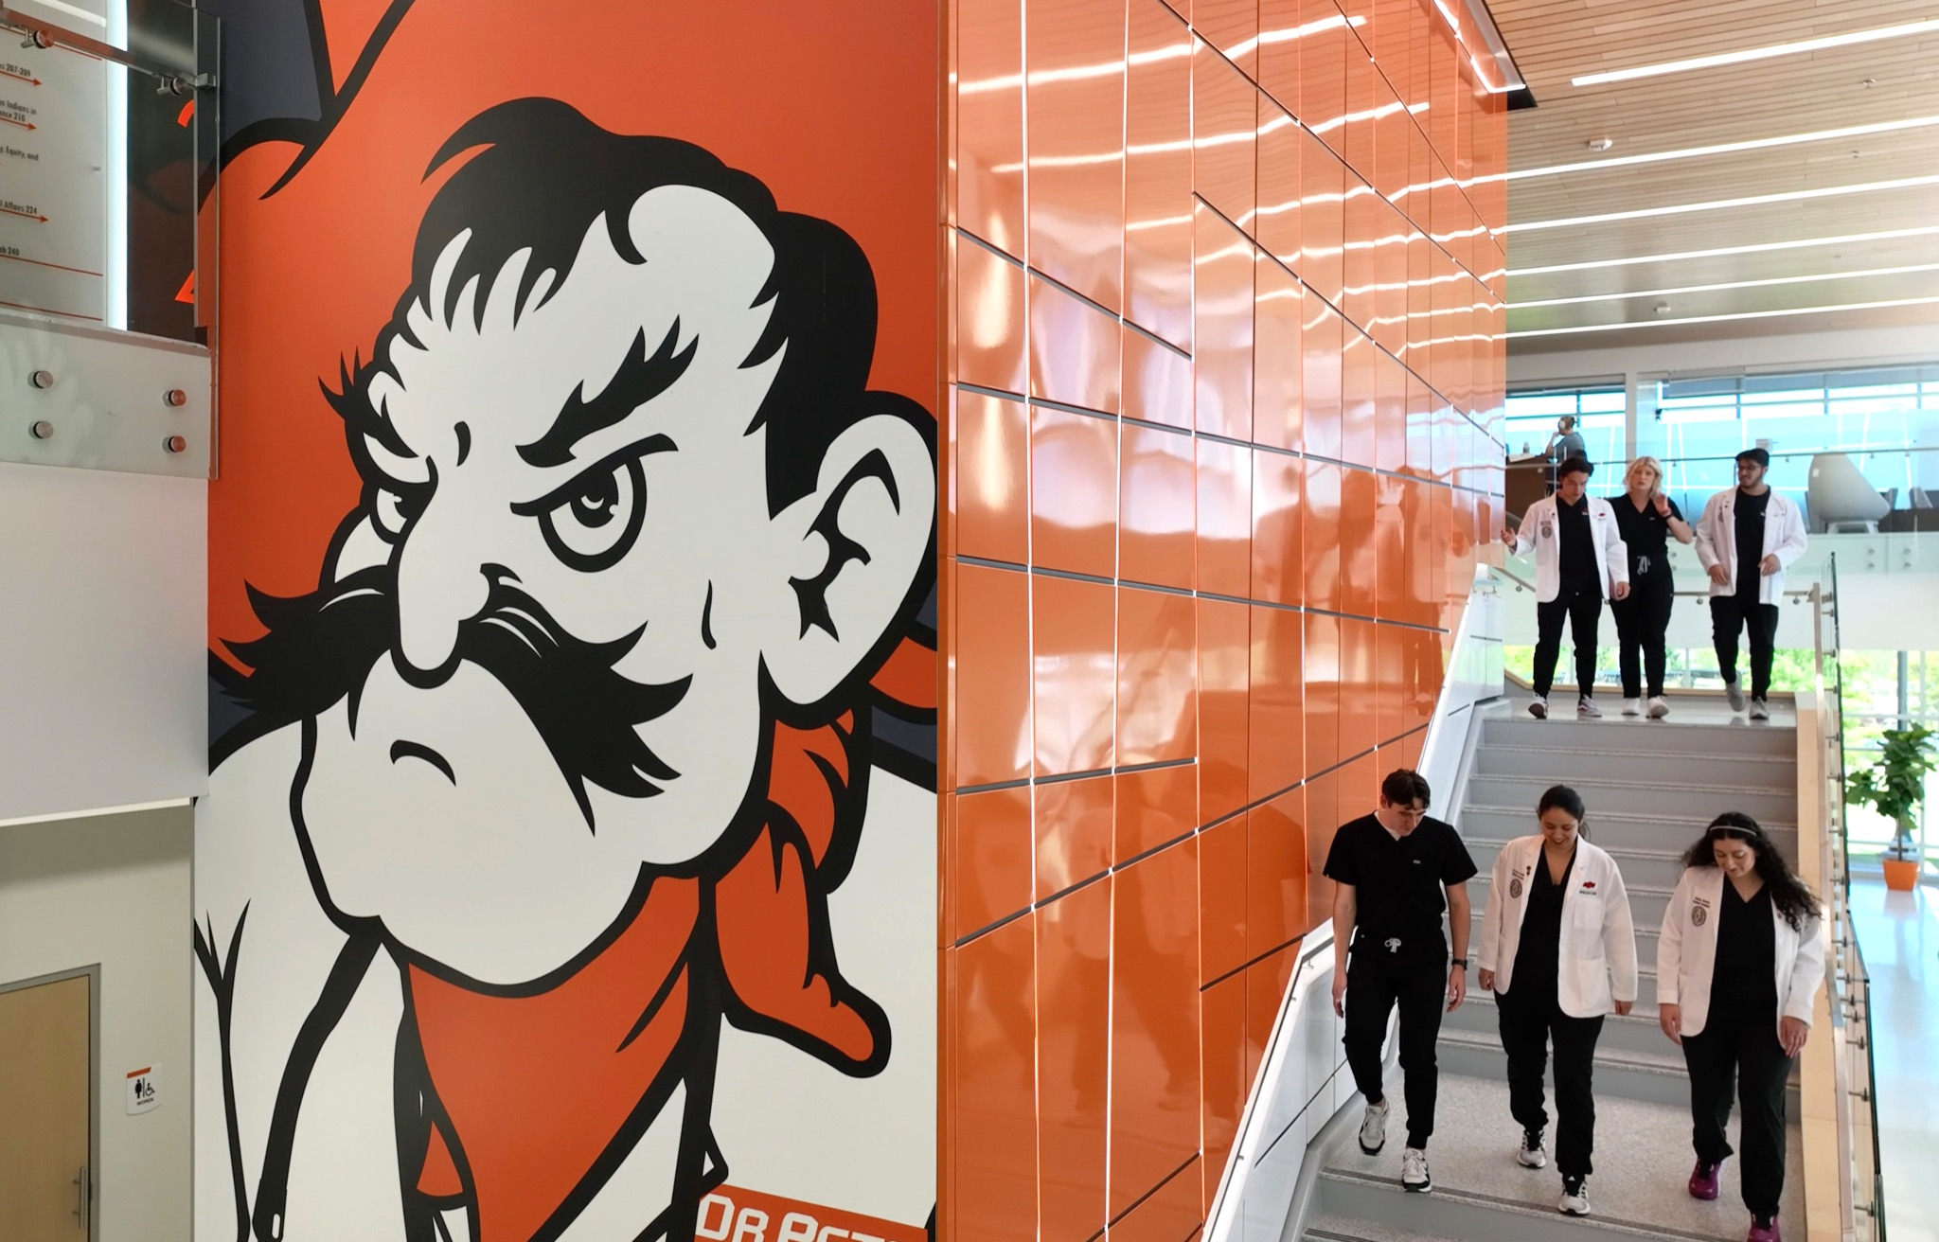
CAMPUS IMPROVEMENTS - NORTH HALL

Slide 4
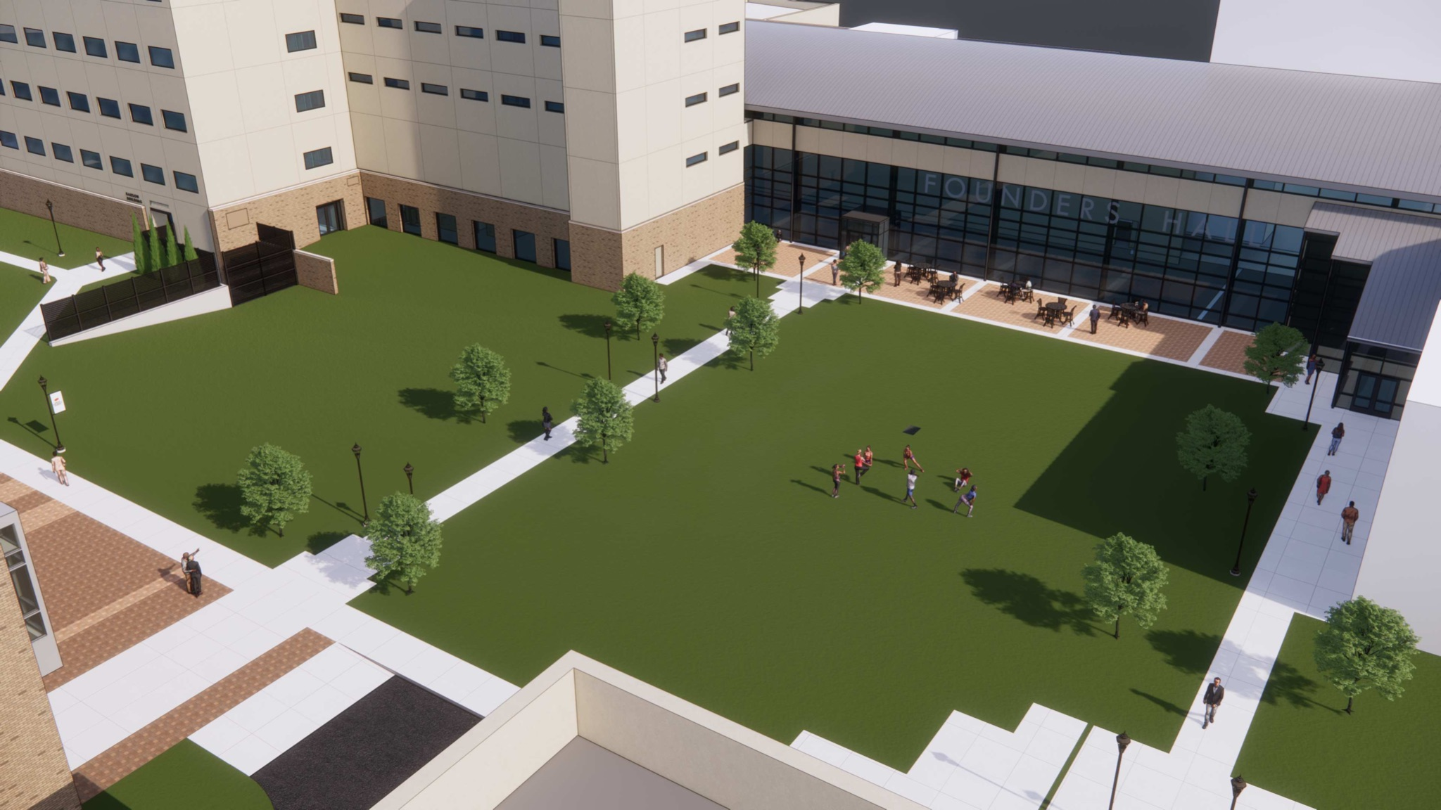
CAMPUS IMPROVEMENTS - PLAZA

Slide 5
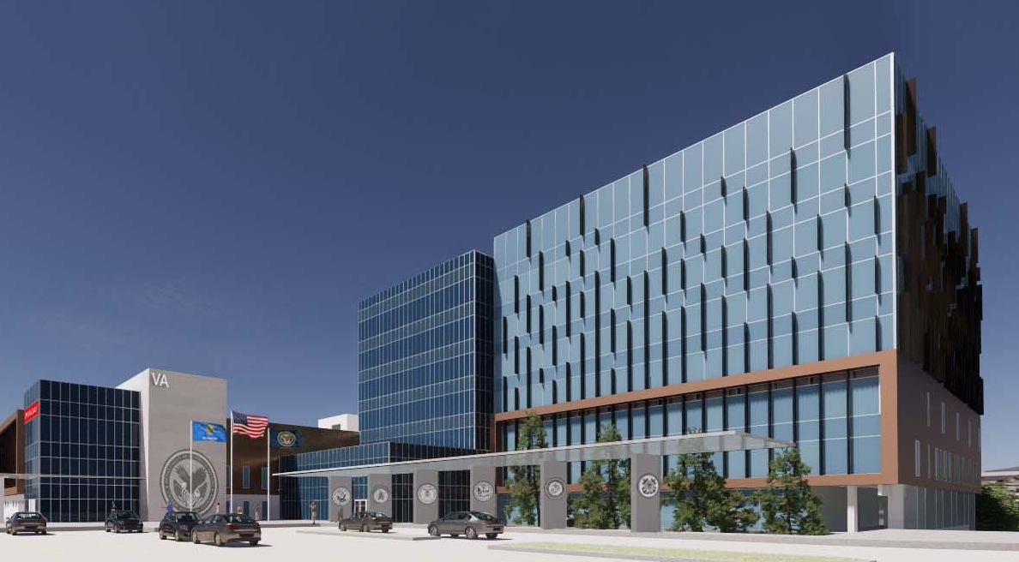
VA HOSPITAL
275,000 SF
58 Estimated Medical/Surgical Beds
Opening 2025
65,000 Veterans in the Tulsa Area

Slide 6
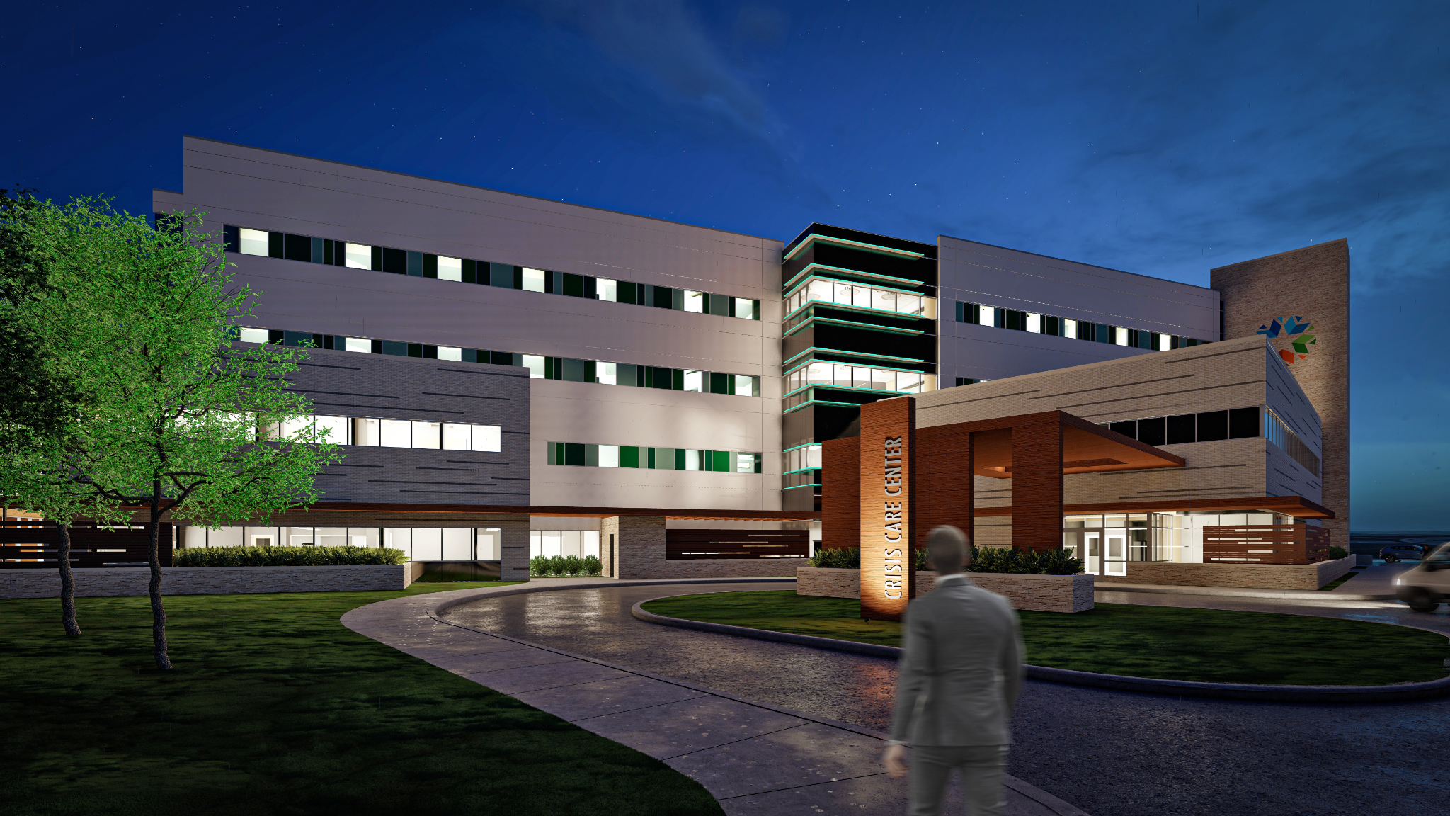
OKLAHOMA PSYCHIATRIC CARE CENTER
150,000 SF
100 Estimated Inpatient Beds
Opening 2025
33,000 Adults and Youth in Tulsa Experience Severe Mental Illness Each Year

Slide 7
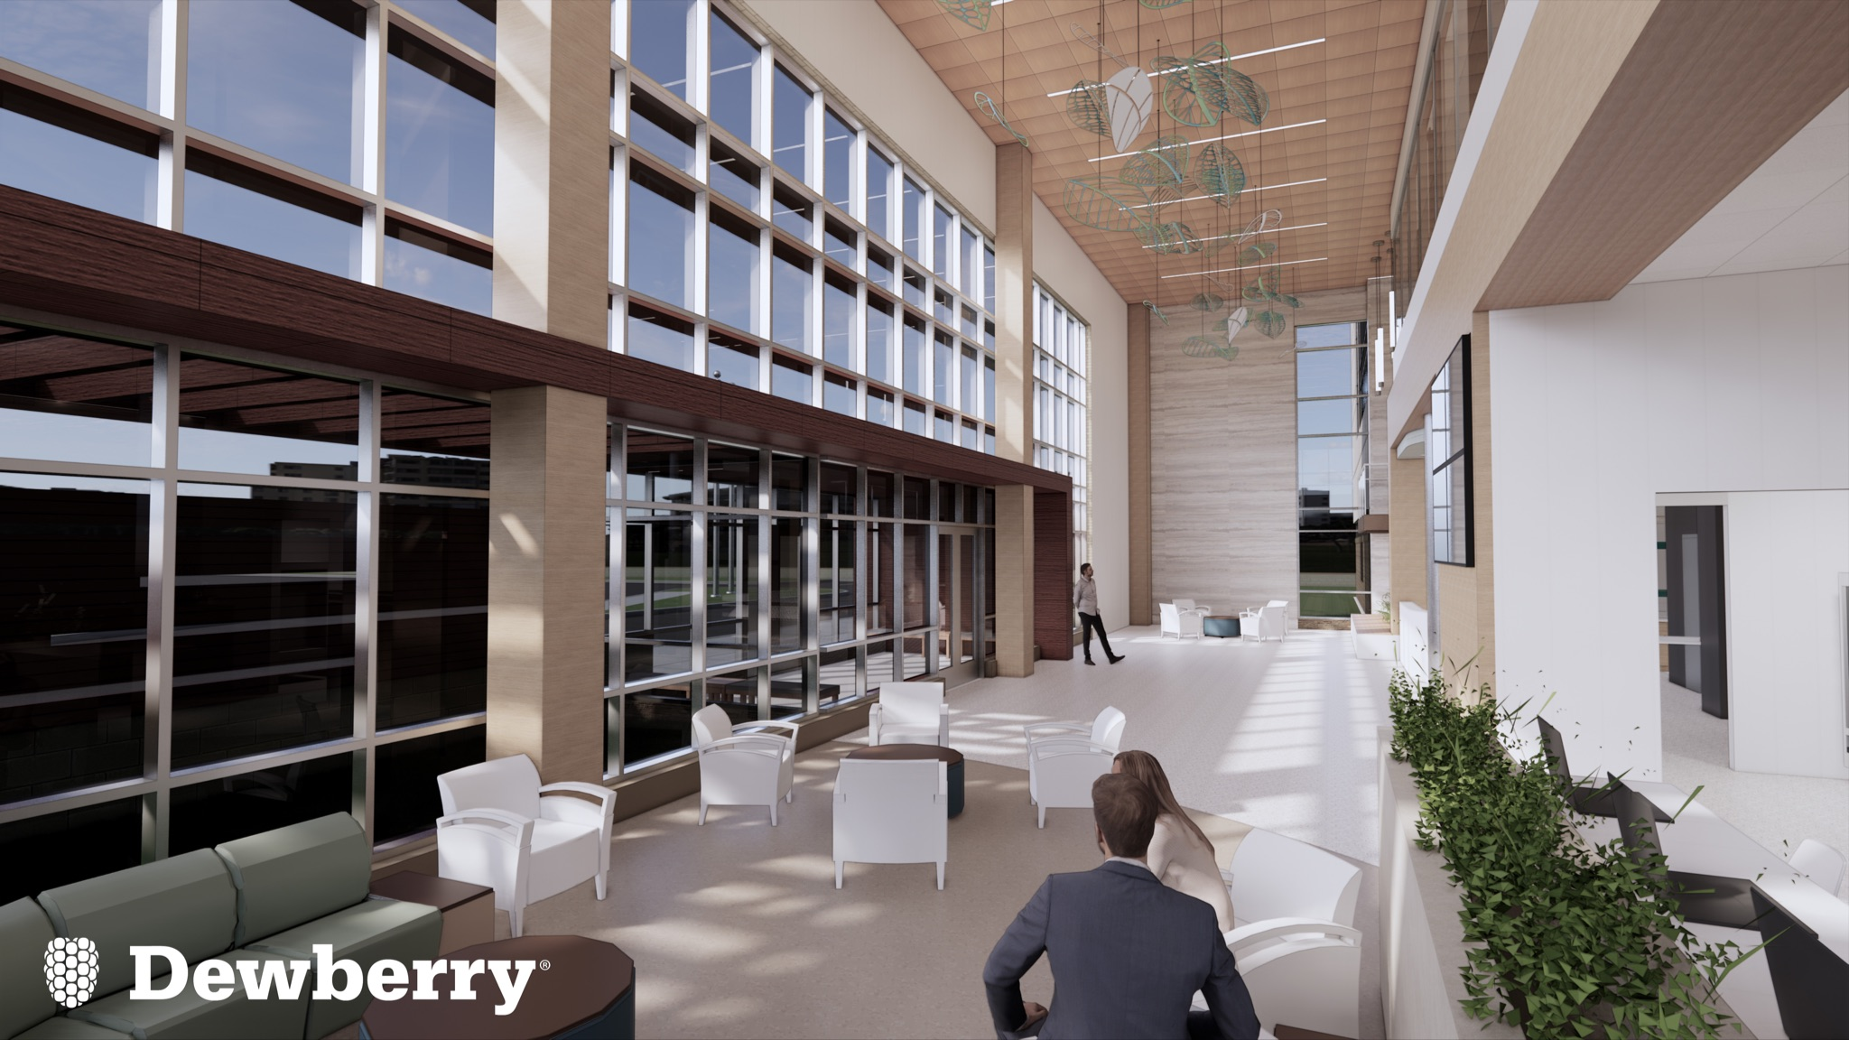
OKLAHOMA PSYCHIATRIC HOSPITAL

Slide 8
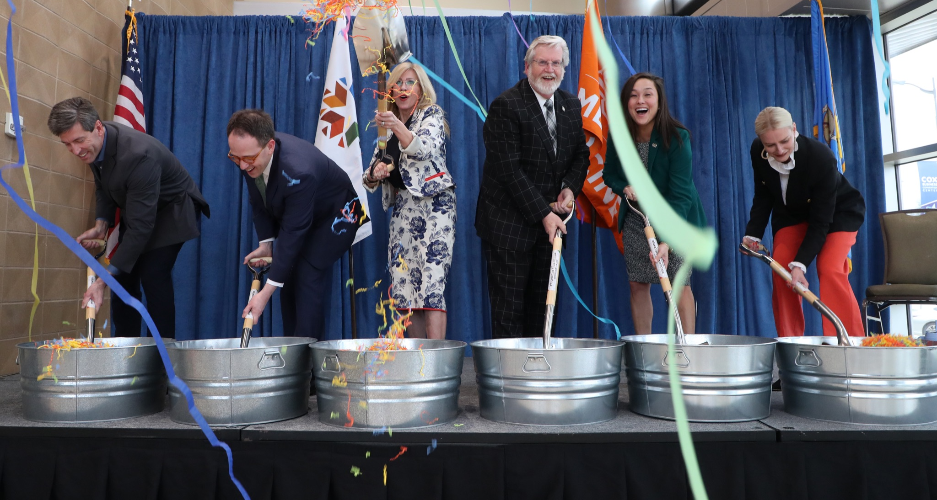
OKLAHOMA PSYCHIATRIC HOSPITAL

Slide 9
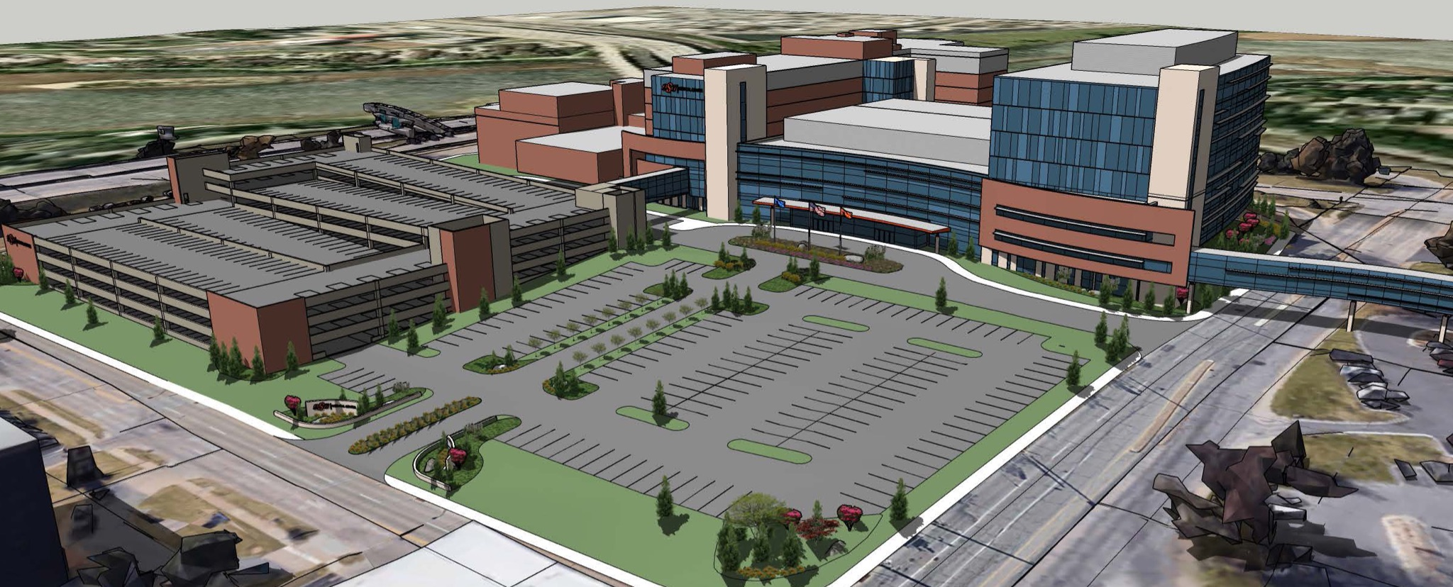
OSUMC EXPANSION

Slide 10

COLLEGE OF OSTEOPATHIC MEDICINE
#1
percentage of graduates practicing medicine in Health Professional Shortage Areas
#10
in graduates practicing in rural areas

Slide 11
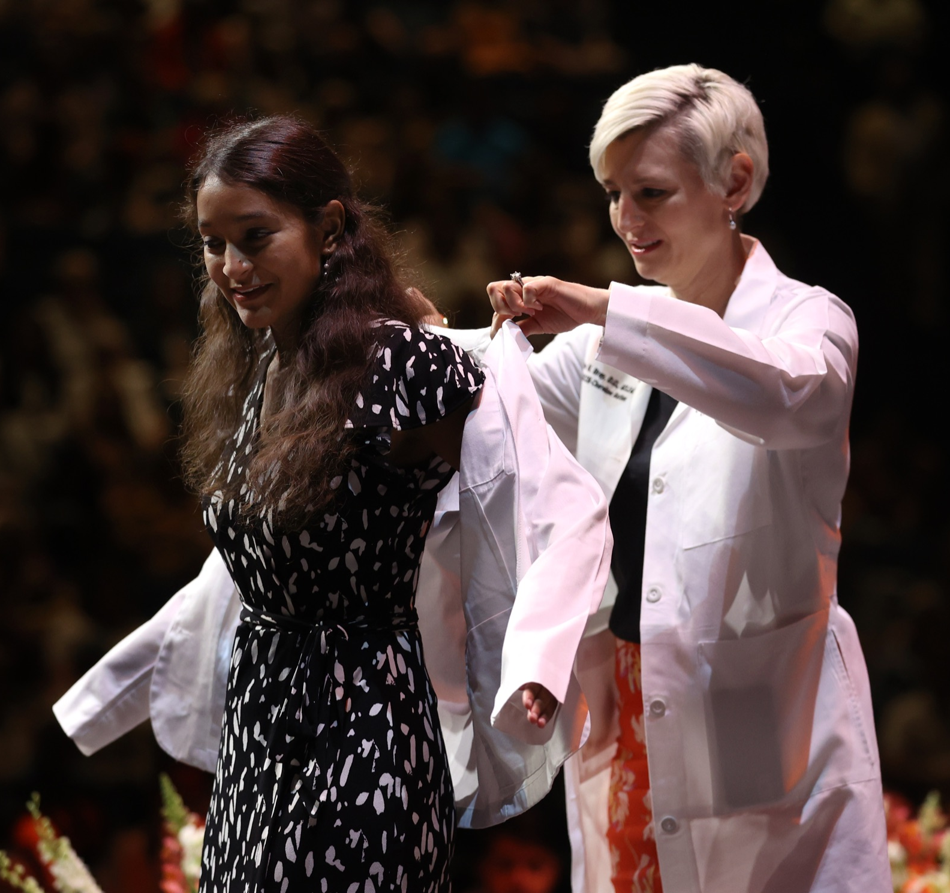
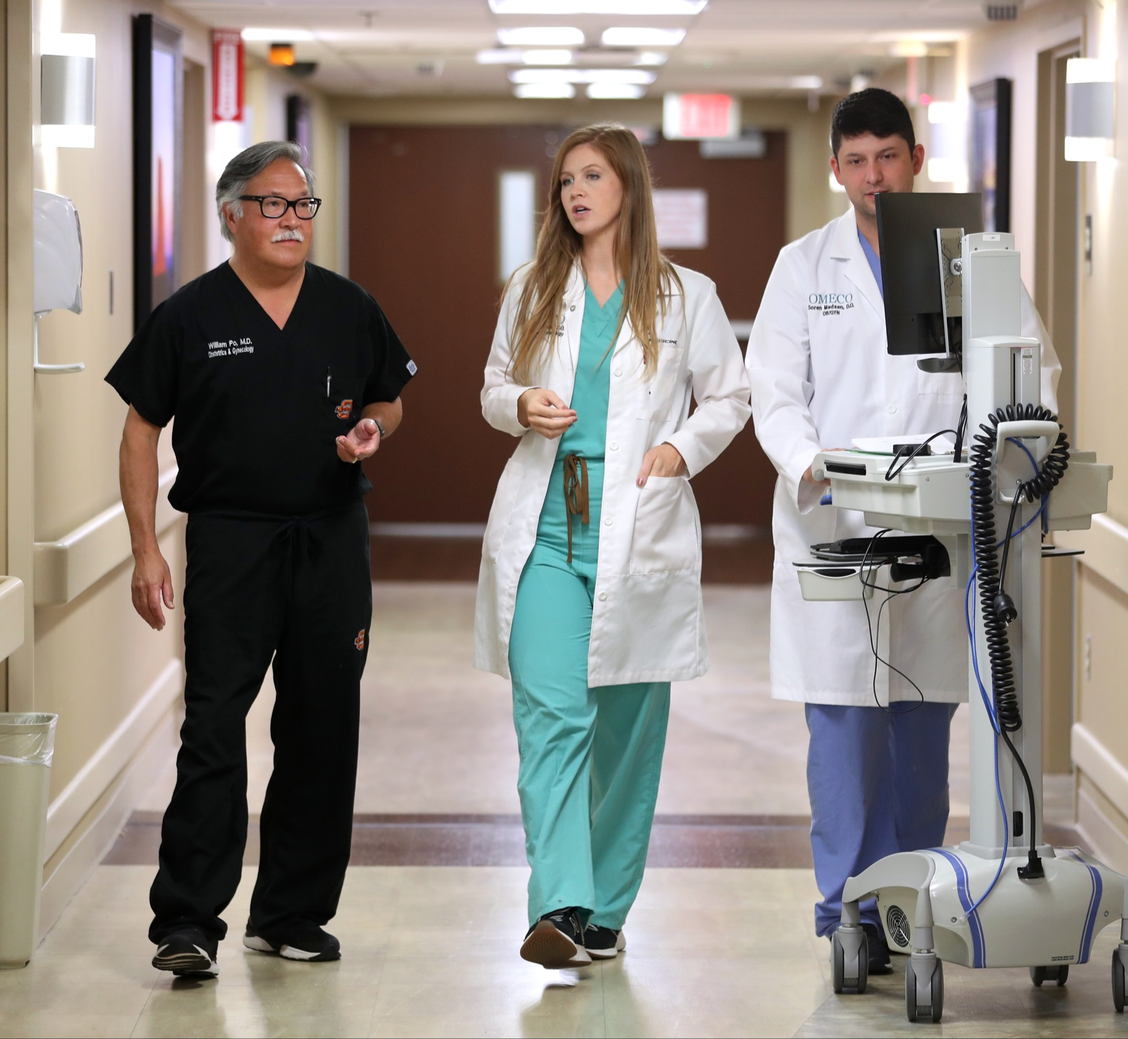
UME TO GME CONTINUUM

