Slide 1
Constructing Exam Questions
Dan Thompson & Brandy Close
OSU-CHS
Educational Development-Clinical Education

Slide 2
Objectives
Use Bloom’s Taxonomy to identify the knowledge level of assessment items
Compose an effective and meaningful stem for Multiple Choice items
Construct effective and plausible distractors for Multiple Choice items
Construct effective assessment questions in the form of: Multiple Choice, True/False/ and Essay/Short Answer

Slide 3
Planning the Assessment
Use Bloom’s taxonomy to categorize content/concepts by knowledge level.
Create a table to breakdown and organize assessment items by outcome level
Example:
http://www.iub.edu/~best/pdf_docs/better_tests.pdf

Slide 4
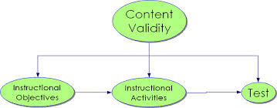
Validity- does the assessment measure the learning outcomes you intend to measure with your assessment items?
Coordinating assessment content with instruction content increases the validity of the assessment.
http://www.iub.edu/~best/pdf_docs/better_tests.pdf

Slide 5
Constructing the Stem
The stem should be meaningful and present a problem
Focus on a learning outcome
Lack of a definite problem in the stem often assesses student’s inference as opposed to a direct measurement of performance
http://cft.vanderbilt.edu/guides-sub-pages/writing-good-multiple-choice-test-questions/

Slide 6
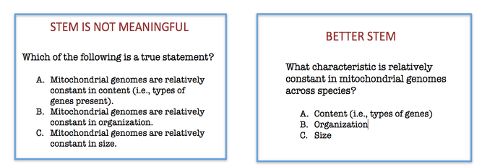
http://cft.vanderbilt.edu/guides-sub-pages/writing-good-multiple-choice-test-questions/

Slide 7
Try to avoid including irrelevant material in the stem
Can decrease the reliability and validity of the assessment item
http://cft.vanderbilt.edu/guides-sub-pages/writing-good-multiple-choice-test-questions/

Slide 8
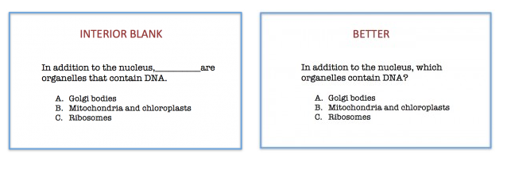
http://cft.vanderbilt.edu/guides-sub-pages/writing-good-multiple-choice-test-questions/
Consider making the stem a question or partial sentence
A question stem allows students to focus on answering the assessment item, increasing validity
Avoid using inserted blanks as it increases cognitive load- can decrease validity of assessment item

Slide 9
Constructing the Distractors
All distractors should be plausible
Serve to effectively indicate what students know
Incorrect distractors should be chosen by students who did not achieve the learning outcome
Incorrect distractors should be ignored by the students who did
http://cft.vanderbilt.edu/guides-sub-pages/writing-good-multiple-choice-test-questions/

Slide 10
Distractors should be clear and concise
Excessive wordiness assesses reading/comprehension as opposed to the actual desired outcome
http://cft.vanderbilt.edu/guides-sub-pages/writing-good-multiple-choice-test-questions/

Slide 11
Avoid using “all of the above” or “none of the above”
Students who can identify more than one correct distractor can choose correct answer without achieving the learning outcome
Conversely, students who can identify on incorrect distractor can choose correct answer without achieving the learning outcome
Distractors can contain inadvertent clues in the language, length, format, and grammar
Keep grammar consistent with the stem
Keep length similar
Keep format similar
Keep language similar
http://cft.vanderbilt.edu/guides-sub-pages/writing-good-multiple-choice-test-questions/

Slide 12
Constructing True/False, Essay/Short Answer Items
True/False Items
Typically used at the knowledge level of assessment to measure recall of factual knowledge
Potential to measure higher level knowledge
Strengths of True/False Items
Easy to write and answered quickly by students
Provide a large sampling of content vs time allotted
Weaknesses of True/False Items
Problem with guessing- 50/50 chance of guessing correctly without achieving learning outcome
Ambiguity due to writing statements that are indisputably true or false
http://www.iub.edu/~best/pdf_docs/better_tests.pdf

Slide 13
Guidelines to Constructing True/False questions:
Assess significant material
Write questions that are indisputably true or false
Avoid taking statements directly from textbooks
Assess only one point in each item
Avoid trick questions
Avoid terms such as : always, all, never…instead use: usually, often, many times
Avoid negatively worded statements
Randomize the order to avoid giving clues
Keep true and false statements/questions similarly formatted
http://www.iub.edu/~best/pdf_docs/better_tests.pdf

Slide 14
Essay/Short Answer Items
Consider class-size
Consider time available to prepare the assessment
Strengths of Essay/Short Answer Items
Effective way to measure higher level thinking
Require less time to construct
Discourages students from memorizing and regurgitating facts
Can provide students with realistic tasks/scenarios
Requires student s to organize, construct, and communicate their thoughts
Weaknesses of True/False Items
Provide a smaller sampling of content due to time needed to answer each question
Require more time for grading: reading and scoring
Scoring is often more subjective than objective which can decrease reliability
http://www.iub.edu/~best/pdf_docs/better_tests.pdf

Slide 15
Guidelines to Constructing Essay/Short Answer questions:
Create clearly defined questions…lead the student towards the approach you desire
To cover more content, consider more questions requiring shorter answers
Avoid giving optional essay questions- students choosing different essay questions to answer are essentially taking different exams
Indicate how much each essay/short answer question is worth
Avoid questions that only require providing factual information
http://www.iub.edu/~best/pdf_docs/better_tests.pdf

Slide 16
Consider that higher level processes build upon lower level processes
If the lower level processes are not achieved, then the higher level one will be deficient
Examples of essay/short answer items by level of Bloom’s Taxonomy
http://www.iub.edu/~best/pdf_docs/better_tests.pdf

Slide 17
Questions?

