Slide 1
Sign Up Here

Slide 2
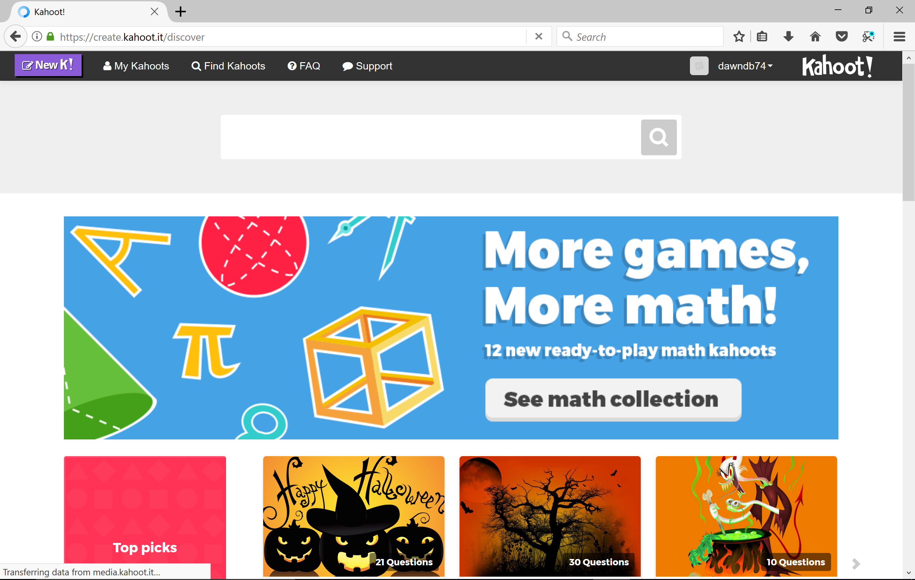
Click Here to Create New Kahoot!

Slide 3
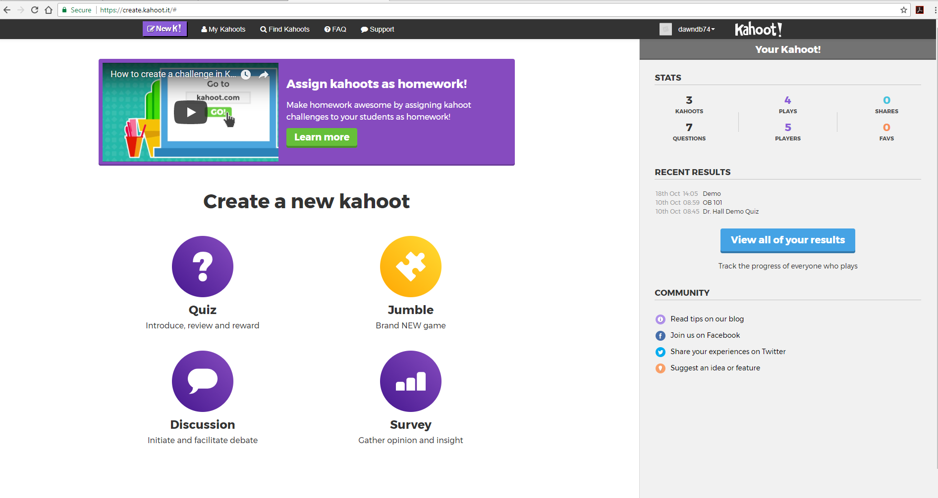
Click Here to create a quiz

Slide 4
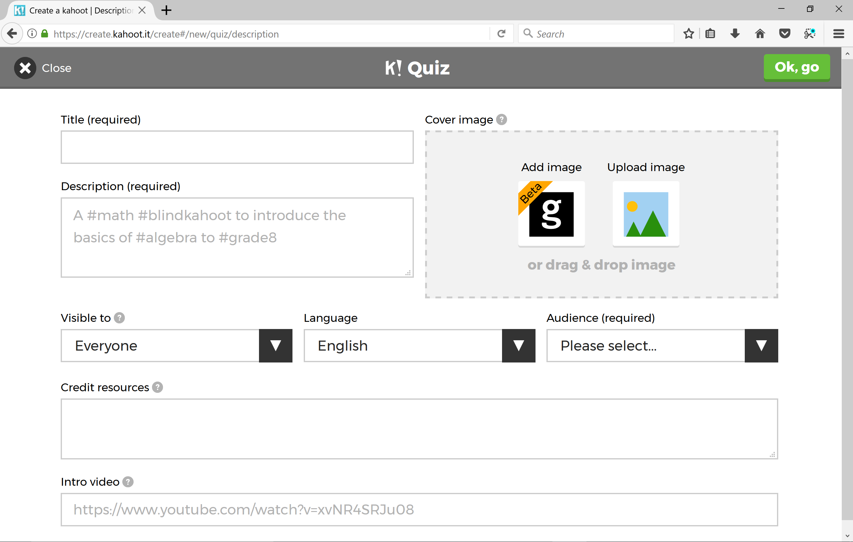
Enter Title Here
Enter Description Here

Slide 5
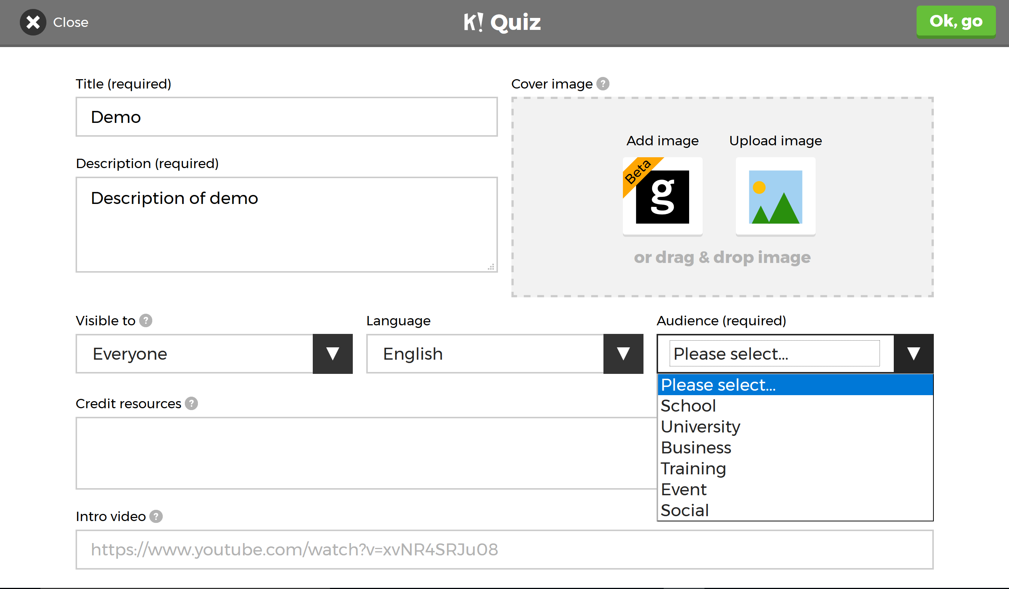
Select your audience

Slide 6
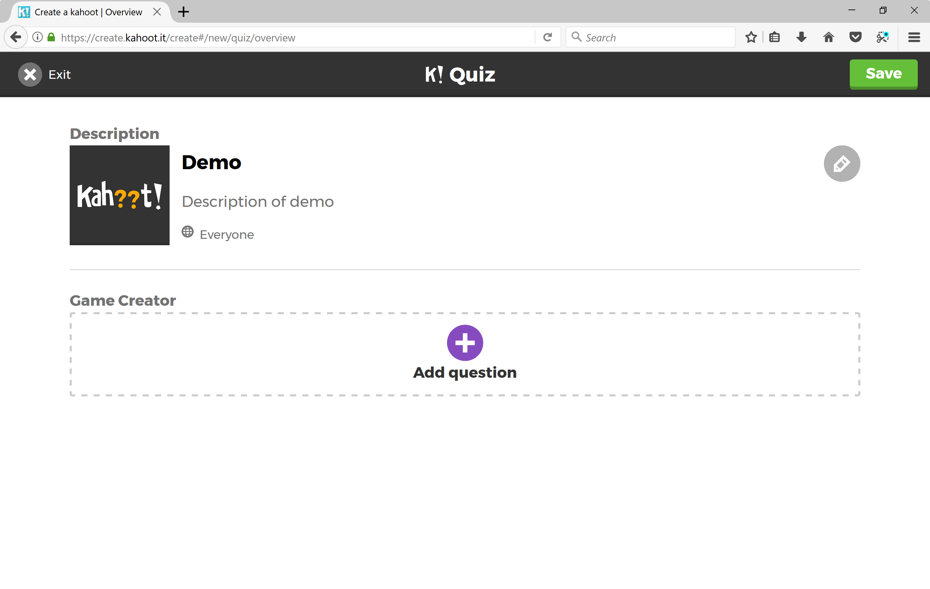
Click + button to add question

Slide 7
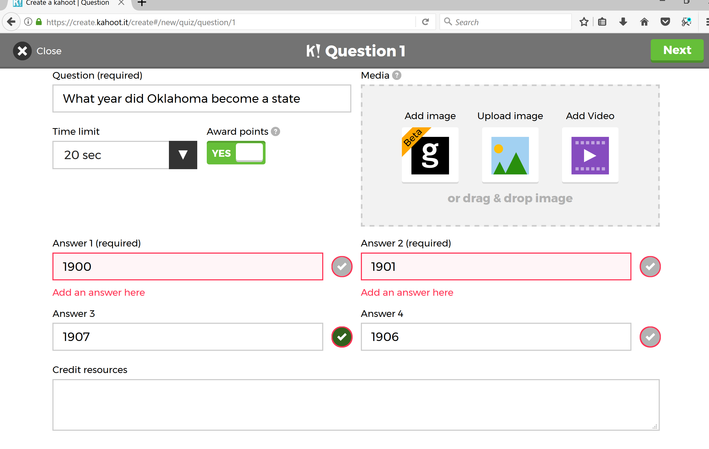
Click here once this screen is completed
Enter question here
At least 2 answers are required
Click drop down arrow to select time limit

Slide 8
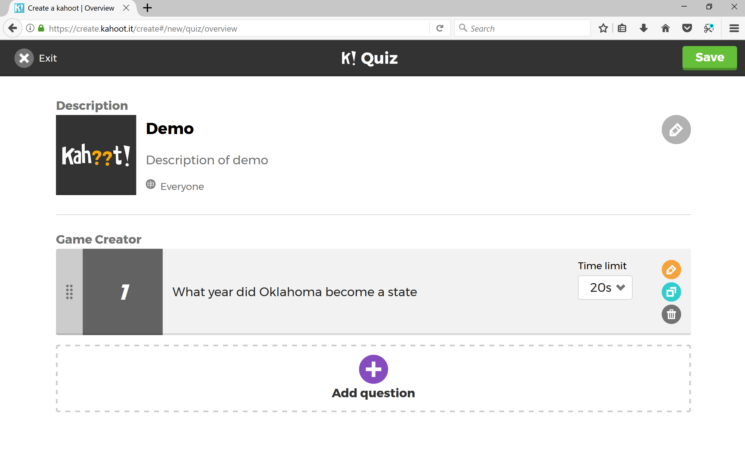
When complete, click Save
Click here to continue to add more questions

Slide 9
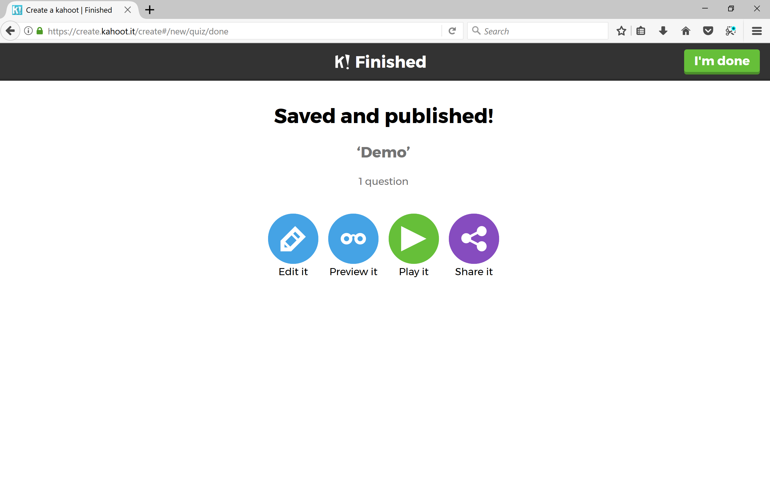
Let’s preview

Slide 10
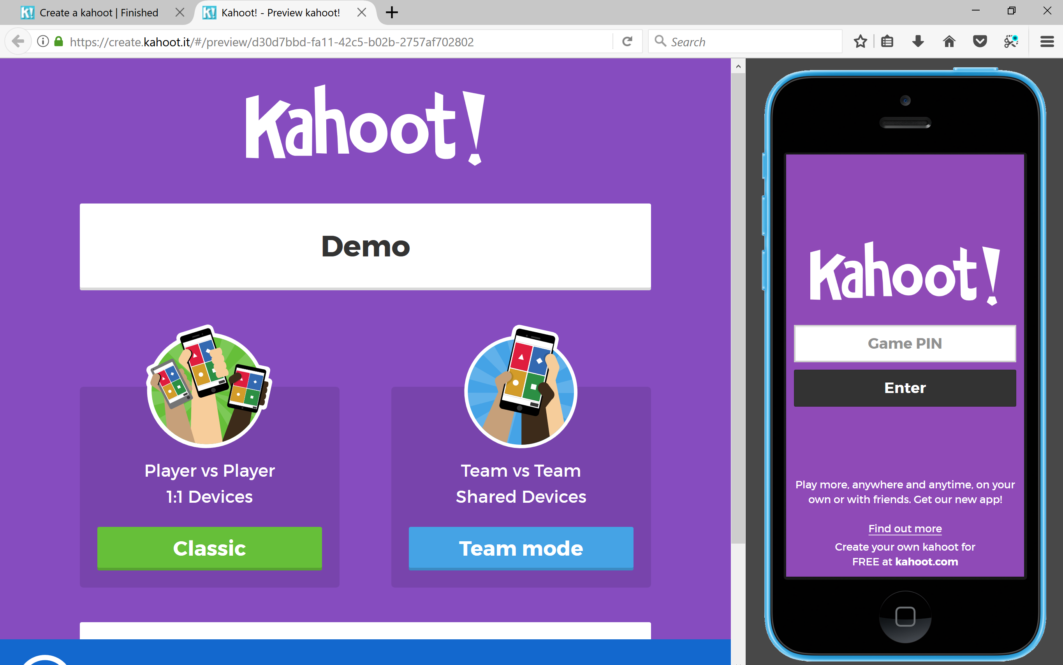
Title of your quiz
Let’s look at Team mode

Slide 11
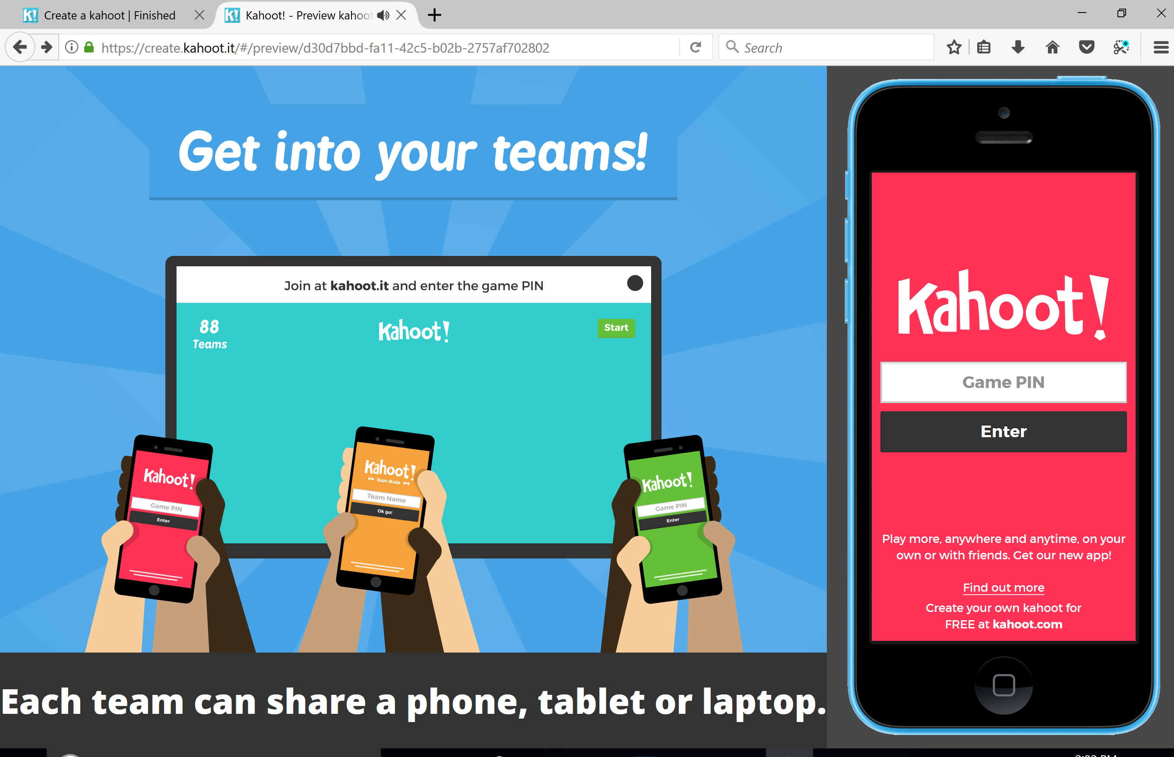
After selecting Team mode, you will see this screen. It will stay here a few seconds and then give the game pin.

Slide 12
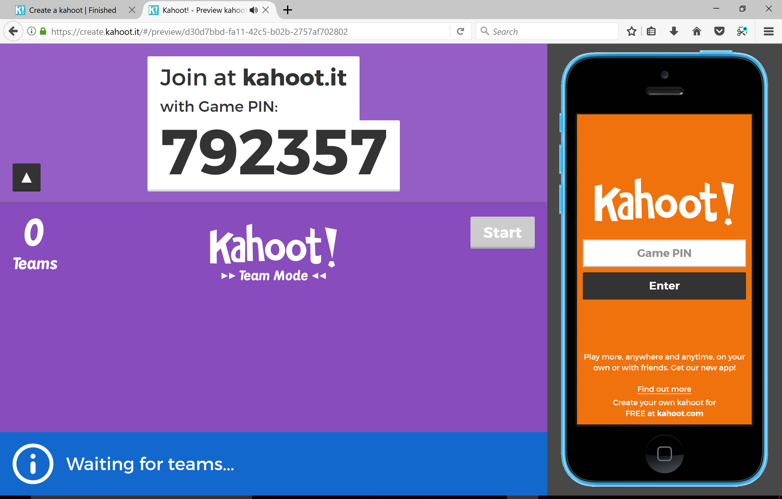
Enter game pin here to log in as student and see what they would see as a user

Slide 13
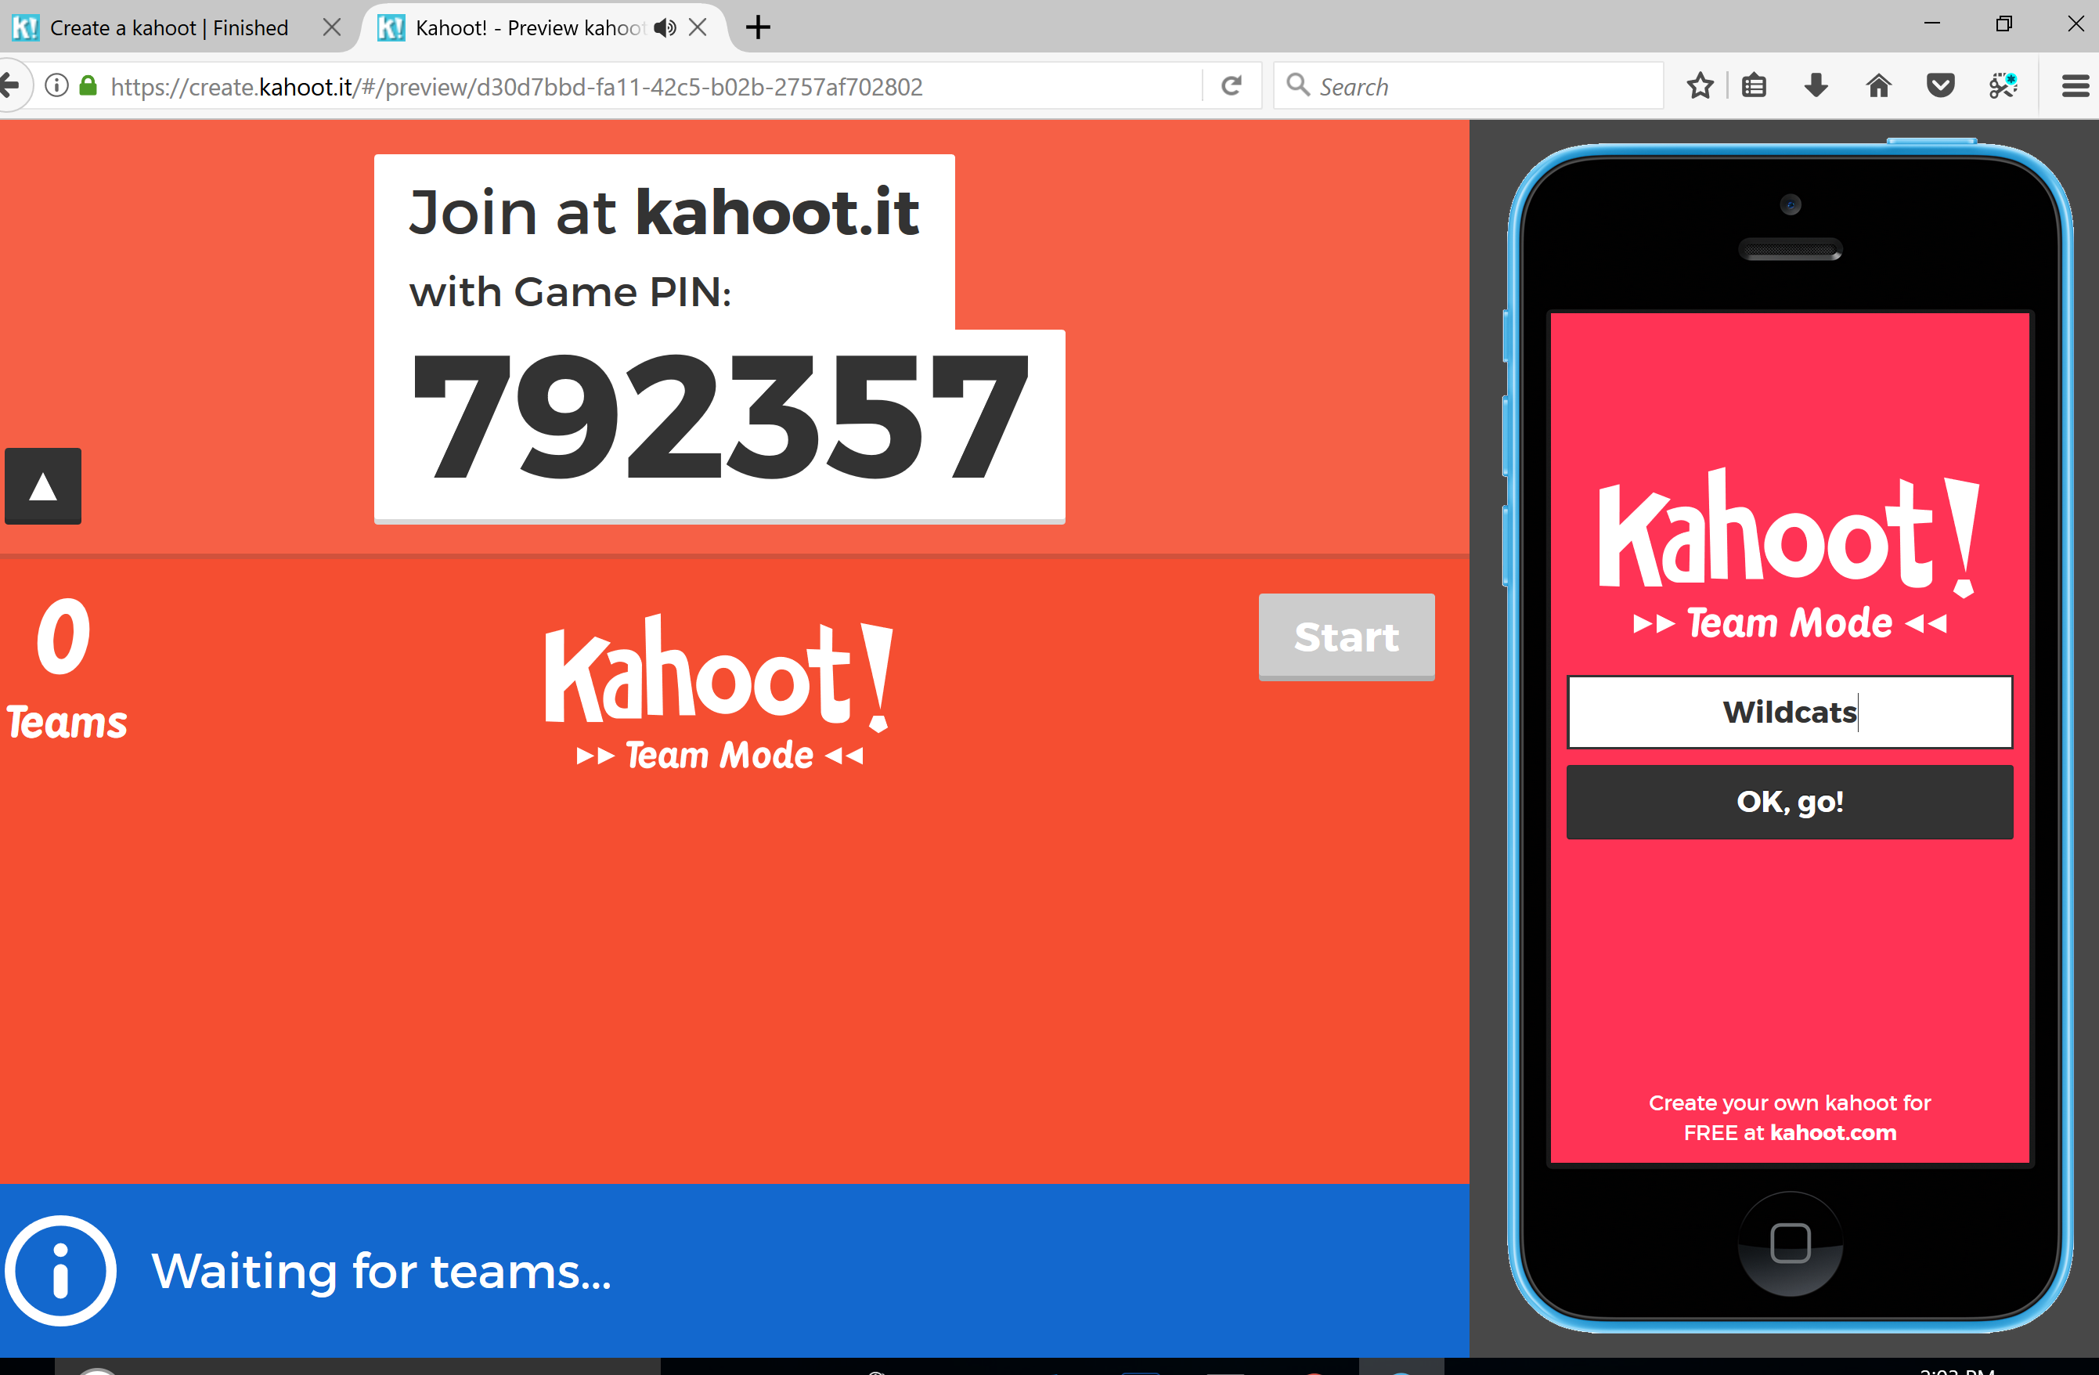
Once you enter the pin, it will ask for a team name

Slide 14
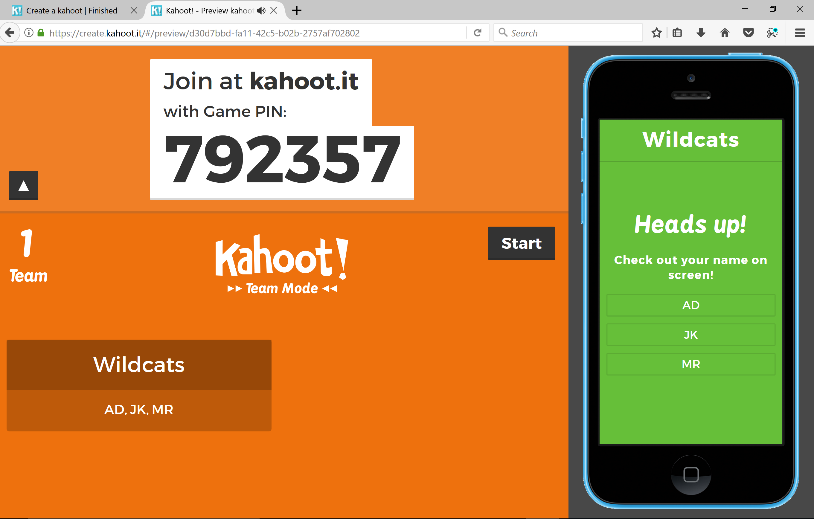
It will then ask you to ener the initials of the team members
Click the box that says ready to join. Will be here. (not available in this picture)
Click start when complete

Slide 15
The question will be displayed

Slide 16
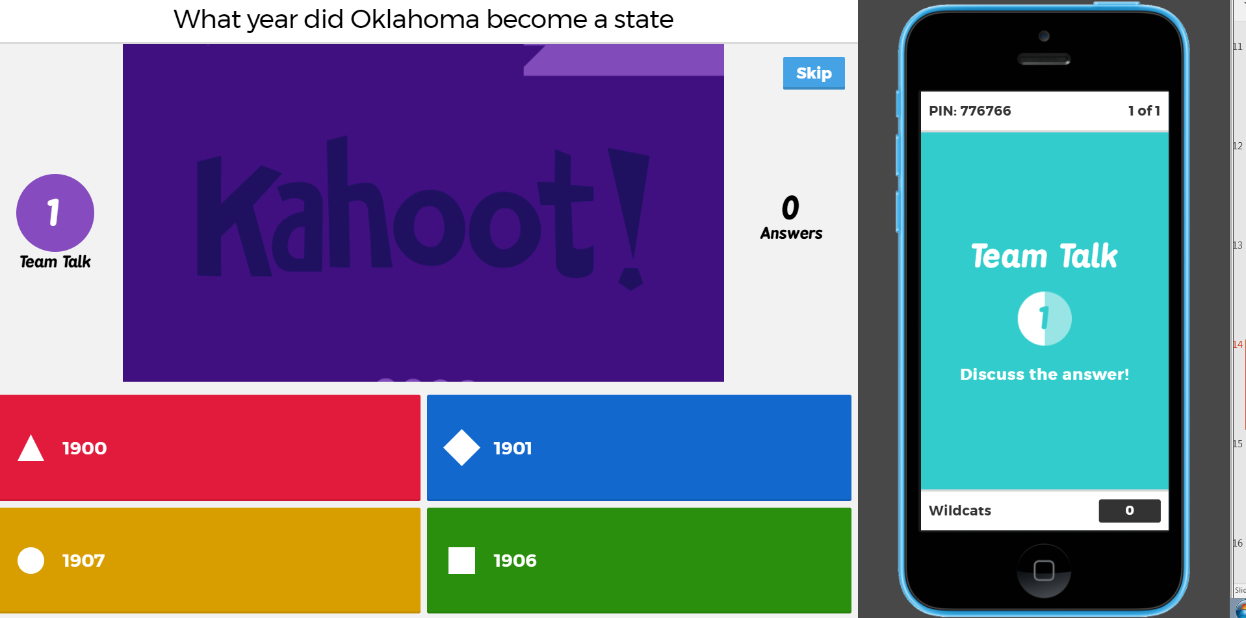

Slide 17
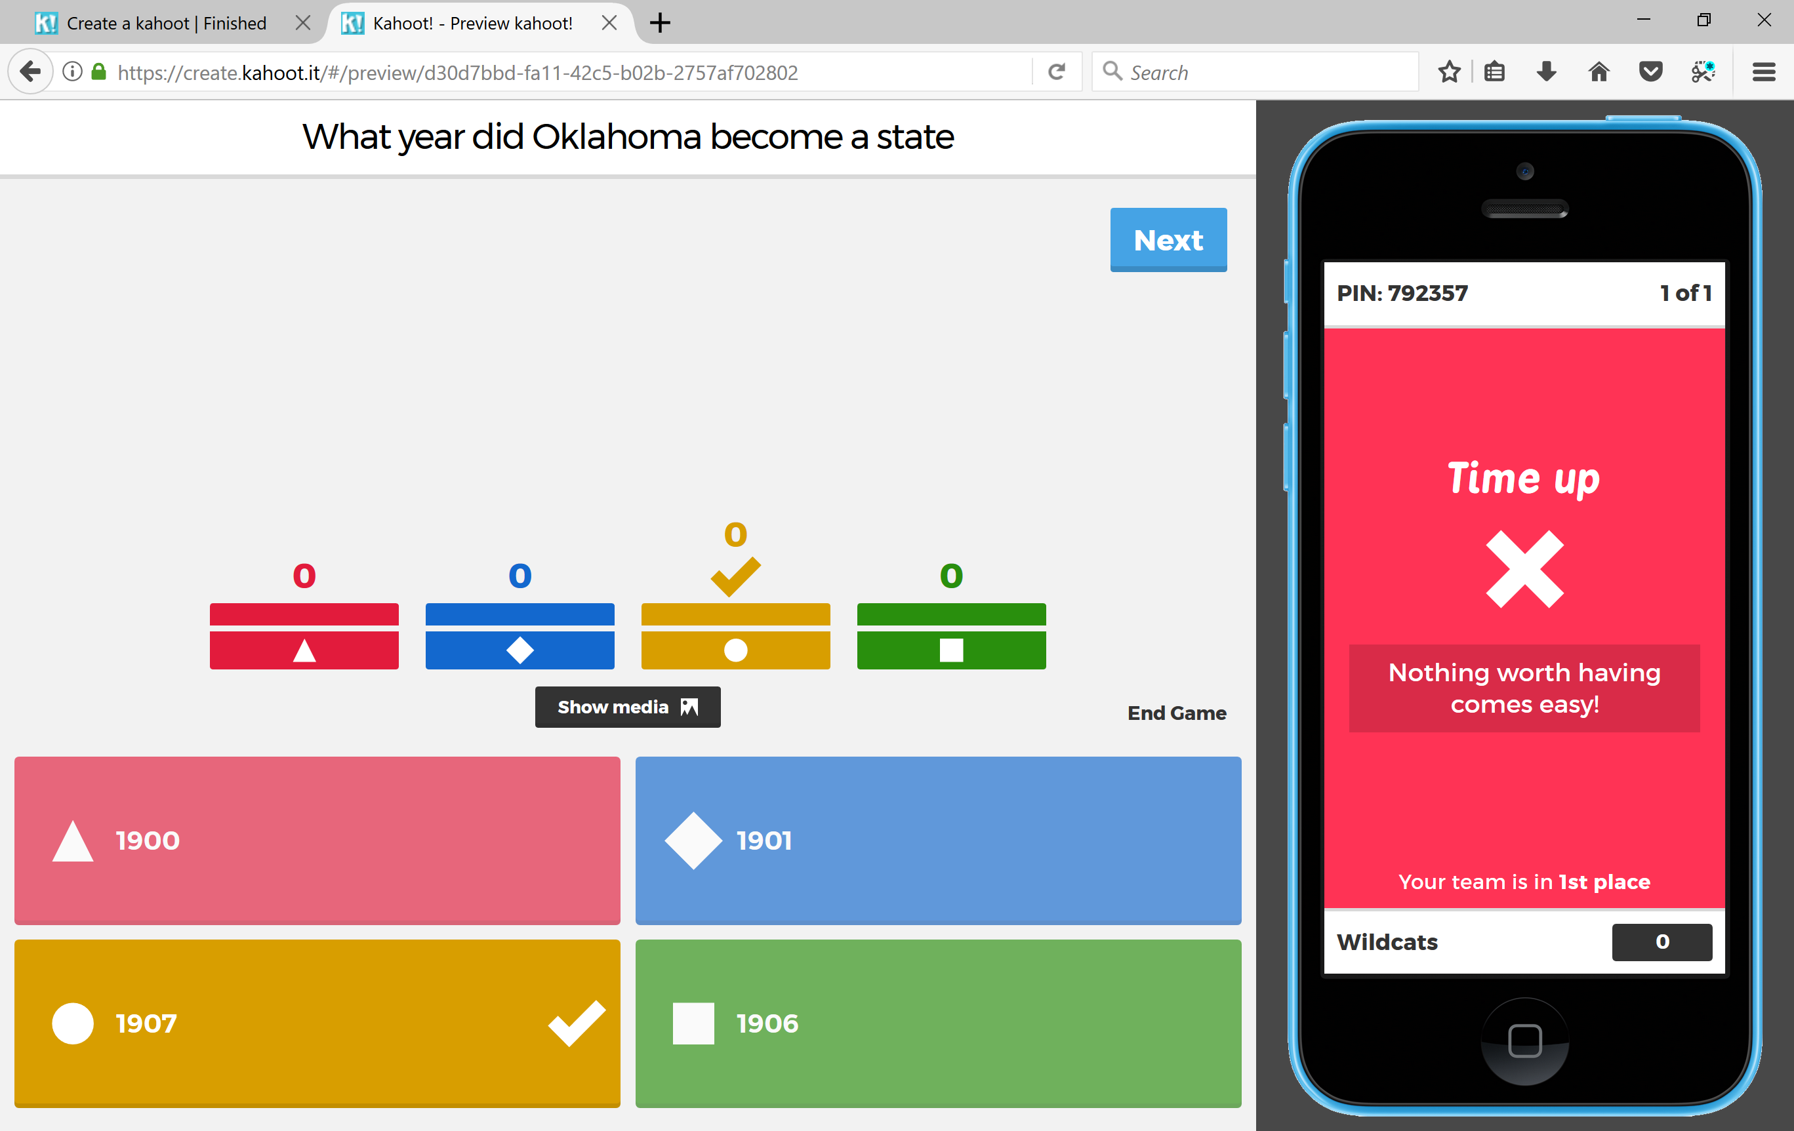
Users will answer based on the color and shapes

Slide 18
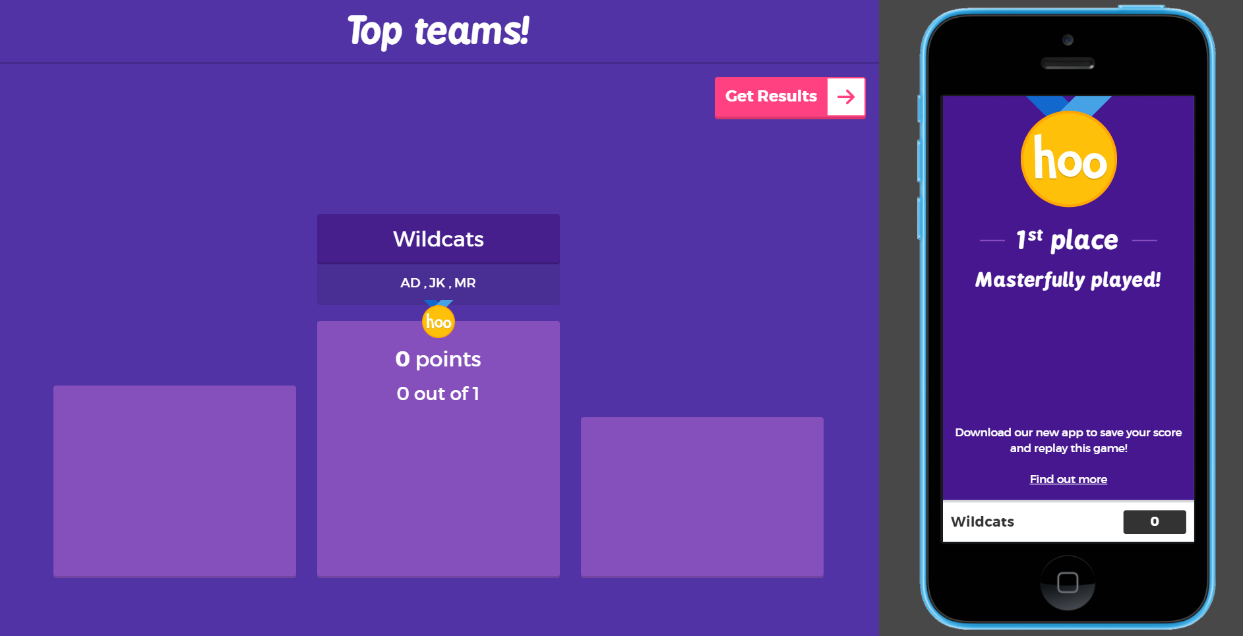
Click here to get results

Slide 19
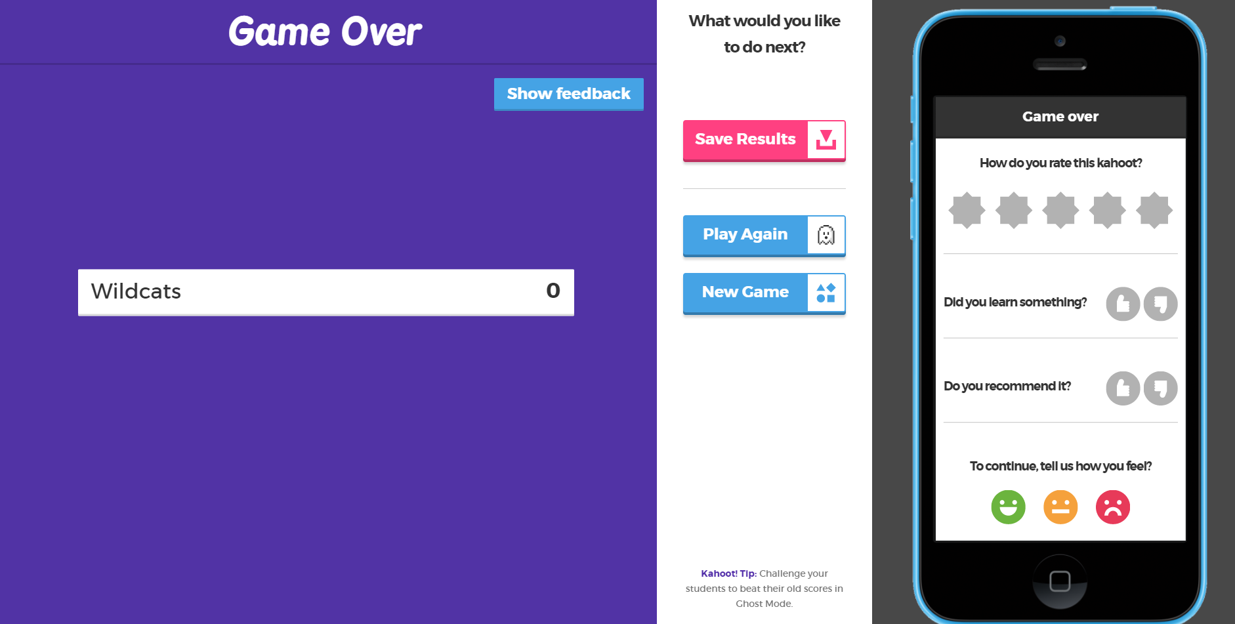
Click save results

Slide 20
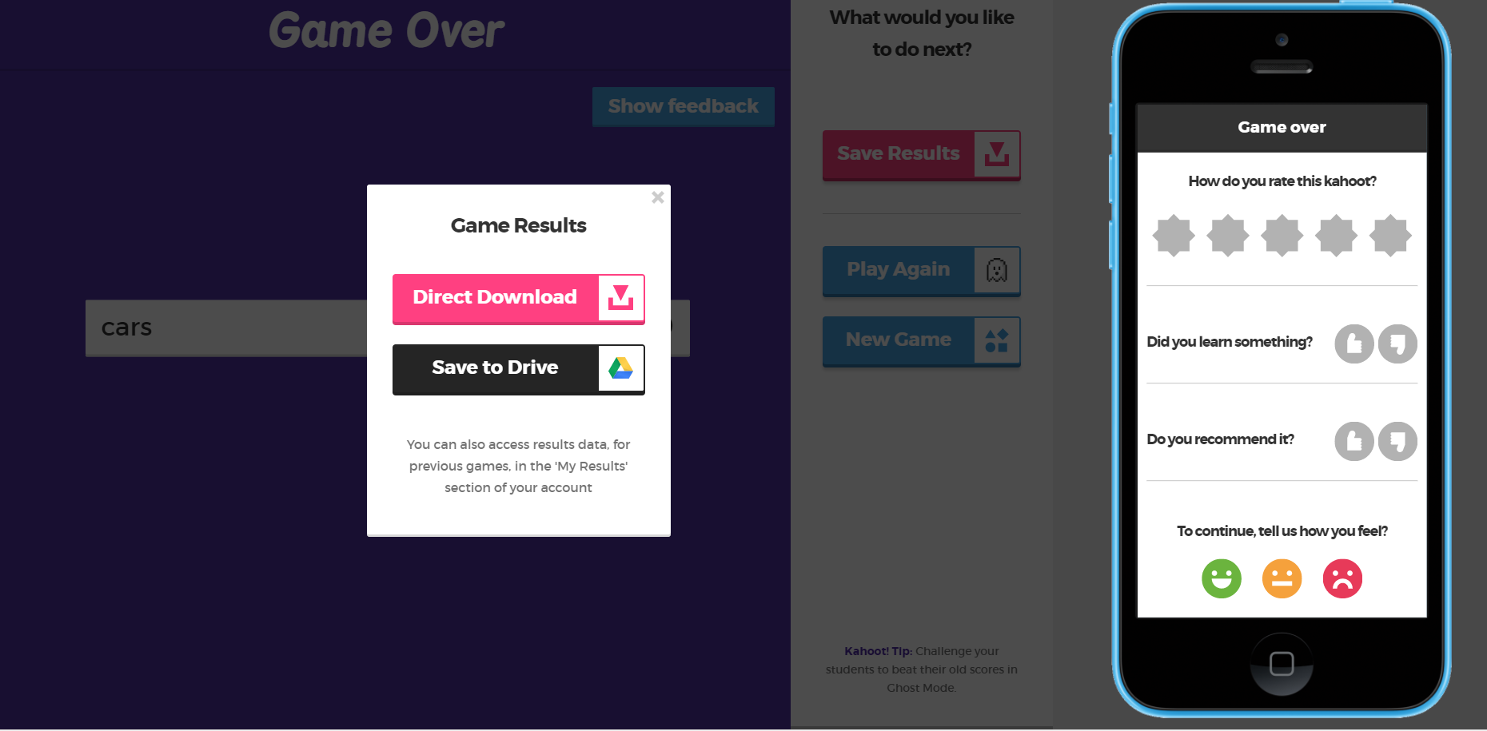
Choose your option to view

Slide 21
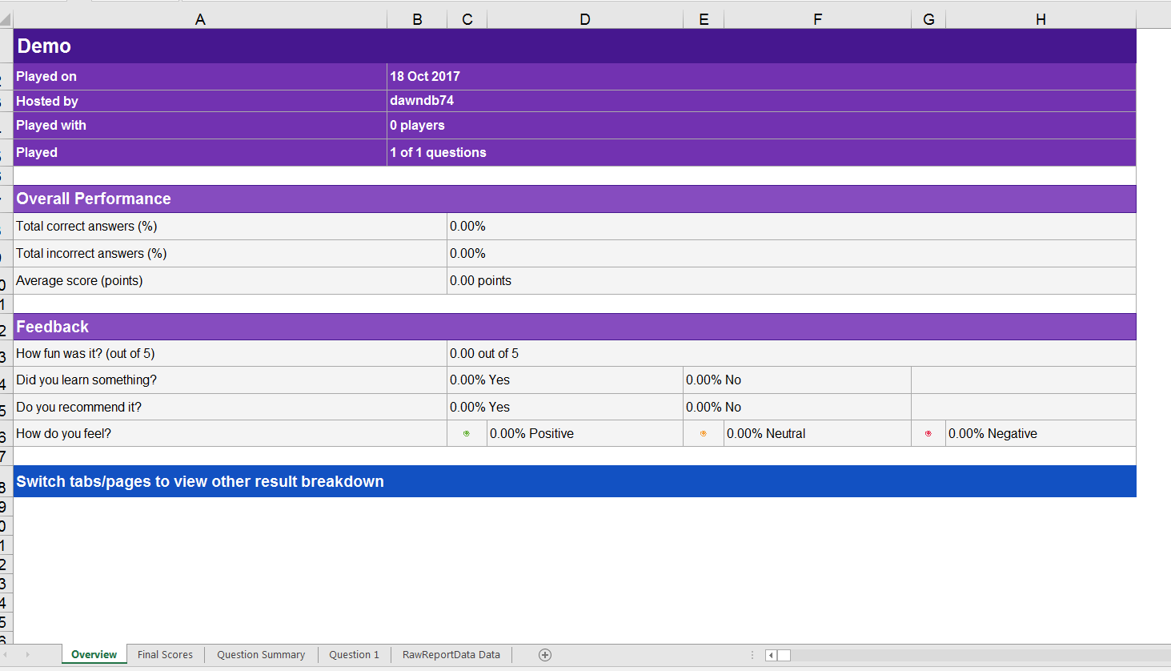
Click on any of the above tabs to see the different scoring data

