Slide 1
OSHA’s Revised Bloodborne Pathogens Standard
Outreach and Education Effort 2001

Slide 2
Bloodborne Pathogens Standard
29 CFR 1910.1030, Occupational Exposure to Bloodborne Pathogens
Published December 1991
Effective March 1992
Scope
  ALL occupational exposure to blood and other potentially infectious material (OPIM)
Notes:
The BBP Standard applies to all employers with employees with reasonably anticipated occupational exposure to blood or OPIM. It applies, not just in healthcare, but in general industry as well (e.g., first aiders). The BBP standard does not apply in construction, agriculture, or maritime; as those industries have adopted different standards.

Slide 3
Bloodborne Pathogens Standard
  Major Provisions by Paragraph
  (b) Definitions
  (c) Exposure Control Plan (ECP)
  (d) Engineering and Work Practice Controls
    - Personal Protective Equipment (PPE)
  (e) HIV and HBV Research Labs
  (f) Vaccination, Post-Exposure Follow-up
  (g) Labeling and Training
  (h) Recordkeeping
Notes:
This presentation will focus on requirements for (1) Exposure Control Plan, (2) Engineering Controls, (3) Recordkeeping, as these are the areas where new requirements have been mandated.
The remaining sections of the standard have been in place since 1991. If you have questions on these sections, feel free to call your OSHA Area or Regional Office. Contact information is available on OSHA’s website at www.osha.gov.

Slide 4
Methods of Compliance
Universal Precautions
Engineering and Work Practice Controls
Personal protective equipment
Housekeeping
Notes:
Since paragraph (d) of the standard is exceptionally important in reducing and eliminating occupational exposure to blood and OPIM, it is important to note all of the major methods of compliance (indicated on this slide).
Universal precautions is an approach to infection control where all human blood and certain human body fluids are treated as if they are known to be infected by HIV, HBV, HCV, and other bloodborne pathogens. The Centers for Disease Control and Prevention (CDC) and local Departments of Health have numerous resources regarding proper infection control practices. Documents are available from the CDC at www.cdc.gov.
Engineering and work practice controls must be used to eliminate or minimize employee exposure. Where occupational exposure remains after the institution of these controls, personal protective equipment must also be used.
Housekeeping ensures that a worksite is maintained in a clean and sanitary condition.

Slide 5

Since 1991…
Advancements in medical technology
September 1998, OSHA’s Request for Information (RFI)
  Findings of RFI
Union and Congressional involvement
November 1999, CPL 02-02-069
Notes:
Nearly 10 years of new technology, medical treatments, and interpretations since publication of 1991 BBP Standard
The information gathered from the RFI demonstrated feasibility and availability of safer medical devices, and the importance of training and work practices controls.
In May of 1999, the Stark Boxer Healthcare Worker Needlestick Prevention Act was introduced to Congress. This was also designed as an attempt to reduce needlesticks.
The Needlestick Safety and Prevention Act was passed unanimously in the House and Senate (introduced by Congressman Cass Ballenger (NC) as HR 5178).

Slide 6
Needlestick Safety and Prevention Act, P.L. 106-430

Slide 7
The Needlestick Safety and Prevention Act mandated…
OSHA clarify and revise
29 CFR 1910.1030, the Bloodborne Pathogens Standard
Notes:
This indicates the intent of the Needlestick Safety and Prevention Act, which was to modify the Bloodborne Pathogens standard to set forth in greater detail its requirement that employers identify, evaluate, and make use of effective safer medical devices (Rep. Ballenger, HR5178)

Slide 8
Needlestick Safety and Prevention Act Timeline
P. L. 106-430 signed; November 6, 2000
Revised Standard published in Federal Register; Jan. 18, 2001
Effective date; April 18, 2001
Enforcement of new provisions; July 17, 2001
Adoption in OSHA state-plan states; October 18, 2001

Slide 9
Revisions to Standard
Additional definitions, paragraph (b)
New requirements in the Exposure Control Plan, paragraph (c)
Solicitation of input from non-managerial employees, paragraph (c)
Sharps injury log, paragraph (h)
Notes:
This is just an overview of the new provisions, these will be discussed in detail as the presentation progresses.

Slide 10
Additional Definitions
1910.1030(b)
Engineering Controls - includes additional definitions and examples:
  Sharps with Engineered Sharps Injury Protections - [SESIP]
  Needleless Systems
Notes:
Specific definitions in slides that follow.

Slide 11
Engineering Controls
New Definition
“… means controls (e.g., sharps disposal containers, self-sheathing needles, safer medical devices, such as sharps with engineered sharps injury protections and needleless systems) that isolate or remove the bloodborne pathogens hazard from the workplace.”

Slide 12
Needleless Systems
New Definition
Device that does not use a needle for:
  Collection of bodily fluids
  Administration of medication/fluids
  Any other procedure with potential percutaneous exposure to a contaminated sharp

Slide 13
“SESIP”
New Definition
  Non-needle sharp or a needle with a built-in safety feature or mechanism that effectively reduces the risk of an exposure incident.

Slide 14
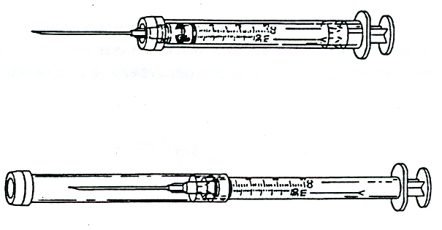
Hypodermic syringes with
“Self-Sheathing” safety feature
Self-sheathed protected position
Notes:
NOTE: The devices pictured in the next few slides are meant to serve as examples of devices that are currently available, this is not an exhaustive list, nor is it meant to favor one device over another. OSHA does not approve, endorse, register, or certify any medical devices.
Needle guard has protected sliding sheath (with some designs the shield must be twisted to engage the lock).
To safely activate the sheath, hold back of syringe in one hand, hold external sheath with other and pull back on the syringe so the sheath is left covering needle. This is better than advancing the sheath forward; if hands slip, a stick may result.
Activated (used) syringe must then be placed in a sharps box, as device activation is considered to be a temporary safety measure, and treated as regulated waste.
[Device drawings courtesy of International Health Care Worker Safety Center, University of Virginia]

Slide 15
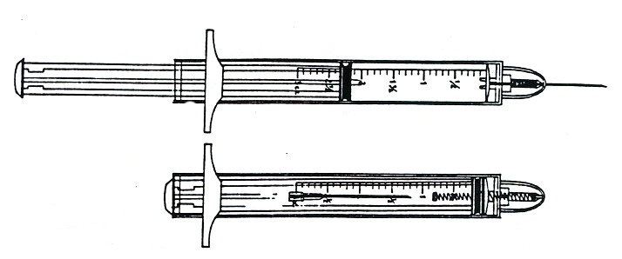
Hypodermic syringes with “Retractable Technology” safety feature
Retracted protected position
Notes:
After injecting medication, further depression of the plunger activates a mechanism that retracts needle into the syringe.
Activated (used) syringe must then be placed in a sharps box and treated as regulated waste.

Slide 16
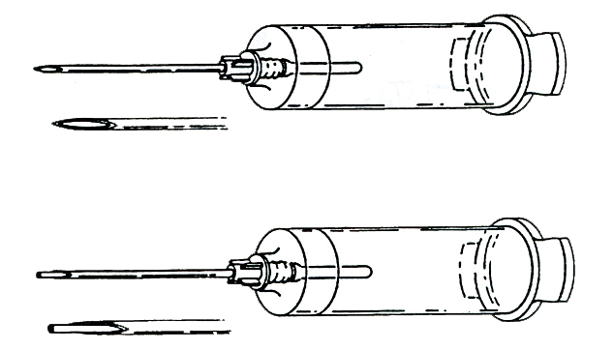
Phlebotomy needle with
“Self-Blunting” safety feature
Blunted protected position
Notes:
After final tube of blood is drawn, blunt internal hub is activated by forward pressure of vacuum tube, blunting needle before it is removed from patient.
Blunting may occur accidentally or deliberately with the first tube, if pushed into the blunting activation mechanism.
If the needle is blunted prematurely, it cannot be used again or repositioned.
Activated (used) syringe must then be placed in sharps box and treated as regulated waste.
Note: The standard prohibits the removal of a needle, unless it is medically necessary. After single use, the device must be deposited in a sharps container.

Slide 17
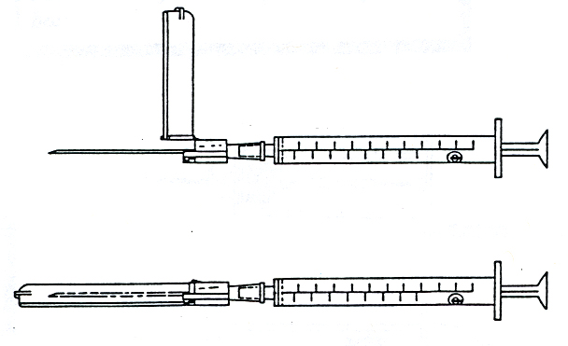
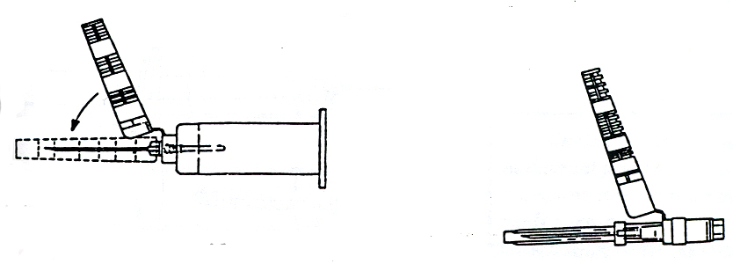
“Add-on” safety feature
Attached to syringe needle
Attached to blood tube holder
Notes:
The hinged safety device can either be purchased separately to add on to an existing syringe or purchased pre-attached to a syringe or blood tube holder.
Once the needle is used, the hinge should be clicked into place using a tabletop-- NOT the other hand.
The activated (used) device must then be placed in a sharps box and treated as regulated waste.

Slide 18
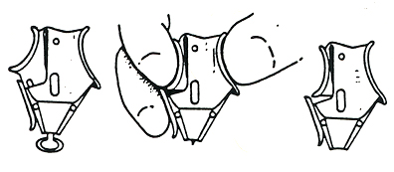
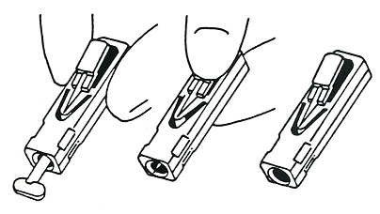
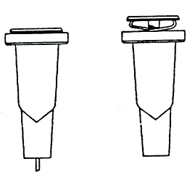
Retracting lancets with safety features
Before During After
Before During After
In use After use
Notes:
These devices are used for finger pricks, most often to test blood sugar in people with diabetes.
When these devices are triggered, the lancet instantly protracts and cannot be used again.
After use, the device must be placed in a sharps box and treated as regulated waste.

Slide 19
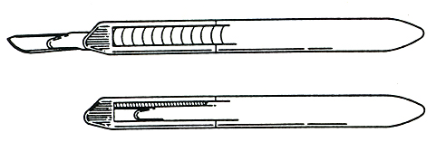
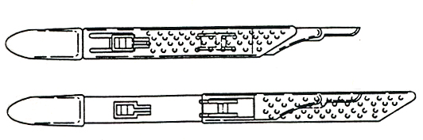
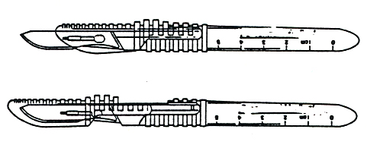
Disposable scalpels with safety features
Retracted position
Protracted position
Protracted position
Notes:
Single use disposable scalpels with blades that retract or sheath. Most of these devices do not lock. Be careful.
After use, safely place the scalpel in a sharps box.

Slide 20
Additional Information
About Safety Devices Available At…
http://www.healthsystem.virginia.edu/internet/epinet/new/oshalinks.cfm
Notes:
These websites include information about particular devices, as well as information about how to effectively evaluate devices. These websites are electronically linked to CPL 2-2.44D on OSHA’s website, www.osha.gov.

Slide 21
Exposure Control Plan:
1910.1030(c)
New Provisions
The ECP must be updated to include:
changes in technology that reduce/eliminate exposure
annual documentation of consideration and implementation of safer medical devices
solicitation of input from non-managerial employees
Notes:
The plan must be updated annually and whenever necessary to reflect any changes.

Slide 22
Solicitation of
Non-Managerial Employees
New Provision
Identification, evaluation, and selection of engineering controls
Must select employees that are:
  Responsible for direct patient care
  Representative sample of those with potential exposure
Notes:
Small medical offices may want to seek input from all employees when making their decisions. Larger facilities are not required to request input from all exposed employees; however, the employees selected should represent the range of exposure situations encountered in the workplace (e.g., pediatrics, emergency department, nuclear medicine, etc.). The solicitation of employees who have been involved in the input and evaluation process must be documented in the Exposure Control Plan.

Slide 23
Engineering and Work Practice Controls: 1910.1030(d)
Employers must select and implement appropriate engineering controls to reduce or eliminate employee exposure.
Notes:
This is an original requirement of the 1991 standard. The Needlestick Safety and Prevention Act merely amplifies and specifies this requirement. (Further discussion follows)

Slide 24
“Where engineering controls will reduce employee exposure either by removing, eliminating, or isolating the hazard, they must be used.”
CPL 02-02-069
Notes:
This quote is taken from CPL 2-2.44D Enforcement Procedures for the Occupational Exposure to Bloodborne Pathogens (November 1999 compliance directive). The directive lends specificity to the standard, setting forth the methods by which employers must protect their employees from the hazards of blood and OPIM with regard to the implementation of engineering and work practice controls.
The directive further explains OSHA’s expectation for preventing exposures includes a comprehensive programs, including engineering controls (e.g., needleless systems, SESIPs, etc.) and proper work practices (e.g., immediately disposing of a contaminated sharp in a sharps box). If engineering and work practice controls do not eliminate exposure, the use of PPE (e.g., eye protection) is required.
Much of the Needlestick Safety and Prevention Act was modeled after the November 1999 directive.

Slide 25
Engineering and Work Practice Controls
Selection of engineering and work practice controls is dependent on the employer’s exposure determination.
Notes:
Exposure Determination is (and has been) required by the original standard. Further discussion about the elements of an exposure determination can be found in the 1991 standard and in CPL 2-2.44D (Enforcement Procedures for the Occupational Exposure to Bloodborne Pathogens Compliance Directive).

Slide 26
Exposure Determination
The employer must:
  Identify worker exposures to blood or OPIM
  Review all processes and procedures with exposure potential
  Re-evaluate when new processes or procedures are used
Notes:
This serves as the basis for determining when and where the use of engineering and work practice controls must be implemented.

Slide 27
Engineering and Work Practice Controls (con’t)
The employer must:
  Evaluate available engineering controls (safer medical devices)
  Train employees on safe use and disposal
  Implement appropriate engineering controls/devices
Notes:
Engineering controls must be appropriate for each process and procedure, independently.
Employee training is key. Devices will not be effective if employees do not feel comfortable using them. Employees must receive training on new devices and/or new medical procedures.

Slide 28
Engineering and Work Practice Controls (con’t)
The employer must:
  Document evaluation and implementation in ECP
  Review, update ECP at least annually
  Review new devices and technologies annually
  Implement new device use, as appropriate and available

Slide 29
Engineering and Work Practice Controls (con’t)
The employer must:
  Train employees to use new devices and/or procedures
  Document in ECP
Notes:
Note: This entire process (review and implementation of engineering controls) must be documented in the employer’s Exposure Control Plan. It is not necessary to include all supporting documents in the ECP, as long as there is reference in the ECP to where the original documents can be found. The ECP must be available to employees.

Slide 30
Recordkeeping: 1910.1030(h)
Sharps Injury Log
  Only mandatory for those keeping records under 29 CFR 1904
  Confidentiality
  Maintained independently from OSHA 300
Notes:
Sharps Injury Logs must be kept by those required to keep records under 29 CFR 1904, Occupational Injury and Illness Recording and Reporting Requirements (may exclude select Standard Industry Classification (SIC) codes and employers with 10 or fewer employees).
The log must be maintained confidentially, as required by paragraph (h)(1)(iii) of the standard. (Personal identifiers must be removed from any list when posting or copying.)
Procedures for maintaining confidentiality for employers are listed in 29 CFR 1904.
Procedures for maintaining confidentiality for CSHOs are listed in 1913.10.
For CSHOs: If additional medical records are needed to ensure compliance, may be necessary to obtain a Medical Access Order under 1913.10. Check with Area Director.

Slide 31

Sharps Injury Log
At a minimum, the log must contain, for each incident:
Type and brand of device involved
Department or area of incident
Description of incident
Notes:
Type and brand must be documented if it is known. [“If known”, refers to situations where a stick occurred through trash or bedding; mostly in housekeeping and maintenance. If attempting to determine the type and brand of a device would increase the potential for an exposure, do not proceed (i.e., do not attempt to remove it from sharps container). Simply list the area of occurrence and a description of the incident.]
As employers, it is important to review your log frequently to determine where needlesticks are occurring and why. This is the rationale behind logging specific information about each incident, as required by the revised standard.

Slide 32
Summary of New Provisions
Additional definitions, paragraph (b)
New requirements in the Exposure Control Plan, paragraph (c)
Non-managerial employees involved in selection of controls, paragraph (c)
Sharps injury log, paragraph (h)
Notes:
Again, this is just a summation of the new provisions of the Bloodborne Pathogens standard.

Slide 33
U.S. Department of Labor, OSHA
200 Constitution Avenue NW, Room N-3603
Washington, DC 20210
(202) 693-2190
Or contact your Regional, Area, or State-Plan Office

Slide 34
www.osha.gov

