Slide 1
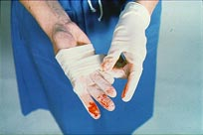

BLOODBORNE PATHOGEN TRAINING
OKLAHOMA STATE UNIVERSITY CENTER FOR HEALTH SCIENCES
Courtesy of Washington State Department of Labor and Industries

Slide 2

Bloodborne Pathogens Training
U.S. Department of Labor Occupational Safety & Health Administration
29CFR1910.1030
Notes:
“You are attending this training program because it has been determined that you have exposure to blood or other potentially infectious materials that may contain bloodborne pathogens. This will be explained during the training. You will also receive refresher training annually.
Each of you has received a copy of the rule Chapter 296-823, Occupational Exposure to Bloodborne Pathogens” (or if you are not distributing copies, describe where employees can get access to a copy).
“Briefly, the rule contains requirements for protecting you from the risk of exposure to bloodborne pathogens while you perform your work. This includes control methods that have been implemented to minimize or reduce the risk of exposure; Hepatitis B vaccination at no cost to you; procedures for what to do if you are exposed; and records that must be maintained.”

Slide 3
Course Objectives
What are Bloodborne Pathogens (BBPs)?
Why are they harmful?
How can I protect myself?
What is CHS’s Exposure Control Manual?
Notes:
“In this training program, you are going to learn about what bloodborne pathogens are; some of the important/serious diseases they cause and their symptoms; how they are transmitted, or spread; what you can do to prevent contracting these diseases; and what our Exposure Control Plan is here at CHS.
“Before we begin discussing bloodborne pathogens, I am going to start with a general overview of microorganisms and how they cause diseases.”

Slide 4
Applicability
While working in a laboratory the following are the most likely sources of BBP exposure:
  Responding to an injured co-worker
  Working with blood products, tissues, cells from humans, primates, or other animals that have been infected with a BBP

Slide 5
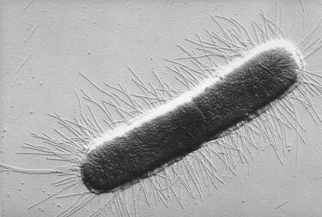
General overview
PATHOGEN: a microorganism that can cause disease
Bloodborne Pathogen and Illnesses Caused
Viruses | AIDS, Hepatitis A, B & C, colds, flu, Herpes
*Image courtesy Indigo Instruments. Visit http://www.indigo.com for more original content like this. Reprint permission is granted with this footer included.*
E. coli (bacteria)
Notes:
“Microorganisms that cause diseases are generally referred to as pathogens. The microorganism generally associated with bloodborne pathogen disease are viruses:
“Viruses: Are extremely small infectious agents that are basically packages of genetic material. They can reproduce only within cells of living hosts by taking over and forcing the host cells to reproduce the virus. Some examples of illnesses they cause include AIDS (caused by HIV); Hepatitis B; a variety of colds and flus; and Herpes.

Slide 6
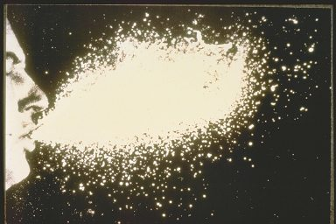

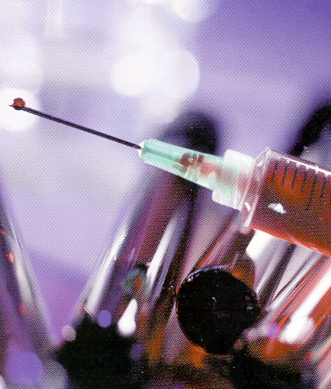
Transmission of Diseases
Organisms can enter the body via
Inhalation
Air
Inhalation
Air
Ingestion
Contaminated food,
water
Contact
Bloodborne
Notes:
“Routes of Transmission: The first step in preventing disease is to keep the organism from entering the body. There are three primary routes of entry:
“Inhalation: a pathogen is usually carried on respiratory droplets in the air and enters the respiratory system; this is not a usual cause of transmission of bloodborne pathogen disease, unless blood or OPIM is aerolized in a lab procedure.
“Ingestion: the pathogen is ingested, usually via contaminated hand or food. For example, in food-borne outbreaks of Hepatitis A, the virus is shed in the feces of an infected restaurant worker who doesn’t wash his/her hands properly after going to the bathroom, and then spreads the virus by handling or preparing uncooked foods or foods after cooking.
“Bloodborne contact: This is the focus of today’s training. In the following slides, I will explain how bloodborne diseases are transmitted, which diseases are of primary concern, their incidence and prevalence, and the symptoms of these diseases.”
NOTE: this slide is animated

Slide 7
Bloodborne Pathogens (BBPs)
Present in
Blood
Other Potentially Infectious Materials
or
Notes:
“Bloodborne Pathogens are microorganisms that are present in blood or other potentially infectious materials (OPIM) and can cause disease.
“’Blood’ includes human blood, human blood components, products made from human blood, and also medications derived from blood (e.g., immune globulins, albumin, etc.).”

Slide 8
Bloodborne Pathogens (BBPs)
OPIM
semen
vaginal secretions
body fluids such as pleural, cerebrospinal, pericardial, peritoneal, synovial, and amniotic
saliva in dental procedures (if blood is present)
any body fluids visibly contaminated with blood
body fluid where it is difficult to differentiate
any unfixed tissue or organ (other than intact skin) from a human (living or dead)
HIV- or HBV-containing cultures (cell, tissue, or organ), culture medium, or other solutions
blood, organs, & tissues from animals infected with HIV, HBV, or BBPs
Notes:
“OPIM include certain body fluids or tissues that may contain bloodborne pathogens, such as”
(Run through the list.)
“Other body fluids and materials, such as saliva, tears, urine, and feces, are not considered OPIM unless they are contaminated with blood or with the OPIM body fluids or tissues listed on this slide.”

Slide 9
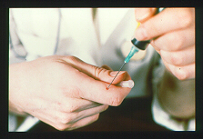
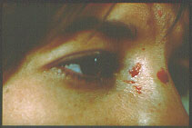
Transmission of BBPs
Bloodborne Pathogens can enter your body through
a break in the skin (cut, burn, lesion, etc.)
mucus membranes (eyes, nose, mouth)
Needlestick injury
other modes
Notes:
“In an infected person, bloodborne pathogens are transmitted to another person when infected blood or body fluids (OPIM) can gain entry through another person’s blood or mucus membranes.. For example: if you get cut with an object (needle, scalpel, glass, etc.) that is contaminated with infected blood or OPIM, or if infected body fluid splashes into your eyes.
“Intact skin will prevent the transmission of bloodborne pathogens because BBPs cannot penetrate intact skin. Non-intact skin – skin that is chapped (cracked) or has cuts, abrasions, lesions, acne, or other openings, or is afflicted with dermatitis – will not. You can, however, become potentially infected if you have infected blood or OPIM on intact skin, for example on your hand, and then you rub your eyes, thus allowing a route of entry through the eyes.
“Other modes of transmission will be discussed when we go over the individual BBPs of concern.”

Slide 10
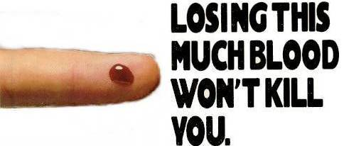


Transmission of BBPs
Risk of infection depends on several factors:
The pathogen involved
The type/route of exposure
The amount of virus in the infected blood at the time of exposure
The amount of infected blood involved in the exposure
Whether post-exposure treatment was taken
Specific immune response of the infected individual
Courtesy of Owen Mumford, Inc.
Notes:
“Most exposures do not result in infection. Following a specific exposure, the risk of infection may vary with factors such as
The pathogen involved
The type or route of exposure
The amount of virus in the infected blood at the time of exposure
The amount of infected blood involved in the exposure
Whether post-exposure treatment was taken
The immune status and specific response of the infected individual
(Note: the graphic shows the tip of an injection needle.)

Slide 11
Bloodborne Pathogen Diseases
Some examples of bloodborne pathogens:
Malaria
Syphilis
Brucellosis
Leptospirosis
Arboviral infections
Relapsing fever
Creutzfeld-Jakob Disease
Viral Hemorrhagic Fever
Main bloodborne pathogens and diseases of concern
Hepatitis B Virus (HBV) | – Hepatitis B
Hepatitis C Virus (HCV) | – Hepatitis C
Human Immunodeficiency Virus (HIV) | – AIDS
Notes:
“Some examples of BBPs are (run through list).
“The main bloodborne pathogens of concern that we are going to go over today are Hepatitis B Virus, Hepatitis C Virus, and Human Immunodeficiency Virus (HIV), which causes Acquired Immunodeficiency Syndrome or AIDS.”
(Note: A person can have co-infections - two or more infections in the body at the same time. For example,a person having HIV/HCV co-infection has both HIV and HCV.)

Slide 12
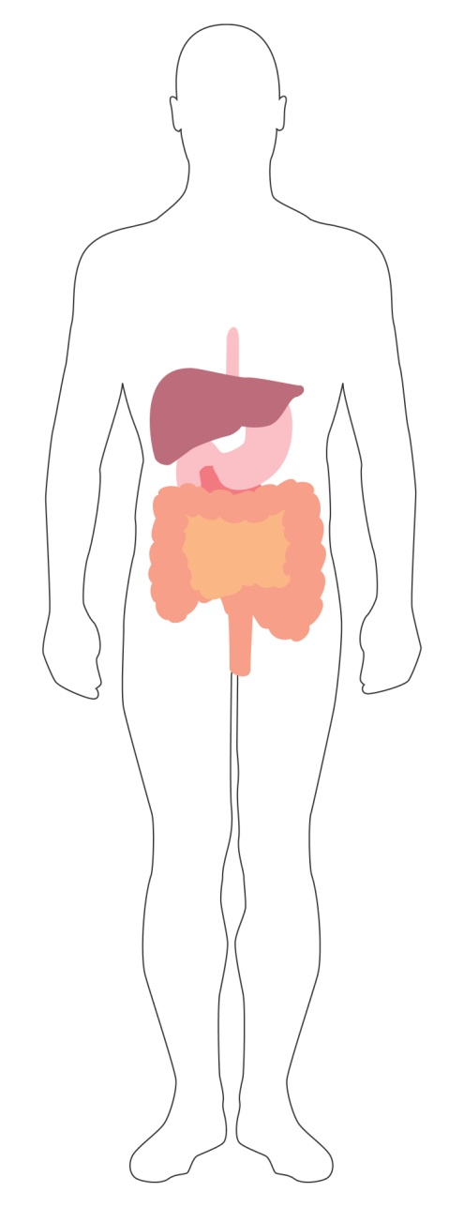
Viral Hepatitis - General Overview
Virus attacks liver  inflammation, enlargement, and tenderness
Acute and chronic infections
Possible liver damage ranging from mild to fatal
The liver is a large, dark red gland located in the upper right abdomen behind the lower ribs. It functions in removing toxins (poisons) from the blood, in the digestion of fats, and in other body processes.
Courtesy of Schering Corporation
Notes:
“Hepatitis viruses are very infectious organisms that attack the liver, causing inflammation of the liver and often enlargement and tenderness of the liver.
“Viral hepatitis infections can be acute (short-term) or some can become chronic (long-term) and last the rest of one’s lifetime.
“Hepatitis infection can result in liver damage that is mild, severe, or fatal.
“Let’s look at Hepatitis B.”

Slide 13
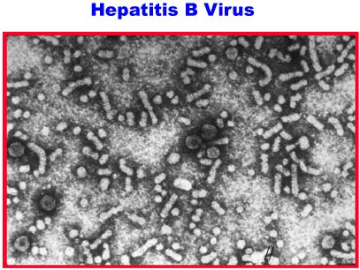
HBV - Hepatitis B
General Facts
CDC Facts - Americans (2009)
Hearty - can live for 14+ days in dried blood
100 times more contagious than HIV
In US approximately ~43,000 new infections per year
800,000 to 1.4 million infected carriers
4,000 deaths/year
No cure, but there is a preventative vaccine
Notes:
“The Hepatitis B virus can survive outside the body for more than 14 days in a dry state on a surface, for instance on a counter top or discarded hypodermic needle.
“HBV is 100 times more contagious than HIV.
“The number of new infections per year has dropped considerably since the 1980’s to about 43,000 in 2007. The highest rate of disease occurs in 20–49 year olds.
“There are an estimated 800,000 to 1.4 million chronically infected Americans who are carriers. Those with chronic hepatitis infection are at higher risk for liver diseases, such as cirrhosis and liver cancer (at 12-300x risk than non-carriers). (Cirrhosis is irreversible scarring of the liver. When liver inflammation doesn’t subside but persists, it leads to the destruction of working liver cells. When these cells die, they are replaced by scar tissue, resulting in its failure to perform many of its usual functions.)
“Approximately 5000 die per year from the disease or later complications such as liver cancer in the U.S.
“There is no cure, but there is a vaccine that can prevent you from getting infected, and is effective before or after exposure. I will discuss the vaccine further later in this presentation.”

Slide 14
HBV - Hepatitis B
Clinical Features
Incubation period | Average 60-90 days Range 45-180 days
No sign or symptoms Acute illness (jaundice) | 30% 30%-50% (≥5 years old)
Chronic infection (carrier) | 2%-10% (of infected adults)
- Premature death from chronic liver disease | 15-25% (of chronically infected)
Immunity | Protected from future infection
Notes:
“The incubation period (the time between initial contact with the virus and onset of the disease) varies from 45 to 180 days and averages 60-90 days. Onset of acute disease is generally gradual.
“About 30% of infected persons show no sign or symptoms. The course and outcome of HBV infection vary substantially depending on the age at which infection occurs. Clinical illness associated with acute infection (jaundice) occurs in 30%-50% of older children and adults.
“About 0.5%-1% of infected persons do die from acute illness, but most acute HBV infections in adults result in complete recovery with immunity from future infection.
“However, up to about 10% of adults who are infected with HBV develop chronic infection and become carriers. Most of the serious consequences associated with HBV occur in these persons, who have recurring episodes of the disease for life and remain potentially infectious. Persons with chronic HBV infection often have no symptoms, but these persons are at high risk for developing chronic hepatitis B, and approximately 15%-25% may die prematurely from either cirrhosis or liver cancer.
“After you have a Hepatitis B infection, you are immune (protected) from any future Hepatitis B infections.”

Slide 15

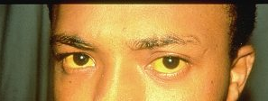
HBV - Hepatitis B
Symptoms
  flu-like symptoms
  fatigue
  abdominal pain
  loss of appetite
  nausea, vomiting
  joint pain
  jaundice
Normal eyes
Jaundiced eyes
Notes:
“Symptoms of Hepatitis B viral infection may include
fatigue
abdominal pain
loss of appetite
nausea, vomiting
joint pain
jaundice
(Jaundice is a yellowing of the skin, sclera or “whites” of the eyes, and mucous membranes. It is due to an increase in bile pigments in the blood resulting from failure of the liver cells to function properly.)

Slide 16
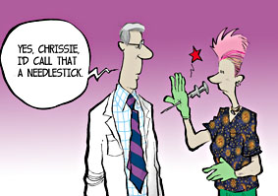
HBV - Hepatitis B
Occupational HBV Transmission
Sharps/needle sticks
Splashes of blood or unprotected skin during care of injured people
Notes:
“HBV is spread from one person to another through blood to blood or mucous membrane. In the United States, the most important route of occupational HBV transmission is by needlestick injury.

Slide 17
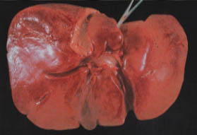
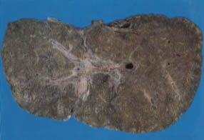
HCV - Hepatitis C
General Facts
The most common chronic bloodborne infection in the U.S.
3.9 million (1.8%) Americans infected; 3.2 million chronically infected
17,000 new infections per year (2007)
Leading cause of liver transplantation in U.S.
~10,000 deaths from chronic disease/year
No broadly effective treatment
No vaccine available
Copyright 1998 Trustees of Dartmouth College
Healthy human liver
Hepatitis C liver
A healthy human liver contrasted with a liver from an individual who died from hepatitis C. Note the extensive damage and scarring from chronic liver disease.
Notes:
“Hepatitis C virus (HCV) is the most common chronic bloodborne infection in the United States.
“An estimated 3.9 million ( 1.8%) Americans have been infected with HCV, of whom 3.2 million are chronically infected.
“The number of new infections per year has declined since the 1980s to about 17,000 in 2007.
“HCV may be responsible for 40%-60% of all chronic liver disease in the United States, and it may be as important as alcohol as a cause of chronic liver disease. It is the leading indicator for liver transplant in the U.S.
“It is estimated that 10,000 deaths may be related to chronic HCV infection each year – many more than are attributable to chronic HBV infection (4,000/year).
“There is no broadly effective treatment and there is no vaccine available currently.
(According to CDC Hepatitis C Fact Sheet and FAQ)

Slide 18
HCV - Hepatitis C
Clinical Features
Incubation period | Average 6-7 weeks Range 2-26 weeks
No sign or symptoms Acute illness (jaundice) | 80% ≤20% (Mild)
Chronic infection Chronic liver disease | 75%-85% 10%-70% (most are asymptomatic)
Deaths from chronic liver disease | 1%-5%
Immunity | No protection from future infection identified
Age-related
Notes:
“The average incubation period for hepatitis C is generally 6-7 weeks with a range of 2 weeks to 26 weeks.
“About 80% of persons having an acute infection show no signs or symptoms, with about 20% having jaundice and mild symptoms.
“It’s rare that death from acute liver failure from hepatitis C occurs. However; the long term effects are that up to 85% of persons infected with HCV may develop life-long chronic infection and become carriers - these persons are at risk for developing cirrhosis and liver cancer. In comparison to the Hepatitis B virus, although the percentage of people who are carriers is higher with Hepatitis C, the infectivity, or probability of infecting others, is low; the infectivity is high for HBV.
“70% of chronically infected persons may develop chronic liver disease; signs and symptoms may not appear until 10 years after infection. 20% of chronically infected persons may develop cirrhosis of the liver over a period of 20 to 30 years.
“1% to 5% of persons may die from the consequences of long term infection (liver cancer or cirrhosis).
“No protective antibody response has been identified following HCV infection.”

Slide 19

HCV - Hepatitis C
Symptoms
  flu-like symptoms
  jaundice
  fatigue
  dark urine
  abdominal pain
  loss of appetite
  nausea
Notes:
“Symptoms of Hepatitis C viral infection may include
flu-like symptoms
jaundice
fatigue
dark urine
abdominal pain
loss of appetite
nausea
“Remember that most people don’t have any symptoms.”

Slide 20
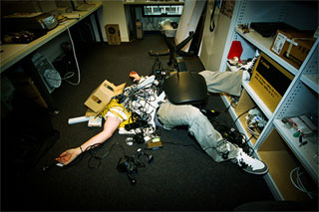
HCV - Hepatitis C
Occupational HCV Transmission
Occupational exposure to blood - mainly needlesticks
Response to injuries without wearing personal protective equipment
Notes:
“HCV is spread through blood to blood.
“HCV transmission may occur through needlestick injuries and sharps exposures on the job.
“HCV is not spread by hugging, sneezing, coughing, food or water, sharing eating utensils or drinking glasses, or casual contact.”

Slide 21
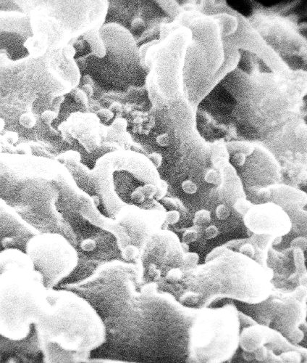
Human Immunodeficiency Virus (HIV)
General Facts
Fragile – few hours in dry environment
Attacks the human immune system
Cause of AIDS
>1 million infected persons in U.S.
No cure; no vaccine available yet
HIV - seen as small spheres on the surface of white blood cells
Notes:
“The Human Immunodeficiency Virus, HIV, is fragile compared to HBV. It does not survive well outside the body and can live in a dry environment for only a few hours. No one has yet been identified as infected with HIV due to contact with an environmental surface.
“HIV attacks your body’s ability to protect itself from disease. It destroys the human immune system by attacking certain cells known as T cells, which are part of the first line of defense that our immune system has to fight infection.
“HIV is the cause of Acquired Immunodeficiency Syndrome, or AIDS.
“There are now more than one million HIV-infected persons in the US.
“There is no cure and no vaccine available yet.”

Slide 22
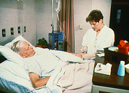
Human Immunodeficiency Virus (HIV)
HIV Infection → AIDS
Many have no symptoms or mild flu-like symptoms
Most infected with HIV eventually develop AIDS
Incubation period ≈10-12 yrs
Opportunistic infections & AIDS-related diseases - TB, toxoplasmosis, Kaposi’s sarcoma, oral thrush (candidiasis)
Treatments are limited; do not cure
Notes:
“Many people who are infected with HIV do not have any symptoms at all for many years or may have mild flu-like symptoms.
“Most persons who become infected with HIV will eventually develop AIDS, which is the most advanced stages of the infection.
“There is usually a latency (inactive) period of years before the onset of AIDS after the initial infection. Before 1996, scientists estimated that about half the people with HIV develop AIDS within 10 years after becoming infected. Some have progressed to AIDS within 2-3 years after infection while very few have had no symptoms after 12 years. The time varies greatly from person to person and can depend on many factors, including a person's health status and health-related behaviors.
“NOTE: Since 1996, the introduction of powerful drug therapies has dramatically changed the progression time between HIV infection and the development of AIDS. There are also other medical treatments that can prevent or cure some of the illnesses associated with AIDS, though the treatments do not cure AIDS itself. Because of these advances in drug therapies and other medical treatments, estimates of how many people will develop AIDS and how soon are being recalculated, revised, or are currently under study.
“The only way to determine for sure whether you are infected is to be tested for HIV infection. You cannot rely on symptoms to know whether or not you are infected with HIV.
“Infection with HIV can weaken the immune system to the point that it has difficulty fighting off certain infections and cancers. These types of infections are known as "opportunistic" infection because they take the opportunity of a weakened immune system to cause illness. A healthy immune system can usually control these types of infections; however, in a person with AIDS, these opportunistic infections may be life-threatening.

Slide 23
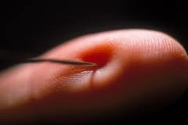
Human Immunodeficiency Virus (HIV)
Occupational HIV Transmission
As with most BBP the greatest risk is needlestick injury
And in taking care of an injured person
Notes:
“HIV is spread from one person to another through blood to blood.
Needlesticks - Most occupational exposures do not result in infection. As of December 2001, there have been 57 documented cases of HIV infection (since reporting began in 1985); 48 of the infections were from percutaneous (puncture/cut injury) exposure and 5 were mucocutaneous (mucous membrane and/or skin) exposure.
Casual contact is not a risk for transmission of HIV.

Slide 24
Transmission of BBPs
Occupational Exposure
means reasonably anticipated skin, eye, mucous membrane, or parenteral (piercing of the skin) contact with blood or OPIM that may result from the performance of an employee's duties
Exposure Incident
is a specific contact with blood or OPIM that is capable of transmitting a bloodborne disease
Notes:
“At the workplace, Occupational Exposure means reasonably anticipated skin, eye, mucous membrane, or parenteral contact with blood or OPIM that may result while an employee is doing his or her job duties.” ‘Reasonably anticipated’ contact means potential contact as well as actual contact with blood or other potentially infectious materials.
“An Exposure Incident is a specific contact with blood or OPIM that is capable of transmitting a bloodborne disease.
(parenteral or percutaneous contact = contact through a piercing of the skin, such as by needlesticks, cuts, or abrasions)

Slide 25
Health Care Workers and BBPs
Occupational Transmission
Causes of percutaneous injuries with hollow-bore needles, by % total percutaneous injuries
Most common: needlesticks
Cuts from other contaminated sharps (scalpels, broken glass, etc.)
Contact of mucous membranes (eye, nose, mouth) or broken (cut or abraded) skin with contaminated blood
Handling/transferring specimens
Manipulating needle in patients
Improperly disposed sharp
Other
Disposal-related causes
4%
5%
10%
27%
12%
8%
8%
10%
5%
11%
IV line-
related causes
Handling or passing device during or after use
Clean-up
Collision w/health care worker or sharp
Recapping
Source: CDC [1999]
Notes:
“Needlestick injuries are the most common cause of occupational exposure to BBPs. Data from the CDC shows that approximately 38% of percutaneous injuries occur during use and 42% occur after use and before disposal. Most needlestick injuries have been associated with hollow bore needles. This chart shows the causes of needlestick injuries with hollow bore needles from CDC data over a four-year period (June 1995-July 1999).
.
“Other exposures from contaminated sharps may include scalpels, broken glass, broken capillary tubes, exposed ends of dental wires, and any other contaminated object that can penetrate the skin. Exposure can also occur from contact of the eye, nose, mouth, or non-intact skin with contaminated blood.”

Slide 26
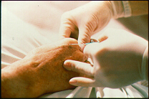
Health Care Workers and BBPs
Occupational Transmission
Risk of infection following needlestick/cut from a positive (infected) source:
HBV: 6%-30%
HCV: 1.8%
(range 0%-7%)
HIV: 0.3%
Notes:
“For an unvaccinated person and who has no immunity from a previous infection, the risk for HBV infection from a single needlestick or a cut exposure to HBV-infected blood ranges from 6-30%. Health-care workers who have received hepatitis B vaccine and have developed immunity to the virus are at virtually no risk for infection.
“The risk for HCV infection after a needlestick or cut exposure to HCV-infected blood averages 1.8%. The risk following a blood splash is unknown, but is believed to be very small; however, HCV infection from such an exposure has been reported.
“The risk for HIV infection after a needlestick or cut exposure to HIV-infected blood is 0.3%, or about 1 in 300. The risk after exposure of the eye, nose, or mouth to HIV-infected blood is estimated to be, on average, 0.1%. (As of December 2001, there have been 57 documented cases of HIV infection (since reporting began in 1985); 48 of the infections were from percutaneous (puncture/cut injury) exposure and 5 were mucocutaneous (mucous membrane and/or skin) exposure.)

Slide 27
Exposure Control Manual
To eliminate/minimize your risk of exposure
Exposure determination
Exposure controls
Training and Hazard Communication
Hepatitis B Vaccine
Post exposure evaluation & follow-up
Recordkeeping
Exposure
Control
Plan
Ask your Supervisor/PI where copy is located
Notes:
“A copy of CHS’s written Exposure Control Plan is located in each lab, online and in the Lab Safety Coordinator’s office. The Exposure Control Plan is designed to eliminate or minimize your risk of exposure to BBPs at work. It includes our policies and procedures, and also identifies persons or departments with specific responsibilities. You should familiarize yourselves with it and refer to the procedures to follow if an exposure incident occurs. If you have any questions concerning the Exposure Control Plan, see the Lab Safety Coordinator or Principle Investigatior.
“Briefly, the Exposure Control Plan contains the following elements:
An exposure determination to identify employees who are at risk for exposure
The methods and controls we use to protect you from exposure to bloodborne pathogens
Training and Hazard Communication requirements
Post-exposure evaluation and follow-up procedures if you experience an exposure incident
Record keeping, including documentation of any occupational exposure incidents

Slide 28
Exposure Determination
Who is at risk on-the-job?
In which job classifications here are ...
  All employees occupationally exposed?
  Some employees occupationally exposed?
    What are the tasks with exposure?
See Appendix B in the Exposure Control Manual
  *Determine exposure without considering the
  use of PPE.
Notes:
“Let’s identify those employees who are at risk for exposure here. Do we have job classifications where all employees are occupationally exposed?”
“Do we have job classifications where some employees are occupationally exposed? What tasks or procedures could these employees have exposure to blood and OPIM?”
(For example,
Needlesticks (during or after use)
Recapping
Transferring a body tissue or human/primate cells
Failing to properly dispose of used needles in a puncture-resistant sharps container
Providing first-aid emergency treatment
Cleaning contaminated surfaces
Disposing of hazardous waste
Etc.

Slide 29
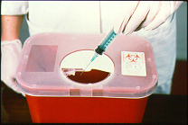
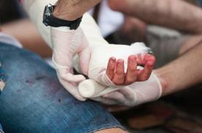
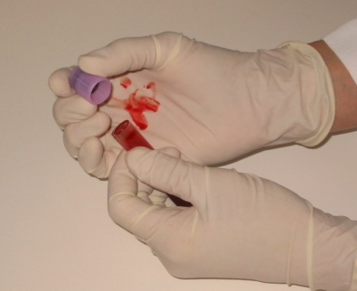
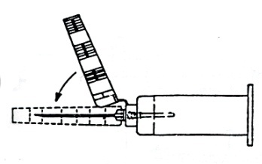
Exposure Controls
Reducing your risk
Universal precautions
Equipment and Safer Medical Devices
Work practices
Personal protective equipment
Housekeeping
Hazard communication
- labeling
Regulated Waste
Notes:
“The risk of occupational exposure to BBPs can be reduced or prevented by these methods, which we will discuss further:
following universal precautions
using safer medical devices and equipment
following proper and safe workplace policies, practices, and procedures
using appropriate PPE when contact with blood or OPIM is expected
maintaining a clean workplace
making sure all contaminated materials are properly labeled

Slide 30
Exposure Controls
UNIVERSAL PRECAUTIONS
– A system of infection control:
TREAT ALL HUMAN BLOOD AND OPIM AS IF KNOWN TO BE INFECTIOUS WITH A BLOODBORNE DISEASE.
Notes:
“ CHS follows Universal Precautions. The concept of universal precautions is an infection control system that considers blood and other potentially infectious materials (OPIM) from all persons as containing a bloodborne disease, whether or not the person has been identified as having a bloodborne disease. Therefore, you must handle all such materials using methods that prevent or reduce the risk of exposure to yourself. Observe and follow Universal Precautions in all situations where there is a potential for contact with blood or OPIM.”

Slide 31
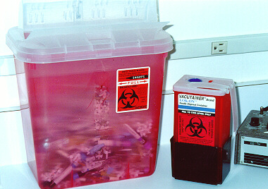
Exposure Controls
Equipment and Safer Medical Devices
Physical guard
Sharps disposal containers
  Closable
  Puncture-resistant
  Leak-proof
  Labeled and can be color-coded
  Upright, placed in area where sharps used
  DO NOT OVERFILL!
Notes:
“The use of safer medical devices and equipment will prevent or minimize your exposure to bloodborne pathogens by eliminating, removing, or isolating the BBP hazard from the work area. These include physical guards, barriers, environmental controls, or other devices.
“An example of a physical guard is a sharps disposal container. It must be closeable, puncture resistant, leak-proof, and labeled.
“During use, place them as close as feasible to the immediate area where sharps are used or anticipated to be found, keep them upright, and don’t allow them to overfill. Replace them regularly or sooner if necessary.
“If they need to be replaced or moved somewhere else, close them securely before you move them and place them in a larger secondary container if leakage is possible.”

Slide 32
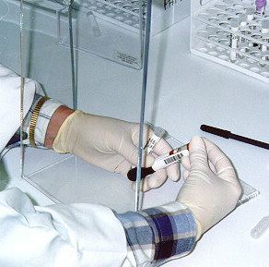
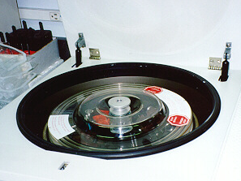
Exposure Controls
Equipment and Safer Medical Devices
Barrier
Shields
Notes:
“Barriers protect you by providing a shield between you and an action that could cause an aerosol or splatter. This slide shows two types of shields.
“On the left is a simple, clear plastic panel that is formed to stand on its own and to provide a barrier between the activity of opening vacutainer tubes that contain blood.
“The other protective device is a shield over the opening of a centrifuge. This will help prevent splashing and splattering of material if a centrifuge tube breaks and loses its contents.”

Slide 33
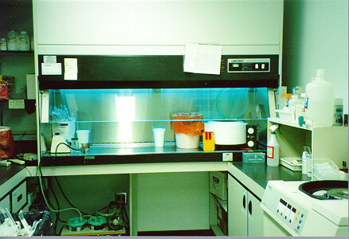
Exposure Controls
Equipment and Safer Medical Devices
Environmental Controls
Ventilation hood
Notes:
“An environmental control may include a biological safety cabinet which combines ventilation control and a barrier.”

Slide 34
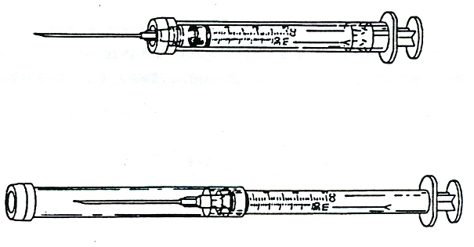
Exposure Controls
Equipment and Safer Medical Devices
Other Devices
Safer Medical Devices
  Sharps with engineered sharps injury protections (SESIP)
  Needleless systems
  Self-blunting needles
  Plastic capillary tubes
Unprotected position
Protected position
Example of needle guard with protected sliding sheath that is pushed forward after use and locks (with some designs the shield must be twisted to engage the lock).
Notes:
“Safer medical devices have been developed to help prevent needle-stick injuries. They must be used where they can prevent or minimize occupational exposure to BBPs. Examples of safer medical devices may include
“Sharps with engineered sharps injury protections, or SESIP. These are non-needle sharps or needle devices that have a built-in safety feature or mechanism that reduces the risk of an exposure incident, e.g., syringes with a hinged or sliding sheath that shields the attached needle after use; needles that retract into a syringe after use.
“Self-blunting needles: after the final use, a blunt internal hub is activated by forward pressure of the vacuum tube, blunting the needle before it is removed.
(It is the employer’s responsibility to keep up to date on feasible and newer devices that prevent needlesticks and other injuries to reduce the risk to employees. Additional Information About Safety Devices Available At…
http://www.cdc.gov/niosh/topics/bbp/#prevent
[Device drawings courtesy of International Health Care Worker Safety Center, University of Virginia]

Slide 35
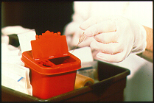
Exposure Controls
Safe Work Practices
Do the job/task in safer ways to minimize any exposure to blood or OPIM:
  Don’t bend, recap, or remove needles or other sharps
  Don’t shear or break needles
  Place contaminated reusable sharps immediately in appropriate containers until properly decontaminated
Notes:
“Safe work practices are steps, procedures, or ways in which a job or task can be done more safely to minimize any exposure to blood or OPIM.
(Work practices must be specific to each workplace and sets of procedures. Do not use generic language. There must be enough specific directions with different sorts of procedures to ensure uniformity. Every single procedure may not need a separate set of directions; you can combine similar tasks.)

Slide 36
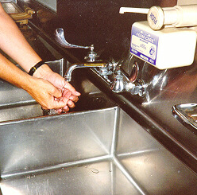
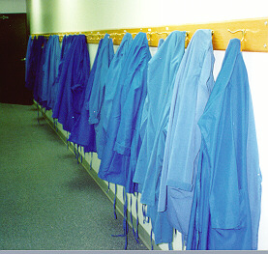
Exposure Controls
Safe Work Practices
  Do not pipette or suction blood or OPIM by mouth.
  Wash hands after each glove use and immediately or ASAP after exposure.
  Remove PPE before leaving work area.
Notes:
(Note: If handwashing facilities are not possible or immediately available, waterless antiseptic hand cleanser and towels or towelettes must be available. When hands are visibly contaminated, follow with washing using soap and water as soon as possible.)

Slide 37
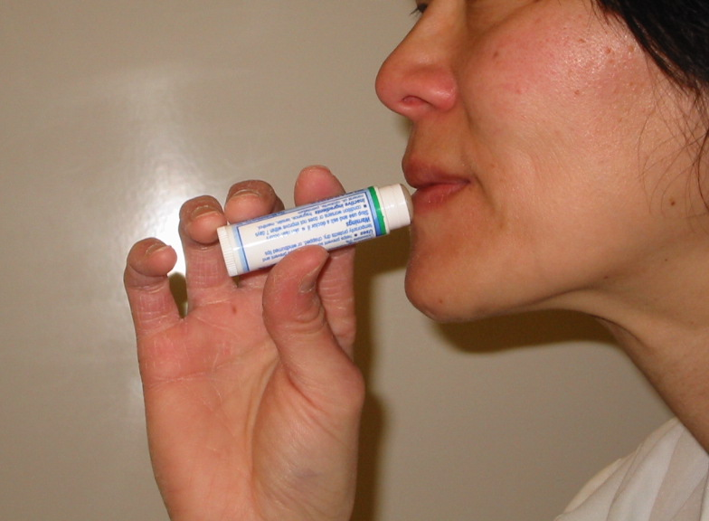
Exposure Controls
Safe Work Practices
  Do not eat, drink, smoke, apply cosmetics or lip balm, or handle contact lenses in any work areas where there is the possibility of exposure to blood or OPIM.
  Do not place food or drink in refrigerators, freezers, shelves, cabinets, or on countertops or bench tops in any work areas.

Slide 38
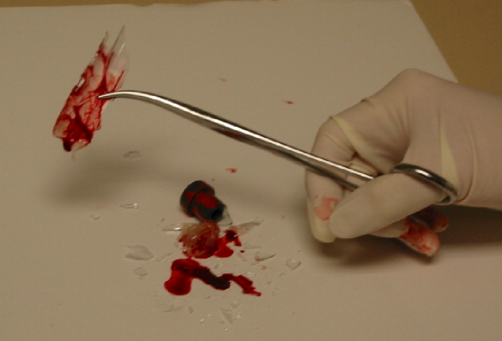
Exposure Controls
Safe Work Practices
Clean-up of spills and broken glassware/sharps contaminated with blood or OPIM
  Wear protective eyewear and mask if splashing is anticipated.
  Remove glass and other sharps materials using a brush and dust pan, forceps, hemostat, etc. Do not use your hands.
  Properly discard all materials into a sharps or puncture-resistant biohazardous waste container.
  Use paper/absorbent towels to soak up the spilled materials.

Slide 39
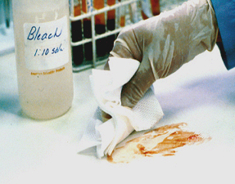
Exposure Controls
Safe Work Practices
Clean-up of spills and broken glassware/sharps (cont.)
  Clean the area with 10% bleach or EPA-registered disinfectant, ex. Hepacide Quat®
  Saturate the spill area with disinfectant. Leave for 10 minutes (or as specified by product manufacturer) or allow to air dry.
  Properly dispose of paper towels and cleaning materials into proper waste containers.

Slide 40
Exposure Controls
Personal Protective Equipment (PPE)
You must wear all required PPE. OSU-CHS provides employees with the following PPE, as needed, at no cost:
  Gloves
  Lab coats
  Gowns
  Shoe covers
  Face shields or
  Masks and eye protection
  Resuscitation devices
Notes:
“When equipment, safer devices, and safe work practices do not eliminate exposure, the use of personal protective equipment, or PPE, is required. PPE that is “appropriate” will not permit blood or other OPIM to pass through or reach your clothes, skin, eyes, mouth, or other mucous membranes.
“We provide you with these PPE at no cost:
The PI/supervisor is responsible for maintaining supplies and providing PPE. See PI/supervisor if you need PPE or have any concerns regarding PPE types, use, sizes, etc.
“Make sure you remove all PPE before leaving the work area. Remove contaminated PPE carefully as to avoid contact with contaminated PPE surfaces and dispose in the designated containers.

Slide 41
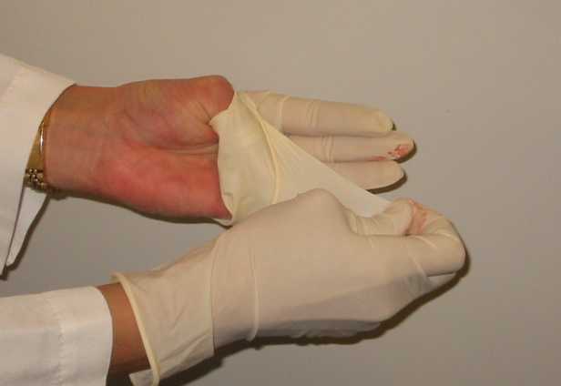
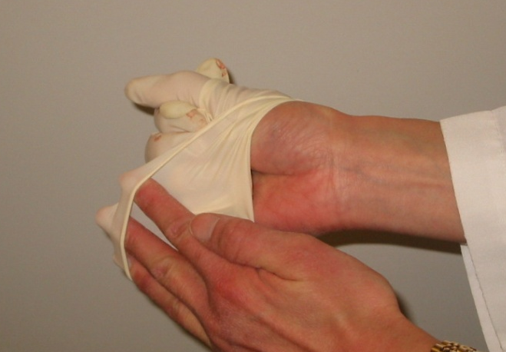
Exposure Controls
Personal Protective Equipment (PPE)
Remove gloves safely and properly
Grasp near cuff of glove and turn it inside out. Hold in the gloved hand.
Place fingers of bare hand inside cuff of gloved hand and also turn inside out and over the first glove.
Dispose gloves into proper waste container.
Clean hands thoroughly with soap and water (or antiseptic hand rub product if handwashing facilities not available).
Notes:
“Make sure you remove your gloves safely and properly to avoid possible contact with blood or OPIM-contaminated gloves.

Slide 42
Safe and proper glove removal

Slide 43
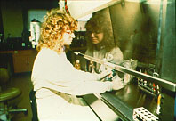
Exposure Controls
Personal Protective Equipment (PPE)
Protective clothing
Lab coat
Gown
Apron
Surgical cap or hood
Shoe cover or boot
Notes:
“You must wear the personal protective equipment that is provided by your PI/supervisor.”
“Remove, as soon as feasible, your protective clothing if blood or other potentially infectious materials (OPIM) penetrate it.”
“We must launder contaminated articles.”
(The amount of protection will depend on the risk and degree of potential splash. This requirement is performance-based.)

Slide 44

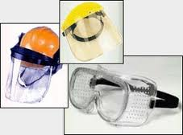
Exposure Controls
Personal Protective Equipment (PPE)
Eye-Face Protection and Masks
Safety glasses with side shields
Splash goggles
Face shield
Mask
Notes:
“Wear appropriate face and eye protection when splashes, sprays, spatters, or droplets of blood or OPIM pose a hazard to the eye, nose, or mouth.
“Face shields would be needed if the risk and amount of potential splash or splatter to the face is substantial. The skin as well as the eyes needs to be protected.
“If the risk of splash is minimal, glasses with side shields might be adequate.
“Splash goggles or the use of a mask in combination with an eye protection device may be required in higher risk situations.

Slide 45
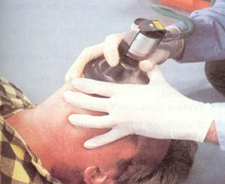
Exposure Controls
Personal Protective Equipment (PPE)
Resuscitation Devices
Notes:
“When administering CPR, use gloves and resuscitation devices, such as mouthpieces, resuscitation bags, pocket masks, microshields, overlay barrier, etc.”

Slide 46
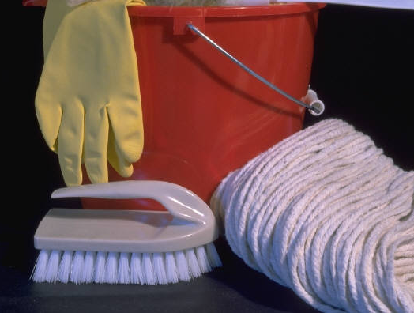

Exposure Controls
Housekeeping
Maintain a clean and sanitary workplace
Written cleaning and decontamination schedule and procedures
Approved disinfectant – bleach, EPA-approved, e.g Hepacide Quat®
Contaminated waste disposal methods
Laundry
DISINFECTANT
Notes:
“All work areas are to be maintained in a clean and sanitary condition.
“A written schedule and detailed procedures for cleaning and decontamination shall be provided.”
“Decontaminate all work surfaces with the appropriate disinfectant after completion of procedures, when surfaces are contaminated, and at the end of each work shift.
The appropriate disinfectant is an *EPA-approved tuberculocidal or HIV/HBV-effective disinfectant, or a diluted (1:10 for spills, 1:100 for routine cleaning) bleach solution made daily.
(Lists of disinfectants are available from the EPA Office of Pesticides, antimicrobial pesticides website at http://www.epa.gov/oppad001/chemregindex.htm.)

Slide 47

Exposure Controls
Communication of Hazards
Biohazard Labels and Signs
Must have biohazard symbol
Labels attached securely to any containers or items containing blood/OPIM
Signs posted at entrance to specified work areas
Labels on any contaminated area
Predominantly fluorescent orange or orange/red background
Lettering and symbol in contrasting color to background
Notes:
“Containers containing blood or OPIM, or equipment contaminated with blood/OPIM must have this orange/red label with the biohazard symbol. The following must be labeled:
- regulated waste disposal
- sharps containers
- containers used to store, transport or ship (e.g., freezers)
- laundry
- contaminated equipment and supplies
- etc.
“The labels must be attached with string, wire, adhesive, or other method so they can't become lost or accidentally removed.”

Slide 48
Exposure Controls
Regulated Waste
Liquid or semi-liquid blood or OPIM
Contaminated items that would release blood or OPIM in a liquid or semi-liquid state if compressed
Items caked with dried blood or OPIM that are capable of releasing these materials
during handling
Contaminated sharps
Pathological and microbiological
wastes containing blood or OPIM
Notes:
“Regulated waste is one that poses a significant risk of exposure to workers, including those who may handle the waste downstream.
“Regulated waste includes
liquid or semi-liquid blood or OPIM
contaminated items that would release liquid or semi-liquid blood or OPIMs if compressed or compacted
dried caked blood or OPIM that might flake off or be released if handled
contaminated sharps
and pathological and biological items or waste with blood or OPIMs.
“This does not include materials that sufficiently absorb blood or OPIM. For example, band aids and feminine hygiene products are not regulated waste.
“All contaminated waste must be handled in a sanitary manner. Waste containers must be lined and regularly disinfected.

Slide 49
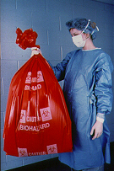
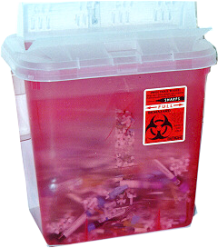
Exposure Controls
Regulated Waste - Containers
Easily accessible
Labeled, color-coded: red/orange
Leak-proof, closeable
Puncture-resistant for sharps
Replaced routinely
(do no overfill!)

Slide 50
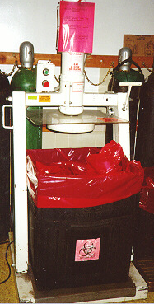
Exposure Controls
Regulated Waste - Containers
Close immediately before removing or replacing
Place in second container if leaking possible or if outside contamination of primary container occurs
If reusable, open, empty, and clean it in a manner that will not expose you and other employees

Slide 51
Exposure Control
Regulated Waste - Disposal
Biomedical or Forensics Research Laboratories (or follow other preset procedures)
  First, complete destruction of pathogens by autoclave or chemical disinfection
  remove/deface biohazard labels and place solids in dark colored waste bag, securely closed
  place solids waste bags in normal trash bin
  Pour liquids to sink drains
All regulated sharp puncture resistant containers must be collected by a disposal service (contact Laboratory Safety Coordinator when full)

Slide 52
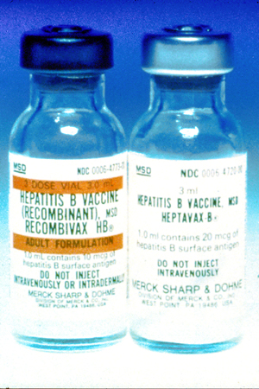
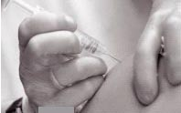
Hepatitis B Vaccine
No cost to you
3 shots: 0, 1, & 6 months
Effective for 95% of adults
If decline, must sign Declination Form
  vaccine available at later date if desired
Post-exposure treatment (if not vaccinated)
  Immune globulin
  Begin vaccination series
Notes:
“Hepatitis B vaccine is provided free of charge to all employees at risk for exposure to BBP. You should make an appointment at HCC.”
“The vaccination consists of a series of three different shots given at 0, 1 and 6 months and is highly effective. (Booster shots are not required, unless recommended by CDC in the future.)
“Post-vaccination testing will be given 1-2 months after the third vaccine dose for high risk health care workers (i.e., those who are at risk for sharps injury)
“If you have an exposure incident and have not been vaccinated, the treatment will usually include Hepatitis B immune globulin and the vaccination series. Post-exposure prophylaxis is more than 90% effective in preventing HBV infection.
“If you choose to decline the vaccination now, you must sign a Declination Statement. However, if you decide later at any time that you would like to have the Hepatitis B vaccination, it will still be available under these same conditions.
The most common side effects from hepatitis B vaccination are pain at the injection site and mild to moderate fever. Studies indicate that these side effects are reported no more frequently among persons vaccinated than among those receiving placebo.
Serious adverse effects from HBIG when administered as recommended have been rare. Local pain and tenderness at the injection site, urticaria and angioedema might occur; anaphylactic reactions, although rare, have been reported following the injection of human immune globulin (IG) preparations.

Slide 53
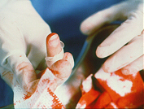
Exposure Incident
If you have an exposure incident to blood or OPIM, immediately do the following:
  Thoroughly clean the affected area
    • Wash needlesticks, cuts, and
    skin with soap and water
    Splashes to the nose and mouth- flush with water
    Irrigate eyes with clean water,
    saline, or sterile irrigants
  Report exposure to supervisor, principal investigator or department chair; fill out HR and CHS Incident Report Forms
Notes:
“In the Incident Report Form, try to describe the exposure event in as much detail as possible and submit the reports to the Health Care Center.”
“An exposed employee may opt out of seeking medical care, however their health may be at extreme risk.”

Slide 54
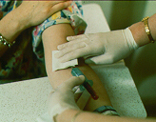
Post-exposure evaluation
OSU-CHS’s Responsibility:
  Offer immediate post-exposure medical evaluation and follow-up to exposed employee:
    At no cost
    Confidential
    Testing for HBV, HCV, HIV
    Preventive treatment when indicated
  If permission given, test blood of source person if HBV/HCV/HIV status unknown; provide results to exposed employee
Notes:
Medical evaluation must be provided as soon as possible, unless the exposed person refuses care. The Center for Disease Control and Prevention recommends the HIV post-exposure prophylaxis PEP be given as soon as possible after exposure. HBV immune globulin may be given within 7 days after exposure but is most effective given as soon as possible after exposure. There is no post-exposure preventative medicine that is available for HCV.

Slide 55
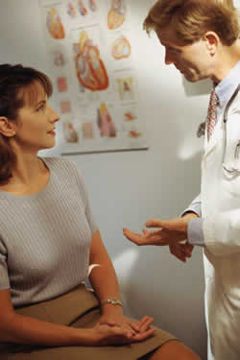
Post-exposure evaluation
OSU-CHS’s Responsibility: (cont.)
  Provide exposed employee with copy of the evaluating health care professional’s (HCP) written opinion within 15 days of completion of evaluation
  Provide employee with information about laws on confidentiality for the source individual
  Provide post-exposure treatment as needed, including counseling
(HCP: OSU Health Care Clinic or of your choice)

Slide 56
Recordkeeping
Medical Records
Confidential
Hepatitis B vaccination and post-exposure evaluations
HCP’s written opinions
Information provided to HCP as required
Maintain for length of employment + 30 years
Notes:
Medical records maintained by (state your company name) do not contain any confidential medical information, except for the HBV vaccination status and Declination Form, if you choose to waive being vaccinated.
The HCP’s written opinions contain generic information. They may not contain any medical diagnosis or disease testing results; these are your confidential medical information.

Slide 57
Any Questions?
Biomedical Research: Laurie St. Clair, laurie.stclair@okstate.edu, Ofc 918-561-1403, cell 918-241-3656 or
Safety Manager, Matt Sharpe, matt.sharpe@okstate.edu, Ofc. 918-561-8391, cell 918-830-1367

